Slide 1

EGH450 Advanced Unmanned Aircraft Systems Tutorial 03 Autopilot & Navigation
Felipe Gonzalez - felipe.gonzalez@qut.edu.au
Kye Morton– morton9@qut.edu.au
Umesh Mutubandara - u.mutubandara@qut.edu.au
Science and Engineering

Slide 2
Autopilot Integration
Science and Engineering

Slide 3
Autopilot Subsystem Summary
Autopilot / GCS Responsibilities:
Ensuring the Autopilot is set up for autonomous flight
Ensuring the GCS is operating as intended with appropriate visualization
Managing ground-level interfaces (such as ROS topics and launch files)
Responsible for operation of the UAV during flight
Useful links for the Autopilot subsystem:
Flight Controller / Firmware Documentation
https://github.com/qutas/robin/blob/master/documents/README.md
Flight Controller / Firmware Documentation
https://github.com/qutas/info/wiki/Flight-Controllers-&-Autopilots
Setup & Configuration Guides
https://github.com/qutas/info/wiki/UAV-Setup-Guides#mavros-first-steps
Science and Engineering

Slide 4
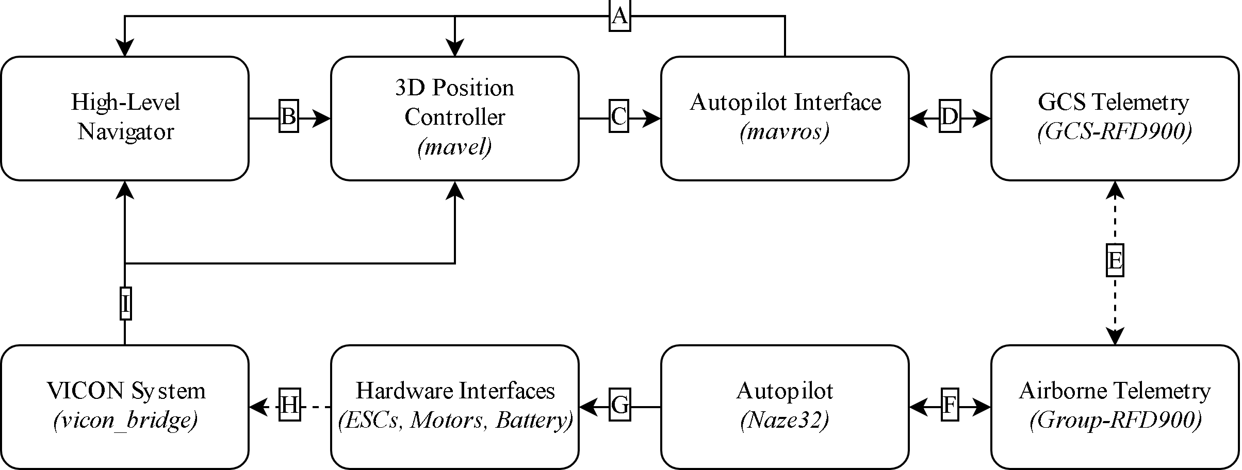
GCS → Autopilot Communication
Science and Engineering

Slide 5
GCS → Autopilot Communication
UAV State Feedback (mavros_msgs/State)
Tracking Reference (nav_msgs/Path, geometry_msgs/PoseStamped)
Attitude/Thrust Vector (mavros_msgs/AttitudeTarget)
USB-Serial Converter (115200 Baud)
Wireless Telemetry (900MHz)
Serial Connection (115200 Baud)
Assorted Hardware Interfaces (PWM, Analog)
UAV Dynamics / VICON Cameras (Flight)
Odometry Reading (geometry_msgs/PoseStamped, nav_msgs/Odometry)
Science and Engineering

Slide 6
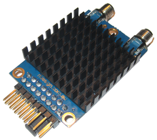
Telemetry Details – Summary
Devices used will be RFD900 serial modems (or similar)
http://store.rfdesign.com.au/rfd-900p-modem/
1 modem will be provided per group, but is to be kept out at Da Vinci (you will be briefed on this during your next lab induction)
All modems will be pre-configured, and should all be plug-and-play
Autopilots will have to be updated with a new firmware to ensure compatibility (this can be done in Practicals 3-5)
Some configuration required for GCS/mavros interfaces, however this will be less than was previously required with WiFi modules
Science and Engineering

Slide 7
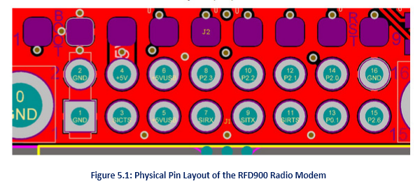
Telemetry Details – Interfacing
“Standard” 6-pin serial adaptor
Only 4 connected: [GND, N/C, 5V, Tx, Rx, N/C]
Can be mounted via:
Airframe using bolts
Clips or tape
Fully seated using all output pins / bracket
Acts as a transparent bridge, i.e. for further testing away from the lab, the connection to the GCS can be simulated with a direct connection
Science and Engineering

Slide 8
GCS Visualisation
ROS session recording with rosbag
RQT Plugins
MAVROS GUI (https://github.com/qutas/rqt_mavros_gui)
Robin GCS (https://github.com/qutas/rqt_robin_gcs)
Generic HUD (https://github.com/qutas/rqt_generic_hud)
Eyedropper (https://github.com/qutas/rqt_eyedropper)
Image View (multiple uses)
Graph (visualise ROS node/topic environment)
MultiPlot (visualise data in on a 2D graph)
RVIZ Plugins
Pose (multiple uses)
Path (visualisation of navigation)
Occupancy Grid (display of obstacle)
Science and Engineering

Slide 9
Navigation
Science and Engineering

Slide 10
Navigation Subsystem Info
This subsystem is responsible for developing a search method for avoiding obstacles and guides UAV through the test area. In addition to this, the navigation must also be capable of diverting from original course and localising to target based on information provided by the image processing.
Additional Links and packages
UAVUSR Emulator – https://github.com/qutas/uavusr_emulator
Contrail –https://github.com/qutas/contrail/blob/master/contrail/README.md
Breadcrumb - Example A* Path Planner - https://github.com/qutas/breadcrumb
Types of Navigational Messages
Pose Stamped Messages – Position in X Y Z and Orientation in Quaternion (X , Y, Z, W)
http://docs.ros.org/melodic/api/geometry_msgs/html/msg/PoseStamped.html
What is Quaternion ? - https://github.com/qutas/info/wiki/Navigation-&-Localization
Science and Engineering

Slide 11
Navigation Background
Pose Stamped Messages
3D Position: [X,Y,Z]
3D Rotation (Quaternion): [W,X,Y,Z]
http://docs.ros.org/melodic/api/geometry_msgs/html/msg/PoseStamped.html
Quaternions
https://github.com/qutas/info/wiki/Navigation-&-Localization#rotational-component
https://quaternions.online/
Science and Engineering

Slide 12
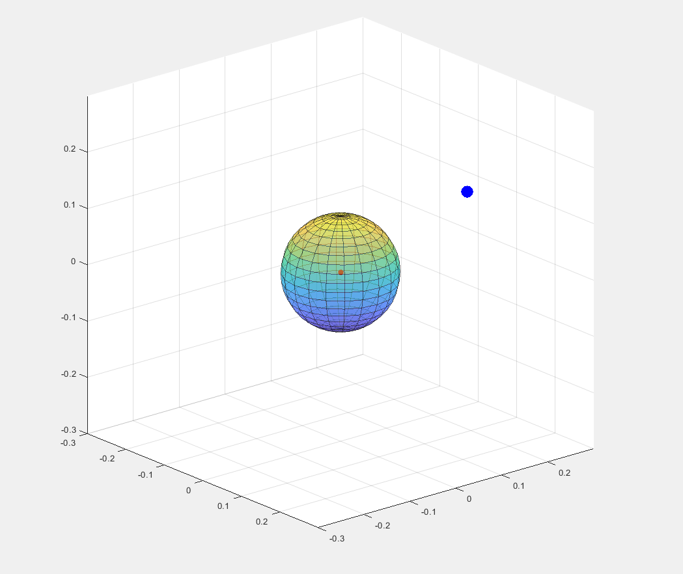
Navigation Background
Basic Waypoint Navigation
https://github.com/qutas/info/wiki/Navigation-&-Localization#simple-waypoints
Define a waypoint by:
Goal Position
Goal Heading
Position & Heading Accuracy
Wait until UAV is within position/heading accuracy
Use Euclidian distance: d = √(x² +y² + z²)
Remember Greater Circle
Hold for some amount of time
Reset timer if the UAV leaves the acceptable accuracy
Move on to the next waypoint and start over
Science and Engineering

Slide 13
Navigation – Contrail Package
A collection of nodes and libraries to generate and track discrete or velocity-dependant trajectories in 3D space.
Basically allows you create your own path initially and completes the Receding Virtual Waypoint tracking (Sub Waypoints) between current position to next goal point.
Allows for the following scenario:
Tracking a pre-determined path
Divert from path to a temporary setpoint
Resume tracking the original path at some future point in time
Some test waypoints (lists of 3D positions and headings) are provided in the UAVUSR package
You may edit these for test purposes, or configure them to run your own path for flight testing
Example integration is given with the uavusr_emulator package, and is also integrated as part of mavel
Science and Engineering

Slide 14
Navigation – UAVUSR Emulator
Small ROS publisher to output dummy data in the form of images, pose messages, and sensor readings and example guidance system. https://github.com/qutas/uavusr_emulator
Anyone who has not yet installed the emulator please follow the Installation Instructions from the beginning of the Readme doc, link above
If you already have installed UAVUSR emulator please open a terminal window and follow from instructions in the Updating Instructions in the Readme doc
Please ensure you installed contrail in order to run the Waypoint example, check steps under Waypoint Example in the Readme.
cd ~/catkin_ws/src
git clone https://github.com/qutas/contrail
cd ~/catkin_ws
catkin_make
source ~/catkin_ws/devel/setup.bash
This should take about 5-10 mins, please check you have done this before the trying the demonstrations
Science and Engineering

Slide 15
Navigation – UAVUSR Emulator Demo
Open up 5 terminal windows and run the following commands for each of the windows:
The ROS core:
roscore
UAVUSR emulator
roslaunch uavusr_emulator emulator.launch
Visualisation:
rviz
Guidance Example: (will open soon)
Guidance Autonomy: (will open soon)
Science and Engineering

Slide 16
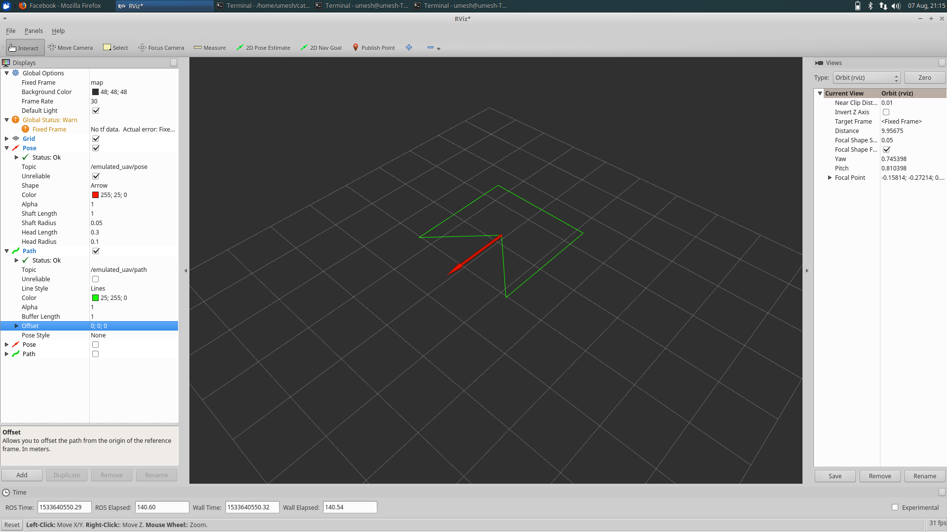
In rviz, add and configure:
A Pose plugin (topic: /emulated_uav/pose, color: red)
A second Pose plugin topic (topic: /emulated_uav/guidance/feedback/contrail/pose, color: blue),
A Path plugin (topic: /emulated_uav/path)
Science and Engineering

Slide 17
Navigation – UAVUSR Emulator Demo
Launch the guidance example:
roslaunch uavusr_emulator guidance.launch wp_name:=square
You should see the simulated UAV pose move within RVIZ along the given test path
To simulate the localisation to a detected target, the following demonstrates breaking off the given original path and localisation some specified location (1.0,1.0,3.0).
Override the current path reference:
rosrun uavusr_emulator send_pose 1.0 1.0 3.0
[Press CTRL+C to close last command] Return to previous path reference:
rosservice call /emulated_uav/guidance/contrail/set_tracking 2
Science and Engineering

Slide 18
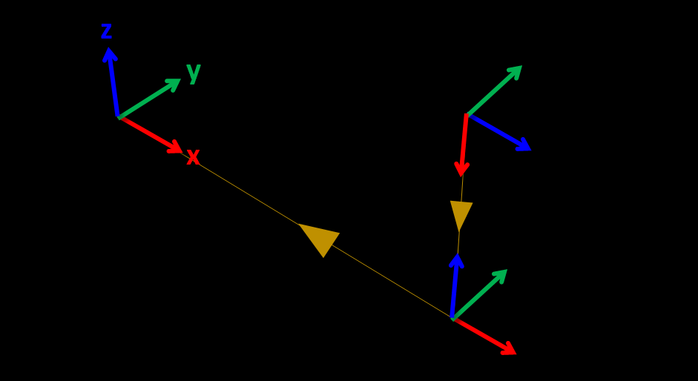
Navigation – Frames of Reference
Three different local frames of Reference
Map(World) → UAV
VICON Pose messages of the UAV location will be in this frame, with the notation East, North, Up (ENU). Centre floor point of the flight area will be the origin. The measurement of the UAV pose is dynamic and will change over time.
UAV → Camera
The pose of the camera relative to the UAV origin. This frame of reference will be static, since the camera is not actuating independently from the UAV.
Camera → Target
The target pose in relation to the camera. This will be dynamic as it is based of the position and the orientation of the UAV.
Eventually, Image Processing should find the a target marker location in the World Frame by calculating:
Target → Camera → UAV → Map (world)
Science and Engineering

