Slide 1

EGH450 Advanced Unmanned Aircraft Systems Tutorial 01 ROS Review
Felipe Gonzalez - felipe.gonzalez@qut.edu.au
Kye Morton– morton9@qut.edu.au
Science and Engineering

Slide 2
Welcome Back!
Hopefully you had a good holiday!
This is the continuation of the UAV design project from EGB349.
Continue the development and testing of the UAV so that your team can meet all the requirements for the final submission.
Be prepared to put in a fair amount of time outside of class for this project.
Administration Information
- S901 Access – Same as last semester this is your designated lab for development in your own time. Please make sure everyone has access to this room. If you don’t have access, contact this email to organise an induction – sef.eei@qut.edu.au
- Ordering Additional Parts – See order sheet available in Blackboard->Assessment
Science and Engineering

Slide 3
Team Allocation and Timetabling
- Split into your current teams
- Wait for further instruction from the tutors

Slide 4
Tutorials
Tutorials will be running from Weeks 1-11
Weeks 1-5 will provide information on your specific subsystems
Note that these tutorial will be specifically for the listed subsystems however we recommend anyone who interested to attend
Only subsystem specific questions will be answer in these sessions
Week 6-11 will be provided for additional support for groups
Each Group will be given a timeslot
Tutorial Topics:
Tutorial 2 - Airframe, Power/Propulsion and Payload Design (AIR, POW, PAY)
Tutorial 3- Navigation Techniques (NAV)
Tutorial 4 – Logistics for Da Vinci(ARCAA) Testing Procedure and General Help (All Students)
Tutorial 5 - Imagery & Processing in ROS (Image Processing)
Tutorial 6 to 11 – Group Meeting time for Project Support
Science and Engineering

Slide 5
Practicals
Practicals will be running from Weeks 3-10
Weeks 3 & 4 will be system preparation and initial testing in O134
Week 5-10 will be for system integration and further test at Da Vinci Precinct
Each Group will be given a timeslot in this tutorial
24/22 Boronia Rd, Brisbane Airport, 4008
Practical sessions (for initial testing):
Week 3 - Motor Testing and Unit Tests
Week 4 –Preparation and Flight testing
Week 5 - First week at Da Vinci
Week 9 – Mid semester Demonstration Assessment
Science and Engineering

Slide 6
Assessment
- CRA Overview for the Semester

Slide 7
ROS Starter Help Session
Today’s worksheet is aimed at assisting with the installation of Ubuntu and ROS Kinetic in a Virtual Machine. The reason for this is to give you a chance to make sure you have a working installation of ROS to do at least some basic development on.
The tutors will be going around and helping with any troubles you may have, so feel free to start going through the workshop as soon as you would like.
This session is entirely optional, so if you would rather use the time to regroup with your team, or ask the tutors specific questions as they walk around, this is fine, but it is not the aim of this session.
Science and Engineering

Slide 8
Pre-Demonstration
Install and setup your Virtual machine with UBUNTU and ROS
Science and Engineering
EGH450 - Tutorial W02 - Accessing & Managing Data in ROS
8

Slide 9
First thing!
Open your Virtual machine, and start a roscore
Science and Engineering
EGH450 - Tutorial W02 - Accessing & Managing Data in ROS
9

Slide 10
ROS & QUTAS Flight Stack
Updating and installing the QUTAS Flight Stack:
Emulator source code and installation instructions:
https://github.com/qutas/info/wiki/UAV-Setup-Guides-(QUTAS-Flight-Stack)
Links available under Blackboard→ Learning Resources
If you already had this running last semester, follow the instructions to update the emulator on the github page above: “Downloading & Updating the Workspace”
Science and Engineering
EGH450 - Lecture W01 - Installing ROS in a Virtual Machine
10

Slide 11
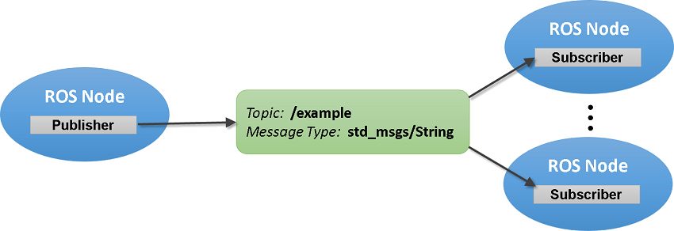
Generating Data
Before we can use or visualize any data, it needs to exist
Due to the structured nature of the ROS topics:
Data sources can be interchangeable (i.e. change the topic)
Data can be split out onto the network without any extra effort
Subscriber nodes can be general about where they receive data from
Science and Engineering
EGH450 - Tutorial W02 - Accessing & Managing Data in ROS
11

Slide 12
Generating Data
Common Message Types
std_msgs:
Simple Trigger – Empty: http://docs.ros.org/api/std_msgs/html/msg/Empty.html
Integer Number – Int32: http://docs.ros.org/api/std_msgs/html/msg/Int32.html
Double Precision Decimal Number – Float64: http://docs.ros.org/api/std_msgs/html/msg/Float64.html
Message Information – Header: http://docs.ros.org/api/std_msgs/html/msg/Header.html
geometry_msgs:
Position & Orientation – Pose Stamped: http://docs.ros.org/api/geometry_msgs/html/msg/PoseStamped.html
Velocity – TwistStamped: http://docs.ros.org/api/geometry_msgs/html/msg/TwistStamped.html
senesor_msgs:
IMU Readings – Imu: http://docs.ros.org/api/sensor_msgs/html/msg/Imu.html
Image – Raw: http://docs.ros.org/api/sensor_msgs/html/msg/Image.html
Image – Compressed: http://docs.ros.org/api/sensor_msgs/html/msg/CompressedImage.html
mavros_msgs:
UAV State – State: http://docs.ros.org/api/mavros_msgs/html/msg/State.html
RC Output Direct Control - OverrideRCIn: http://docs.ros.org/api/mavros_msgs/html/msg/OverrideRCIn.html
Battery Reading – BatteryStatus: http://docs.ros.org/api/mavros_msgs/html/msg/BatteryStatus.html
Science and Engineering
EGH450 - Tutorial W02 - Accessing & Managing Data in ROS
12

Slide 13
Make a Catkin Workspace
The Catkin Workspace is a place for you to develop ROS packages. By creating a ROS package, you will be able to automate your subsystems later down the line, and it will make sure your system is more reliable.
While it is not strictly necessary to create a package to run Python nodes in ROS, it is necessary to compile C++ nodes.
These steps are extracted from the QUTAS Flight Stack instructions, do not repeat if you’ve already followed that guide:
$ mkdir -p ~/catkin_ws/src
$ cd ~/catkin_ws/src
$ catkin_init_workspace
$ cd ../
$ catkin_make
$ echo "source ~catkin_ws/devel/setup.bash" >> ~/.bashrc
$ source ~/.bashrc
Science and Engineering
EGH450 - Tutorial W02 - Accessing & Managing Data in ROS
13

Slide 14
Generating Data
For our UAV example, lets look for a ROS package to generate some fake UAV data
The uavusr_emulator node has been designed to do just that!
https://github.com/qutas/uavusr_emulator
The types of data that is generated includes:
Position information (what is made available by VICON)
geometry_msgs/PoseStamped
Basic position control simulation (same as what the position controller expects)
geometry_msgs/PoseStamped
Sample images
Using the image_transport method
An occupancy grid (uses a latched topic, only gets sent once to each subscriber)
nav_msgs/OccupancyGrid
Science and Engineering
EGH450 - Tutorial W02 - Accessing & Managing Data in ROS
14

Slide 15
First thing!
Open your Virtual machine, and start a roscore
Science and Engineering
EGH450 - Tutorial W02 - Accessing & Managing Data in ROS
15

Slide 16
Generating Data
With the QUTAS Flight Stack configured, follow the instructions on running the uavusr_emulator package:
https://github.com/qutas/uavusr_emulator#running
Science and Engineering
EGH450 - Tutorial W02 - Accessing & Managing Data in ROS
16

Slide 17
Accessing Data
Many of our interactions as a user will be searching or debugging in the ROS environment. This will be through the use of command line (CLI) tools.
One of the most useful packages in ROS is called rostopic:
http://wiki.ros.org/rostopic#rostopic_command-line_tool
With rostopic, we can inspect data on a topic for all sorts of purposes:
Print information about active topics: rostopic list
Find topics by type: rostopic find example_pkg/ExampleType
Print information about active topic: rostopic info /example/topic
Print topic type: rostopic type /example/topic
Display publishing rate of topic: rostopic hz /example/topic
Print messages to screen: rostopic echo /example/topic
Display bandwidth used by topic: rostopic bw /example/topic
Display delay for topic which has header: rostopic delay /example/topic
Publish data to topic: rostopic pub ...
Try these for yourself!
Science and Engineering
EGH450 - Tutorial W02 - Accessing & Managing Data in ROS
17

Slide 18
Accessing Data
For development, and for the purpose of making our system, we probably want to make a subscriber node to listen out for messages
In any ROS node, we can subscribe to as many topics as we want, and we can also publish to as many topics as we wish
Very basic script to subscribe to topics (terrible way to do it!)
https://gist.github.com/pryre/f5f694573821c30b1e0ab714bab0cefe
More in-depth explanation:
http://wiki.ros.org/rospy/Overview/Publishers%20and%20Subscribers
Example packages:
https://github.com/qutas/kinetic_sample_packages
Science and Engineering
EGH450 - Tutorial W02 - Accessing & Managing Data in ROS
18

Slide 19
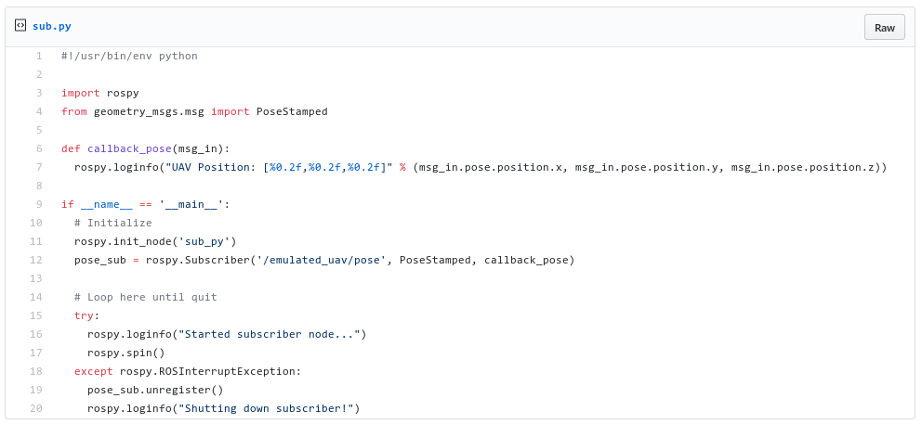
Accessing Data
Science and Engineering
EGH450 - Tutorial W02 - Accessing & Managing Data in ROS
19

Slide 20
Accessing Data
Very basic subscriber example
Go to the basic script example and copy the code
Very basic script to subscribe to topics (terrible way to do it!)
https://gist.github.com/pryre/f5f694573821c30b1e0ab714bab0cefe
In a terminal, run the following commands:
Save the script:
Paste in the example code from above
Press “CTRL+X” to exit nano
Press “y” to save the code
Press “Enter” to confirm the file name
Run the following commands to run the script
Press “CTRL+C” to quit the script
$ nano ~/catkin_ws/sub.py
$ python ~/catkin_ws/sub.py
Science and Engineering
EGH450 - Tutorial W02 - Accessing & Managing Data in ROS
20

Slide 21
Visualization
To view data in ROS, we have 2 main options:
rqt
Allows us to create multiple panels and layouts
Great for a GCS and very easy to use for viewing images
rviz
Has multiple plugins that render to a 3D view
Great for visualizing special data (e.g. UAV position)
Start both these programs now!
Science and Engineering
EGH450 - Tutorial W02 - Accessing & Managing Data in ROS
21

Slide 22
Visualization using rqt
rqt_imageview
rqt_graph
rqt_multiplot
Science and Engineering
EGH450 - Tutorial W02 - Accessing & Managing Data in ROS
22

Slide 23
Visualization using rviz
Adding Plugins
Visualizing the UAV
Science and Engineering
EGH450 - Tutorial W02 - Accessing & Managing Data in ROS
23

Slide 24
Recording Data
The tools available in the rosbag package allow use to record data through ROS
http://wiki.ros.org/rosbag/Tutorials/Recording%20and%20playing%20back%20data
Recorded data can then be:
Replayed through ROS
As a “simulation”
As additional data in real-time
Filtered and repackaged
Can be manipulated
Have more data added in later
Exported for use outside of ROS
Exported to MATLAB
An image feed can be turned into a video
Science and Engineering
EGH450 - Tutorial W02 - Accessing & Managing Data in ROS
24

