Slide 1

EGH450 Advanced Unmanned Aircraft Systems Tutorial 02 Airframe, Power/Propulsion and Payload
Felipe Gonzalez - felipe.gonzalez@qut.edu.au
Kye Morton– morton9@qut.edu.au
Science and Engineering

Slide 2
Reminders
S901 Access – Please attend one of the orientations with Steve Bulmer held in this week or in Week 3. Check Blackboard announcement for induction times.
UAV Collection- UAV are ready for collection in S9 store. Please contact Steve Bulmer or Kye if there are any issues with this.
Ordering Parts– If any group has not received an ordered item/s please check the store and email Kye.
Science and Engineering

Slide 3
Airframe

Slide 4
Airframe Subsystem Info
This subsystem is responsible for design, development and modification of the airframe structure.
The construction of the airframe for the all the UAVs should be complete at this stage however additional modification maybe be required, for example
Payload Mounts
Camera/gimbal Attachments
VICON Tracking Marker Attachments
Weight and Payload Balancing
Mounting Plates designs are available on QUTAS/Wiki
Link - https://github.com/qutas/info/tree/master/Schematics
Science and Engineering

Slide 5
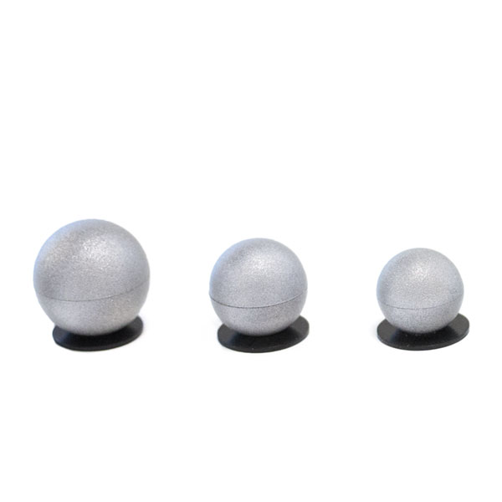
Airframe Subsystem Info
Vicon IR Marker Attachment
Crucial for tracking the UAV within the test area, if any move and fall off during flight can cause inaccurate position tracking from VICON system.
You can use double sided tape available at Da Vinci however it is recommend that
Recommended to modify airframe to attach marker M4 bolts
Ensure the marker holds are symmetrically placed around the airframe
Ensure the camera mounts are attached by week 6
Allows you to do a live test during week 6 at Da Vinci and record a bag file with video for testing outside of practicals.
Science and Engineering

Slide 6
Power and Propulsion

Slide 7
POW/PRO Subsystem Info
Your role in the team is to ensure all the systems that require power is distributed accordingly from the battery
Provide Regulated 3.3v-5v lines for the O/B computes, Servo/Solenoids, Autopilot
Make sure the BEC is rated to handle the load required
It is your job to understand what each subsystems' power requirements are and the type of connection and method of distribution.
For example a Rpi can be given 5V power using either Micro USB or Servo connector
Reminder that you may be required to do additional thrust testing at the practicals from week 3.
Please contact Kye so he can bring the thrust test rig down
Science and Engineering

Slide 8
POW/PRO Subsystem Info
Most of this subsystem is complete, however you may need to modify changes as the other subsystems develop.
Motors, ECS, and Autopilot are already installed
Document the connections and provide a final power distribution schematic for final demonstration and submission.
Science and Engineering

Slide 9
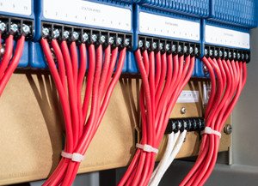
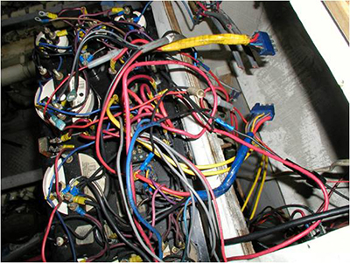

POW/PRO Subsystem Info
Cable Management
Zip ties are your friend, please ensure there are no loose cables as this is very hazardous during flight
High Gauge cable for motor/esc, ensure any soldered cables/connectors are insulated with heat shrink
A neat system is much easier to debug than a messy one.
Tutor will come around and check whether you need rearrange wiring and secure to the frame.
Science and Engineering

Slide 10
PAYLOAD

Slide 11
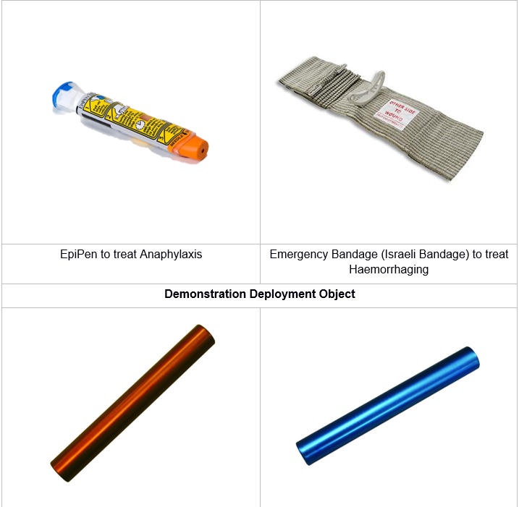
Payload Subsystem Info
“When each marker is identified and localised, the UAV^{U}SR must immediately deploy the correct simulated medication” - HLO 5 Medication Delivery
Science and Engineering

Slide 12
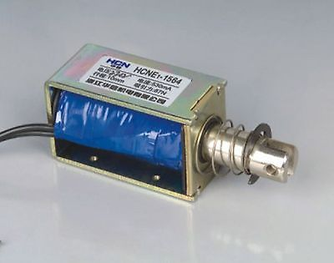
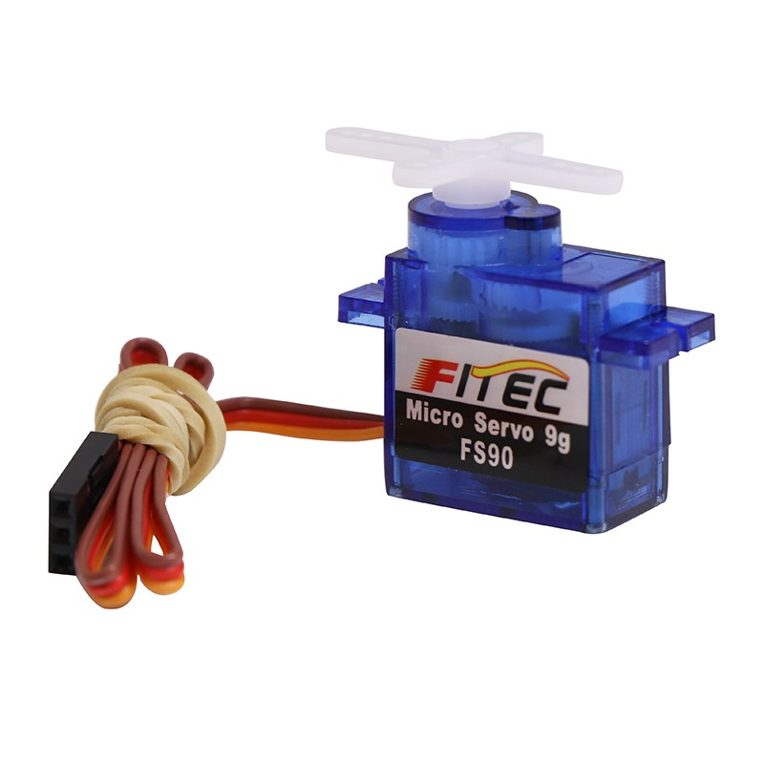
Payload Subsystem Info
Your role in the team is to the payload is to accurately delivered when the specific target is detected
Design and mechanism to drop a right package to the right target
Make sure you test the accuracy and precision of your delivery
Science and Engineering

Slide 13
Payload Subsystem Info
Week 9 Demonstration
This is only a bench test but must be electronically activated but no involvement to the actual mechanism.
You may activate the mechanism using the following- ROS control node, electronic switch, basic pi script
Recommended that you use ROS control node as this will be needed in the final demo
Week 12 Final Demonstration
Fully autonomous operation so you should already be integrating the system the UAV by week 9.
Science and Engineering

Slide 14
Payload Subsystem Info
Interfacing with others subsystem
You will be required to write a ROS node/s to control/activate you mechanisation when target are detected and localised.
Servo based Payloads delivery
Can use onboard computer -PIGPIO/wiringpi, http://abyz.me.uk/rpi/pigpio/ Odroids- https://wiki.odroid.com/odroid-xu4/application_note/gpio/wiringpi
Can also use autopilot(mavros) as the hardware interface(very simple)
Solenoid based Payloads delivery
Must use onboard computer -PIGPIO/wiringpi, http://abyz.me.uk/rpi/pigpio/ Odroids- https://wiki.odroid.com/odroid-xu4/application_note/gpio/wiringpi
Reminder that 3D printing of your system may take up to 3 weeks, especially toward the latter end of the semester
Please complete your mechanical design early in the semester to allow time for modification and possible troubleshooting.
3D Printing can be done at the Launchpad in O Block
Science and Engineering

