Slide 1
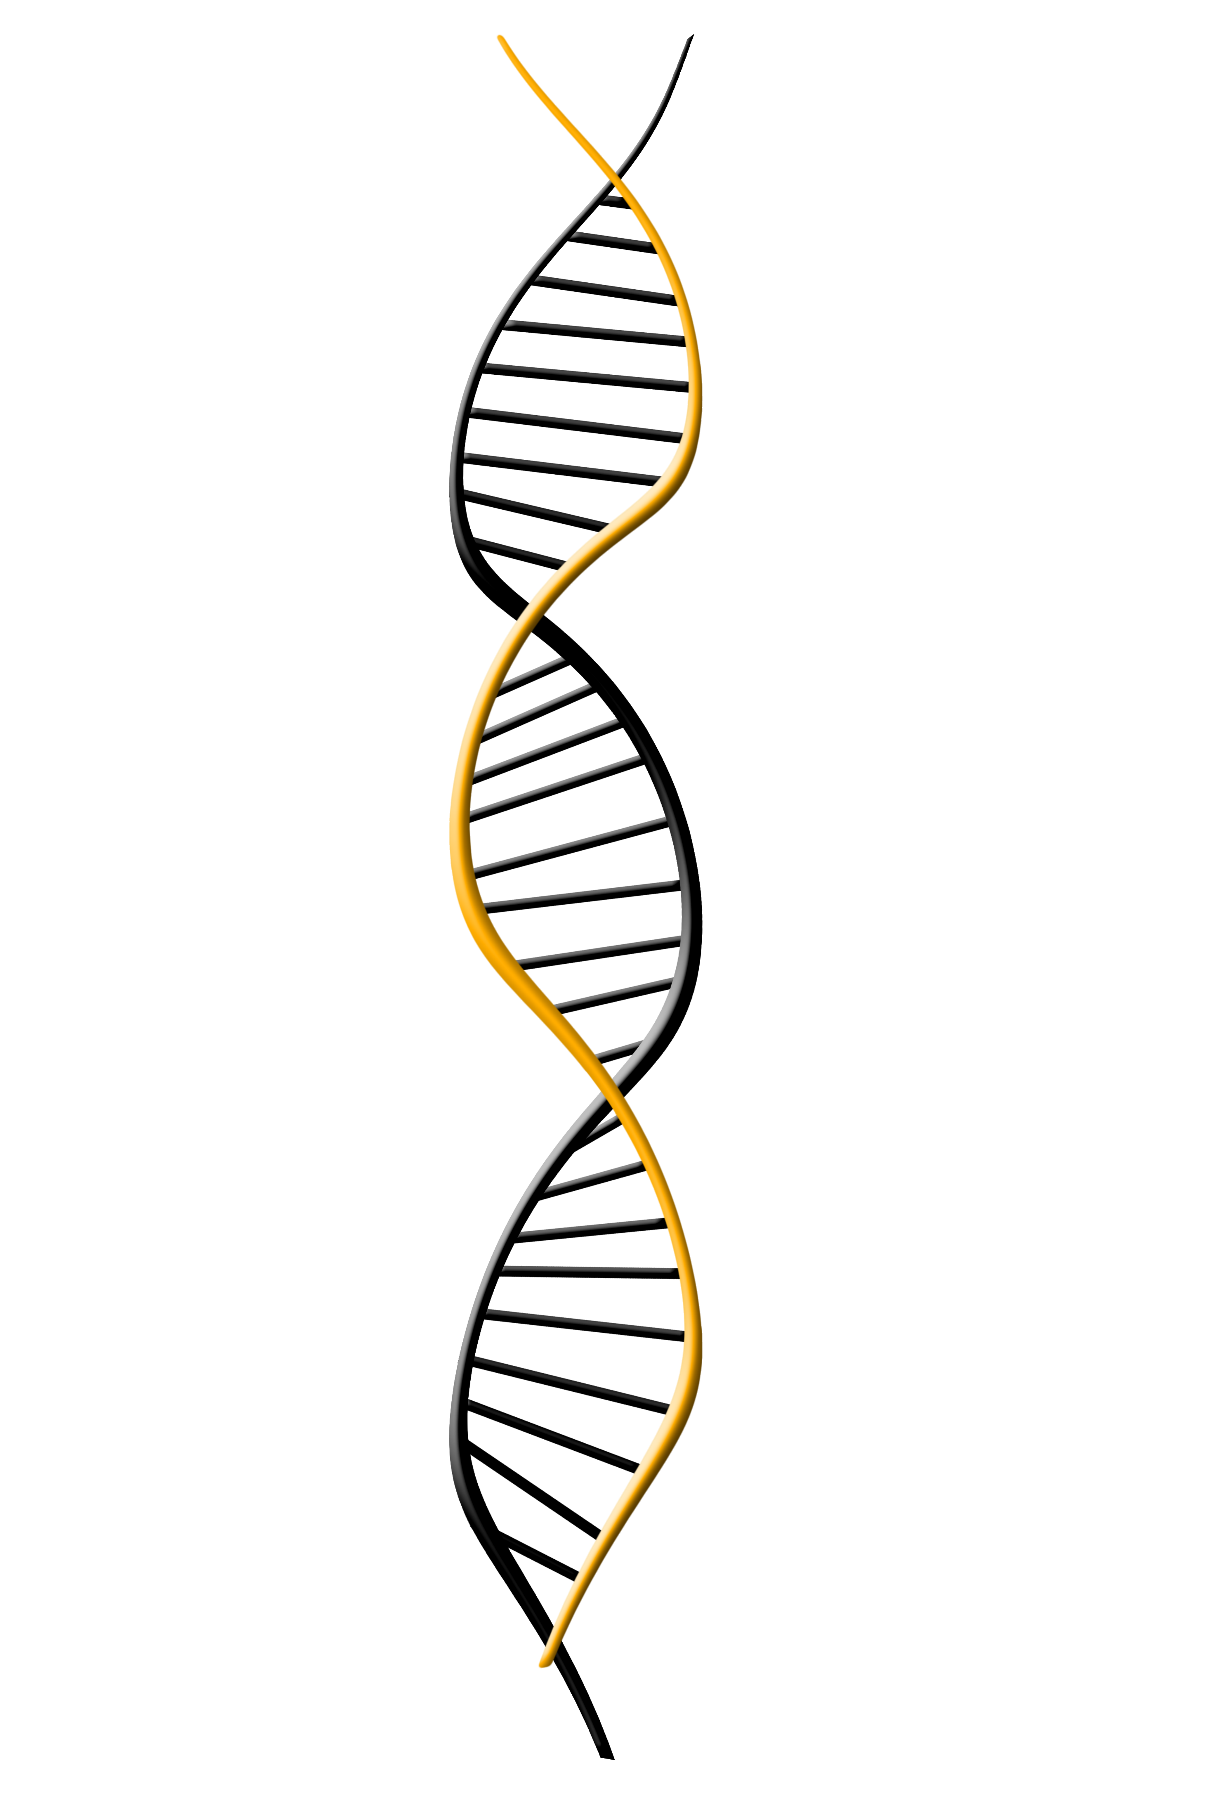
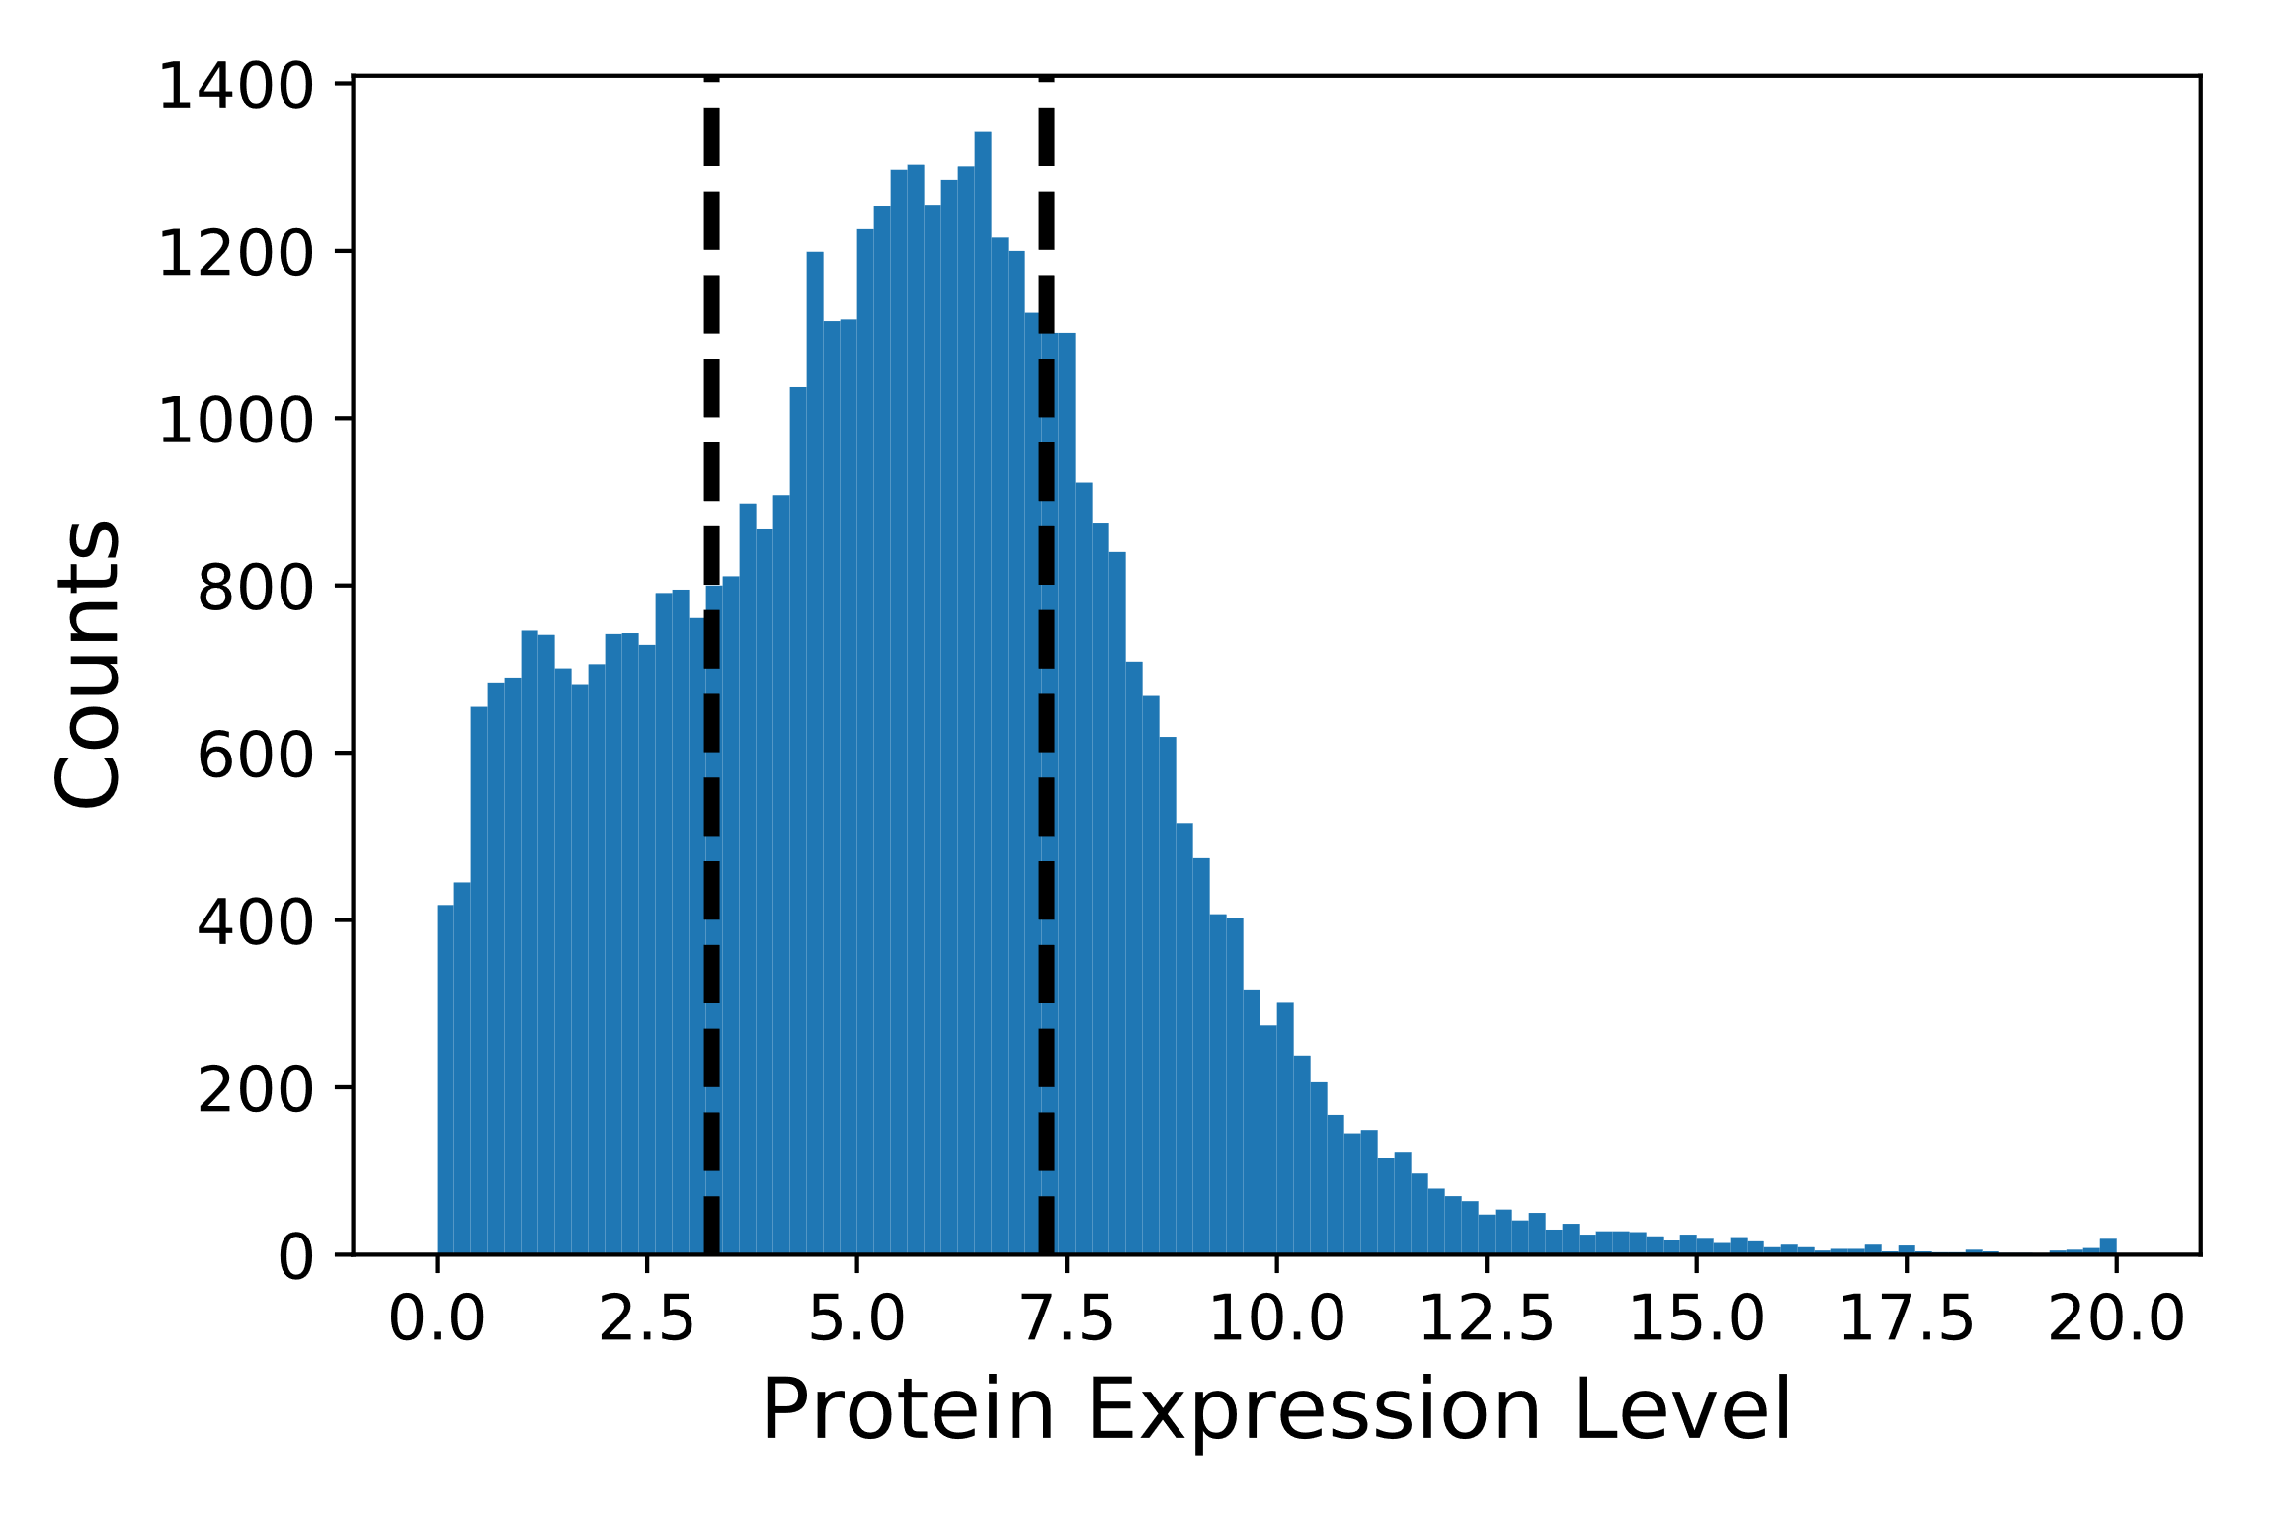
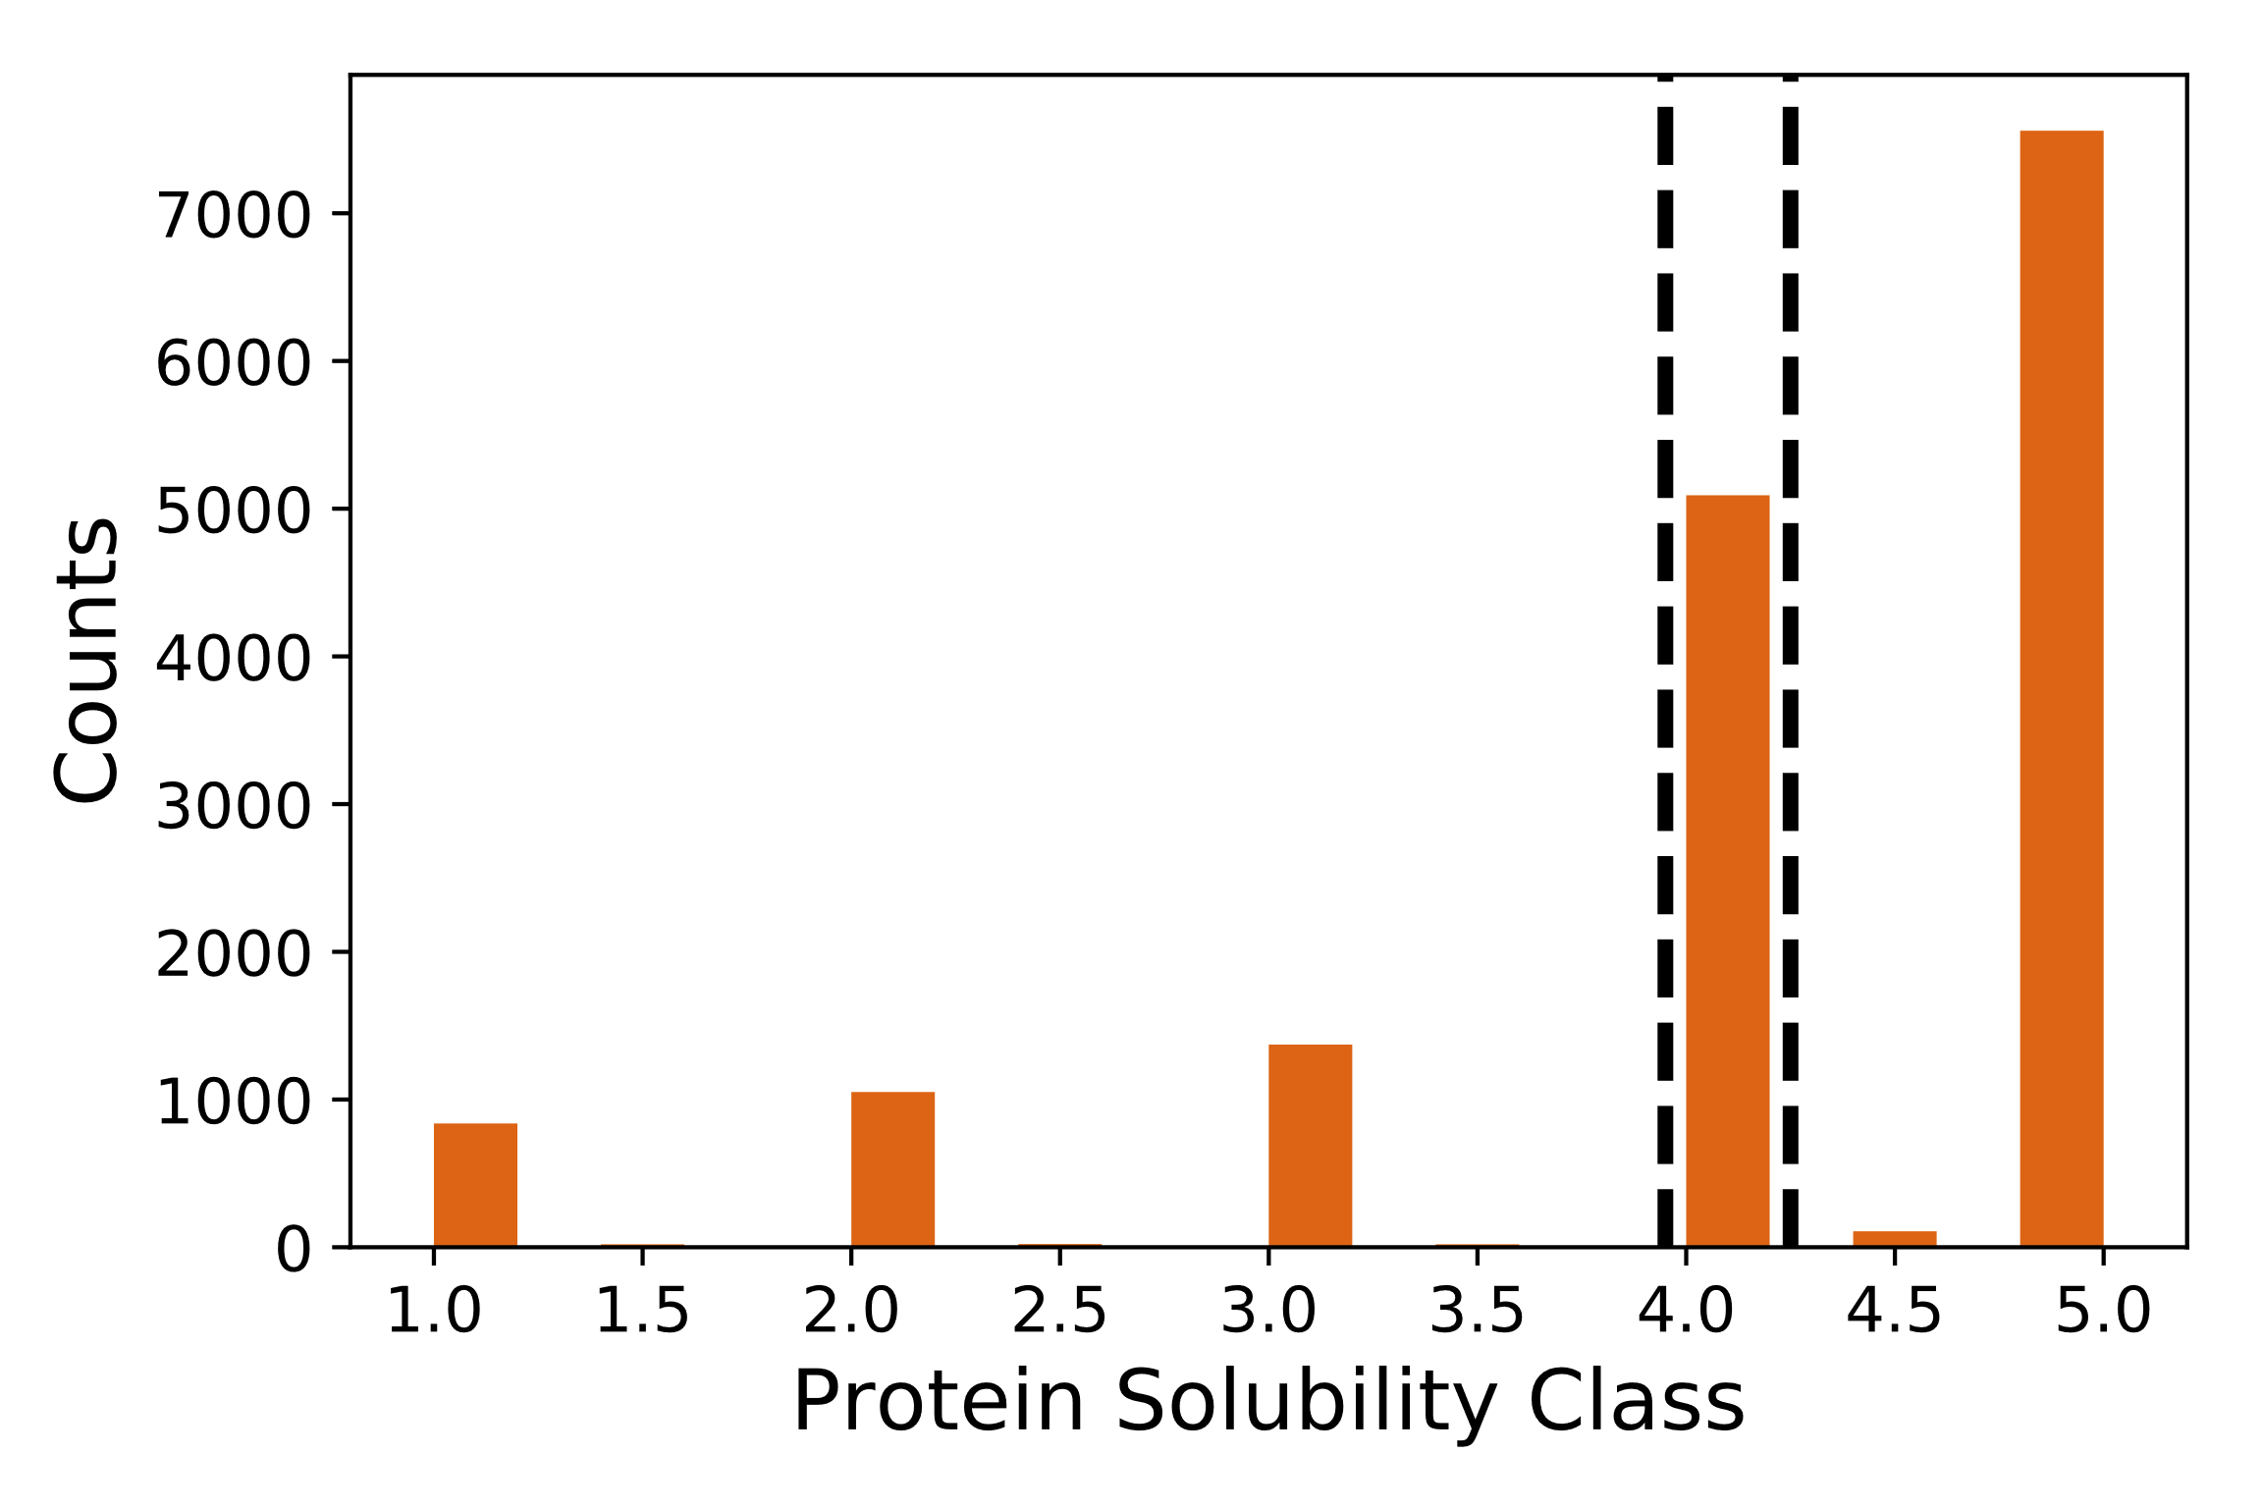
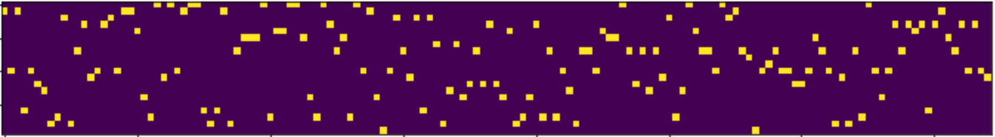

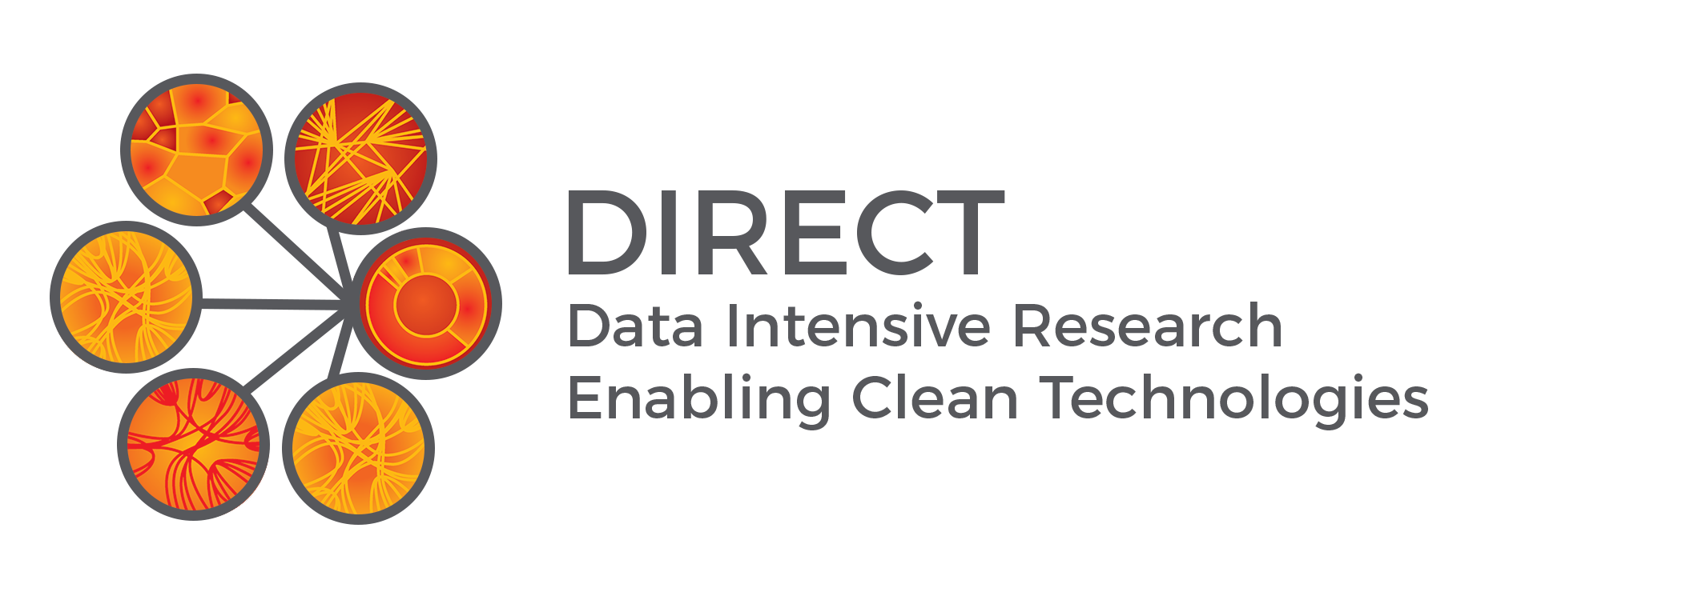
NDAC:
Classification of Protein Expression from Amino Acid or Nucleotide Sequence
Joshua Smith, Jay Rutherford, & Chris Nyambura | Chemical Engineering | University of Washington
Problem
The Dataset
Results
Running lots of protein expression experiments is costly, but possible. Data is becoming available for protein expression levels so now it is possible to use the data from these experiments to help screen potential sequences
Protein Epitote Signature Tags (PrESTs), consisting of 20-150 amino acids
Expressed for Proteomics – Human Protein Atlas (**Ref)
Classified according to Sastry et. al.
Protein expression data for 45,206 PrESTs
1st quantile = low expression (11302 samples)
4th quantile = high expression (11301 samples)
2nd and 3rd quantiles removed (22603 samples)
Protein solubility data for 16,082 PrESTs
Low solubility classes 1 - 3.5 (3324 samples)
High solubility classes 4.5 – 5 (5091 samples)
Solubility class 4 removed (7667 samples)
Objectives
Classify protein expression level based on sequence data
The Network
Classification results here.
Sensitivity analysis for different quantiles
Other descriptions of the results…
Methods
Description of the network
(Need to draw something up to describe)
Property Calculation Method Used by Sastry et al
Amino Acid Sequence
KSKFSGAVLNVPDTSDNSKKQMLRTRS…
One-Hot Encoded
Graphic explaining how Sastry et al accomplished classification
Embedded Sequence
Sequence to Prediction Method
1D Convolution
Conclusion
We achieved an accuracy of ___ compared to an accuracy of __ as reported by Sastry
Pooling
LSTM
Graphic showing sequence to classification approach
Works Cited
Prediction
1. Sastry …
2. C-LSTM paper
This work makes use of: Keras, TensorFlow, matplotlib, sklearn, h5py, numpy, and pandas
Acknowledgements:
Prof. Jonathan Posner and Prof. Igor Novosselov for funding and guidance.
Prof. David Beck for his dedication to teaching both DIRECT courses this quarter.
Arushi Prakash, Nick Montoni, and Coco Mao for their work as TA for the DIRECT courses.
Funded in part by a grant from the NIH National Institute of Biomedical Imaging and Bioengineering (U01 EB021923).

