Slide 1
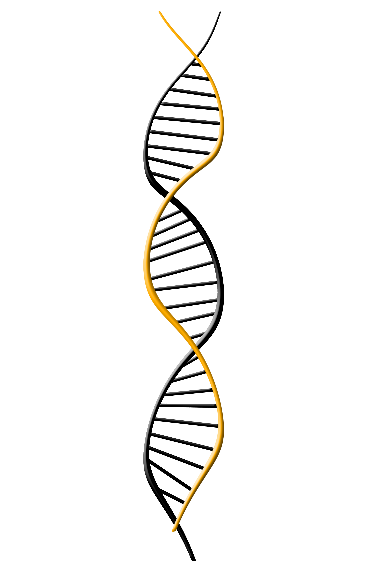
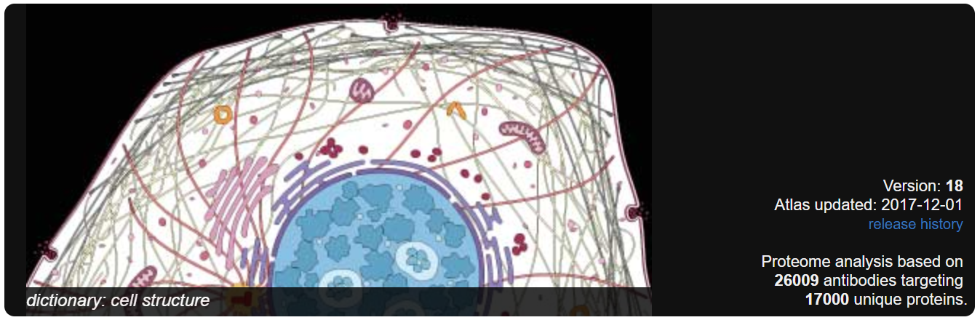
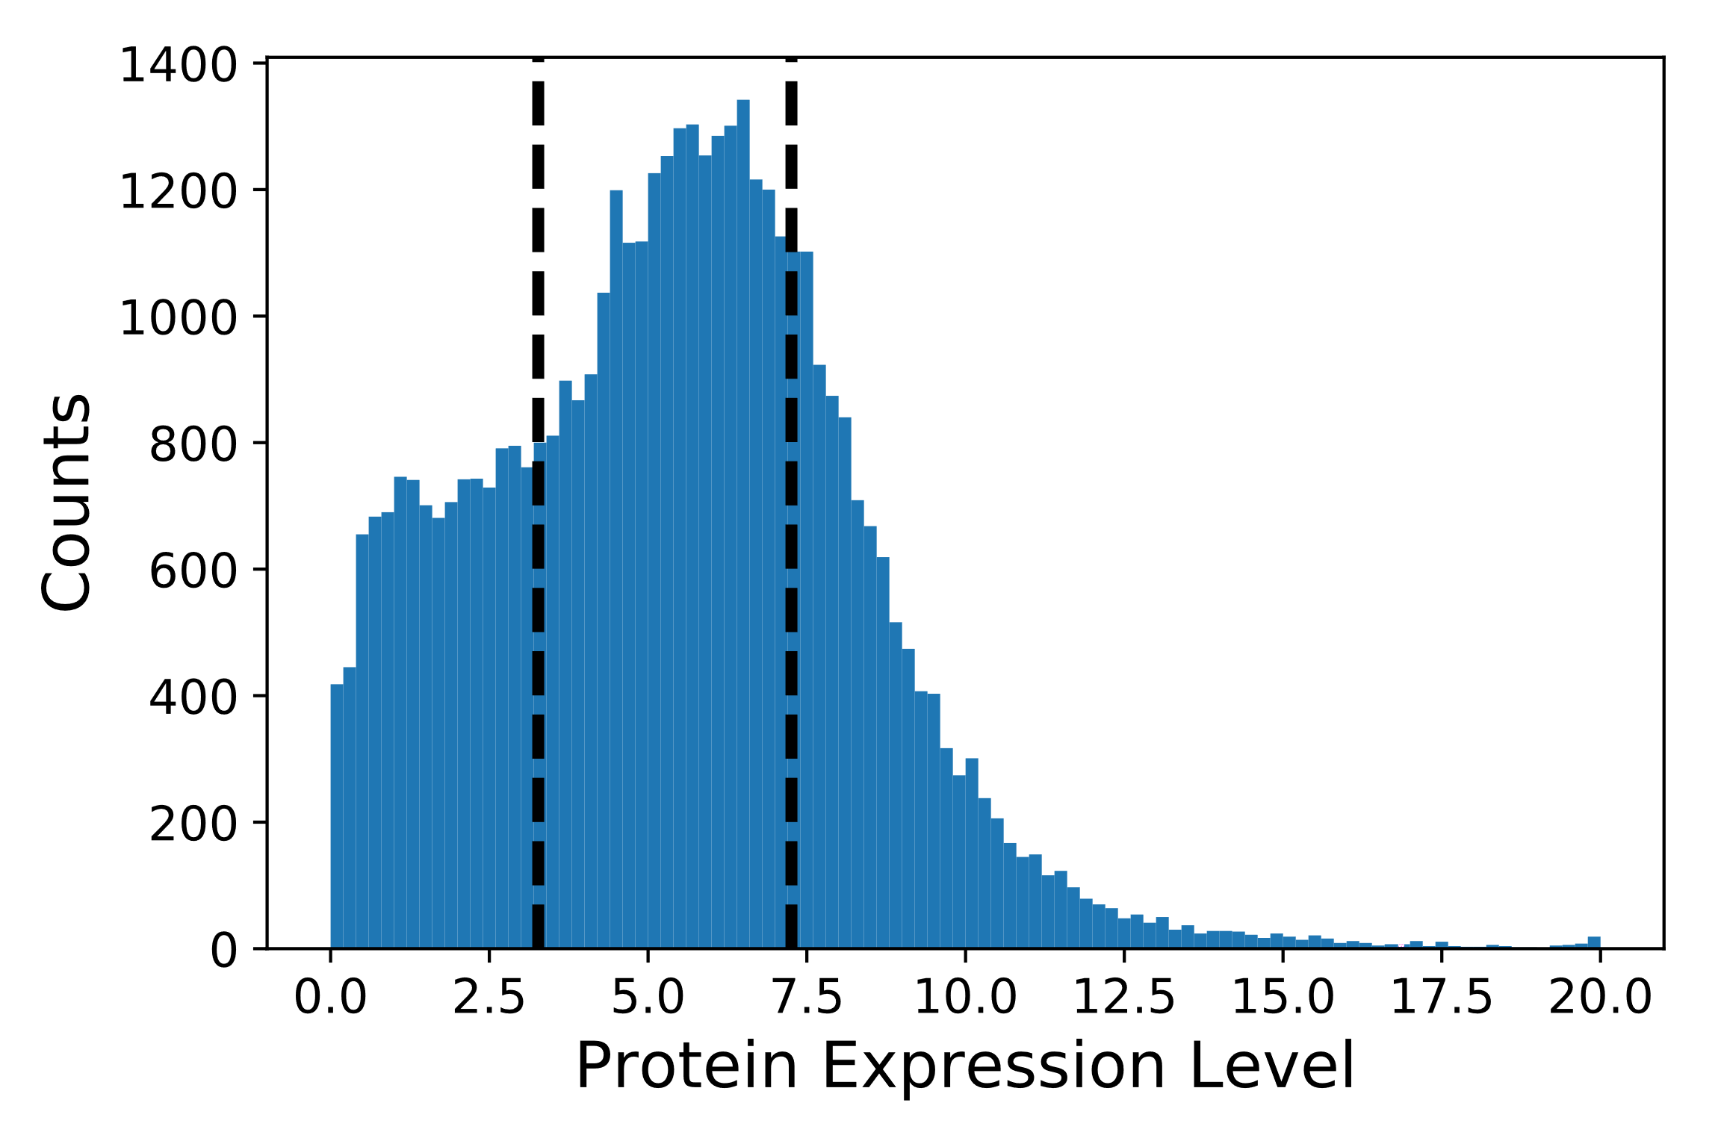
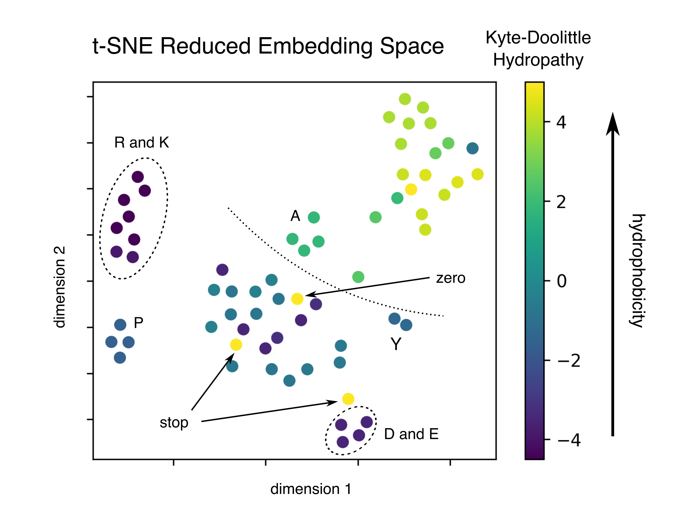
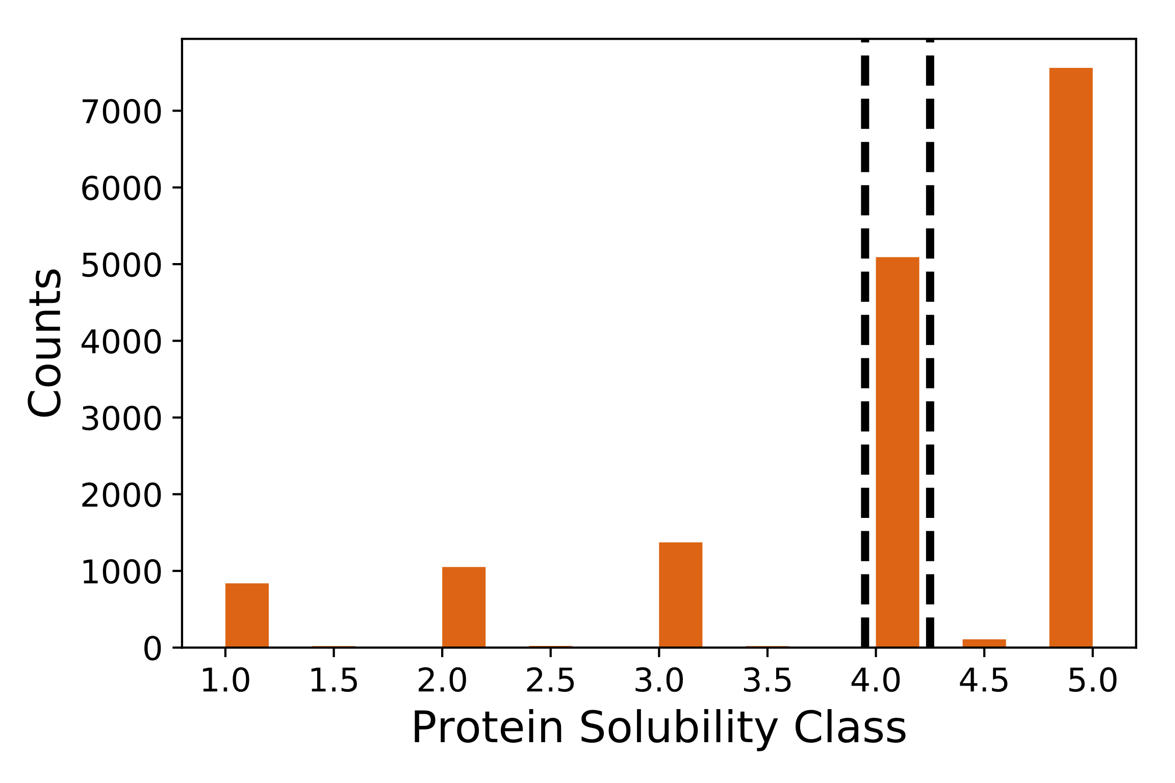
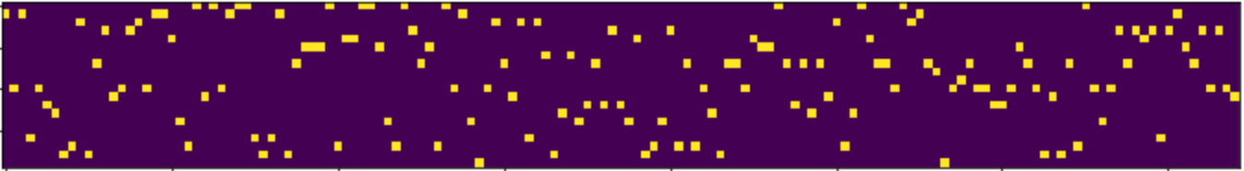
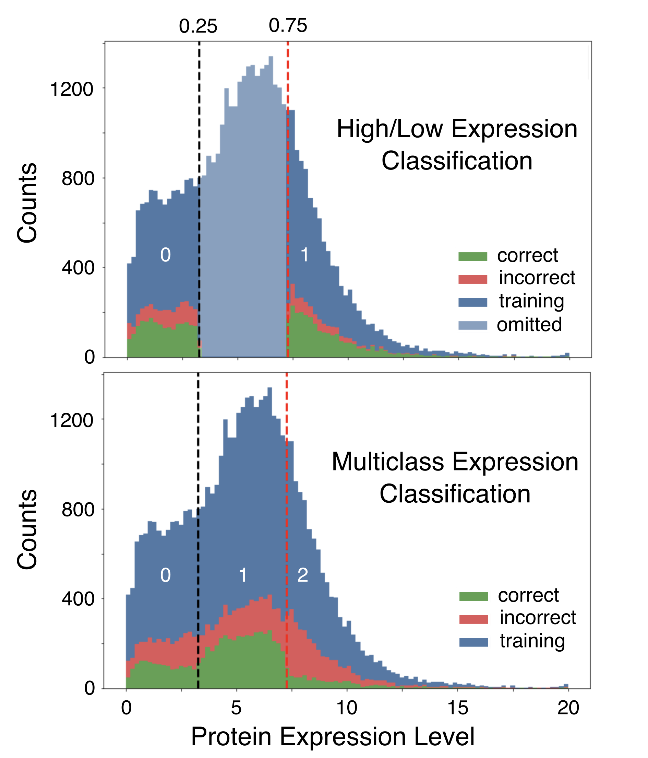


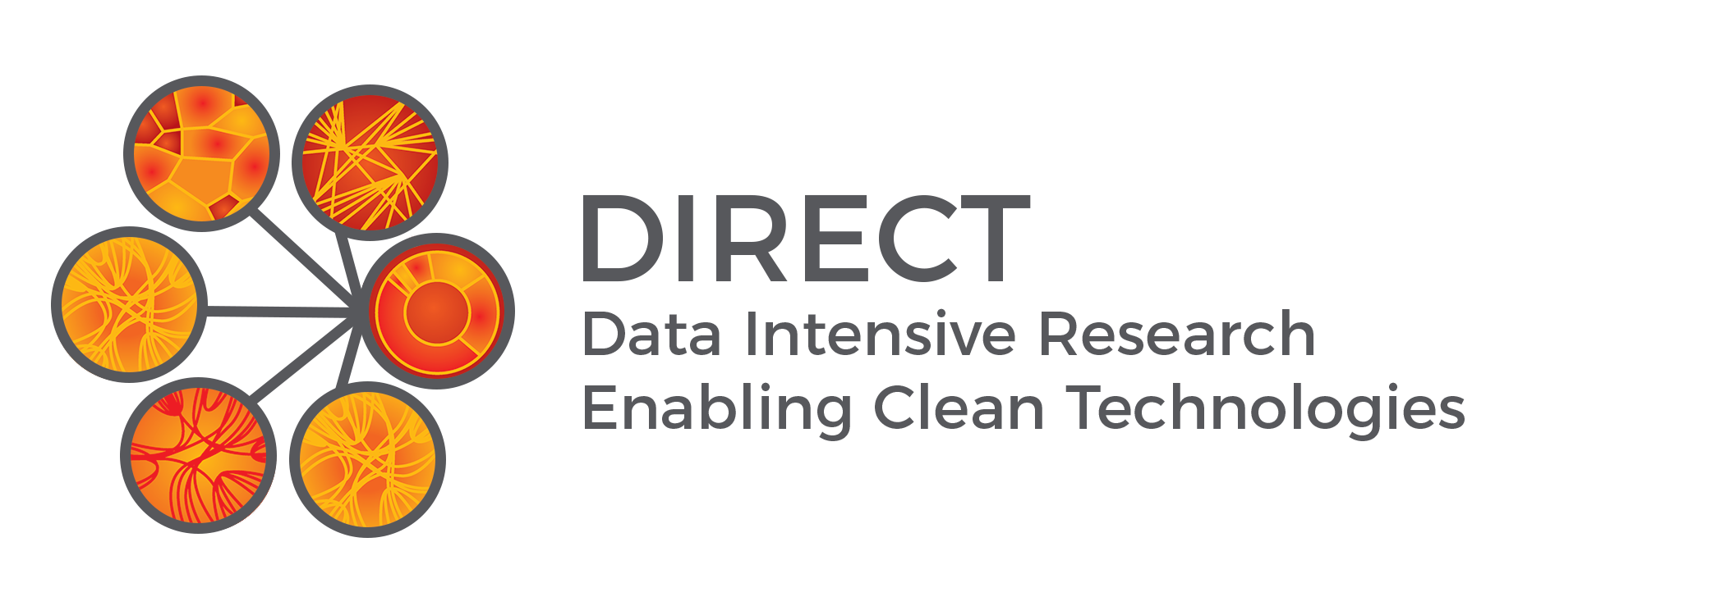

NDAC:
Classification of Protein Expression from Amino Acid or Nucleotide Sequence
Joshua Smith, Jay Rutherford, & Chris Nyambura | Chemical Engineering | University of Washington
Problem
The Dataset
Results
The Human Protein Atlas aims to map
all the proteins in the human body. This ambitious goal requires expressing thousands of different recombinant proteins to generate antibodies.
Protein Epitote Signature Tags (PrESTs), consisting of 20-150 amino acids
Expressed for Proteomics – Human Protein Atlas
Classified according to Sastry et. al.
Protein expression data for 45,206 PrESTs
1st quantile = low expression (11302 samples)
4th quantile = high expression (11301 samples)
2nd and 3rd quantiles removed (22603 samples)
Protein solubility data for 16,082 PrESTs
Low solubility classes 1 - 3.5 (3324 samples)
High solubility classes 4.5 – 5 (5091 samples)
Solubility class 4 removed (7667 samples)
What did the the embedding layer learn?
We evaluated the embedding weights using t-SNE and found that codons that code for the same amino acids grouped together as well as codons of similar hydropathy… (sorry if this is non-sense, just trying to gauge space**)
proteinatlas.org
Currently the protein atlas targets 17,000 unique proteins using 26,009 antibodies. Finding recombinant DNA sequences that express well requires extensive experimentation that could be reduced using high performance computing.
Objectives
Use data generated by the Human Protein Atlas to predict protein expression and solubility directly from DNA or amino acid sequences using a neural network.
Compare this approach with the computational biology approach of Sastry et. al.¹
The Network
Results
Model Aided Experimentation
Model Aided Experimentation
Accuracy of various approaches
 | Number of Experiments | Expressed Proteins
Iteration 1 | 1877 | 1187
Iteration 2 | 690 | 201
Iteration 3 | 176 | 27
Total | 2780 | 1395
Actual Experiments | 4556 | 1395
Amino Acid Sequence
Amino acid or DNA sequence input
One-Hot Encode – represent as a matrix and pad with zeros to make all sequences the same length.
Embedding– learn similarities between amino acids/codons
AA embedding length = 16
DNA embedding length = 16
Convolution – learn short range patterns
AA - filter length 8, 100 filters
DNA - filter length 5, 200 filters
Pooling – generalize pattern recognition
AA – pool size = 3
DNA – pool size = 4
LSTM – Learn long range patterns
AA - 200 nodes
DNA - 150 nodes
 | Sastry et. al | CNN – Nucleotide Sequence | Optimized Network – Nucleotide Sequence | Optimized Network – Amino Acid Sequence
Expression | 70.0% ± 0.8% | 63.8% ± 0.8% | 72.7% ± 2.0% | 73.5% ± 1.0%
Solubility | 82% | -- | -- | 80.1% ± 1.4%
KSKFSGAVLNVPDTSDNSKKQMLRTRS…
One-Hot Encoding
Embedded Sequence
Sensitivity to quantiles
Following the same prediction pipeline used in Sastry et. al., our optimized network showed only 2780 experiments are necessary for high expression PrESTs (38.98% reduction), compared to 38.70% reduction for their best ensemble model.
Discuss potential for multiclass prediction or changing quantiles to make use of more or less data. Multiclass apparently hurts classification performance, especially for highly expressed peptides. Potentially interesting, given that the high/medium expression proteins appear to belong to a single Gaussian. Will add effect of changing the bounds in the morning if we think it’ll be a nice addition.
Conclusion
1D Convolution
We achieved an accuracy of 73.5% compared to an accuracy of 70% reported by Sastry et. al. for predicting protein expression showing direct prediction from sequence data is may be the best approach. Predicting solubility gave a less accurate result than reported by Sastry et. al. indicating a computation biology approach may be superior for predicting solubility.
Max Pooling
LSTM
Works Cited
1. Sastry, Anand, et al. Machine Learning in Computational Biology to Accelerate High-Throughput Protein Expression. 2017
2. Zhou, Chunting, et al. A C-LSTM Neural Network for Text Classification. 2015
This work makes use of: Keras, TensorFlow, matplotlib, sklearn, h5py, numpy, and pandas
Prediction
Acknowledgements:
Jon Rue at Novo-Nordisk for his support, guidance and ideas.
Prof. David Beck for his guidance and instruction of the DIRECT courses.
Prof. Jim Pfaendtner for coordinating funding while on sabbatical and the Chemical Engineering department for providing funding

