Slide 1
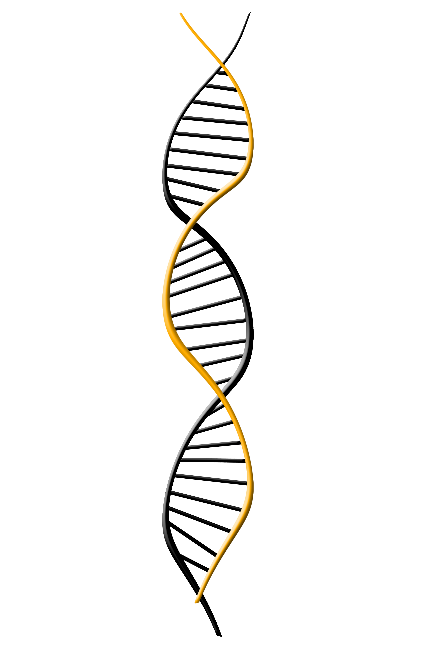


NDAC:
Classification of Protein Expression from Amino Acid or Nucleotide Sequence
Joshua Smith, Jay Rutherford, & Chris Nyambura | Chemical Engineering | University of Washington
Problem
The Dataset
Results
Running lots of protein expression experiments is costly, but possible. Data is becoming available for protein expression levels so now it is possible to use the data from these experiments to help screen potential sequences
Description of the dataset here
Objectives
Classify protein expression level based on sequence data
Sequence Encoding and Embedding
Methods
Classification results here.
Sensitivity analysis for different quantiles
Other descriptions of the results…
Property Calculation Method Used by Sastry et al
Images of one hot encoded and embedded sequence representations
Graphic explaining how Sastry et al accomplished classification
The Network
Sequence to Prediction Method
Conclusion
We achieved an accuracy of ___ compared to an accuracy of __ as reported by Sastry
Description of the network
(Need to draw something up to describe)
Graphic showing sequence to classification approach
Works Cited
1. Sastry …
2. C-LSTM paper
This work makes use of: Keras, TensorFlow, matplotlib, sklearn, h5py, numpy, and pandas
Acknowledgements:
Prof. Jonathan Posner and Prof. Igor Novosselov for funding and guidance.
Prof. David Beck for his dedication to teaching both DIRECT courses this quarter.
Arushi Prakash, Nick Montoni, and Coco Mao for their work as TA for the DIRECT courses.
Funded in part by a grant from the NIH National Institute of Biomedical Imaging and Bioengineering (U01 EB021923).

