Slide 1
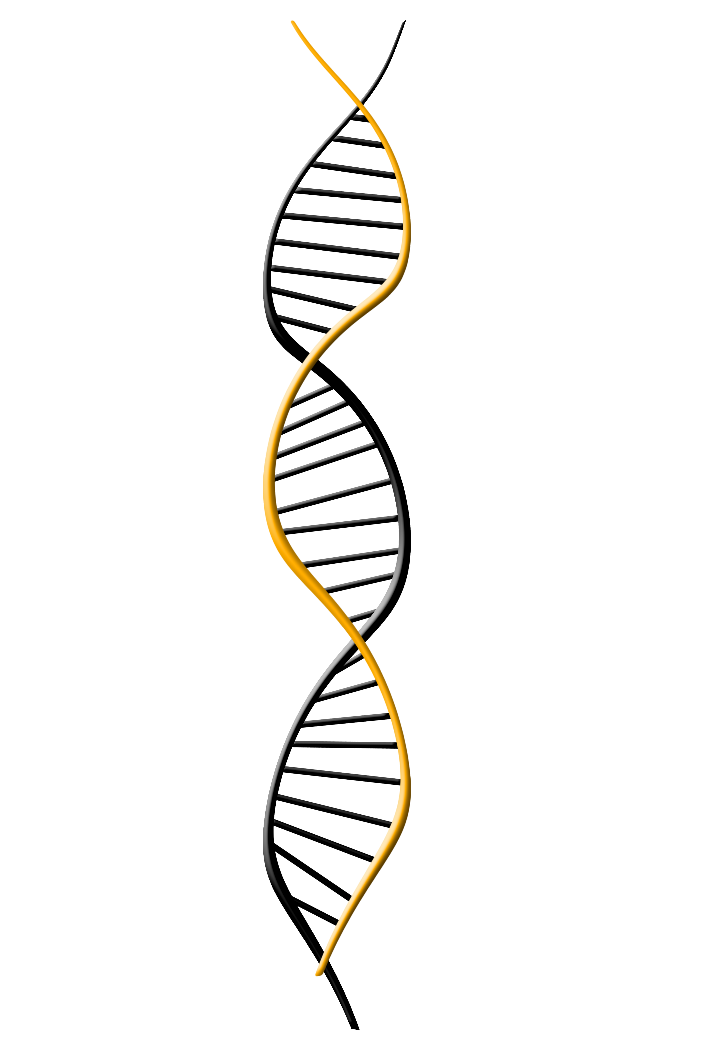
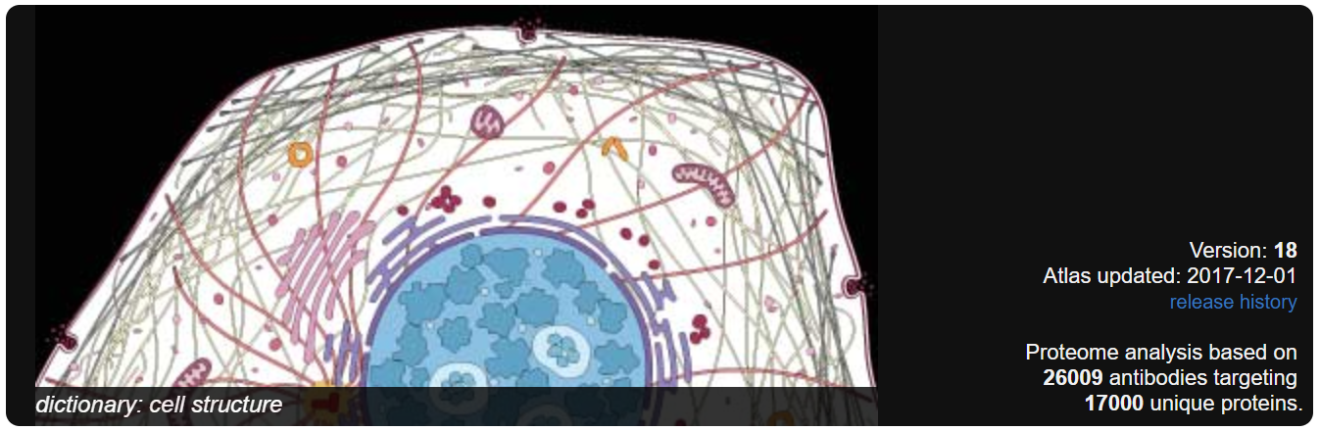
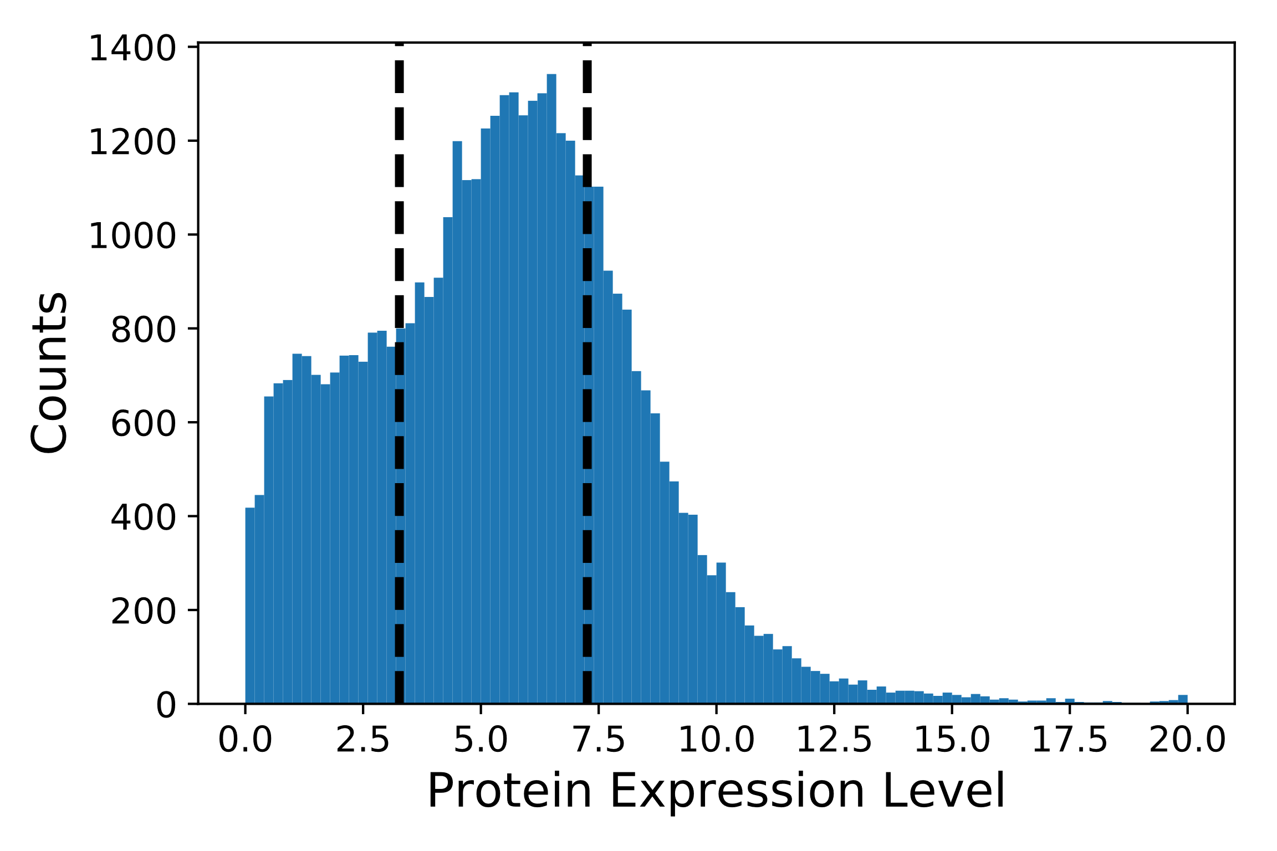
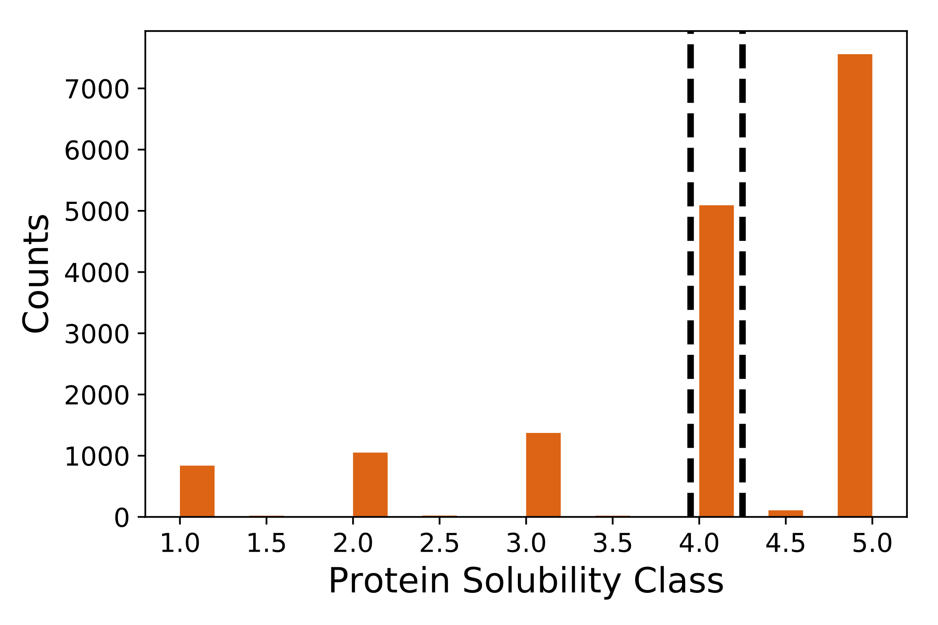
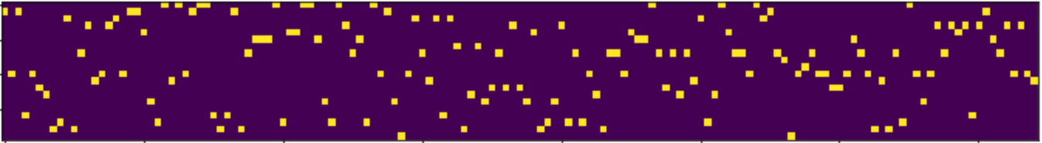




NDAC:
Classification of Protein Expression from Amino Acid or Nucleotide Sequence
Joshua Smith, Jay Rutherford, & Chris Nyambura | Chemical Engineering | University of Washington
Problem
The Dataset
Results
The Human Protein Atlas aims to map
all the proteins in the human body. This
ambitious goal requires expressing
thousands of different recombinant
proteins. Currently the protein atlas
Targets 17,000 unique proteins using 26,009 antibodies. Finding recombinant proteins that express well requires extensive experimentation that could be reduced with the use of computational methods.
Protein Epitote Signature Tags (PrESTs), consisting of 20-150 amino acids
Expressed for Proteomics – Human Protein Atlas (**Ref)
Classified according to Sastry et. al.
Protein expression data for 45,206 PrESTs
1st quantile = low expression (11302 samples)
4th quantile = high expression (11301 samples)
2nd and 3rd quantiles removed (22603 samples)
Protein solubility data for 16,082 PrESTs
Low solubility classes 1 - 3.5 (3324 samples)
High solubility classes 4.5 – 5 (5091 samples)
Solubility class 4 removed (7667 samples)
proteinatlas.org
Objectives
Classify protein expression level based on sequence data
Classification results here.
Sensitivity analysis for different quantiles
Other descriptions of the results…
Methods
The Network
Property Calculation Method Used by Sastry et al
Amino Acid Sequence
Amino Acid or DNA sequence input
One-Hot Encode – represent as a matrix and pad with zeros to make all sequences the same length.
Embedding– learn similarities between amino acids/codons
AA embedding length = **
DNA embedding length = **
Convolution – learn short range patterns
AA - ** filter length x ** filters
DNA - ** filter length x ** filters
Pooling - *what does this do?*
AA – pooling width = **
DNA – pool width = **
LSTM – Learn long range patterns
AA - ** nodes
DNA - ** nodes
KSKFSGAVLNVPDTSDNSKKQMLRTRS…
One-Hot Encoding
Graphic explaining how Sastry et al accomplished classification
Sequence to Prediction Method
Embedded Sequence
Conclusion
We achieved an accuracy of ___ compared to an accuracy of __ as reported by Sastry
1D Convolution
Graphic showing sequence to classification approach
Max Pooling
LSTM
Works Cited
1. Sastry …
2. C-LSTM paper
This work makes use of: Keras, TensorFlow, matplotlib, sklearn, h5py, numpy, and pandas
Prediction
Acknowledgements:
Jon Rue at Novo-Nordisk for his support, guidance and ideas.
Prof. David Beck for his guidance and instruction of the DIRECT courses.
Prof. Jim Pfaendtner for coordinating and the Chemical Engineering department for providing funding

