Slide 1

Convolutional
Neural Network For Pneumonia Classification
Using X-Ray Images

Slide 2
Overview
Network Goals
Network Parameters
Evaluation

Slide 3
Network Goals
Resize input of arbitratily sized image of chest x-ray*
Classify input images into Healthy, Bacterial or Viral Pneumonia
*images taken from kaggle.com

Slide 4
Network Parameters
750x500 pixel images input with one colour channel
Custom PyTorch dataset class to further transform, normalize and deliver data do the dataloader
3 convolutional layers and 3 linear layers
Cross-entropy loss computation
Adam algorithm optimizer
Notes:
- Input Size was defined by biggest/mean dimensions of the original input data
- Cross Entropy Loss because it is the standard for classification problems
- Adams Solver after trial
-gradient descent with adaptive momentum, each learning rate adapted for each parameter (not fixed)
-uses momentum to smooth out fluctuations and local minima
-scales learning rate based on magnitude of reent gradient
-Adam now calculates an exponential moving average of both gradient and their squares (^2) to adaptively adjust learning rate
- Hyperparameter tuning: Learning Rates and Batch Sizes were adjusted by hand

Slide 5




Network Layers
Step 1
Step 2
3 Layers
3 Layers
Convolution
ReLu
ReLu
Linear
In
Flatten
Out
30% Dropout
3x3 Max
Pooling
50% Dropout
Notes:
Steps:
3x3 kernel Convolutional layer, a rectified linear unit activation (ReLu) function and a dropout of 30% of nodes to reduce overfitting
3x3 kernel Convolutional layer, ReLu function
3x3 kernel Convolutional layer, ReLu function, max pooling of 3x3 squares into one to lower size and translation sensitivity
Flattening to prepare for linear layers (make it one dimensional), resulting dimension: 16x166x250=664000
Linear Layer, ReLu, dropout 30%
Linear Lyer, ReLu
Linear Layer, 3 Outputs (normal, bacterial or viral)
->Middle layers have proven to increase accuracy
What do these things mean?
Convolution:
- 2d-data (in pixels of a gray-scale image ) is „convolved“(gefaltet) together with a kernel matrix (Faltungsmatrix, hier 3x3, kann geupdated werden) as a filter
- a neuron in the next layer is only dependent on local data points around the examined data point of the previous layer (e.g. for edge recognition in an image)
- activation function takes the weighted input (previous layer*kernel) and gives output
Dropout:
- dropout layer nullifies contribution of some neurons towards next layer (by dropping them)to prevent the learning of features that only appeare in later samples or batches and therefore prevent overfitting of training data (first batch would disproportionally influence the learning, to much fitting of the training data instead of generalization)
-neurons are dropped at random
Max Pooling:
- unnecessary data is discarded, highest values in a defined area of the single depth matrix (here 3x3) are taken and only the highest value in it is further used, reduces dimensions/computation need/overfitting significantly
Why ReLu?
- non negative activation functions better because if input includes negative values that node will for some values contribute negatively to the output (this is generally undesirable)
Extra:
- Padding of 1: additional pixel around the original image was used (frame of 1 pixel width added around the image)
- Stride of 1: means how many steps are taken starting from first pixel ergo how many are skipped, for 1 every pixel is taken (you can even set them for movement in different dimensions, can have advantages for dimension reduction for large kernels)

Slide 6
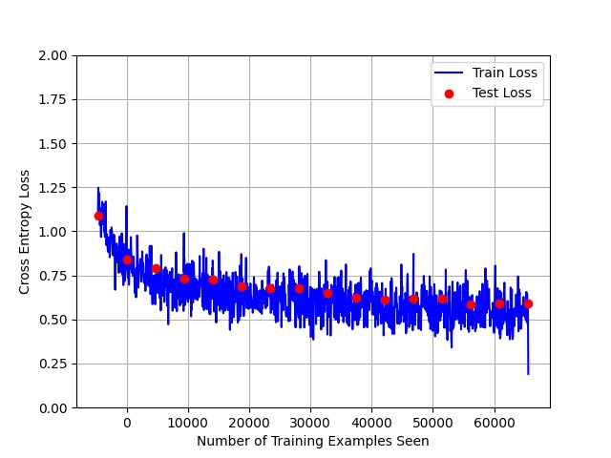
Evaluation
15 Epochs
Accuracy of up to 77%
Notes:
Accuracy ~75%, max 77%
Optical distinguishment between viral and bacterial is difficult (for a human)
Data is split about evenly in normal and infected, data not equally distributed
Viral was hardest to distinguish

Slide 7
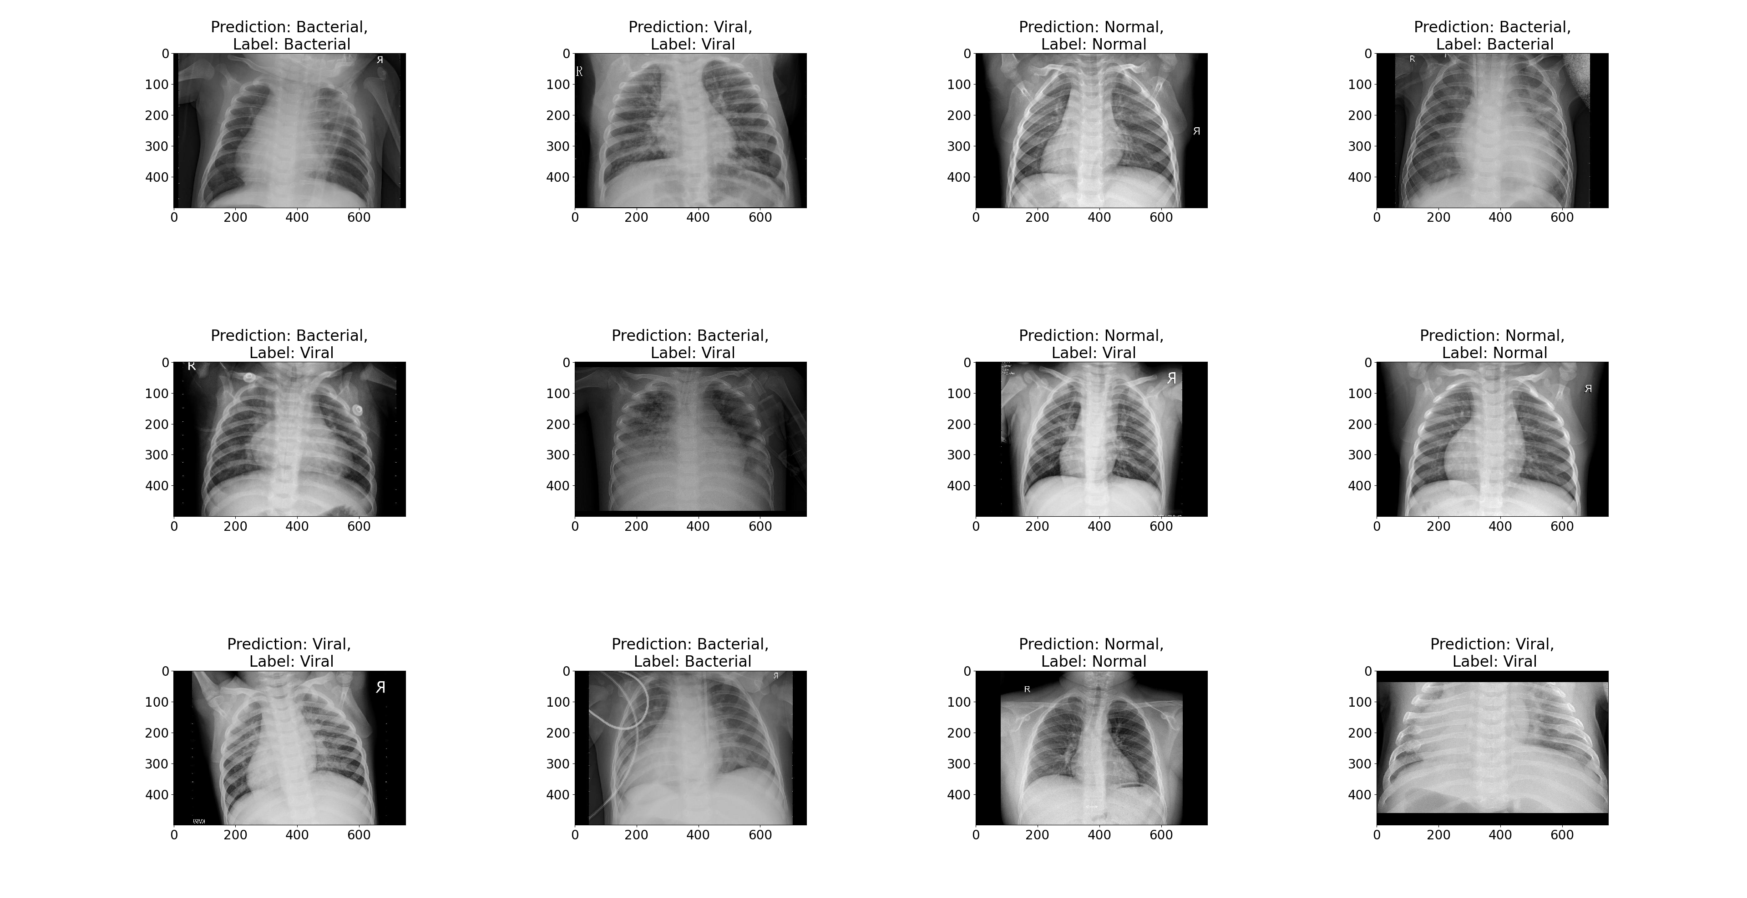


Evaluation
Viral recognition most problematic
Notes:
Accuracy ~75%
Data is split about evenly in normal and infected, data not equally distributed
Optical distinguishment between viral and bacterial is difficult (for a human)
Viral was hardest to distinguish

Slide 8
Outlook
Weighting of features
Resampling of training set
Adjustment of cost function
More computational power
Notes:
Could be better if higher computation power -> further increase in layer complexity and number was not possible
Adjust const function to penalize wrong prediction of rarer class (viral)

Slide 9
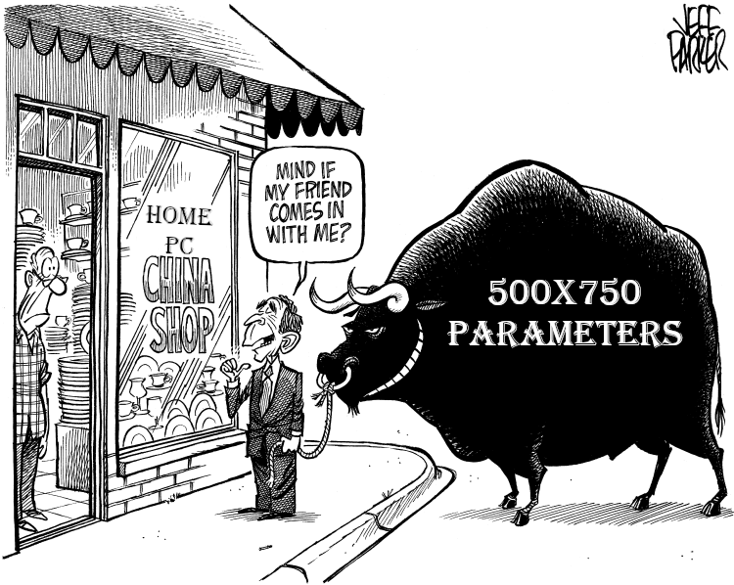
Questions?

