Slide 1
Non-intrusive load monitoring
By Rune Arbjerg Heick 3. Maj 2016

Slide 2
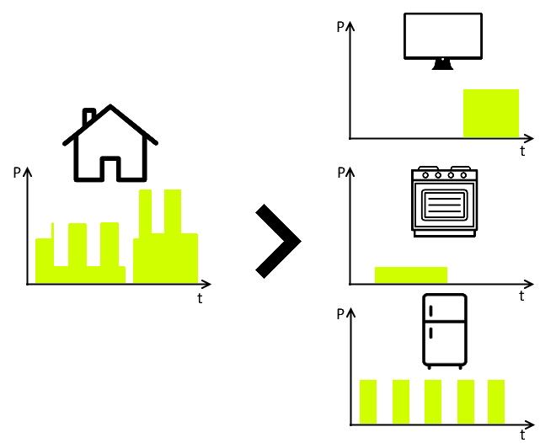
Non-intrusive load monitoring Basis
Source: From Master’s Thesis

Slide 3
Overview
George W. Hart, Ed Kern and Fred Schweppe
Pattern Recognition
NILM-TK
1980
1995
2000
2010
2014
Commercial NILM Applications
”Smart- revolution”
Source: Samplig headlines from https://scholar.google.dk/scholar?start=10&q=%22non+intrusive+load+monitoring%22&hl=en&as_sdt=0,5&as_ylo=1980&as_yhi=2016&as_vis=1

Slide 4



The Current research
Data collection & processing
Algoritmes
Usage

Slide 5
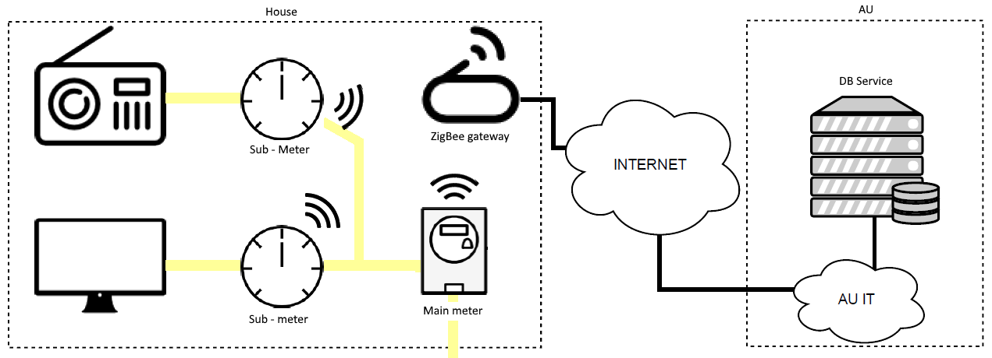
The SmartHG Dataset
Source: From Master’s Thesis

Slide 6
Quality In NILM
Purpose
Purpose of NILM
Purpose of Analysis
Factors
Availability
Activity
Consumption part
Additional information

Slide 7
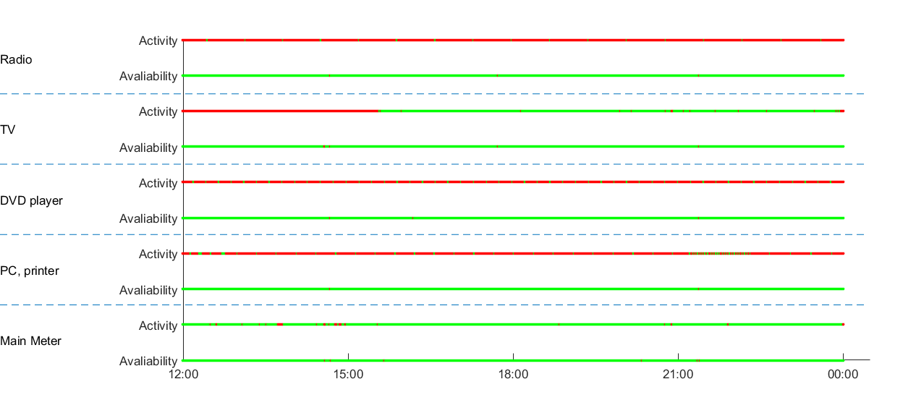
Quality In NILM
Source: From Master’s Thesis

Slide 8
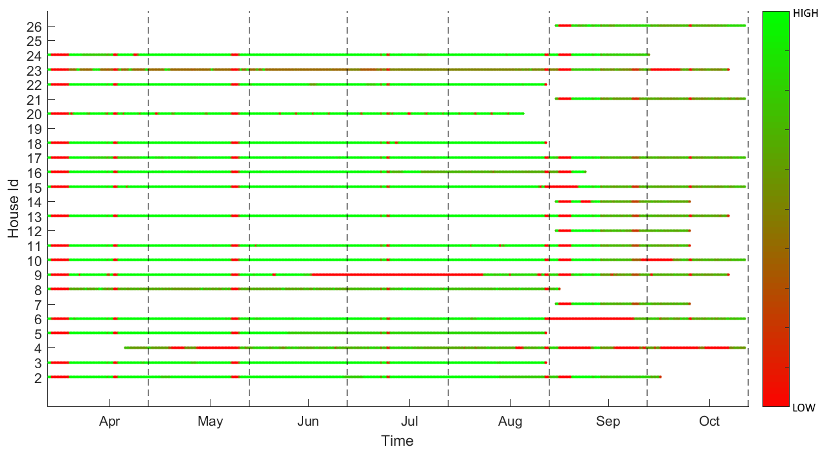
Quality In NILM
Source: From Master’s Thesis

Slide 9
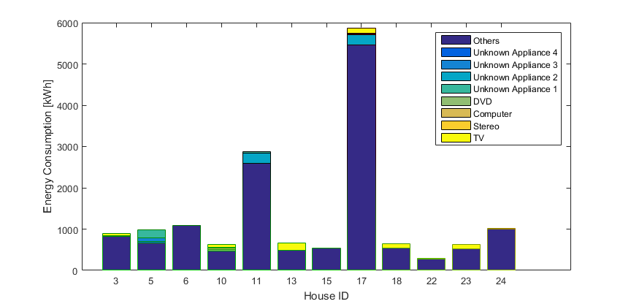
Power Usage for 3. Month in SMARThg
Source: From Master’s Thesis

Slide 10
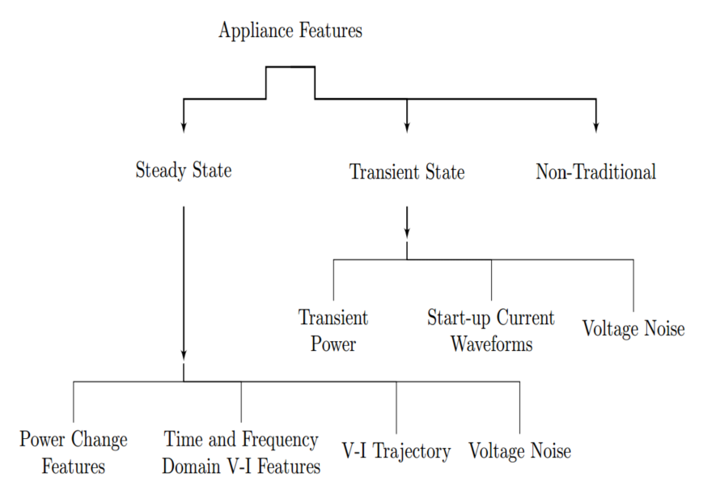
The process
Model Creation
Filter
Feature exstraction
Filter
Filter
Application
Model Validation
Methods
Optimzation
Clustering
HMM
SVM
ANN
DANN

Slide 11







Appliance types and challenges
Type I
Type II
Type III
Type IV
Source: A. Zoha, A. Gluhak, M. A. Imran, and S. Rajasegarar, Non-intrusive load monitoring
approaches for disaggregated energy sensing: A survey, Sensors, vol. 12, no. 12, pp.
16 83816 866, 2012.

Slide 12
Detection Methods
FHMM
Parson
Weiss
Simple FHMM
Difference HMM Combined with FHMM
K-Means clustering

Slide 13
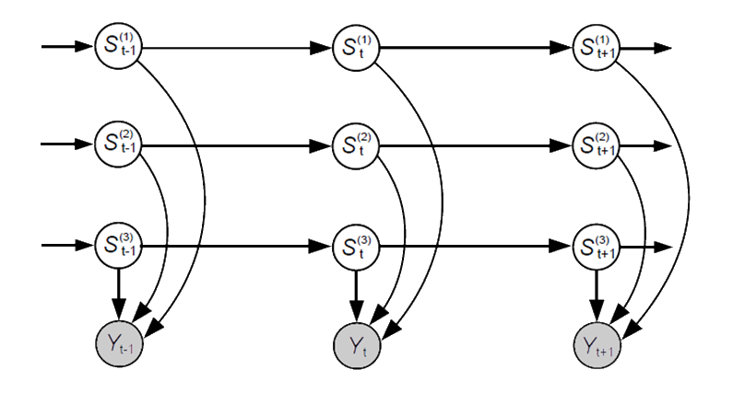

FHMM
Source: Z. Ghahramani and M. I. Jordan, Factorial hidden markov models, Machine Learning,
vol. 29, no. 2, pp. 245273, 1997.

Slide 14
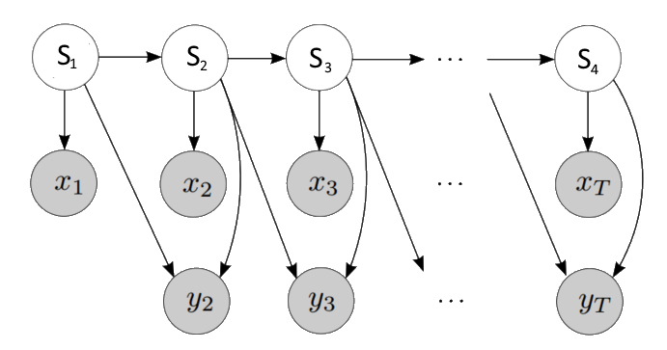
Parson
Source: O. Parson, S. Ghosh, M. Weal, and A. Rogers, Non-intrusive load monitoring using prior
models of general appliance types, pp. 356362, July 2012.

Slide 15

Weiss
Q
P
Source: M. Weiss, A. Helfenstein, F. Mattern, and T. Staake, Leveraging smart meter data to
recognize home appliances, pp. 190197, 2012.

Slide 16
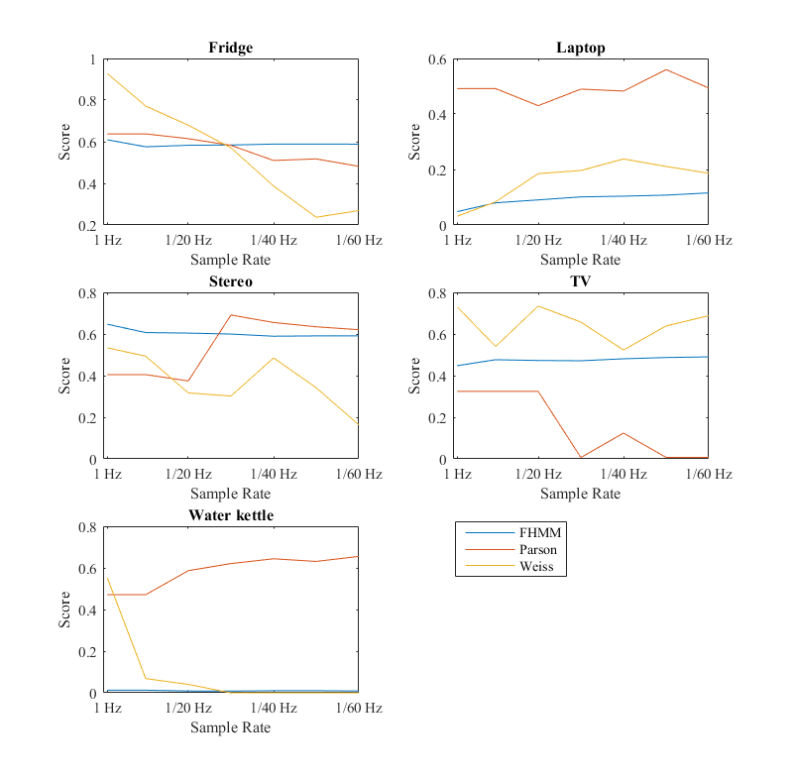
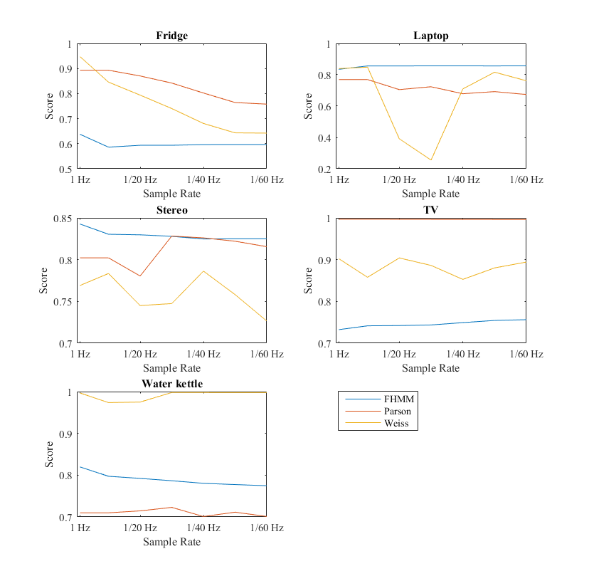
Detection Methods
F1
Accuracy
Source: From Master’s Thesis

Slide 17
Challenges and pitfalls
Type III & Type IV is hard
Uniqueness is the key
Limited Sample rates
Processing power
Training Data / Environment Knowledge

Slide 18
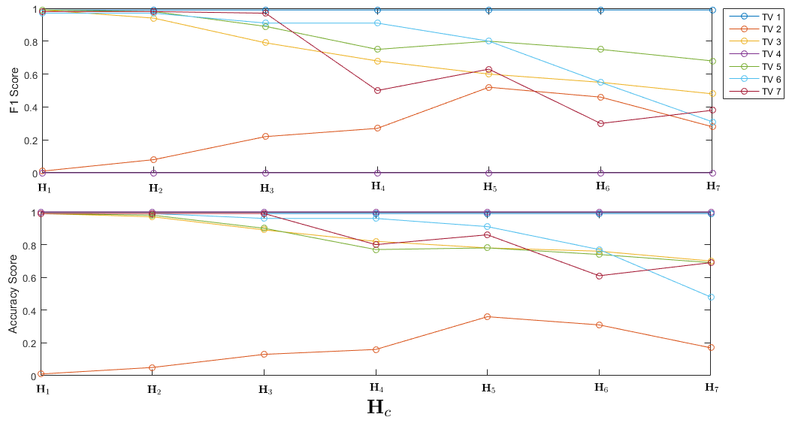
Environment Complexity
Source: From Master’s Thesis

Slide 19
Data acquisition
Data Monitoring
Micro Enviroments
Additional Environment Knowledge
ON/OFF time registration

