Slide 1
Non-intrusive load monitoring
By Rune Arbjerg Heick 3. Maj 2016

Slide 2
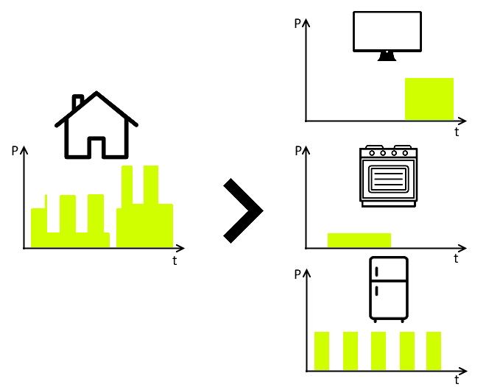
Non-intrusive load monitoring Basis

Slide 3
Overview
George W. Hart, Ed Kern and Fred Schweppe
Pattern Recognition
NILM-TK
1980
1995
2000
2010
2014
Commercial NILM Applications
”Smart- revolution”

Slide 4
The Current research
Data collection & processing
Algorithems
Usage

Slide 5
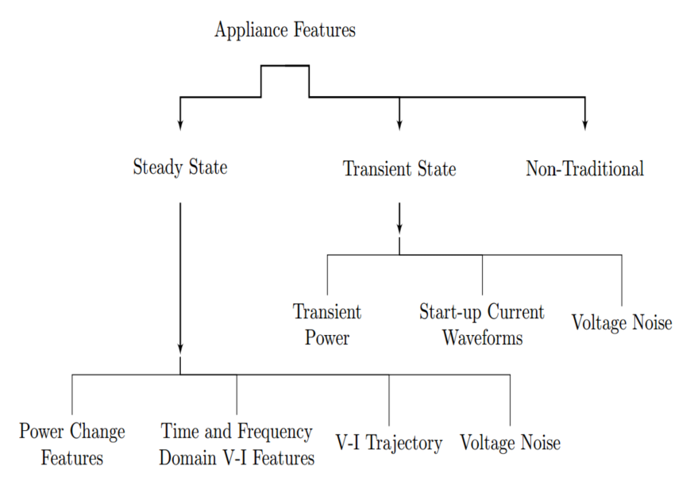
The process
Model Creation
Filter
Feature exstraction
Filter
Filter
Application
Model Validation
Methods
Optimzation
Clustering
HMM
SVM
ANN
DANN

Slide 6
Quality In NILM
Purpose
Purpose of NILM
Purpose of Analysis
Factors
Activity
Availability
Consumption part
Additional information

Slide 7
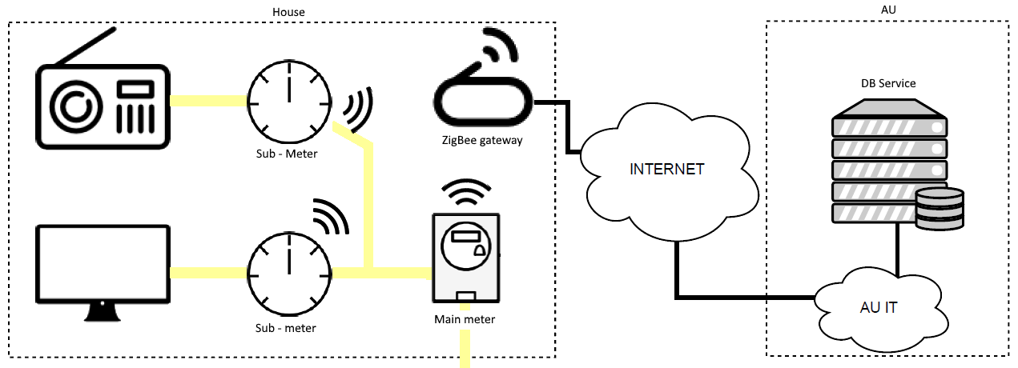
The SmartHG Dataset

Slide 8
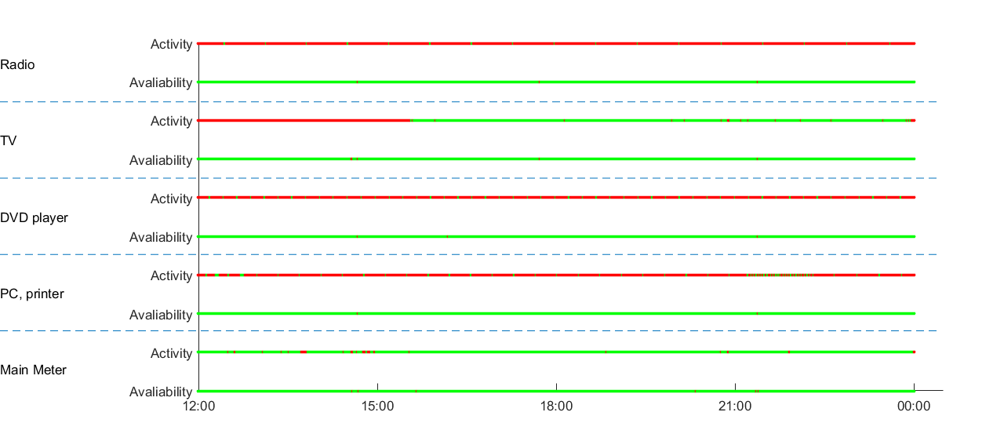
Quality In NILM

Slide 9
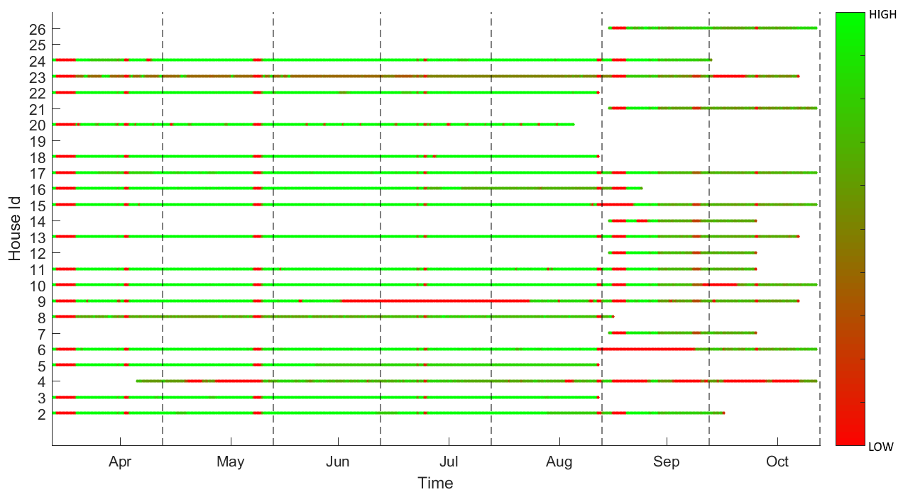
Quality In NILM

Slide 10







Appliance types and challenges
Type I
Type II
Type III
Type IV

Slide 11
Detection Methods
FHMM
Parson
Weiss
Simple FHMM
Difference HMM Combined with FHMM
K-Means clustering

Slide 12
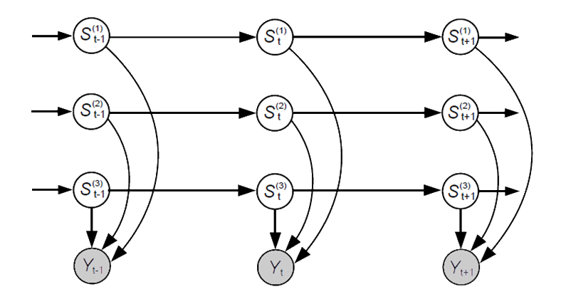

FHMM

Slide 13
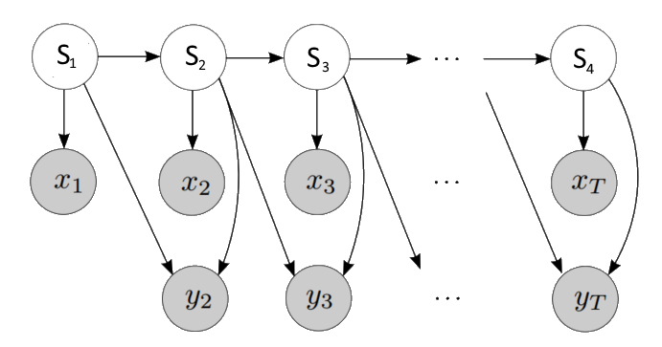
Parson

Slide 14

Weiss
Q
P

Slide 15
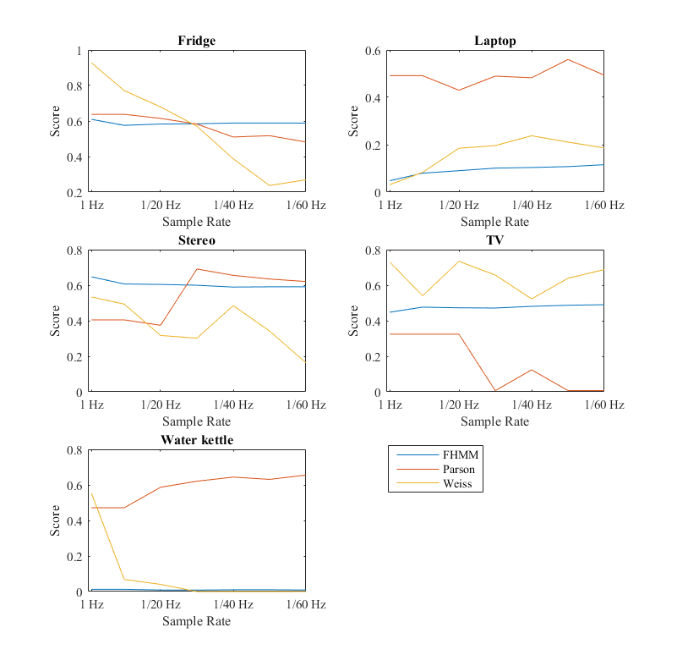
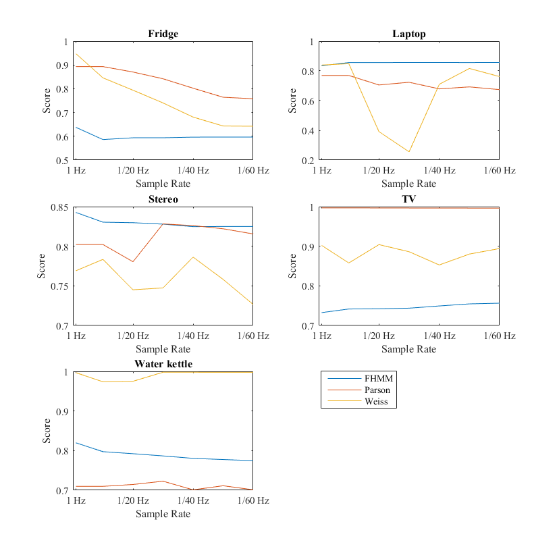
Detection Methods
F1
Accuracy

Slide 16
Challenges and pitfalls
Limited Sample rates
Processing power
Environment Knowledge

Slide 17
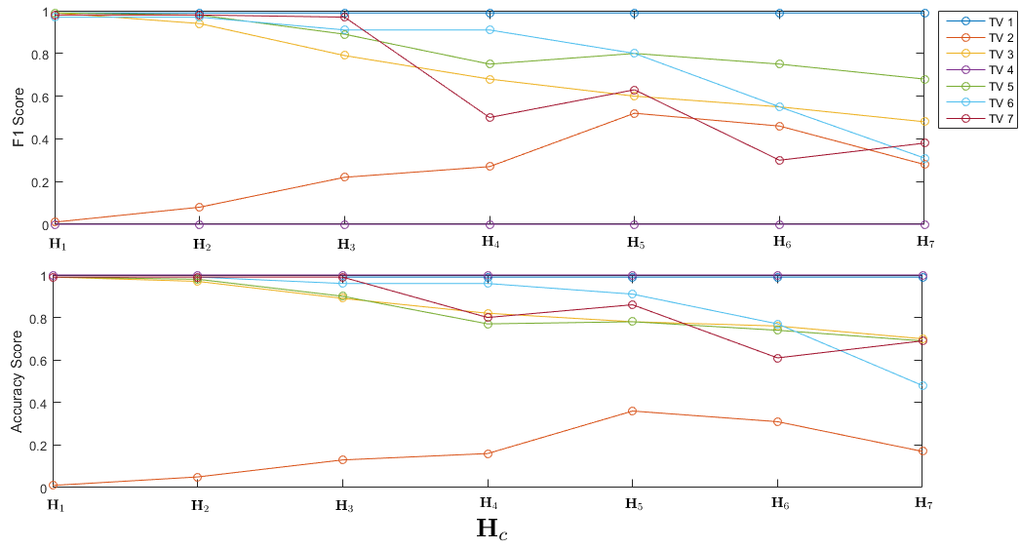
Environment Complexity

Slide 18
Data acquisition
Data Monitoring
Micro Enviroments
Additional Environment Knowledge
Type III & Type IV
ON/OFF time registration

