Slide 1


RXJS
2h
Reactive Extensions (JS, Java, .NET, …)
The LoDash for Events
Hands-On
Introduction

Slide 2
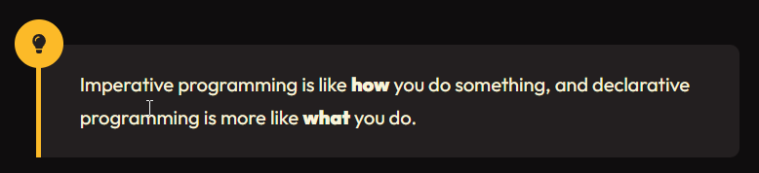
WHAT
Imperative vs Declarative Programming
Notes:
https://ui.dev/imperative-vs-declarative-programming
→ The examples there are pretty cool!!

Slide 3
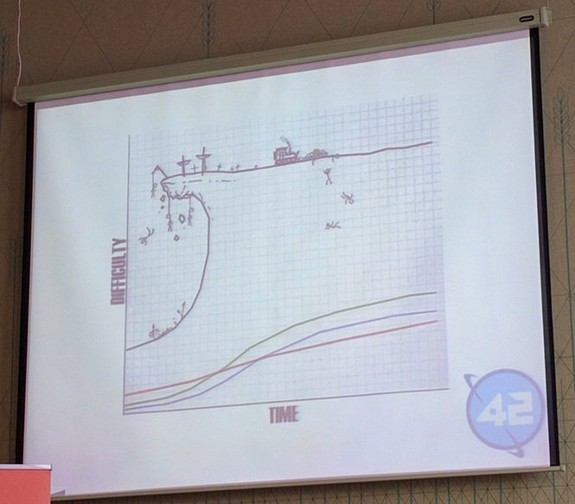
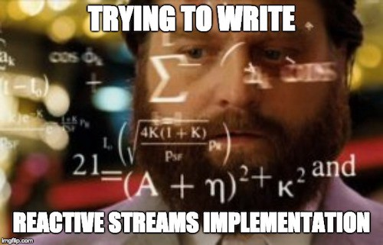
That Learning Curve

Slide 4
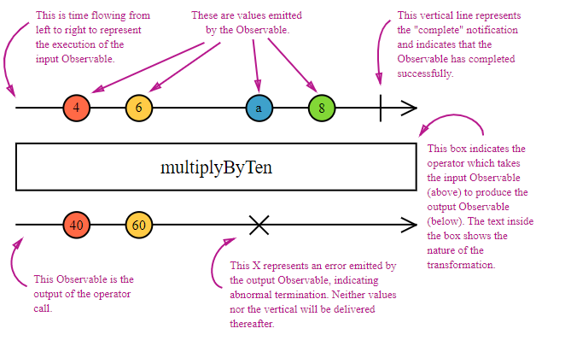
MARBLES
Notes:
Interactive Site:
https://rxmarbles.com/
Unfortunately quite outdated ☹
RXJS Changes API every full moon (Deprecations everywhere)
Many examples online are outdated ☹
New Alternative:
https://thinkrx.io/
RXJS Testing:
https://rxjs.dev/guide/testing/marble-testing

Slide 5
WHY - Example
A datagrid component needs to reload data:
On load / navigation
When changing filters, sorting, pagesize, …
When the user changes her language
When the user changes the tennant
When the role of a user changes
Notes:
Other parts of your code can mess up your state. Using RXJS & Pure Functions this cannot happen.

Slide 6
Combining Observables
mergeMap (deprecated alias: flatMap)
switchMap: you typically want this one for API calls
concatMap
exhaustMap
Notes:
https://thinkrx.io/rxjs/mergeMap-vs-exhaustMap-vs-switchMap-vs-concatMap/
mergeMap: merges as they come
concatMap: waits for the inner subscription to complete
switchMap: unsubscribes from the inner subscription when the outer emits
exhaustMap: ignores outer emits if the inner subscription has not yet completed
https://blog.angular-university.io/rxjs-higher-order-mapping/
https://stackoverflow.com/questions/49698640/flatmap-mergemap-switchmap-and-concatmap-in-rxjs

Slide 7
Combining Observables
forkJoin: wait for all to complete
combineLatest: for all emits once all emitted once
zip: combine emits per source
withLatestFrom: emit with main source
Notes:
Good resource:
https://www.digitalocean.com/community/tutorials/rxjs-operators-forkjoin-zip-combinelatest-withlatestfrom
combineLatest:
Emits first value as soon as all sources have emitted at least once.
Then emit anytime any source emits.
forkJoin:
All sources must complete, then the value is emitted.
withLatestFrom:
Waits for all sources to have emitted a value.
Then starts emitting whenever the main source emits a value
main$.pipe(withLatestFrom(inner$))
zip:
Emits once all sources have emitted once
Then emits every next source values once they all emitted a new value

Slide 8
resources
RXJS Marbles (outdated!!)
How to read
RXJS Fruits
Angular Exercises
Official Docs

Slide 9
Questions?

Slide 10
MENU
What
Patterns
Why

Slide 11
WHAT
A library

Slide 12
WHAT - Patterns
Observer
Iterator / IEnumerable
Scheduler???

Slide 13
WHAT - ???
Next
Error
Complete

Slide 14
WHAT - ???
Multicast: one producer, multiple consumers Unicast: one producer, one consumer
Cold:
Hot:
Notes:
https://rxjs.dev/guide/glossary-and-semantics:
Producer:
Consumer:

Slide 15
WHY
WHERE? User interfaces & near-real-time applications
Replace Pull with Push

Slide 16
Operators
Creational:
of / from
defer / iif
fromEvent
empty → EMPTY constant
interval / timer
Notes:
scan vs reduce → reduce only when completes, scan every value emitted

Slide 17
Subjects
Also something on Schedulers?

Slide 18
Example
Streams: Set up a backend with…
CO2
Temperature
???

Slide 19
TITLE
Content

