Slide 1
Contrast Enhancement Algorithm
Runhua Gao 04/14/20

Slide 2
Part 1: Histogram Equalization
Stanard histogram equalization(HE) is used to enhance the contrast of an image
the basic idea behind this method is to change the cumulative distribution function (CDF) based on the histogram.

Slide 3
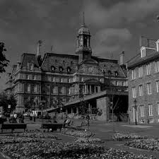
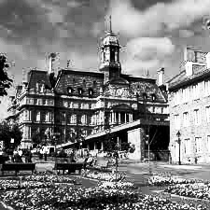
Part 1: Histogram Equalization
Before Hist equalization:
After Hist equalization:

Slide 4
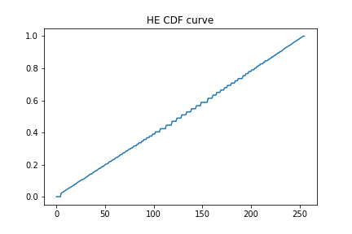
Part 1: Histogram equalization
However, HE has its own disadvantage: Whatever the original image is, the mean value of the result image will always be around 128.
the processed image's CDF will always be a straight line.

Slide 5
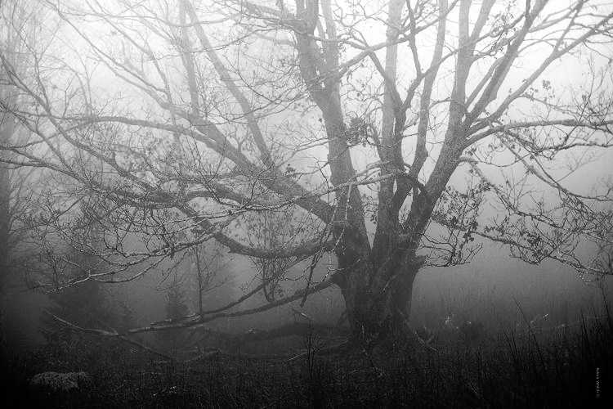

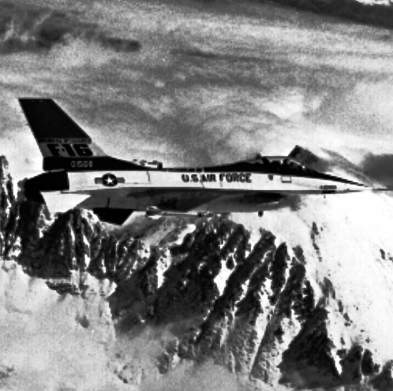
Part 1: Histogram equalization
More examples:
Mean = 128.2
Mean = 128.3
Mean = 129.1

Slide 6
Part 1: Histogram Equalization
Conclusion: it always produce an image with a constant mean brightness:128.
Discussion: What if an image's original mean brightness is much lower/higher than 128?
An improvement method: Brightness preserving Bi-Histogram Equalization(BBHE)

Slide 7
Part 2: BBHE
The idea behind BBHE is: Split the original image by a threshold
Use the threshold to split the original image. Apply histogram equalization to two subimages individually
Recitation: Yeong-Taeg Kim, "Contrast enhancement using brightness preserving bi-histogram equalization," in IEEE Transactions on Consumer Electronics, vol. 43, no. 1, pp. 1-8, Feb. 1997.

Slide 8
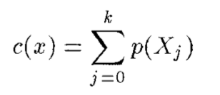

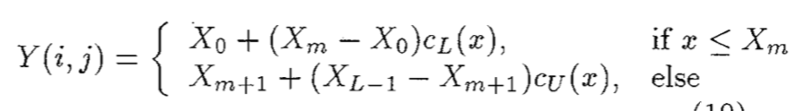
Part 2: BBHE
Mathematical Equation:
Cumulative Distribution Function:
General Histogram Equalization:
BBHE(Xm here is the mean value):

Slide 9
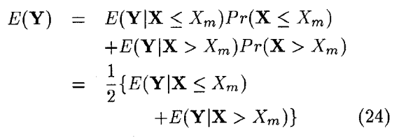


Part 2: BBHE Mathematic Analysis
Calculate average brightness of BBHE image
Xm is threshold(mean value), Xg here is 128
The final equation tells us that the BBHE image's mean value will also depends original image's mean value.
In this way, we could make sure that BBHE could preserve the brightness

Slide 10
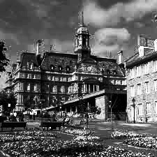
Part 2: BBHE Experiment: house
Original:
HE:
BBHE:
BBHE threshold = 70.2

Slide 11
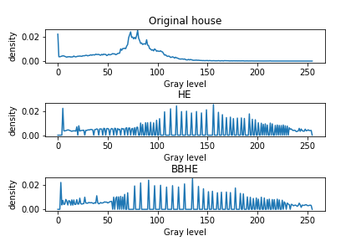
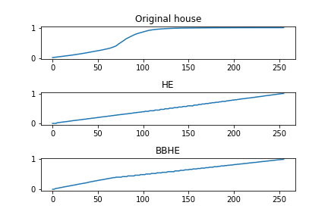
Part 2: BBHE Experiment: house
Hist Comparison
CDF comparison
Within high value area(>150), BBHE shows a more balanced distribution

Slide 12
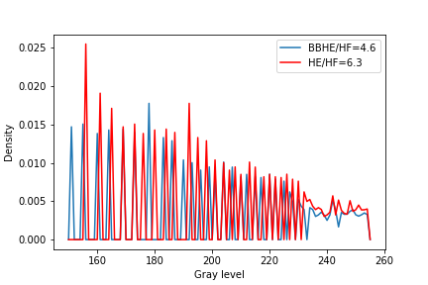
Part 2: BBHE Experiment: house
Split the histogram and compare:
HF: Histogram Flatness-variance of the histogram
HF Magnitude: e-5

Slide 13
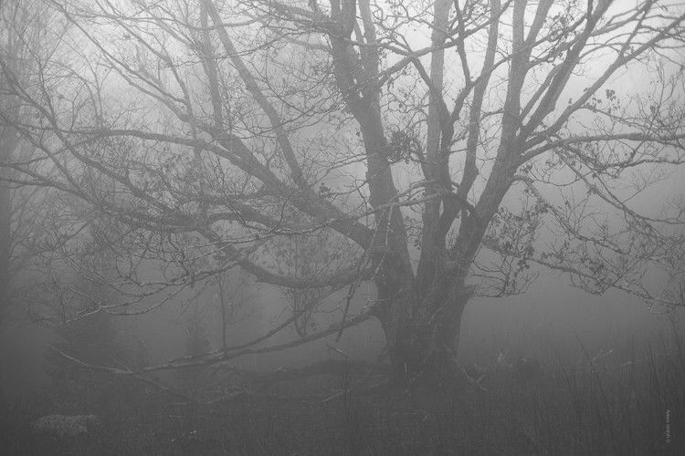
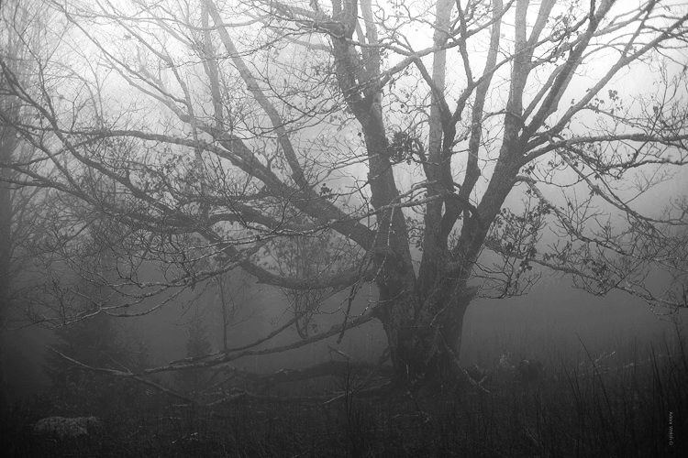
Part 2: BBHE Experiment: forest
Original:
HE:
BBHE:
BBHE threshold = 127.2

Slide 14
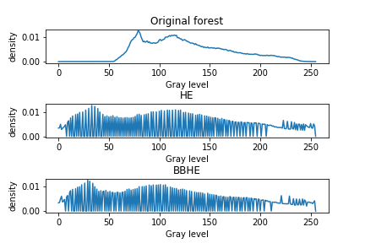
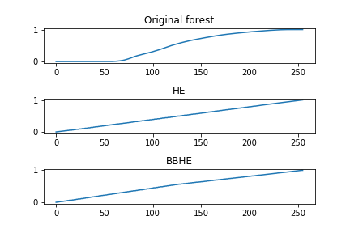
Part 2: BBHE Experiment: forest
Hist comparison
CDF comparison
As the original's mean value is close to 128, BBHE & HE performs similarly

Slide 15
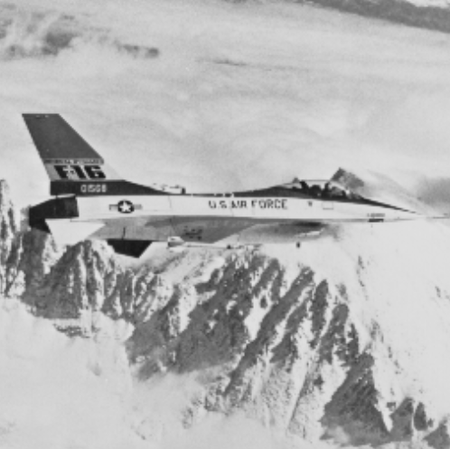
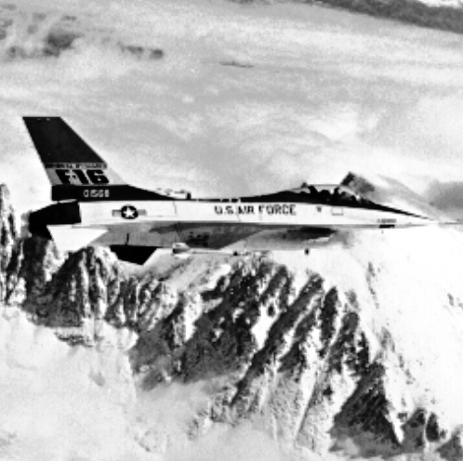
Part 2: BBHE Experiment: F16
Original:
HE:
BBHE:
BBHE threshold = 179.4

Slide 16
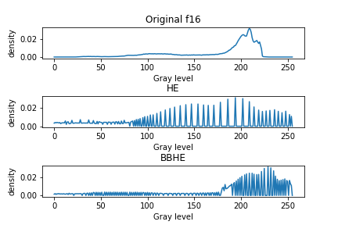
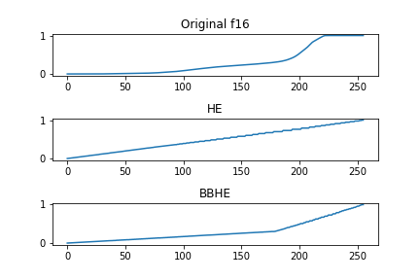
Part 2: BBHE Experiment: F16
Hist comparison
CDF comparison
Turning point around the mean value
A lot of pixels are distributed in high value area, so we could see an obvious split here in both histogram and CDF curve

Slide 17
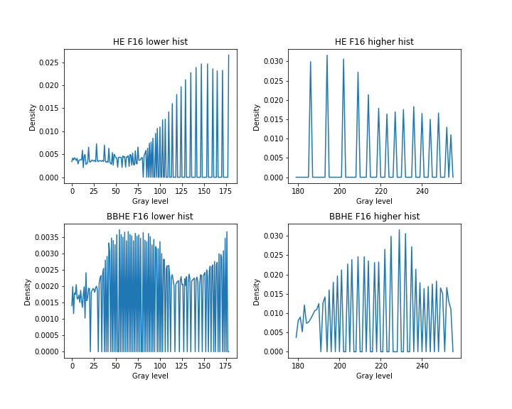
Part 2: BBHE Experiment: F16
Split the histogram and compare:
HF | lower | higher
HE | 5.5 | 3.4
BBHE | 0.3 | 1.8
Magnitude: e-5

Slide 18
Part 2: BBHE Value Table
Mean: show BBHE could 'preserve' the brightness
Mean Value | Original | HE | BBHE
House | 70.2 | 128.4 | 99.4
Lena | 124.1 | 128.3 | 131.4
f16 | 179.4 | 129.1 | 169.3
Forest | 127.2 | 128.2 | 119.9

Slide 19
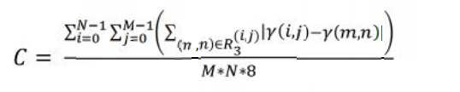
Part 2: BBHE Value Table
CPP: Contrast Per Pixel(8-neighbor mean difference)：
CPP | Original | HE | BBHE
House | 0.49 | 0.74 | 0.85
Lena | 0.35 | 0.36 | 0.36
F16 | 0.37 | 0.43 | 0.59
Forest | 0.20 | 0.27 | 0.26
Conclusion: For images with mean value much lower/higher than 128, BBHE could enhance the contrast better and preserve the brightness at the same time.

Slide 20
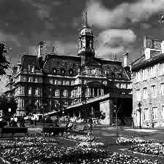
Part 3: Extension: Median BBHE
The original BBHE algorithm uses image's average value as threshold to do the contrast enhancement.
Here I also did some exploration, use median value as threshold, and according to the observation, it has the similar performance on example images.
BBHE with median threshold
BBHE with mean threshold

Slide 21
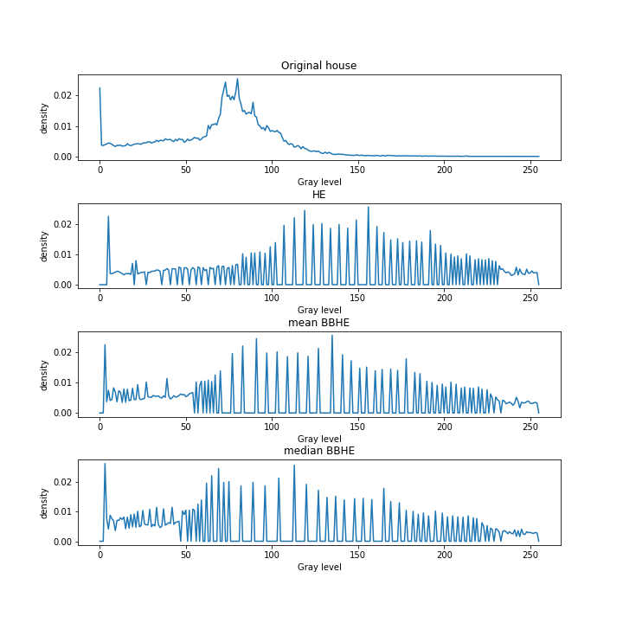
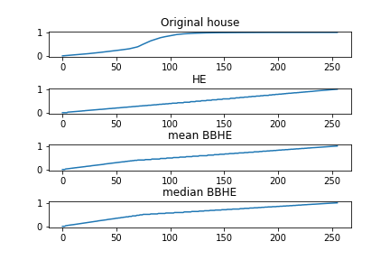
Part 3: Extension: Median BBHE
Hist comparison
CDF comparison
Mean = 70.2/Median = 75.0

Slide 22
Part 3: Extension Table Value
Comparison Between mean/median BBHE for house
mode/Value | mean | CPP
Mean BBHE | 99.4 | 0.85
Median BBHE | 101.7 | 0.77

