Slide 1

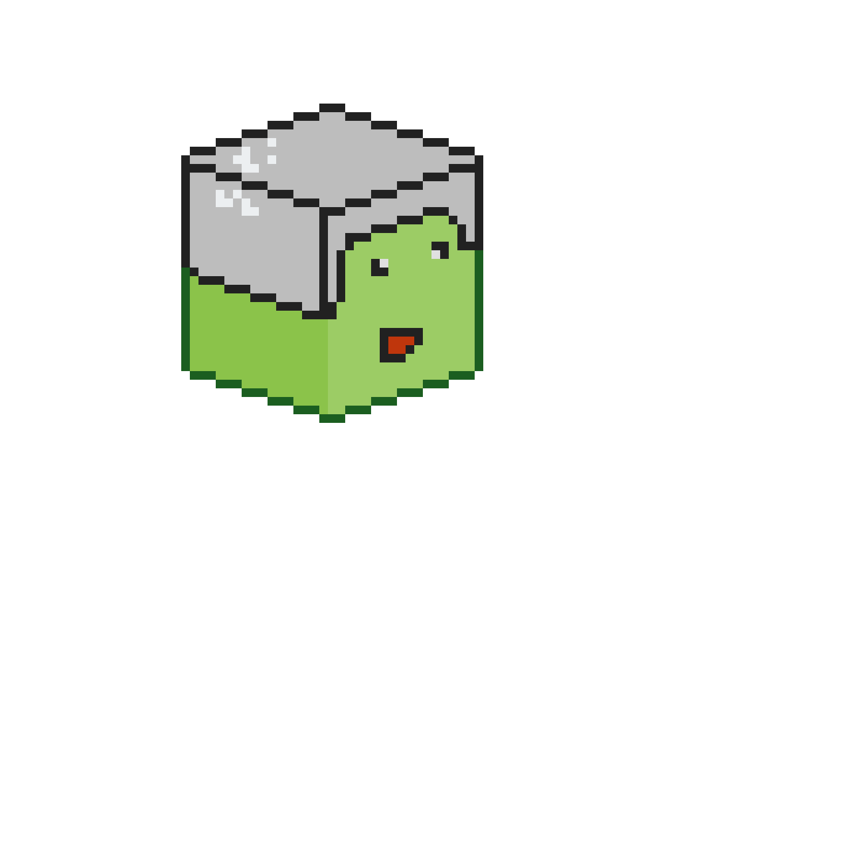
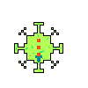


W A S D
MOVEMENT
CURSOR
W
TAB
A
S
D
Player follows cursor position
Right click to aim
Left click to shoot
ENEMIES
Power ups
Slime minion
Stationary plants
Found in:
Slime boss
Multishot

