Slide 1
Introduction to angular.jS
By Tyler DOtson

Slide 2
Who

Slide 3
WHO
Developed by a Google employee Misko Hevery in 2009.
Angular 1.0 was released in 2012
Angular is full supported by the Google Development team.

Slide 4
What
Angular.js is a front end /client side javascript framework that adds interactivity to the HTML.
Angular.js uses a Model-View-Controller(MVC) design pattern.

Slide 5
Why
Organizes Javascript
Build responsive(extremely fast) websites
Angular interacts well with jQuery and Bootstrap
Extremely easy to test(maintainable software)
Angular minified version is 126 KB to Ember’s 385KB(Another well established Frontend MVC Framework)
Easy to learn and use
Lots of documentation and internet examples

Slide 6
Where
Download Here
https://angularjs.org/
Learn Here
http://campus.codeschool.com/courses/shaping-up-with-angular-js/
Practice here!

Slide 7
How
Include this in your html header
<script src="https://ajax.googleapis.com/ajax/libs/angularjs/1.3.15/angular.min.js"></script>
We then create our app by setting up a module.
Use Modules because it makes the code more maintainable, testable, and readable
Also define the dependencies.

Slide 8
HOW
Include the app directive html tag at the top of the html code.
This is our base skeleton for our starter pages.
This html is now part of the angular app.
See example index zero

Slide 9
Directives
Directives are HTML annotations that trigger javascript behaviors

Slide 10
Expressions
Now we can include expressions in the html code!!
Expressions are how values from the javascript are displayed on the page.
See example one.

Slide 11
Filters on Expressions
{{ data | filter: options}}
{{'1399123412323' | date: ’MM/dd/yyyy @ h:mma'}}
05/03/2014 @ 9:23AM
{{"Rethink " + "Group" | uppercase}}
RETHINK GROUP
{{'This is a very long sentence' | limitTo: 8}}
This is
We can also use this to expression to limit the number of elements displayed by an array.
<div ng-repeat=”id in users.id | limitTo: 2”> will only show the first 2 elements in the array
We can even use order by as a filter that will order the elements in a specific way.

Slide 12
Other Directives
ng-app to include the app
Ng-controller to attach the controller to the body
Ng-show to show content
Ng-repeat iterates over a given period.
See code example 2

Slide 13
Controllers
Controllers are where we add application behavior.
app.controller('exampleController', function(){
// Behaviors go here
});
See code example three

Slide 14
MODELS
The directive ng-model uses what is called two way binding. This allows the template to change anytime the variable is changed. The variable doesn’t have to be defined in the javascript either.
See code example 4

Slide 15
Services
A bunch of cool services. Makes accessing APIS in a restful way quick and easy.
See Video.
See Code.

Slide 16
Resources
Codeschool.com offers a free interactive course with high quality videos and screencasts.
https://www.codeschool.com/courses/shaping-up-with-angular-js
Developer documents https://docs.angularjs.org/

Slide 17
Batarang
Chrome developer tools extension for testing Angular.js applications
https://www.youtube.com/watch?v=q-7mhcHXSfM

Slide 18
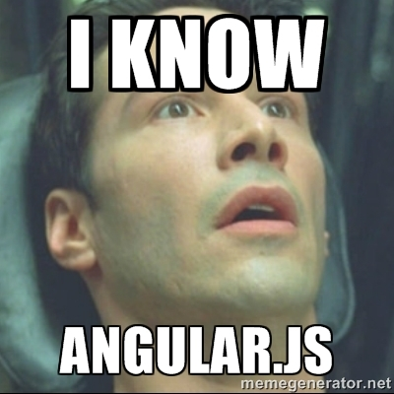
Now You know angular.js

