Slide 1
Test Report
David Mercer

Slide 2
Summery of software being tested
My test project used software I wrote for architecture class.
The software simulates register memory and accumulator architectures.
The software is capable of reading an assembly file, parsing the code and executing the program.

Slide 3
Assumptions and Dependencies
There are very few dependencies in this test.
I require access to Microsoft Visual studio.
I require access the architecture software source code.
Assumptions
Like in real life the simulated processor’s are not responsible for any output if they are given an invalid impute.

Slide 4
Methodology of Testing
I created a modular framework for unit testing.
I designed generic unit tests for each processor function.
These tests were then executed many times with different imputes to detect errors.
These tests are white box and do entail modification of the original source code.
I did not modify the original program outside of program.cs
The testing code extends classes that already exist and can be removed without modifying the original classes.
Inputs to the unit tests are a mixture of random, user selected, and domain specific.

Slide 5

Code coverage
Coverage is achieved in the assembler simply by assembling a program with valid instructions.
Coverage for each of the instructions in the architectures is achieved by executing their respective unit tests.

Slide 6
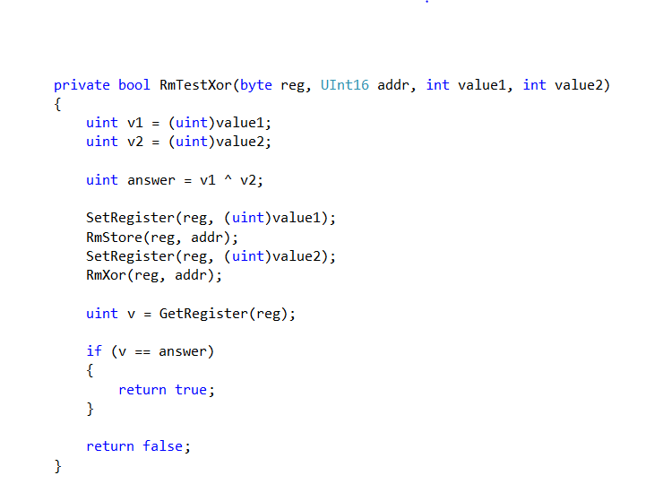
Example of a test

Slide 7
Results
I did not intentionally provide inputs that are illegal to the processor as the processors reaction to invalid inputs is undefined by design.
Ran 4440tests, failed 0.

Slide 8
Conclusion
I do not believe that the software I am testing is perfect.
However the fact that it can successfully run assembly programs means that it must be fairly robust software.
Additional unit tests and better inputs would likely bring some flaws to light.

Slide 9
Questions?

