Slide 1
单击此处添加您的标题文字
Survival Analysis of Patients with Arrhythmia
——Identifying high-risk patients most in need of an ICD
单击此处添加您的副标题
刘润祺 11711331
武思齐 11711114
冯真 11711135

Slide 2

Outline
1. Introduction
2. Data Overview and Analysis
2.1 Data Overview
2.2 Demographic Statistics
2.3 Classification
3. Exploratory Analysis
3.1 Correlation
3.2 Comparation
4. Modelling
4.1 Survival and hazard functions
4.2 Variable selection
4,3 Cox Proportional model
4.4 AFT model
5. Model Verification
6. Conclusion

Slide 3
01
Introduction

Slide 4

01 Introduction
Arrhythmias are abnormal beats.
Arrhythmias may be completely harmless or life-threatening.
Arrhythmias
Implantable cardioverter-defibrillator (ICD) is a battery-powered device placed under the skin.
The device continuously monitors patient’s heartbeat and delivers electrical pulses to restore a normal heart rhythm when necessary.
ICD

Slide 5
01 Introduction
From a large, multi-hospital study of patients with ICDs.
Primary outcomes: Overall survival (time until death) and the time until the ICD delivered its first shock
Predictors: demographic, laboratory values, medical history, and electrocardiogram (ECG)-derived variables
Data
Detect the predictors that significantly influence the risk of abnormal heartbeats
Construct efficient models for identifying high-risk patients most in need of an ICD.
Goals

Slide 6
02
Data Overview and Analysis

Slide 7

2.1 Data Overview
946 observations
27 predictors: 16 predictors are categorical and the rest are numeric.
Four response variables are indicators for shock and death and the time when shock and death happen or censor
Overview
Abnormal Observation
Died at 41.6 months but shock time censored at 51.1 months.
We remove the abnormal observation.

Slide 8
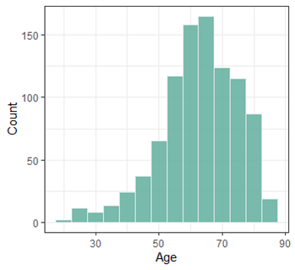
2.2 Demographic Statistics
Age
Most patients are older than 50 years
Youngest: 20
Oldest: 87
Median: 64

Slide 9
2.2 Demographic Statistics
Race and Gender
Most are white, followed by African American
Much more males than females
 | African American | American Indian | Asian | White | Other | No answer | Total
Female | 50 | 1 | 0 | 138 | 0 | 2 | 191
Male | 111 | 2 | 5 | 621 | 2 | 13 | 754
Total | 161 | 3 | 5 | 759 | 2 | 15 | 945

Slide 10
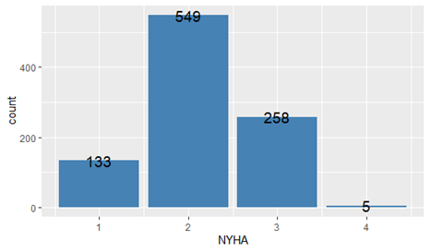
2.2 Demographic Statistics
NYHA
New York Heart Association classification (NYHA) is the most common measure of heart failure severity
class I and class II are mild cardiac disease, class III is moderate and class IV is severe.

Slide 11
2.3 Classification
If a patient died within one day after shock, we consider ICD is useless
Group 1
N=3
If a patient’s shock censors at short time before he/she dies, we consider shocks have never happen to him/her during the study so the individual does not need ICD
Group 2
N=5
If shock once happened to a patient, and the patient lives longer than one day after shock, then we consider ICD is an effective treatment for him/her
Group 3
N=187

Slide 12
03
Exploratory Analysis

Slide 13
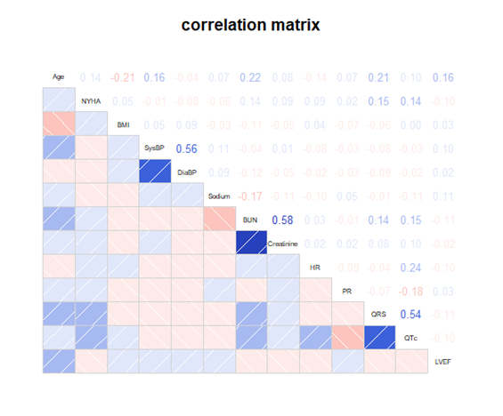
3.1 Correlation
Correlation
Cor(SysBP,DiaBP)=0.56
Cr(BUN,Creatinine)=0.58
Cor(QRS,QTc)=0.54.

Slide 14
3.2 Comparation
To identify the patients who need ICD most, an effective approach is to compare the risk of patients with different features.
Motivation
We compare the Kaplan-Meier estimate survival curve for shock of patients in different groups.
Approach

Slide 15
3.2 Comparation
Grouping
Categorical variables
Numeric variables
Quartile: Age
Low, Normal, and High: BMI, Blood pressure, Heart rate…
Particular cases: QRS, QTc, LVEF
* Possible reasons * Solution

Slide 16
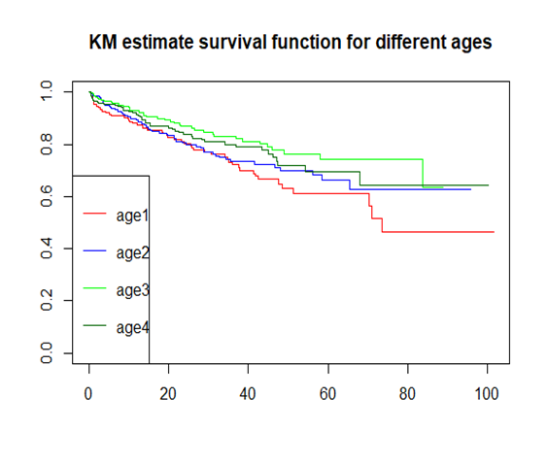
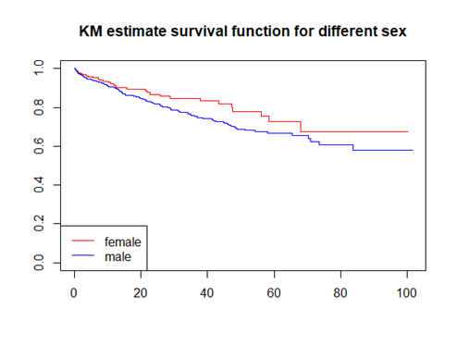
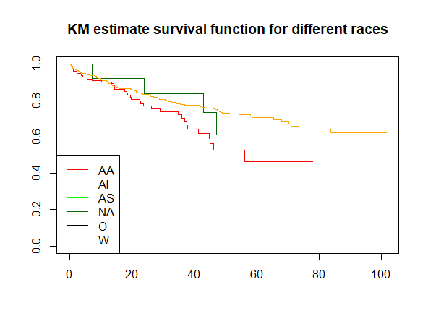
3.2 Comparation

Slide 17
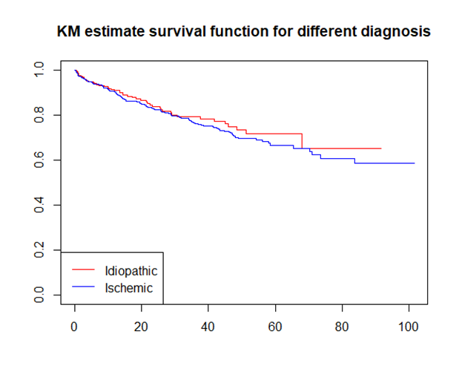
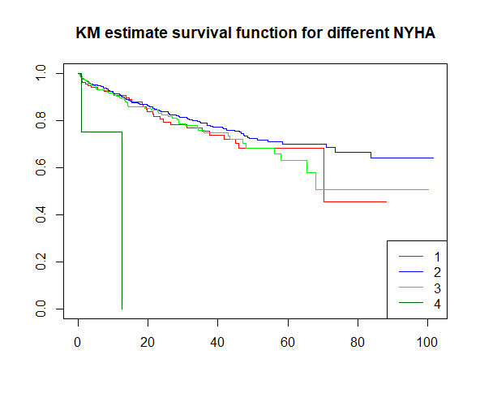
3.2 Comparation

Slide 18
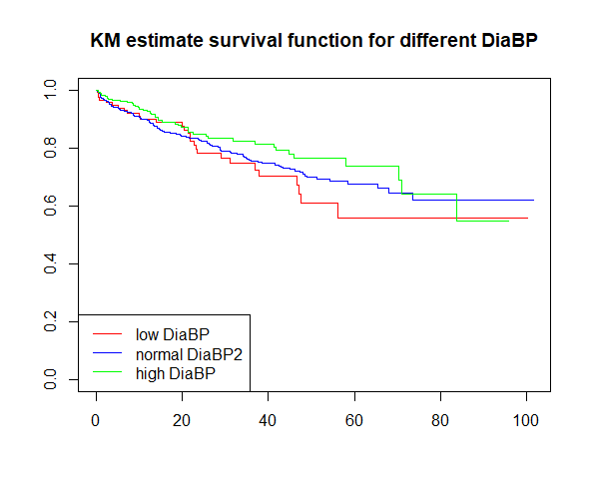
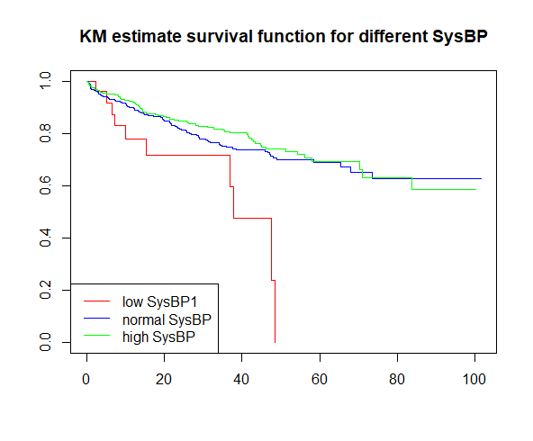
3.2 Comparation

Slide 19
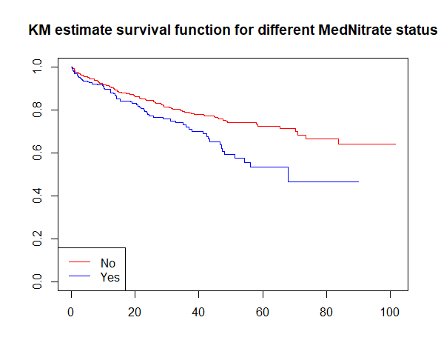
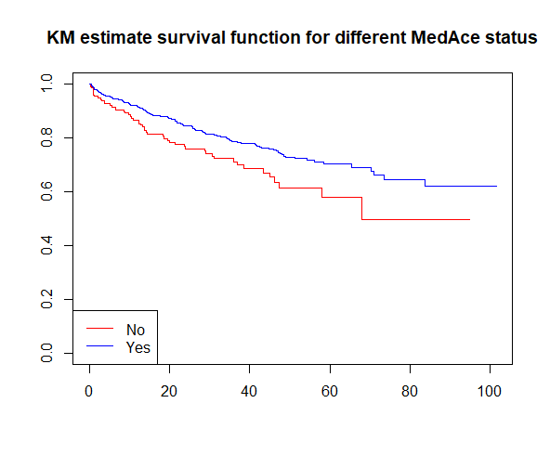
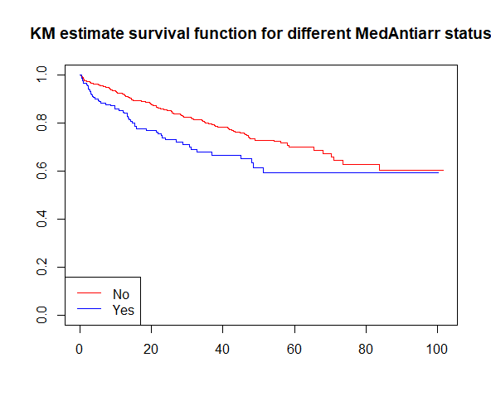
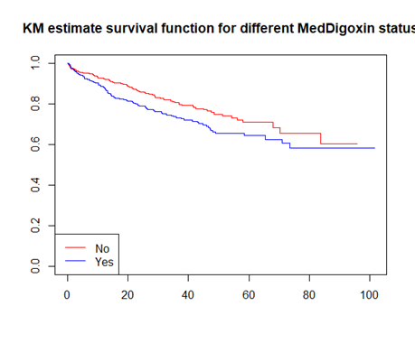
3.2 Comparation

Slide 20
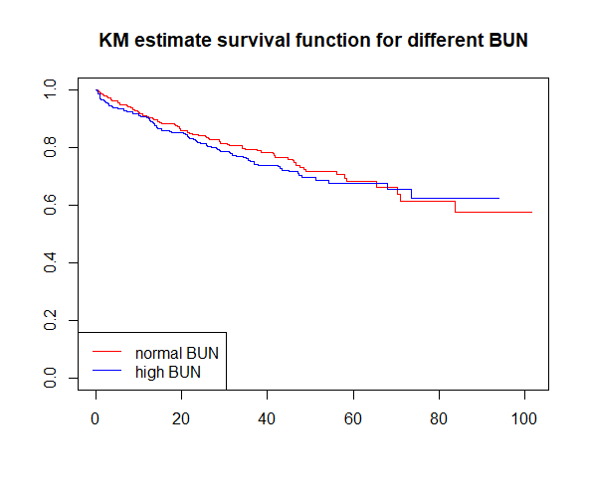
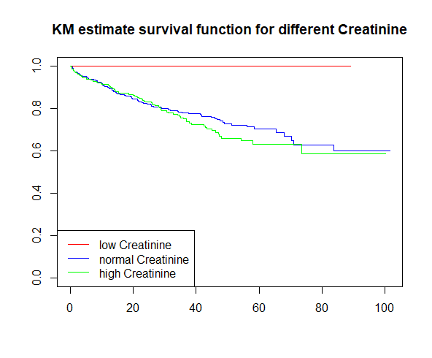
3.2 Comparation

Slide 21
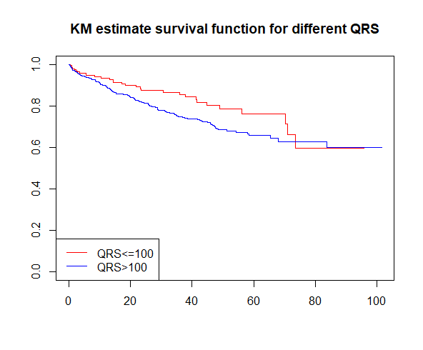
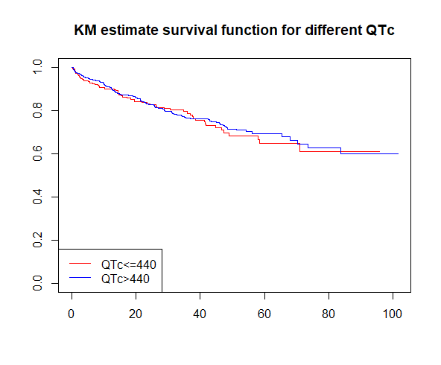
3.2 Comparation

Slide 22
04
Modeling

Slide 23
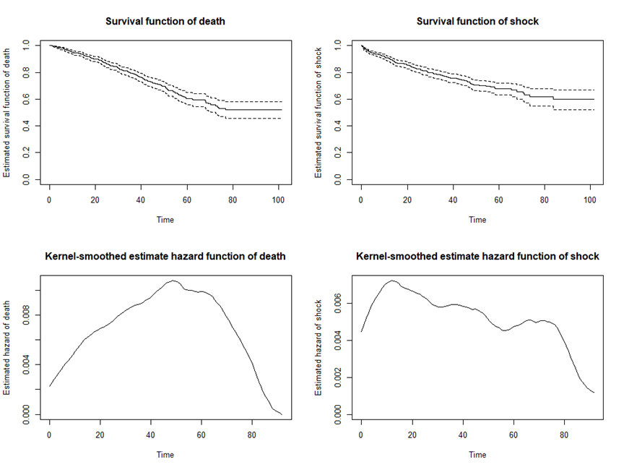
4.1 Overall estimated survival and hazard functions
Assumption: All ICDs were working
Hazard of death is not statistically related to hazard of shock

Slide 24
4.2. Variable selection
Results in exploratory analysis
Age, Sex, Race, Diagnosis, NYHA, HxHTN, HxChol, BMI, SysBP, DiaBP, MedAce, MedNitrate, MedDigoxin, MedAntiarr, BUN, Creatinine, PR, QRS, LVEF. (19 variables)
Variables
Correlation matrix
(SysBP, DiaBP), (BUN, Creatinine), (QRS, LVEF)
SysBP, BUN and LVEF
Age, Sex, Race, Diagnosis, NYHA, HxHTN, HxChol, BMI, SysBP, MedAce, MedNitrate, MedDigoxin, MedAntiarr, BUN, PR, LVEF. (16 variables)
Correlation

Slide 25
4.3 Fitting Cox proportional hazard model
Final Cox model
Stepwise model
Comparing subject model with stepwise model, then get the final Cox model.
Subjective model
Apply stepwise selection procedure on full model and get a model with smallest AIC value.
Full model
Using variables we selected subjectively.
Put all variables in the model.

Slide 26
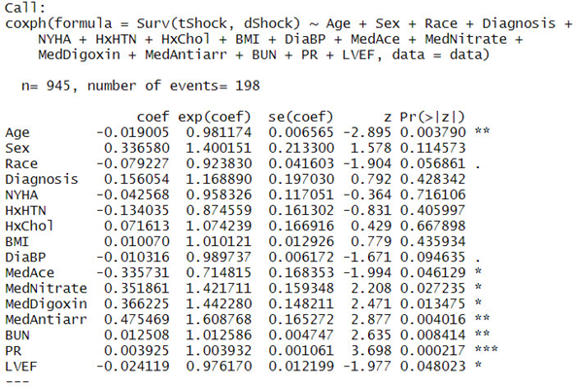
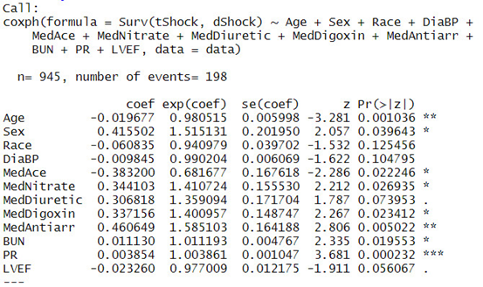
4.3 Fitting Cox proportional hazard model
Subjective model
Stepwise model
Differences: Diagnosis, NYHA, HxHTN, HxChol and BMI.

Slide 27

4.3 Fitting Cox proportional hazard model
Diagnosis
Idiopathic or Ischemic cardiomyopathy
A study in 2015 indicated that Arrhythmias frequently happen on both ischemic cardiomyopathy and non–ischemic cardiomyopathy patients
Not included in the final model
Chen, Z., Sohal, M., Voigt, T., Sammut, E., Tobon-Gomez, C., Child, N., ... & O’Neill, M. (2015). Myocardial tissue characterization by cardiac magnetic resonance imaging using T1 mapping predicts ventricular arrhythmia in ischemic and non–ischemic cardiomyopathy patients with implantable cardioverter-defibrillators. Heart Rhythm, 12(4), 792-801.

Slide 28
4.3 Fitting Cox proportional hazard model
NYHA
New York Heart Association classification
In a research in 2010, doctors concluded that, “In chronic ischemic patients with an ICD for primary prevention, the presence of diabetes, renal dysfunction, higher NYHA class, and impaired peri-infarct zone function were predictors of all-cause mortality”
Included in the final model
Ng, A. C., Bertini, M., Borleffs, C. J. W., Delgado, V., Boersma, E., Piers, S. R., ... & Biffi, M. (2010). Predictors of death and occurrence of appropriate implantable defibrillator therapies in patients with ischemic cardiomyopathy. The American journal of cardiology, 106(11), 1566-1573.

Slide 29
4.3 Fitting Cox proportional hazard model
HxHTN HxChol
History of hypertension
History of high cholesterol
A study in 2002 introduced that Arrhythmias are common problems in hypertensive patients, while the relation between high cholesterol and Arrhythmias can be controversial.
Include HxHTN
Yildirir, A., Batur, M. K., & Oto, A. (2002). Hypertension and arrhythmia: blood pressure control and beyond. Europace, 4(2), 175-182.
Suzuki, S. (2011). " Cholesterol Paradox" in Atrial Fibrillation. Circulation Journal, 1110171434-1110171434.

Slide 30
4.3 Fitting Cox proportional hazard model
BMI
Body mass index (weight / height^2)
“Atrial fibrillation (AF) is commonly associated with overweight and obesity”, said by European researchers in 2016.
Included in the final model
Nalliah, C. J., Sanders, P., Kottkamp, H., & Kalman, J. M. (2016). The role of obesity in atrial fibrillation. European heart journal, 37(20), 1565-1572.

Slide 31
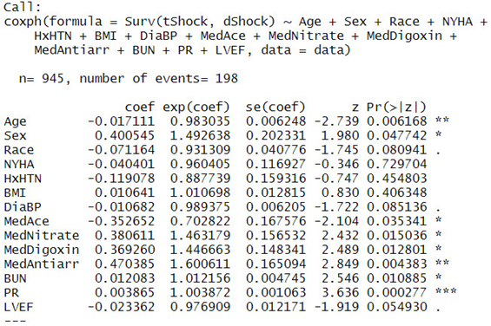
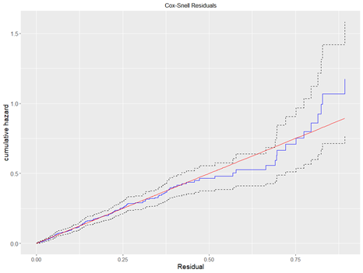
4.3 Fitting Cox proportional hazard model
Final Cox model (14 variables)

Slide 32
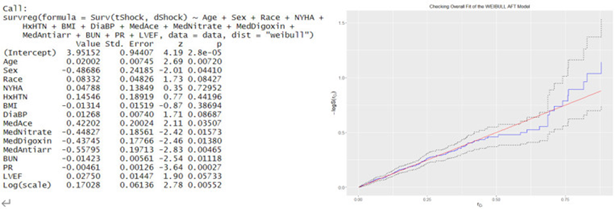
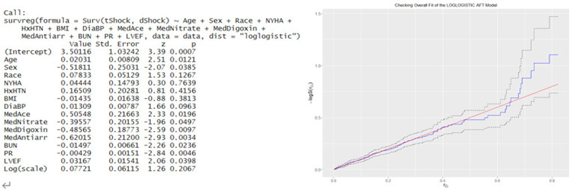
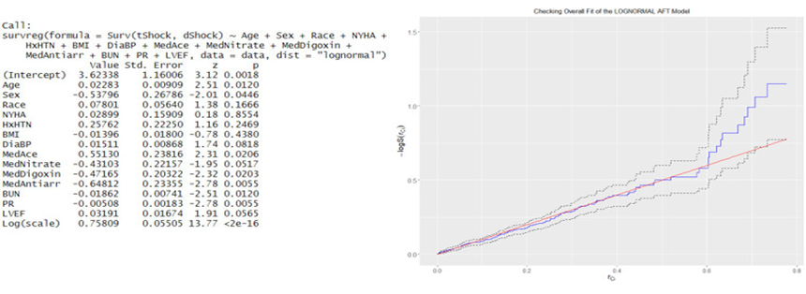
4.4 Fitting AFT model
Weibull AFT model
Log-logistic AFT model
Log-normal AFT model

Slide 33
05
Model Verification

Slide 34
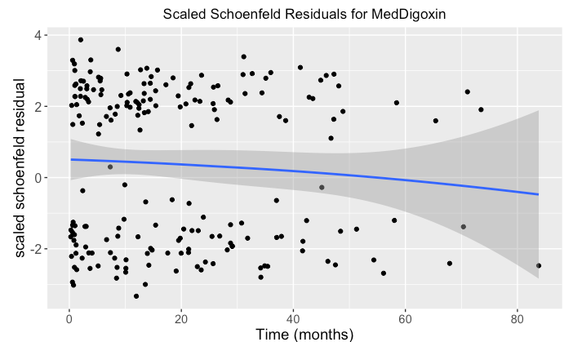
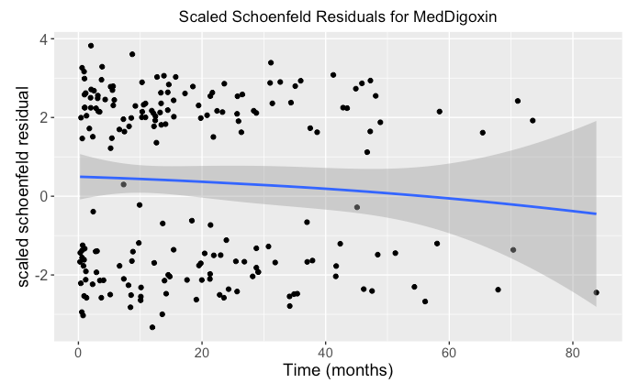
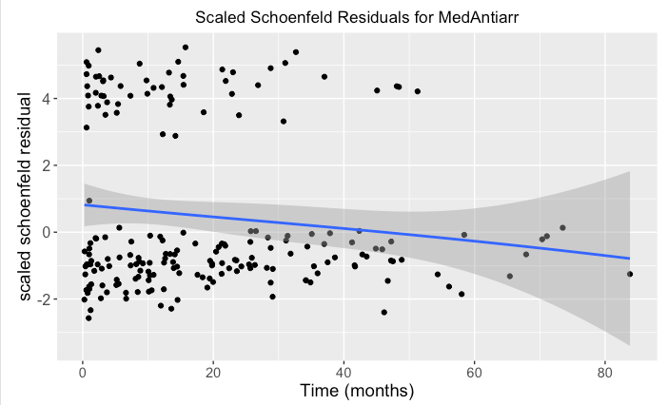

5.1 Model Diagnosis for the Cox PH Model
Drop the outliers whose deviance residuals > 3 or < -3 and get Cox Model 1
ID | Deviance Residuals
587 | 3.0183
673 | 3.1855
793 | 3.1176
844 | 3.2241
919 | 3.4367
ID

Slide 35
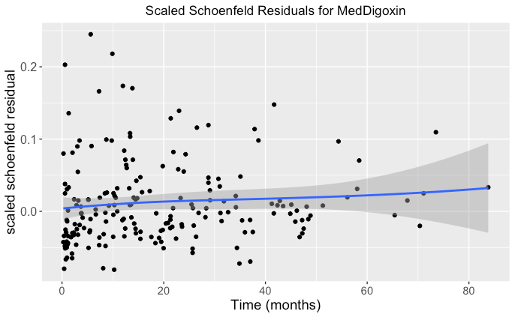
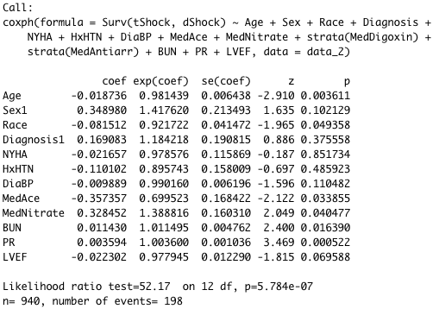
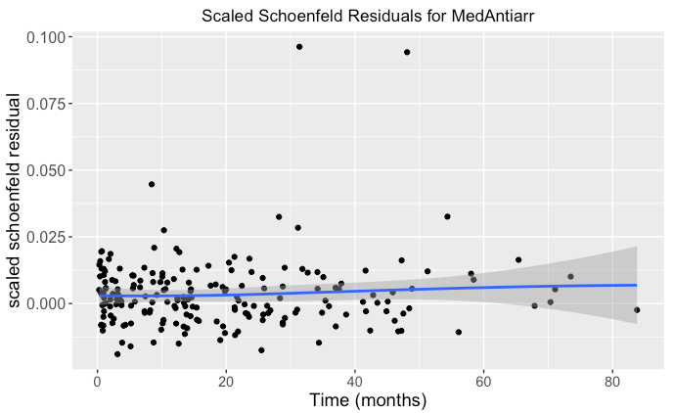
5.1 Model Diagnosis for the Cox PH Model
2. Adding stratification factors and get Cox Model 2

Slide 36
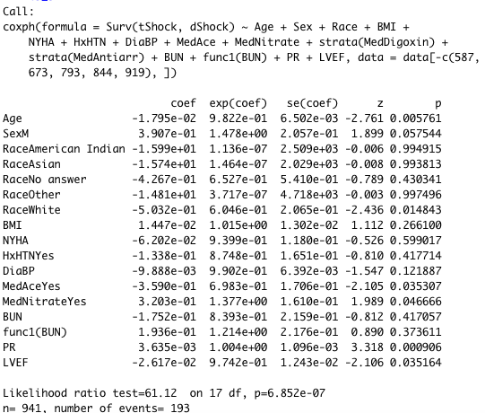
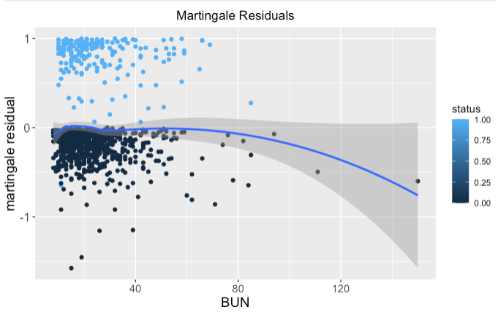
5.1 Model Diagnosis for the Cox PH Model
3. Check whether the correct functional forms are used and get Cox model 3

Slide 37
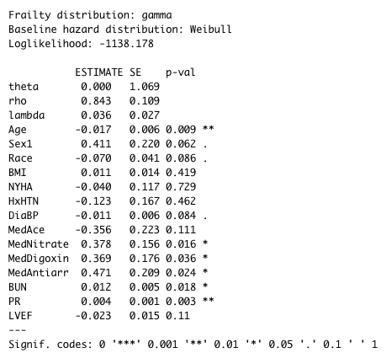
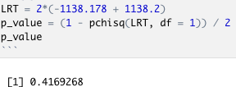
5.2 Model Diagnosis for Weibull AFT Model
1. Consider adding frailty
Frailty effect is not significant

Slide 38
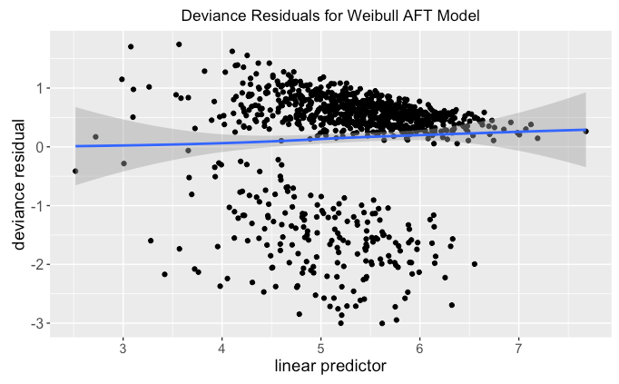
5.2 Model Diagnosis for Weibull AFT Model
2. Drop the outliers
ID | 844 | 919
Deviance Residuals | -3.0036 | -3.0003

Slide 39
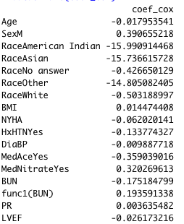
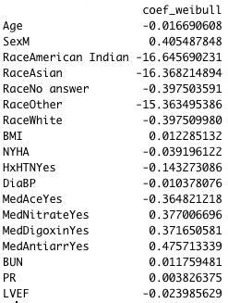
5.3 Model Comparison
Compare coefficients of cox model and AFT Model:
Model | Log-likelihood
Cox Model 3 | -953.9214
AFT Model | -1172.991
Select Cox Model 3 as our final model.

Slide 40
06
Conclusions

Slide 41
6.1 Results and Interpretation
Important Variables | Positive Impact for dShock | Negative Impact for dShock
Age |  | ✔
Sex and Race | White Male | American Indian, Asian, Other, No Answer
BMI | ✔
NYHA |  | ✔
History of Hypertension |  | ✔
Blood Pressure (DiaBP) |  | ✔
Taking Medicine | Nitrate, Digoxin, Anti-arrhythmia | ACE Inhibitors
Blood Urea Nitrogen | >= 80 | <80
PR Interval | ✔
LVER |  | ✔

Slide 42
6.2 Final Conclusions
Patients are most in need of an ICD if they …
are white males,
have taken drugs including nitrates, digoxin and anti-arrhythmia,
BUN >= 80 mg/dL,
have longer PR interval than the average level

Slide 43
单击此处添加您的标题文字
Thanks for listening
单击此处添加您的副标题
刘润祺 11711331
武思齐 11711114
冯真 11711135

Slide 44
References:
[1] https://medschool.ucla.edu/cardiovascular-arrhythmia
[2] https://www.chf-solutions.com/heart-failure-classifications/
[3]https://www.sciencedirect.com/topics/neuroscience/qrs-complex#:~:text=Wide%20QRS%20complex%20tachycardia%20%28WCT%29%2C%20defined%20as%20heart,accurate%20diagnosis%20with%20initiation%20of%20appropriate%20therapy%20essential.
[4]https://www.mdapp.co/qtc-calculator-57/#:~:text=Abnormally%20high%20or%20low%20QTc%20Values%20lower%20than,the%20heart%20and%20can%20appear%20at%20any%20age.
[5]https://www.aurorahealthcare.org/services/heart-vascular/conditions/low-ejection-fraction
[6] Chen, Z., Sohal, M., Voigt, T., Sammut, E., Tobon-Gomez, C., Child, N., ... & O’Neill, M. (2015). Myocardial tissue characterization by cardiac magnetic resonance imaging using T1 mapping predicts ventricular arrhythmia in ischemic and non–ischemic cardiomyopathy patients with implantable cardioverter-defibrillators. Heart Rhythm, 12(4), 792-801.
[7] Ng, A. C., Bertini, M., Borleffs, C. J. W., Delgado, V., Boersma, E., Piers, S. R., ... & Biffi, M. (2010). Predictors of death and occurrence of appropriate implantable defibrillator therapies in patients with ischemic cardiomyopathy. The American journal of cardiology, 106(11), 1566-1573.
[8] Yildirir, A., Batur, M. K., & Oto, A. (2002). Hypertension and arrhythmia: blood pressure control and beyond. Europace, 4(2), 175-182.
[9] Goonasekara, C. L., Balse, E., Hatem, S., Steele, D. F., & Fedida, D. (2010). Cholesterol and cardiac arrhythmias. Expert review of cardiovascular therapy, 8(7), 965-979.
[10] Suzuki, S. (2011). " Cholesterol Paradox" in Atrial Fibrillation. Circulation Journal, 1110171434-1110171434.

