Slide 1
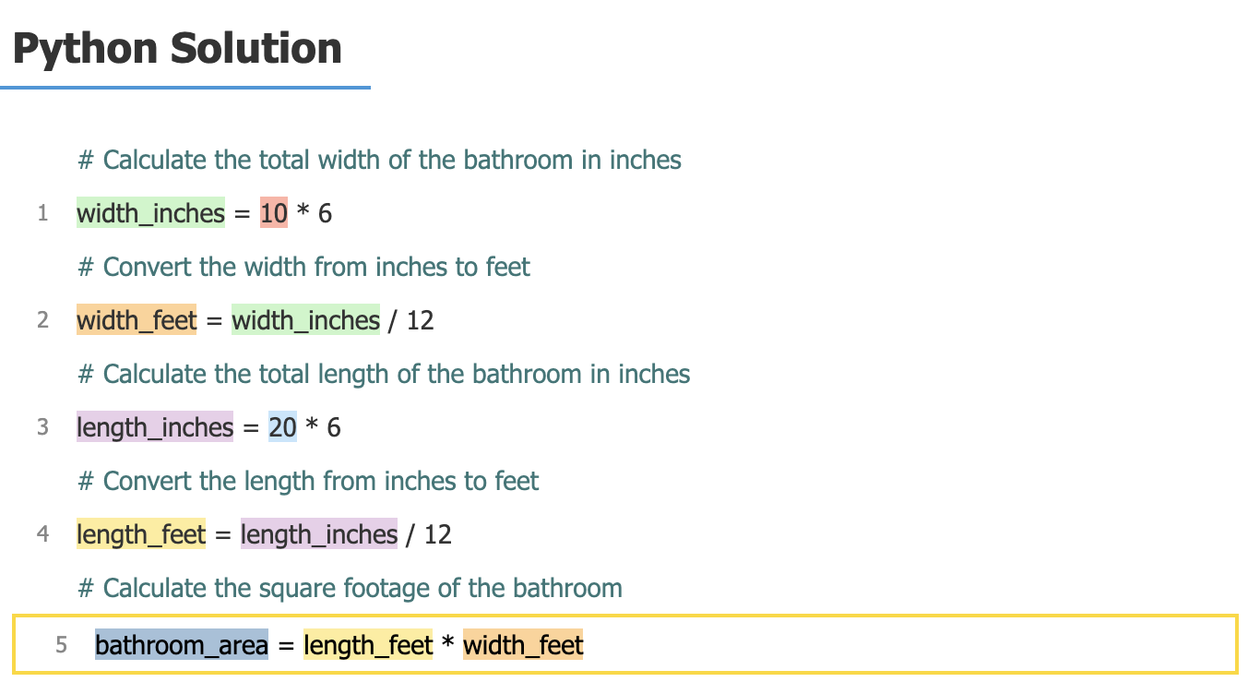
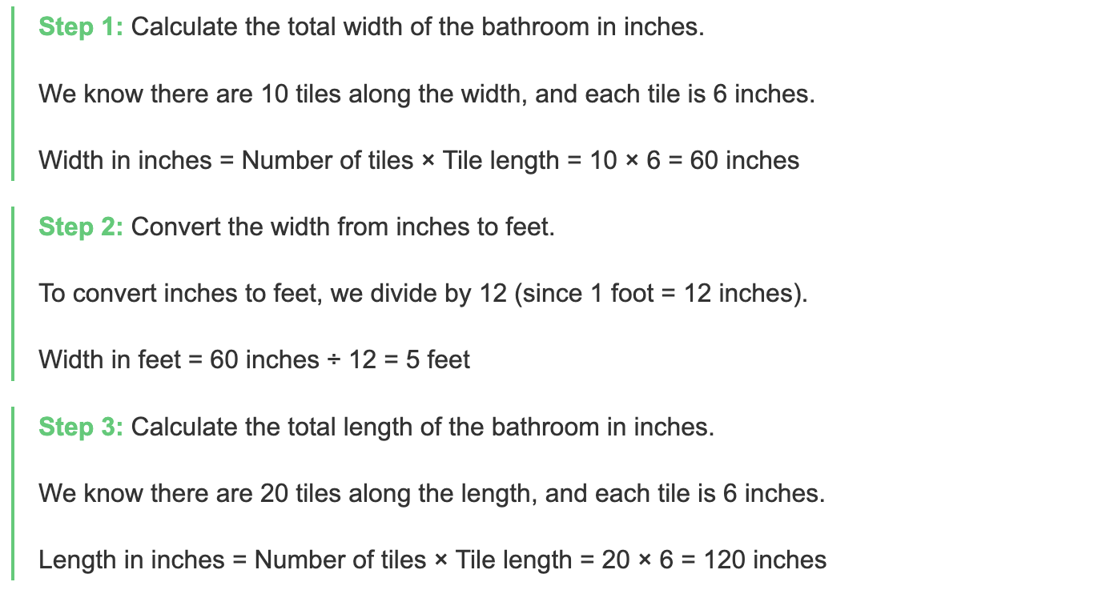
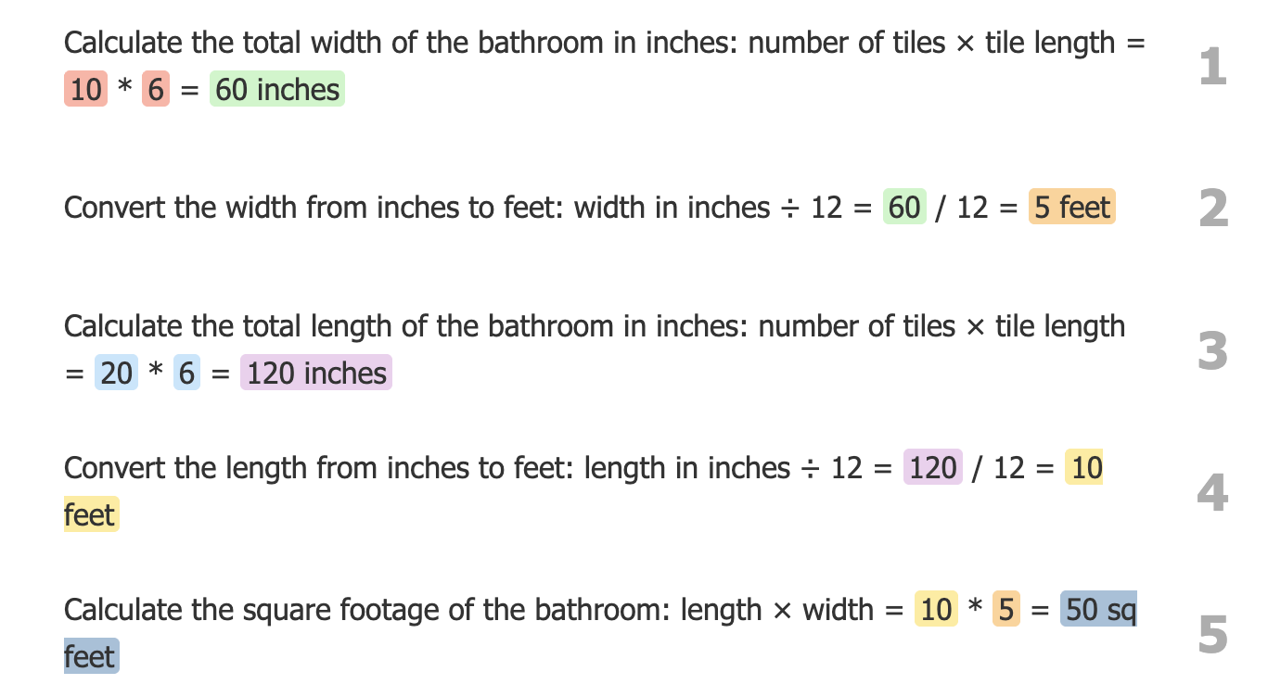
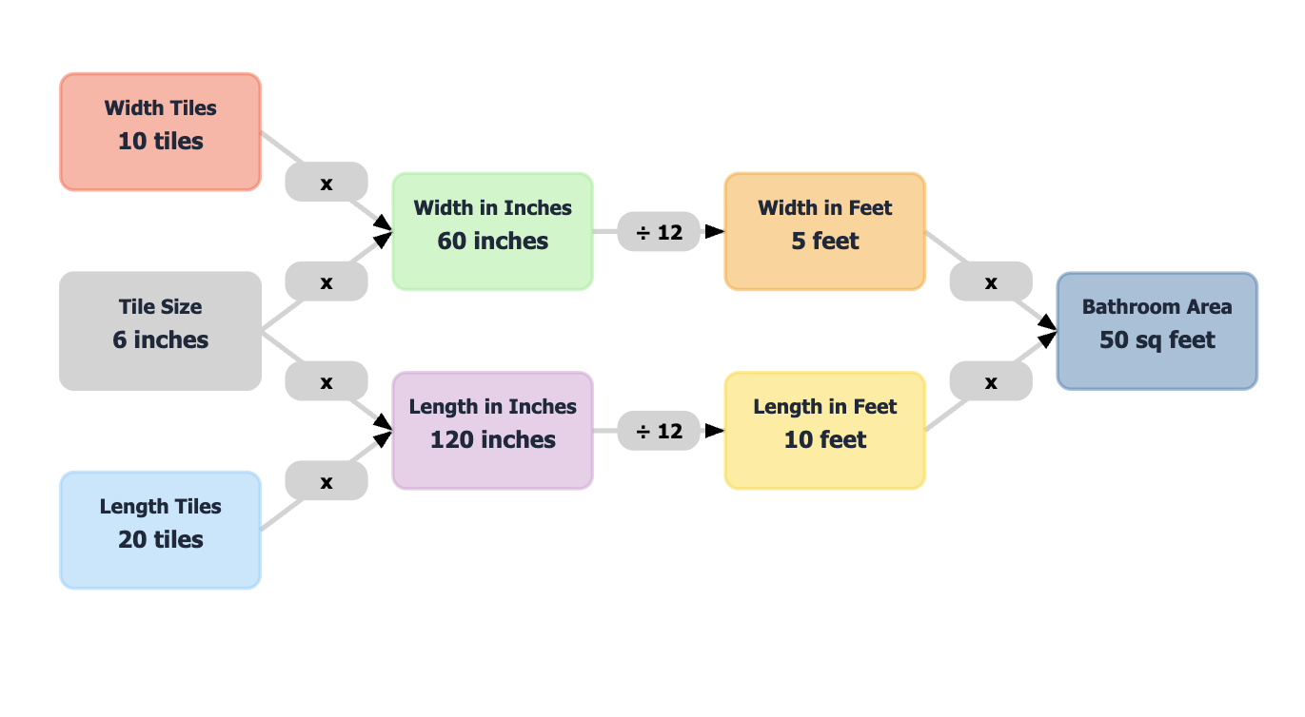
Question: A bathroom has 10 6 inch tiles along its width and 20 6 inch tiles along its length. What is the square footage of the bathroom?
CoT
iCoT
iPoT
iGraph

