Slide 1
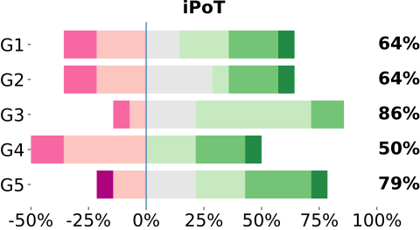
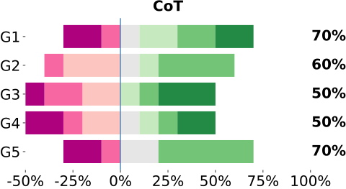
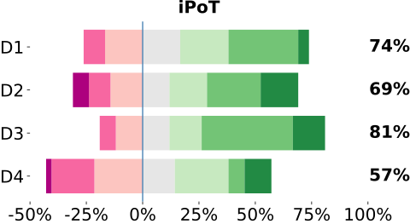
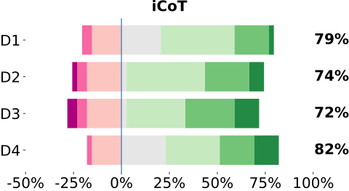
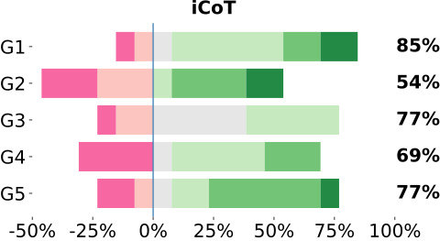
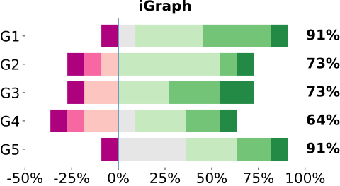
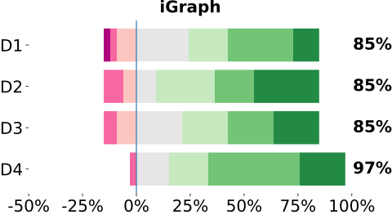
A)
D)
E)
B)
F)
G1: This explanation format helped me understand how the problem was solved.
G2: This explanation format made it easier to identify incorrect reasoning or faulty steps.
G3:The experience of using this explanation format was engaging.
G4: Given the choice, I would prefer to study math problems using this explanation format in the future.
G5: Overall, I was satisfied with this explanation experience.
D1: The dual-panel layout (problem on the left, explanation on the right) made it easier to connect the explanation to the original problem.
D2: The problem summary helped me quickly identify the key variables and constraints.
D3:Color coding made it easier to trace variables consistently across steps.
D4: Showing one step at a time improved the clarity of the explanation.
C)
G)

