Slide 1
Workshop 2: Using Arduino: Intro to Arduino. Control one LED. LED matrix. Working with registers and large LED matrices

Slide 2
Overview:
- Learning outcome: Basics of Arduino programming (C programming, compiling code).
- Project: LED cube
- C programming: 45 min
- compiling code: 10 min
- registers: 20 min
- LED cube: 1 hr

Slide 3
C programming
Go to https://repl.it/languages/c

Slide 4
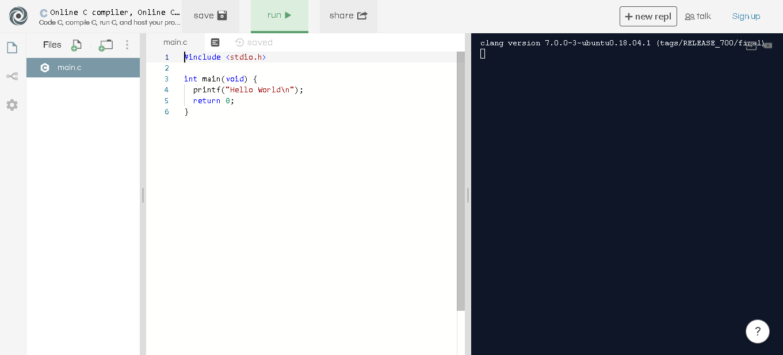

Slide 5
Overview of programming
Instructions sent to computer
Run sequentially
Do A, then B, etc
Can store data in variables
Types include: int, character, float, Boolean
Can run operations on variables
Assign value
Increment/decrement value
Sum, division, multiplication, subtraction

Slide 6
Comparisons
Boolean algebra is crucial to programming
Boolean variable:
2 values: true, false
Three operations exist: AND, OR, NOT
Let x = true, y = false
NOT x = false
x and y = false
x or y = true

Slide 7
How to think of Boolean expressions
A combination of Boolean variables is a Boolean expression
Ex: x AND y, NOT x, x
Boolean expressions are, themselves, either true or false
The easiest way to process Boolean expressions is with if statements
I’ll do ‘B’ if ‘A’
You would only do B if A is true.

Slide 8
How to think of Boolean expressions
A = x OR y
I’ll do B if x OR y
I’ll go to sleep if it’s later than 1am OR my phone runs out of battery
Will go to sleep as long as 1 of the 2 is true
A = x AND y
I’ll do B if x AND y
I’ll lend you 5$ if you do my hw AND you drive me home
Will only lend $$ if driven home AND hw done

