Slide 1
Workshop 2: Using Arduino: Intro to Arduino. Control an LED

Slide 2
Overview:
Learning outcome:
Basics of Arduino programming (C programming, compiling code).
C programming: 45 min
Arduino programming: 20 min
Compiling code: 10 min

Slide 3
C programming
Go to https://repl.it/languages/c
Go through the Programming-1 workshop

Slide 4
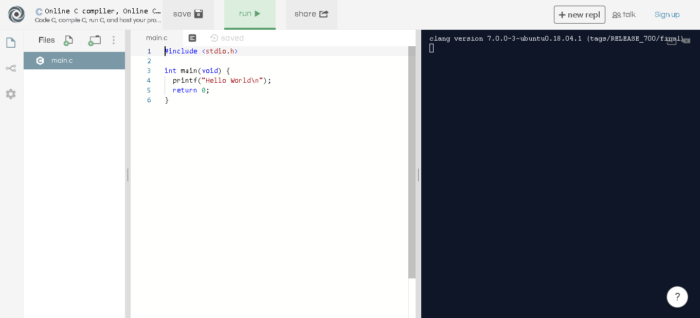

Slide 5
Programming an Arduino
background information
what is an arduino?
What can you do with it?

Slide 6
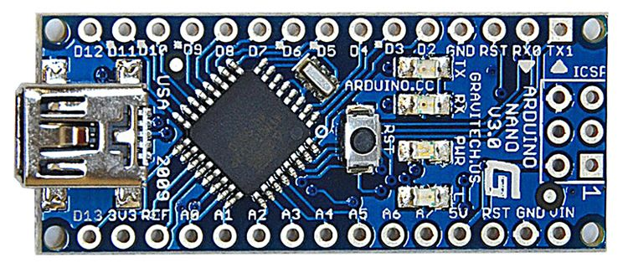
What is an Arduino?
Microcontroller. Has programmable pins that allow you to read and transmit data

Slide 7
Pins:
Pins A0-A7
Analog pins. Can read/write values between 0V and 5V
Pins D2-D13
Digital pins. Either on or off (5V or 0V)
Need to set a pin to be an OUTPUT, INPUT, or INPUT_PULLUP in the setup()
ex:
pinMode(A0, OUTPUT);
pinMode(10, INPUT);

Slide 8
Input pins:
if digital pin (D2-D13)
digitalRead(pin#) returns the state of the pin
value either LOW or HIGH (0 or 1)
if analog pin (A0-A7)
analogRead(pin#) returns the state of the pin
value between 0 and 1023
ex:
pinMode(A0, INPUT);
int x = analogRead(A0);

Slide 9
Output pins:
if digital pin (D2-D13)
digitalWrite(pin#, value)
value = HIGH or LOW
if analog pin (A0-A7)
analogWrite(pin#, value) return the state of the pin
value between 0 and 255
ex:
pinMode(A0, OUTPUT);
int x = analogRead(A0, 255);

Slide 10
Compiling code for the Arduino Nano
Go to Tools > Board
Select Arduino Nano
Go to Tools > Processor
Select Atmega328P (Old Bootloader)
Go to Tools > Port
Select the port on which your Arduino is connected
Compile the sketch and it will upload to your Arduino

Slide 11
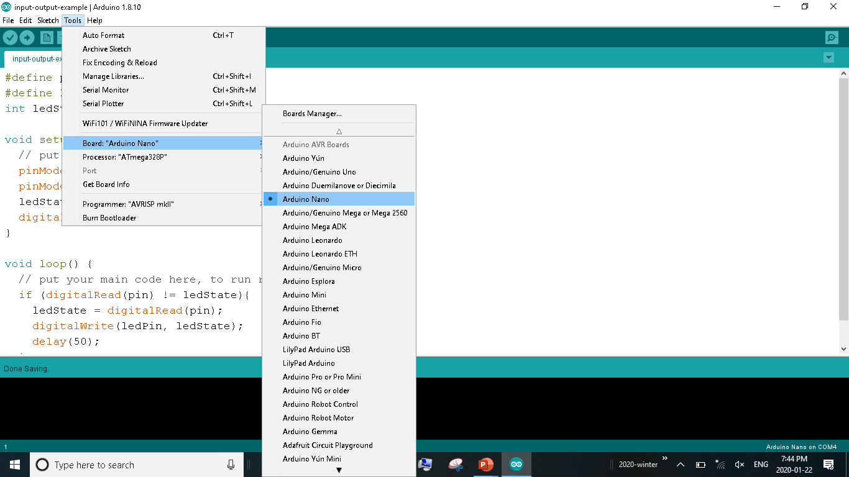

Slide 12
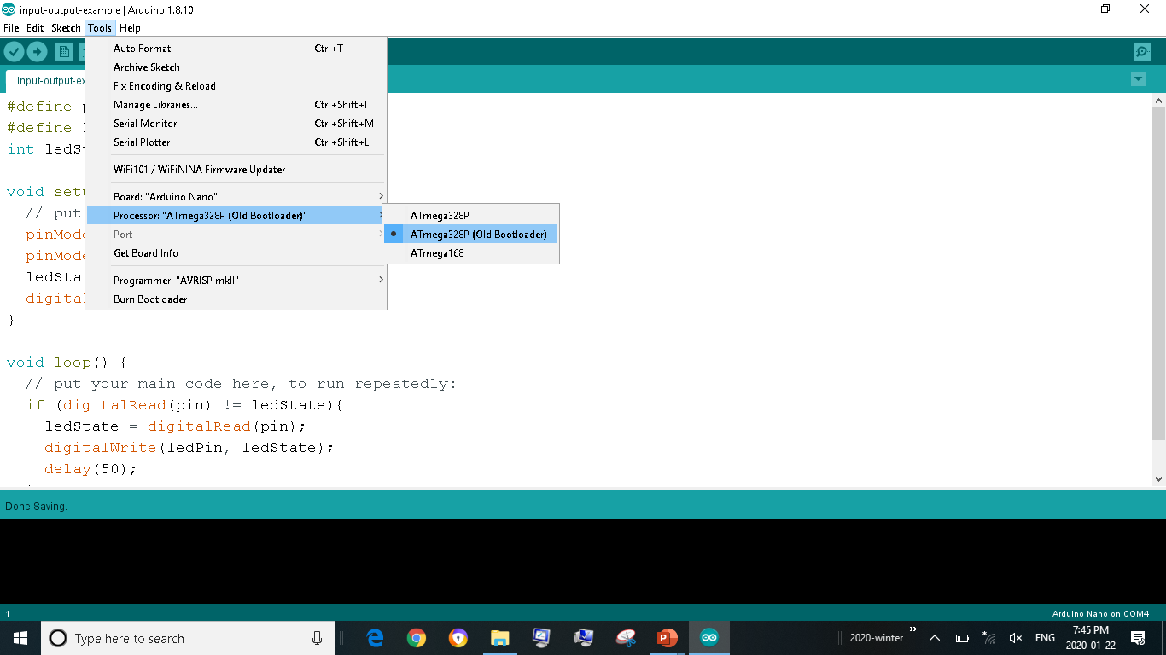

Slide 13
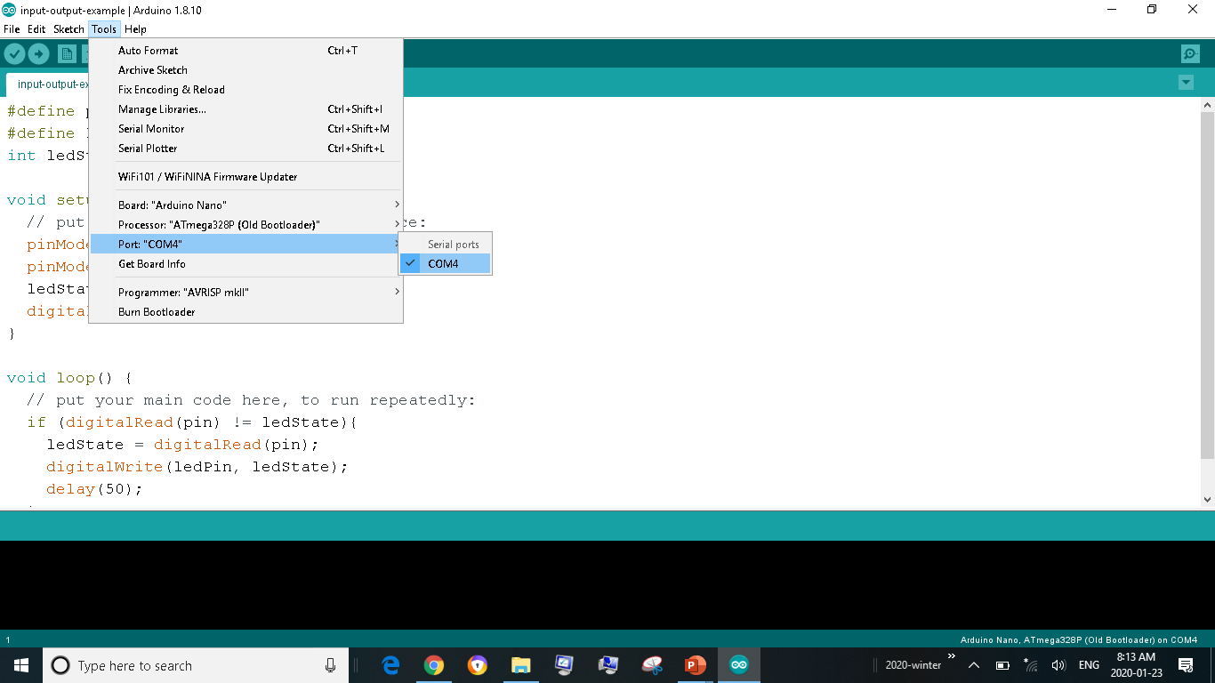

Slide 14
