Slide 1
Workshop 1:Electronic components and circuitry
McGill BattleBots Club

Slide 2
Overview:
- Learning outcome: Basics of circuit analysis
- Basics of circuit analysis: 30 min

Slide 3
Voltage and Current
Voltage: electric potential (energy)
Charge difference
Current: electrons travelling through circuit (matter)
“Kinetic energy”, in some sense
OHM’s LAW: V = IR
V = voltage Volts: [V]
I = current Amps: [A]
R = resistance Ohms: [Ω]
P = POWER = VI Watts: [w]

Slide 4









Battery and ground
Voltage is relative
Notes:
Voltage is a relative measure. Everything around us has a charge. If you think about voltage as being a height, then you can see that we can only measure things in relation to others.
A battery, like the one you see on the slide, does not produce “5V”. It produces a difference between its two nodes. When we are analyzing a circuit, it is useful to declare a node as being the “ground”, or 0V.

Slide 5


Schematic representation
Resistor:
Capacitor:
Inductor:
Notes:
resistor -> wire -> what is current (pushing against the one next to you) -> stop, every stops (switch)

Slide 6
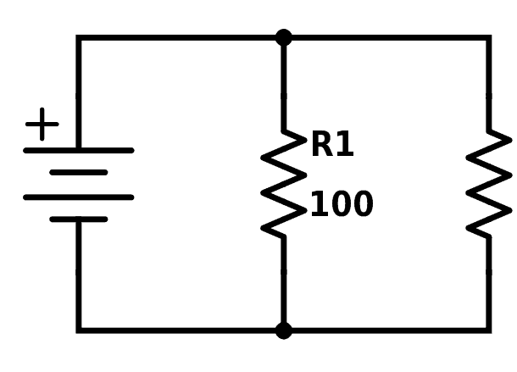
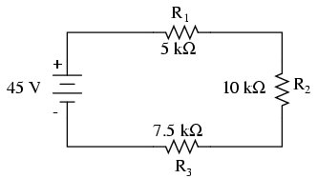
Series: Current same for all components, Voltage different
Parallel: Voltage same for all components, Current different

Slide 7
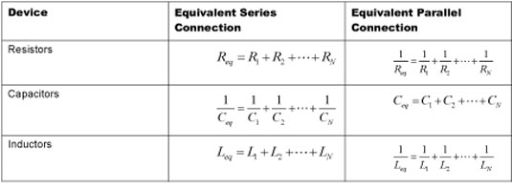
Basics of circuit analysis: simplifying circuits
Resistors:
Series: Req = R1+R2
Parallel: Req = 1/(1/R1 + 1/R2)
Capacitors:
Series: Ceq = 1/(1/C1 + 1/C2)
Parallel: Ceq = C1+C2
Inductors:
Series: Leq = L1+L2
Parallel: Leq = 1/(1/L1 + 1/L2)

Slide 8








Electrical circuit:
Open/closed circuit
Current can flow, or not.
Made of branches (components) connected at nodes

Slide 9


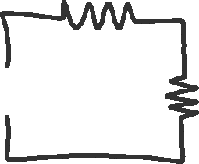










Exercise 1: Find the current

Slide 10







Exercise 2: Find the Voltage

Slide 11
When will I need to use this?
Ex: HC-05 Bluetooth module:
The RX pin for this module is rated for 3.3V
The Arduino pins can only output 5V
Need a voltage divider to turn the 5V into 3.3V
exercise: What resistor ratio would give us the right voltage at the RX pin?

Slide 12
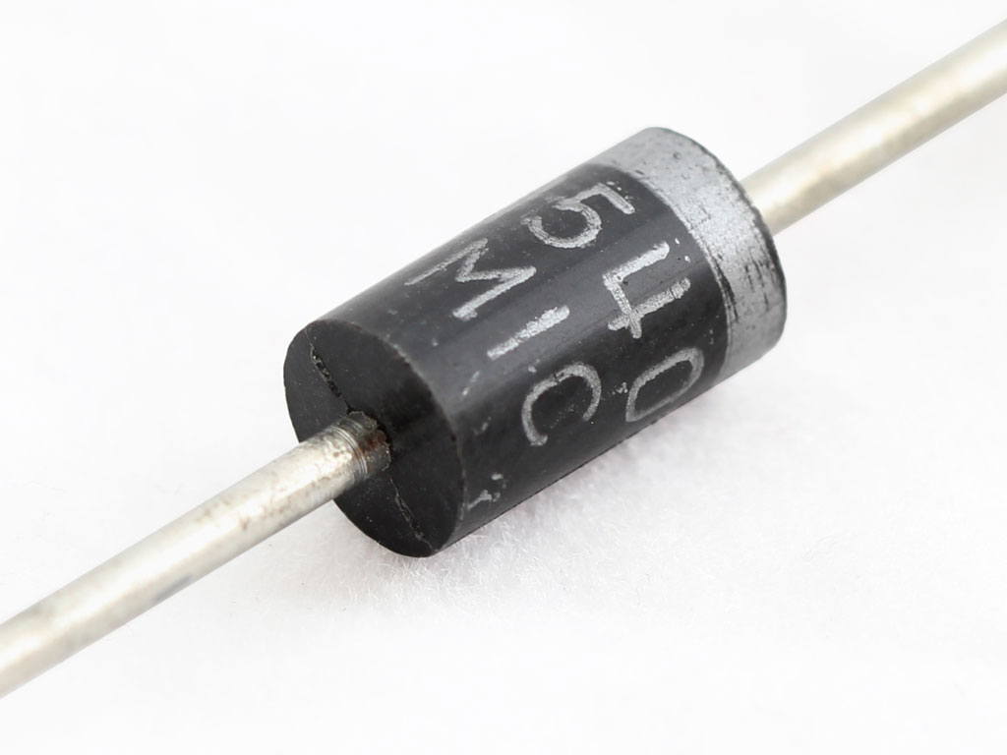
Useful components: Diodes
One way valve: Allows current to travel freely in one direction, but not in the other
Used to protect circuit from connecting a power source backwards
Used to protect circuit from back EMF
Used to transform AC to DC (e.g: full bridge rectifier)
LEDs are diodes
There are different types of diodes.
Can find list on GitHub Common Circuits folder
Notes:
maybe talk about capacitors

