Slide 1

Workshop 2: Programming intuition

Slide 2
Overview:
- Learning outcome: Understand how programming works
variables
control statements
boolean operations
functions
preprocessors (specific to C programming language)

Slide 3
Programming in a nutshell…
Write commands that the computer can interpret.
Commands must be properly formatted
Do “A”, then do “B”, etc…
Orders are executed in a sequential manner.
If you write “A” then “B”, the computer will execute “A” before “B”
Computers can store data in variables for later use.
Computers can operate on data (addition, subtraction, comparison, etc…)

Slide 4
Programming in a nutshell…
Write commands that the computer can interpret.
Commands must be properly formatted
Do “A”, then do “B”, etc…
Orders are executed in a sequential manner.
If you write “A” then “B”, the computer will execute “A” before “B”
Computers can store data in variables for later use.
Computers can operate on data (addition, subtraction, comparison, etc…)

Slide 5
Before using a variable, you must define/declare it
Syntax: A variable is declared as followed
[Data Type] name;
Ex: Integer myVariable
-> declares a variable named myVariable that stores an integer
Ex2: Document myEssay
-> declares a variable named _________ that stores __________
Ex3: Shape aShape
-> declares a variable named _________ that stores __________
Notes:
Big Asterix: these data types are used to give you intuition in how variables work. These data types either do not exist or are called differently

Slide 6
Actual datatypes in C
int -> stores integer values (whole numbers)
ex: 1, 7, -2434
float -> stores decimal numbers
ex: 10.5, -99.7, 100.00001, 8.0
char -> stores a single character
ex: ‘e’, ‘t’, ‘1’, ‘B’
boolean -> stores a boolean value
{true, false}
{1, 0}
Declaring variables:
int x;
float y;
char c;
boolean b;
Assigning values to variables:
variable = new value
x = 10;
y = 17.4;
c = ‘r’;
b = false;
Declaring + assigning at the same time
int var = 19;
boolean b2 = true;

Slide 7
Exercise: find the final values of x and y
Ex1:
int x = 10;
int y = 14;
x = y;
y = x;
Ex2:
int x = 4;
int y = 15;
y = y – 4;
x = y + 4;

Slide 8
Programming in a nutshell…
Write commands that the computer can interpret.
Commands must be properly formatted
Do “A”, then do “B”, etc…
Orders are executed in a sequential manner.
If you write “A” then “B”, the computer will execute “A” before “B”
Computers can store data in variables for later use.
Computers can operate on data (addition, subtraction, comparison, etc…)

Slide 9
Arithmetic operators
Arithmetic operation | Meaning | Example
+ | Addition | 10 + 5 = 15
- | Subtraction | 10 – 5 = 5
* | Multiplication | 10 * 5 = 50
/ | Division | 5 / 2 = 2
% | Modulo (gives you the remainder of the division) | 5 % 2 = 1

Slide 10
Programming in a nutshell…
Write commands that the computer can interpret.
Commands must be properly formatted
Do “A”, then do “B”, etc…
Orders are executed in a sequential manner.
If you write “A” then “B”, the computer will execute “A” before “B”
Computers can store data in variables for later use.
Computers can operate on data (addition, subtraction, comparison, etc…)

Slide 11
Control statements: if else
if (Boolean expression)
{
//run this if the Boolean //expression is true
}
else
{
//run this if the Boolean //expression is false
}
ex: int x = 5;
if (x < 3)
{
printf(“This will not print”);
}
else
{
printf(“This will print”);
}
Notes:
Don’t need to add the else statement if you don’t need it

Slide 12
Boolean operators (logical/relational)
Operator | Meaning | Example | Result
< | Less than | 4 < 3 | false
> | Greater than | 4 > 3 | true
== | Equal to | 4 == 3 | false
<= | Less than or equal | 4 <= 3 | false
>= | Greater than or equal | 4 >= 3 | true
!= | Not equal to | 4 != 3 | true
! | LOGICAL NOT | !true | false
&& | LOGICAL AND | true && false | false
|| | LOGICAL OR | true || false | true

Slide 13
Control statements: while loop
while (Boolean expression)
{
//keep on running this code until the Boolean expression is false
}
ex:
int counter = 0;
while (counter < 10)
{
counter = counter + 1;
}

Slide 14
Control statements: for loop
for (declare counter; Boolean expression; change to counter)
{
//run code until Boolean expression is false
}
ex: for (int counter = 0; counter < 10; counter = counter+1)
{
printf(“hello”);
}

Slide 15
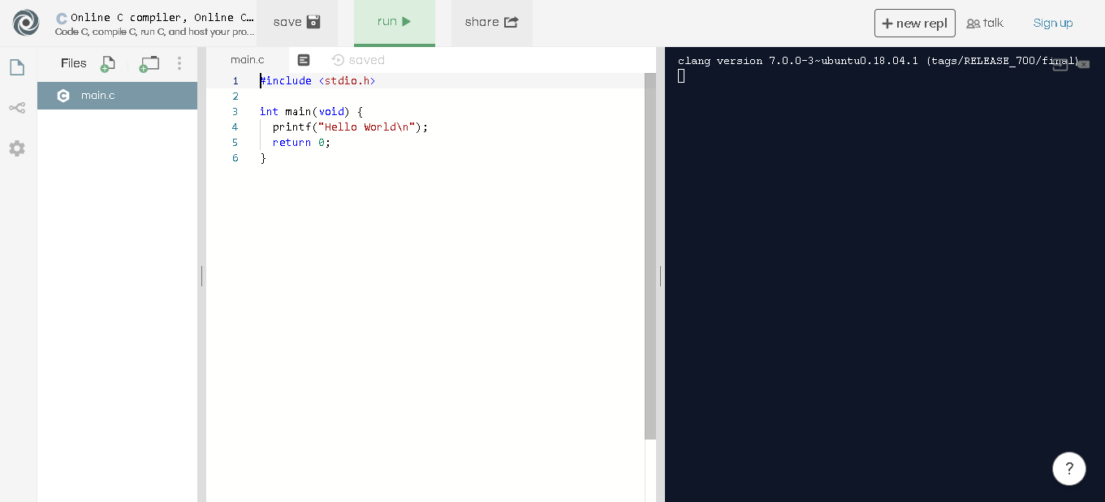



Functions, libraries, control statements
Notes:
You include libraries to define functions and constants that other programmers have written before you.

Slide 16
Functions
Functions are pieces of code that you can reuse without rewriting.
Functions are ‘called’ from your program
Can take parameters
Can return data to its caller
[return type] name(parameters)
{
//function code
}
parameters are defined as
void -> no parameters
[data type] name, [data type] name2, …

Slide 17
Examples of functions
int main(void)
{
return 0;
}
returns an integer
takes no parameters (void = no parameters)
int getSquare(int x)
{
return x * x;
}
returns an integer
takes a parameter x of type int
int getSum(int x, int y)
{
int sum = x + y;
return sum;
}
returns an integer
takes two integers as parameters
void sayHi(void)
{
printf(“hi”);
return;
}
returns nothing
takes no parameters

Slide 18
Preprocessors
#include
includes a header file in your code
Header files have function definitions and constants that you will be using in your code
ex: #include <stdio.h>
#define
defines a constant that will be replaced in your code with its assigned value
ex: #define CONSTANT 10

Slide 19
Format specifiers
In order to print out variable values, you must tell your program what data type you want to print out.
*string is not a data type. it is an array of characters.
Data type | String literal | Example
int | %d | printf(“%d”, 8);
float | %f | printf(“%f”, 17.44);
char | %c | printf(“%c”, ‘h’);
boolean | %d | printf(“%d”, true);
String * | %s | printf(“%s”, “hi”);

Slide 20
repl.it starter code

