Slide 1
MVC패턴
조은향

Slide 2
MVC패턴 Model 2
Client
Controller
Business
DAO
Database

Slide 3
Database
DAO
Business
Controller
Client

Slide 4
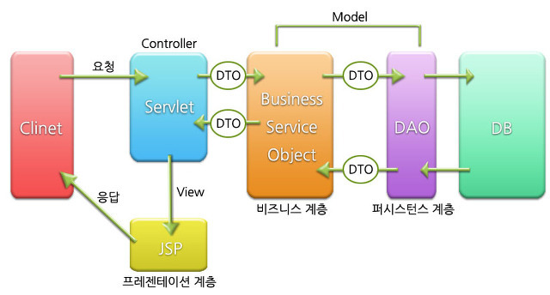
MVC패턴
Model 2
출처 : http://blog.daum.net/_blog/hdn/BgmFrame.do?blogname=gunsu0j&articleno=165&id=gunsu0j

