Slide 1
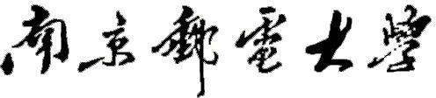

硕 士 学 位 论 文
单位代码： 10293 密 级：
论文题目：
基于深度学习的高精度
点云配准算法研究
_{学}
_{姓}
_{导}
_{号} 1019020913
_{名} 梅青
_{师} 肖建
学 科 专 业
电路与系统
智能信息处理
工学硕士
2022.04
研 究 方 向
申请学位类别
论文提交日期

Slide 2
Research of High-precision Point Cloud Registration Algorithm Based on Deep Learning
Thesis Submitted to Nanjing University of Posts and Telecommunications for the Degree of
Master of Science in Engineering
By
Qing Mei Supervisor: Prof. Jian Xiao
April 2022

Slide 3
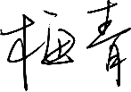


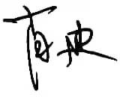
南京邮电大学学位论文原创性声明
本人声明所呈交的学位论文是我个人在导师指导下进行的研究工作及取得的研究成果。
尽我所知，除了文中特别加以标注和致谢的地方外，论文中不包含其他人已经发表或撰写过 的研究成果，也不包含为获得南京邮电大学或其它教育机构的学位或证书而使用过的材料。 与我一同工作的同志对本研究所做的任何贡献均已在论文中作了明确的说明并表示了谢意。
本人学位论文及涉及相关资料若有不实，愿意承担一切相关的法律责任。
研究生学号： 研究生签名： 日期：
南京邮电大学学位论文使用授权声明
本人承诺所呈交的学位论文不涉及任何国家秘密，本人及导师为本论文的涉密责任并列 第一责任人。
本人授权南京邮电大学可以保留并向国家有关部门或机构送交论文的复印件和电子文 档；允许论文被查阅和借阅；可以将学位论文的全部或部分内容编入有关数据库进行检索； 可以采用影印、缩印或扫描等复制手段保存、汇编本学位论文。本文电子文档的内容和纸质
论文的内容相一致。论文的公布（包括刊登）授权南京邮电大学研究生院办理。 非国家秘密类涉密学位论文在解密后适用本授权书。
研究生签名： 导师签名： 日期：

Slide 4
摘要
点云配准是三维计算机视觉和图形学中一个重要的研究课题，在三维重建、三维数据融 合、即时定位与地图构建（Simultaneous Localization and Mapping，SLAM）等领域中都有重 要的应用。随着自动驾驶、人工智能、虚拟现实技术等领域的兴起，将深度学习技术应用于 点云配准也取得了很多极具启发意义的成果。但外部传感器采集到的点云数据往往存在冗余 性与质量缺陷，这一方面使得配准过程占用大量的内存资源和处理时间，另一方面噪声干扰 也会导致特征匹配产生的对应关系出现异常值，从而影响点云配准的精度。在深度学习领域 中，以点云配准经典网络 PCRNet（Point Cloud Registration Network）为代表的点云配准方法 在特征提取时只关注点云的全局信息，并没有考虑到点云的局部特征，难以表征点云空间复 杂的变化关系，一定程度上限制了其对场景的理解能力，从而降低点云配准的精度。同时， PCRNet 网络在特征融合模块仅仅以数组拼接的方式将两组点云的特征在维度上进行连接，不 能充分利用不同层次特征的互补性，无法很好地融合点云的局部特征和全局信息，从而破坏 点云配准的精度。本文针对上述点云配准任务中存在的问题，主要对以下三个方面进行研究 与改进：
针对外部传感器采集到的点云数据存在冗余性与质量缺陷的问题，本文提出一种 基于几何特征的点云数据预处理方案。该方案主要分为点云滤波和点云分割两个部分。其中 点云滤波部分使用随机降采样（Random Sampling）方法对采集到的原始点云数据完成指定数 量的采集，再使用统计滤波器对降采样后的点云进行离群点去除。点云分割部分使用欧式聚 类算法对离群点去除后的点云进行分割，可以较好地分离出目标物体，为后续利用有效点云 信息进行点云配准奠定基础。
针对以点云配准经典网络 PCRNet 为代表的点云配准方法在特征提取模块只关注点
云的全局信息而忽略局部特征的问题，本文在基础网络PCRNet 的特征提取模块进行了改进， 提出了一种基于位置自适应卷积的点云配准网络 PACNet（Point Cloud Registration Network Based on Position Adaptive Convolution）。实验结果表明，PACNet 对比 PCRNet，在评价旋转 矩阵和平移向量的均方误差（Mean Squared Error，MSE）、均方根误差（Root Mean Square Error， RMSE）以及平均绝对误差（Mean Absolute Error，MAE）等 6 个指标上分别提升了 25.6％、 13.7%、21.6%、39.4%、22.1%、19.1%。与同类主流算法相比，本文提出的方法在点云配准任 务中也具有更高的精度。
针对 PCRNet 在特征融合模块将两组点云的特征在维度上进行连接而无法很好地 融合不同层次特征的问题，本文对 PCRNet 的特征融合模块进行了改进，提出了一种基于双 重
i

Slide 5
注意力机制的点云配准网络 PACNet-Att（Point Cloud Registration Network Based on Position
Adaptive Convolution and Attention Mechanism）。实验结果表明，PACNet-Att 对比 PCRNet，在 评价旋转矩阵和平移向量的 MSE、RMSE 以及 MAE 等 6 个指标上分别提升了 30.3％、16.5%、 23.4%、40.7%、22.9%、24%。与同类主流算法相比，本文提出的方法在点云配准任务中具有 更高的精度、更高的泛化性能以及更稳健的噪声鲁棒性。
关键词: 深度学习，点云配准，欧式聚类，动态卷积，注意力机制
ii

Slide 6
Abstract
Point cloud registration is essential in 3D computer vision and graphics and has important applications in 3D reconstruction, 3D data fusion, simultaneous localization and mapping (SLAM), and many other research fields. With the development of autonomous driving, artificial intelligence, virtual reality technology etc., deep learning in point cloud registration has also achieved many inspiring research findings. However, point cloud data collected by external sensors often have redundancy and quality defects. On the one hand, the registration process takes up a lot of memory resources and processing time. On the other hand, noise interference will also lead to abnormal correspondences generated by feature matching, thereby influencing the accuracy of point cloud registration. In the field of deep learning, point cloud registration methods represented by PCRNet only focus on the global information of point cloud without considering local features, which makes it difficult to characterize the complex space and restricts the ability of scene understanding, thereby reducing the accuracy of point cloud registration. At the same time, PCRNet only connects the features of two groups of point cloud data in dimensions based on concatenation, which cannot fully use the complementarity of different levels and cannot well fuse the local features with global information, thereby destroying the accuracy of point cloud registration. Aiming at the aforementioned problems, this thesis mainly focuses on studying and improving the following three issues:
Aiming at the redundancy and quality defects in point cloud data collected by external sensors, this thesis proposes a point cloud data preprocessing scheme based on geometric features, mainly containing point cloud filtering and point cloud segmentation. The point cloud filtering part utilizes
the random sampling method to complete a specified number of collections for the original point cloud data and then utilizes a statistical filter to remove outliers from the downsampled point cloud. The point cloud segmentation part utilizes the euclidean clustering algorithm to separate the target object better, which can lay the foundation for the next point cloud registration using effective point cloud information.
Aiming at the problem that the deep-learning-based methods for point cloud registration represented by PCRNet only focus on the global information of point cloud without considering local features, this thesis improves the feature extraction module of the primary PCRNet, and uses position adaptive convolution to construct our network PACNet. Compared with the primary PCRNet, the
iii

Slide 7
experimental results demonstrate that PACNet has brought 25.6%, 13.7%, 21.6%, 39.4%, 22.1%, and
19.1% improvements in the six criteria: mean squared error (MSE), root mean square error (RMSE) and mean absolute error (MAE) of the rotation matrix and translation vector, respectively. Compared with other state-of-the-art algorithms, the method proposed in the thesis also has higher accuracy in point cloud registration.
(3) Aiming at the problem that PCRNet only connects the features of two groups of point cloud data in dimension based on concatenation, which cannot well fuse the features of different levels, this thesis improves the feature extraction module of the primary PCRNet, and utilizes the dual attention
mechanism to form our point cloud registration network PACNet-att. Compared with the primary PCRNet, the experimental results show that PACNet-Att brings 30.3%, 16.5%, 23.4%, 40.7%, 22.9%, and 24% improvement in the six criteria mentioned in issue (2). Compared with other state-of-the-art algorithms, the method proposed in the thesis has higher accuracy, better generalization performance, and stronger noise robustness in point cloud registration tasks.
Keywords: deep learning, point cloud registration, euclidean clustering, dynamic convolution, attention mechanism
iv

Slide 8
目录
专用术语注释表....................................................................................................................................................VII
插图清单.............................................................................................................................................................. VIII
插表清单................................................................................................................................................................. IX
第一章 绪论............................................................................................................................................................. 1
研究背景与意义........................................................................................................................................ 1
国内外研究现状........................................................................................................................................ 1
论文研究内容............................................................................................................................................ 4
论文组织结构............................................................................................................................................ 5
第二章 点云配准基本理论概述............................................................................................................................. 7
点云数据.................................................................................................................................................... 7
2.1.1 点云数据特点................................................................................................................................. 7
2.1.2 点云特征描述................................................................................................................................. 8
刚体运动参数估计.................................................................................................................................... 8
2.2.1 基于 SVD 的线性代数求解........................................................................................................... 8
2.2.2 基于Levenberg-Marquardt 的非线性优化.................................................................................. 12
标准数据集.............................................................................................................................................. 15
2.3.1 ShapeNet......................................................................................................................................... 15
2.3.2 ModelNet ........................................................................................................................................ 16
2.3.3 S3DIS.............................................................................................................................................. 17
点云配准评价指标.................................................................................................................................. 17
2.4.1 基于特征提取与匹配的评价指标................................................................................................ 18
2.4.2 基于刚体运动参数估计的评价指标............................................................................................ 19
本章小结.................................................................................................................................................. 19
第三章 基于几何特征的点云数据预处理........................................................................................................... 21
点云滤波.................................................................................................................................................. 21
3.1.1 降采样........................................................................................................................................... 21
3.1.2 离群点去除................................................................................................................................... 23
点云分割.................................................................................................................................................. 24
3.2.1 欧式聚类算法............................................................................................................................... 24
3.2.2 区域生长算法............................................................................................................................... 25
实验结果与对比分析.............................................................................................................................. 27
3.3.1 实验环境与硬件配置................................................................................................................... 27
3.3.2 对比实验分析............................................................................................................................... 28
本章小结.................................................................................................................................................. 32
第四章 基于位置自适应卷积提取特征的点云配准优化.................................................................................... 33
基础网络PCRNet.................................................................................................................................... 33
4.1.1 PointNet .......................................................................................................................................... 33
4.1.2 EMD 损失函数 .............................................................................................................................. 34
4.1.3 PCRNet 网络设计.......................................................................................................................... 35
基于位置自适应卷积提取特征的 PACNet ............................................................................................ 37
4.2.1 位置自适应卷积........................................................................................................................... 37
4.2.2 PACNet 网络设计.......................................................................................................................... 38
实验结果与分析...................................................................................................................................... 39
4.3.1 数据集与硬件配置....................................................................................................................... 39
v

Slide 9
4.3.2 训练参数设置............................................................................................................................... 40
4.3.3 整体配准效果............................................................................................................................... 40
4.3.4 测试对比....................................................................................................................................... 41
本章小结.................................................................................................................................................. 42
第五章 基于双重注意力机制融合特征的点云配准优化.................................................................................... 43
注意力机制.............................................................................................................................................. 43 基于双重注意力机制融合特征的 PACNet-Att ...................................................................................... 43 5.2.1 空间注意力机制........................................................................................................................... 43
5.2.2 通道注意力机制........................................................................................................................... 44
5.2.3 PACNet-Att 网络设计.................................................................................................................... 45
实验结果与对比分析.............................................................................................................................. 46
5.3.1 实验环境和训练参数设置........................................................................................................... 46
5.3.2 整体配准效果............................................................................................................................... 46
5.3.3 测试对比....................................................................................................................................... 47
5.3.4 消融实验....................................................................................................................................... 49
本章小结.................................................................................................................................................. 49
第六章 总结与展望............................................................................................................................................... 51
本文总结.................................................................................................................................................. 51
研究展望.................................................................................................................................................. 52
参考文献................................................................................................................................................................. 53
附录 1 攻读硕士学位期间撰写的论文................................................................................................................ 57
附录 2 攻读硕士学位期间申请的专利................................................................................................................ 58
附录 3 攻读硕士学位期间参加的科研项目........................................................................................................ 59
附录 4 攻读硕士学位期间参加的学科竞赛........................................................................................................ 60
致谢......................................................................................................................................................................... 61
vi

Slide 10
南京邮电大学硕士研究生学位论文
专用术语注释表
专用术语注释表
缩略词说明：
AP | Average Precision | 平均精度
AMOTA | Average Multi-Object Tracking Accuracy | 平均多目标跟踪精度
AMOTP | Average Multi-Object Tracking PreciSion | 平均多目标跟踪精度
BnB | Branch and Bound | 分枝定界
EMD | Earth Mover Distance | 搬土距离
FPFH | Fast Point Feature Histogram | 快速点特征直方图
FPS | Farthest Point Sampling | 最远点采样
GPU | Graphics Processing Unit | 图形处理器
GPS | Global Positioning System | 全球定位系统
ICP | Iterative Closest Point | 迭代最近点算法
INS | Inertia Navigation System | 惯性导航系统
LM | Levenberg-Marquardt | 列文伯格·马夸尔特方法
mAcc | mean class Accuracy | 平均类别准确率
mIoU | mean Intersection over Union | 平均交叉联合
mAP | mean Average Precision | 平均精度
MSE | Mean Squared Erro | 均方误差
MAE | Mean Absolute Error | 平均绝对误差
MLP | Multi-layer Perceptron | 多层感知机
NDT | Normal Distributions Transform | 正态分布变换
OA | Overall Accuracy | 总体准确率
RMSE | Root Mean Square Error | 均方根误差
SHOT | Signature of Histograms of OrienTations | 方向直方图
SVD | Singular Value Decomposition | 奇异值分解
SLAM | Simultaneous Localization and Mapping | 即时定位与地图构建
Seq2Seq | Sequence to Sequence | 序列到序列模型
vii

Slide 11
南京邮电大学硕士研究生学位论文
插图清单
插图清单
图 2.1
图 2.2
图 2.3
图 2.4
图 2.5
图 2.6
图 3.1
图 3.2
图 3.3
图 3.4
图 3.5
图 3.6
图 3.7
图 3.8
图 4.1
图 4.2
图 4.3
图 4.4
图 4.5
图 4.6
图 4.7
图 4.8
图 5.1
图 5.2
图 5.3
图 5.4
城市点云数据示例图......................................................................................................................... 7
根据对应点求解刚性坐标变换的简单示例图.................................................................................. 9
最小化 point-to-plane 误差示意图................................................................................................... 13
ShapeNet 数据集的部分可视化效果图........................................................................................... 16
ModelNet 据集的部分可视化效果图.............................................................................................. 17
S3DIS 数据集的部分可视化效果图................................................................................................ 17
点云预处理方案示意图................................................................................................................... 21
均匀降采样算法过程示意图........................................................................................................... 22
真实场景二维图像........................................................................................................................... 27
真实场景点云可视化效果图........................................................................................................... 27
三种降采样结果对比图................................................................................................................... 28
统计滤波器不同参数效果对比图.................................................................................................... 29
半径滤波器不同参数效果对比图.................................................................................................... 29
点云分割效果对比图....................................................................................................................... 31
PointNet 的轻量级架构示意图........................................................................................................ 34
EMD 原理示意图 ............................................................................................................................. 34
PCRNet 网络模型整体框架示意图................................................................................................. 36
PCRNet 网络预测坐标变换示意图................................................................................................. 37
位置自适应卷积原理示意图........................................................................................................... 38
PACNet 网络整体框架示意图......................................................................................................... 39
不同评价指标的训练曲线和测试曲线对比图................................................................................ 40
配准效果展示图............................................................................................................................... 41
PACNet-Att 网络模型整体框架示意图........................................................................................... 45
双重注意力机制结构示意图........................................................................................................... 45
不同评价指标的训练曲线和测试曲线对比图................................................................................ 46
配准效果展示图............................................................................................................................... 47
viii

Slide 12
南京邮电大学硕士研究生学位论文
插表清单
插表清单
表 2.1
表 3.1
表 3.2
表 3.3
表 3.4
表 4.1
表 4.2
表 5.1
表 5.2
表 5.3
表 5.4
点云信息处理任务中常见的数据集列表........................................................................................ 15
降采样实验结果对比表................................................................................................................... 28
离群点去除实验结果对比表........................................................................................................... 30
点云分割实验结果对比表............................................................................................................... 31
点云预处理实验结果汇总表........................................................................................................... 32
不同卷积层数测试结果对比表....................................................................................................... 41
精度测试结果对比表....................................................................................................................... 42
各算法精度测试结果对比表........................................................................................................... 48
泛化性测试结果对比表................................................................................................................... 48
噪声鲁棒性测试结果对比表........................................................................................................... 49
消融实验测试结果对比表............................................................................................................... 49
ix

Slide 13
南京邮电大学硕士研究生学位论文
第一章 绪论
第一章 绪论
研究背景与意义
计算机视觉是人工智能领域具有前沿性的研究方向，经过数十年的发展和众多科学工作 者的共同努力，计算机系统可以成功地感知信号，并从视频、图像以及其他输入信息中获得 有价值的信息^{[1]}。计算机视觉已经跨越了不同层次的发展，从边缘识别等^{[2]}低级任务到场景理 解等^{[3]}高级任务，都产生了优异的成效。其中，这些发展离不开以下三个要素：一是机器学习 的发展让深度学习走向成熟，能够在原始信息中对复杂的算法执行端到端学习。二是通过图 形处理器（Graphics Processing Unit，GPU）提高算力，极大地提升了算法的运行效率^{[4]}。三 是大量标记精准的开源数据集为算法的训练提供了基础性的数据支撑。
随着高精度传感器的快速发展，点云数据的获取变得越来越方便，在数字城市^{[5]}、无人驾 驶^{[6]}、人机交互^{[7]}等领域都有着广泛的应用。不同的三维传感器有其独特的优势和局限性，例
如，三维相机可以生成稠密的点云数据，但是视野范围通常被限制在 5 米以内。激光雷达具 有较长的视野范围，但生成的点云数据比较稀疏^{[8]}。由于传感器只能在有限视野范围内对物体 进行扫描，因此，大型三维场景需要点云配准算法来生成完整的点云模型。点云配准是三维 计算机视觉和图形学中的一个重要的基础领域，在三维重建^{[9]}、三维数据融合^{[10]}、SLAM^{[11]}等 应用中都有着特殊而重要的意义。点云配准旨在估计源点云和模板点云之间的刚性运动变换 参数，应用变换参数后实现两片点云的对齐，从而将不同视角采集的点云数据拼接成一个完 整的三维点云模型^{[12]}。一般来说，采集来自不同视角的点云之间会存在一定的重叠区域，如 何从重叠区域找到用于配准的“匹配点对”是匹配算法的关键^{[13]}。因此，点云的配准问题可 以转化成点对的配准问题。传统方法中，查找匹配点对时会计算几何特征的相似性，但是对 点云的初始位置要求较为严格，需要在空间上有一定的重叠部分才能获得较好的配准效果。 随着深度学习的发展，点云配准网络可以直接处理无序的原始点云数据，逐渐对点云的初始 位置不敏感，并获得了高精度并且健壮的鲁棒性效果^{[14]}。最近，基于深度学习方法和优化方 法的组合进一步提高了点云配准的性能，属于当前点云配准领域研究的热点问题^{[15]}。
国内外研究现状
目前，点云配准根据其实现方法主要可以分为两类，一类是基于传统方法的点云配准，

Slide 14
南京邮电大学硕士研究生学位论文 第一章 绪论
通常分为两个阶段，即粗配准和精配准^{[16]}。一般首先使用粗配准算法获得一个良好的初始值，
其次使用精配准算法最小化两片点云之间的刚性变换误差。另一类是基于深度学习的点云配 准，一般分为端到端的学习方法和基于特征学习的方法。端到端的学习方法一次性完成所有 特征点的学习和刚性变换的估计，更关注点云之间的全局特征。基于特征学习的方法集中关 注描述特征点的学习，而刚性变换则由一些鲁棒的姿态估计器获得^{[17]}。
传统方法中应用最广泛的点云配准算法就是 1992 年 Besl 等^{[18]}提出的迭代最近点算法
（Iterative Closest Point，ICP），该算法作为开山之作对点云精配准来说具有开创性的意义。 ICP 算法原理简单，实现起来也很容易，但是该算法对初始值的要求很高，并且非常容易陷入
局部最优，算法效率不高，因此点云配准领域科研工作者们在此基础上做出了许多改进，并 衍生出了各种 ICP 算法的变形。2009 年，M.Magnusson 等^{[19]}提出了 3D-NDT（Normal Distributions Transform）算法，该算法对局部点的统计特性进行了表征，将点云分割为多个同 尺寸的栅格，每个栅格用正态分布表示，并使用 ICP 算法计算了每个栅格中所有点的均值和 方差，通过匹配每个栅格的正态分布来匹配点集。NDT 算法对点集进行了抽象，并不需要逐 点找对应点，但它本质上仍是基于最近点假设，仍然容易陷入局部极小值。2015 年，J.Yang 等^{[20]}提出了 Go-ICP 算法，Go-ICP 算法基于搜索整个三维运动空间𝑆𝐸(3)的分枝定界（Branch and Bound，BnB）方案，利用𝑆𝐸(3)的特殊几何结构，推导出配准误差函数的上下界，之后将 局部 ICP 应用于 BnB 方案中，能够保证算法获得全局最优，同时加快了配准的速度。2016 年， Zhou 等^{[21]}提出了 FGR（Fast Global Registration）算法，该算法利用损失函数将非凸的问题进 行凸化，通过引入 GM（Geman-McClure）估计量和回归损失函数，在一定程度上都可以将函 数光滑化，但是 GM 估计量下降更快，所以它对噪点的限制作用更大。传统方法中，还有一 类方法基于手动设计的特征获得匹配关系。这类方法通常首先从输入的原始点云中提取关键 点和特征描述符。其次利用异常值剔除法和最近邻算法选择内部关键点，获得更准确的关键 点对应关系。最后估计从源点云到目标点云的转换。现有的相对较好的手工特征，如快速点 特征直方图^{[22]}（Fast Point Feature Histogram，FPFH）、方向直方图^{[23]}（Signature of Histograms of OrienTations，SHOT）等已经取得了显著的效果，可以对特殊场景下的点云实现特征提取 与匹配。然而，这类方法对异常值和重复几何结构很敏感，缺乏点云的语义信息，因此精度 较低且鲁棒性较差。
2017 年，Charles 等^{[24]}人提出首个可以直接处理点云数据的深度学习模型框架 PointNet，
该网络通过一个简单的对称函数即最大池化来处理每个点，消除了输出结果因点云数据的无 序性所受到的影响。之后，基于深度学习的点云配准研究也取得了一些重要成果。Zeng 等^{[25]} 提出了 3DMatch 深度网络模型，通过学习自定义局部空间域的描述子，该网络可以建立局部

Slide 15
南京邮电大学硕士研究生学位论文 第一章 绪论
三维数据的对应关系。实验结果表明，该方法不仅在重建的局部几何匹配上表现很好，并且
可以扩展到不同的任务和尺度中。2018 年，Deng 等^{[26]}提出了PPFNe（t Point Pair Feature Network） 模型，将一些简单的几何特征属性组合成原始特征，生成易区分且抗旋转的三维局部特征子。 实验结果表明，该方法可以得到一个理想的三维局部特征子，但对于旋转操作很敏感。Yew 等 ^{[27]}提出了 3DFeat-Net 网络模型，使用弱监督学习来学习三维特征检测器和描述子，对来自 GPS/INS（Global Positioning System/ Inertia Navigation System）组合导航系统标记的三维点云 使用对齐操作和注意力机制来学习特征点匹配。2019 年，Aoki 等^{[28]}提出了 PointNetLK 网络 模型，把 PointNet 网络看作是一个成像函数，并提取两片输入点云的全局特征，然后使用雅 可比矩阵的逆形式估计变换矩阵。通过估计变换矩阵，目标是最小化两个特征之间的特征差 异。Wang 等^{[29]}提出了一种新的 DCP（Deep Closest Point）网络模型，该网络使用动态图卷积 提取特征，并使用注意力模块将点云配准问题视为序列到序列模型（Sequence to Sequence， Seq2Seq）问题，之后利用奇异值分解（Singular Value Decomposition，SVD）线性求解旋转矩 阵和平移向量。Lu 等^{[30]}提出了 DeepVCP（Virtual Corresponding Points）网络模型，通过引入 语义特征自动避开动态目标并选取易于匹配的关键点。在关键点的候选匹配区域内，通过计 算特征相似概率的方式来生成同名点，最后网络损失综合了关键点的局部和全局匹配效果。 实验结果表明，该方法达到了与传统 ICP 算法相当的匹配精度以及更高的稳定性。Sarode 等 ^{[31]}提出了 PCRNet，其使用 PointNet 对点云提取全局特征，再将两个全局特征进行连接，然后 使用 5 层全连接网络回归相对位姿。由于不需要计算点云之间的一一对应关系，PCRNet 能够 快速地进行点云配准。2020 年，Pairs 等^{[32]}通过使用深度残差层和卷积层构建了 3DRegNet 网 络模型，将匹配点的对应关系区分为正常或错误，并回归了当前扫描帧对齐到参考帧的运动 参数。实验结果显示，该算法效果远远优于传统模型，并已推广至多视图场景。2021 年，Fu 等^{[33]}在点云中构建图，再通过基于深度图匹配的方法建立更好的对应关系。实验结果表明该 方法虽然配准效果很好，但完全无法应用于真实场景，且泛化性能较差。目前，主流的基于 深度学习的点云配准方法往往集成了用于建立两组未对齐点云对应关系的深度神经网络和用 于计算两组未对齐点云刚性运动变换的线性或非线性算法，从而构建用于点云配准的端到端 可训练网络。这些方法探索深层抽象特征来建立对应关系，尽管它们具有良好的性能，但从 点云中提取的所有关键特征辨别能力较差，而输入点云中的噪声干扰也会导致特征匹配产生 的对应关系容易出现异常值，从而破坏了配准精度^{[34]}。因此，基于深度学习的点云配准还有 待国内外学者们的进一步研究探索。

Slide 16
南京邮电大学硕士研究生学位论文
第一章 绪论
论文研究内容
由于外部传感器采集到的点云数据往往存在冗余性与质量缺陷，这一方面使得配准过程 需要占用大量的内存资源和处理时间，另一方面输入点云中的噪声干扰也会导致特征匹配产 生的对应关系出现异常值，从而影响点云配准的精度。因此，研究并实现有效的点云数据预 处理方案是后续进行特征提取与匹配的基础，也是利用关键特征进行点云配准的基础。
在深度学习领域，以 PCRNet 为代表的点云配准网络在特征提取模块只关注了点云的全 局信息，并没有考虑到点云的局部特征，难以表征点云空间复杂的变化关系，一定程度限制
了其对场景的理解能力。同时，PCRNet 网络在特征融合模块仅以数组拼接的方式将两组点云 的特征在维度上进行连接，不能充分利用不同层次特征的互补性，无法很好地融合点云的局 部特征和全局信息。在特征提取模块和特征融合模块的局限性都导致了 PCRNet 网络在点云 配准任务中精度的欠缺。因此，研究并改进点云配准网络中的特征提取模块和特征融合模块 是提高点云配准精度的有效方法。
本文主要有三个研究点，主要内容如下：
针对外部传感器采集到的点云数据存在冗余性与质量缺陷的问题，本文提出一种 基于几何特征的点云数据预处理方案，该方案主要分为点云滤波和点云分割两个部分。通过 分析和对比不同方法以及不同参数的算法，本文确定了点云预处理的有效方案，即使用随机 降采样对采集到的原始点云数据完成指定数量的采集，再使用统计滤波器对降采样后的点云 进行离群点去除，最后使用欧式聚类算法对离群点去除后的点云进行分割。相比于均匀降采 样和体素降采样，随机降采样在三种降采样方法中算法复杂度最低，运行速度最快，同时可 以指定采样点的数量。统计滤波器根据全局距离平均值和方差来定义阈值标准，无需人工指 定阈值标准，更为高效，并且更能适应不同的点云场景。欧式聚类算法以邻域内点与点之间 的距离作为判定标准，算法复杂度更低，可以较好地分离出目标物体，为后续利用有效点云 信息进行点云配准奠定基础。
针对以点云配准经典网络 PCRNet 为代表的点云配准方法在特征提取模块只关注点 云的全局信息而忽略局部特征的问题，本文在基础网络PCRNet 的特征提取模块进行了改进， 提出了一种新的基于深度学习的点云配准网络模型 PACNet。本网络引入了位置自适应卷积， 其根据每个点与其邻域点的位置关系学习权重系数，并组合权重矩阵自适应地构建卷积内核， 可以灵活地捕获局部区域的信息，获得更好的场景理解能力，从而提高点云配准的精度。
针对 PCRNet 在特征融合模块仅仅以数组拼接方式将两组点云的特征在维度上进 行连接而无法很好地融合不同层次特征的问题，本文在基础网络 PCRNet 的特征融合模块进 行

Slide 17
南京邮电大学硕士研究生学位论文 第一章 绪论
了改进，提出了一种新的基于深度学习的点云配准网络模型 PACNet-Att。该网络引入了结合
空间注意力机制和通道注意力机制的双重注意力机制，其中的空间注意力机制通过对空间维 度上的特征进行聚焦，可以加深网络结构更深层次的信息传递。通道注意力机制通过对通道 维度上的特定语义进行响应增强，可以提高特征的可分辨性。将两者结合的双重注意力机制 可以捕获不同层次特征的长期语义依赖关系，有效融合局部特征和全局信息，从而提高点云 配准的精度。
论文组织结构
第一章绪论阐述了本文基于深度学习的点云配准的研究背景与意义，并分析了传统方法 和深度学习方法这两个方面在点云配准课题中的研究现状，最后明确了本文的主要内容和组 织结构。
第二章介绍了与点云配准相关的基本理论。首先介绍了点云数据具有的特点，其次阐述 了点云数据的两类特征描述方式，分别是局部特征描述和全局特征描述。然后详细分析了点 云配准任务中基于SVD 的线性代数法和基于列文伯格·马夸尔特算法（Levenberg-Marquardt， LM）的非线性优化法估计刚体运动参数的过程，接着介绍了点云配准中的两类数据集，即合 成数据集和真实场景数据集，并展示了 ShapeNet、ModelNet 以及 S3DIS 这三种常用的标准数 据集。最后介绍了点云信息处理任务中常用的评价标准，并重点介绍了点云配准任务中基于 特征提取与匹配以及基于刚体运动参数估计的两类评价指标。
第三章主要研究了基于几何特征的点云数据预处理方案。针对外部传感器采集到的点云 数据存在冗余性与质量缺陷的问题，本文提出一种基于几何特征的点云数据预处理方案，分 析并对比不同的点云滤波方法以及不同的点云分割方法处理点云的效果，确定了点云预处理
的有效方案，为后续利用有效点云信息进行点云配准奠定了基础。
第四章提出了基于位置自适应卷积提取特征的点云配准优化方法。针对以点云配准经典 网络 PCRNet 为代表的点云配准方法在特征提取模块只关注点云的全局信息而忽略局部特征 的问题，本章基于 PCRNet 网络提出了一种基于位置自适应卷积提取特征的点云配准网络 PACNet。首先阐述并分析了 PCRNet 网络的工作机制和存在的局限性，其次解释了位置自适 应卷积的工作原理，并介绍了 PACNet 网络在特征提取模块的改进思路，最后在标准数据集 上，将本章提出的方法与现有的同类主流算法进行对比，验证了本章提出的方法在点云配准 任务中具有更高的精度。
第五章提出了基于双重注意力机制融合特征的点云配准优化方法。针对 PCRNet 在特征

Slide 18
南京邮电大学硕士研究生学位论文 第一章 绪论
融合模块仅仅以数组拼接方式将两组点云的特征在维度上进行连接而无法很好地融合不同层
次特征的问题，本章基于 PCRNet 深度学习网络模型提出了一种基于双重注意力机制融合特 征的点云配准网络 PACNet-Att。首先介绍了与注意力机制有关的背景知识，其次解释了双重 注意力机制中空间注意力机制和通道注意力机制的工作原理，并介绍了 PACNet-Att 网络在特 征融合模块的改进思路。最后在标准数据集上，将本章提出的方法与现有的同类主流算法进 行对比，证明了本章提出的方法在点云配准任务中具有更高的精度、更高的泛化性能以及更 稳健的噪声鲁棒性。同时，通过消融实验，验证了位置自适应卷积和双重注意力机制在点云 配准任务中的有效性。
第六章对本文的研究工作进行了总结与展望。本章首先对本文所做出的研究工作进行了 详细的总结，其次指出了本文提出的方法可进一步探索的空间，并提出了可行的改进思路与 方向，最后对今后的研究进行了展望。

Slide 19
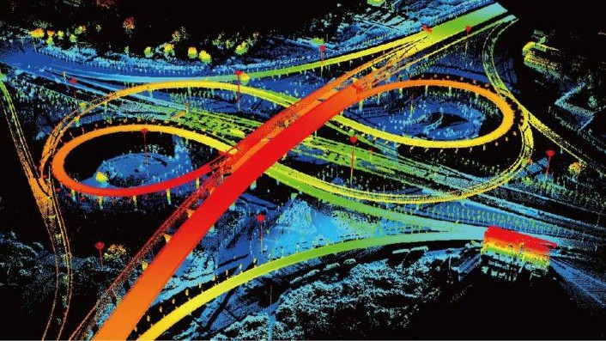
南京邮电大学硕士研究生学位论文
第二章 点云配准基本理论概述
第二章 点云配准基本理论概述
本章首先介绍了点云数据的特点，并且介绍了点云数据的两类特征描述方式，其次分析
了点云配准任务中刚体运动参数估计的方法，最后详细阐述了点云配准任务中常用的标准数 据集以及评价指标。
点云数据
三维数据的表征方式可以有多种类型，例如点云、体素^{[35]}、网格^{[36]}和深度图像等。点云 作为其中最为常用的格式之一，保留了三维空间中原始的几何信息，不需要任何离散化。因 此，点云是许多与场景理解相关的应用领域首选的三维数据表征方法，如图 2.1 所示为激光 雷达采集到的城市点云数据。
图 2.1 城市点云数据示例图
2.1.1 点云数据特点
点云数据的本质是一个点集，它具有以下特征：（1）无序性（Unordered）：在欧式空间的 度量中，点和点之间并不像一维和二维空间有固定的顺序。对于点云数据信息，每个点的顺 序不应当影响到结果。（2）局部相关性（Interaction Among Points）：在空间中的点并不独立， 与其邻域点之间的位置关系信息是有意义的， 它代表了物体的形状特征。（ 3） 不变性
（Invariance Under Transformation）：对于点云数据应该满足一些空间变换的不变性，例如平 移和旋转，这些都不会影响输出的结果。卷积网络通常需要规则的数据形式作为输入，但由 于点云是非规则数据类型，所以通常的做法大多都是先对点云进行规则化的处理，将空间划 分成栅格的体素^{[37]}就是一种典型的做法。但这类方法会造成有很多不必要的体积划分，使得

Slide 20
南京邮电大学硕士研究生学位论文 第二章 点云配准基本理论概述
输入数据变得稀疏，同时会影响点云数据的不变性。之后，PointNet 作为首个可以直接处理点
云数据的深度学习网络模型，很好地解决了上述的问题。
2.1.2 点云特征描述
三维点云特征描述在点云信息处理任务中具有重要的作用，点云特征描述的精确度直接 影响到后续点云特征提取的准确性。以尺度为分类标准，三维点云特征描述一般可以分为局 部特征描述和全局特征描述。局部特征描述包含法向量、曲率等几何特征^{[38]}，全局特征描述 包含点云的拓扑结构^{[39]}等。
刚体运动参数估计
刚性运动参数估计是点云配准任务的最后阶段。运动参数有不同的表示形式，如四元数
^{[40]}、欧拉角^{[41]}、旋转矩阵和平移向量等。其中，旋转矩阵和平移向量是最常用的，并且已被
证明是基于对应的奇异值分解的最优解。
2.2.1 基于 SVD 的线性代数求解
奇异值分解^{[42]}（SVD）是线性代数中的特征分解在任意矩阵上的推广，在机器学习领域 有着重要应用。
在刚体对齐问题中，假设点云𝑃 = {𝑝_{𝑖}|𝑖 = 1,2, … , 𝑛} ⊂ 𝑅^{𝟛}从空间中的一个姿态刚体运动到
另一个姿态，运动后的点云为𝑄 = {𝑞_{𝑗}|𝑗 = 1,2, … , 𝑚} ⊂ 𝑅^{𝟛}，不包括拉伸、弯曲、变形等仿射变
换。刚体运动参数由旋转矩阵𝑅 ∈ 𝑆𝑂(3)和平移向量𝑡 ∈ ℝ³组成。通常情况下，刚体是如何运 动的无法确定，但知道刚体在运动前后的对应点坐标，因此可以通过这些对应点求解出旋转 矩阵𝑅和平移向量𝑡。如下图 2.2 所示为简单的 3 组对应点的例子，对应点具有相同的颜色。 点云配准任务希望找到最佳的旋转矩阵𝑅和平移向量𝑡，将数据集 A 中的点与数据集 B 中的点 对齐。

Slide 21
南京邮电大学硕士研究生学位论文
第二章 点云配准基本理论概述
R, t
数据集A 数据集B
图 2.2 根据对应点求解刚性坐标变换的简单示例图
假设𝑛 = 𝑚，则目标函数可表示为：
𝑛
𝐹(𝑅, 𝑡) = 𝑎𝑟𝑔𝑚𝑖𝑛 ∑ ∥(𝑅𝑝 + 𝑡) − 𝑞 ∥²
𝑖 𝑖
(2.1)
𝑖=1
首先对公式 2.1 求导，可以得到：
𝑛 𝑛 𝑛
∂𝐹
0 = = ∑ 2(𝑅𝑝_{𝑖} + 𝑡 − 𝑞_{𝑖}) = 2𝑛𝑡 + 2𝑅 (∑ 𝑝_{𝑖}) − 2 ∑ 𝑞_{𝑖}
∂𝑡
(2.2)
𝑖=1 𝑖=1 𝑖=1
再对公式 2.2 两边同时除以𝑛，可以得到：
0 2𝑅(∑^{𝑛} 𝑝_{𝑖}) 2 ∑^{𝑛} 𝑞_{𝑖}
𝑛 n n
_{= 2𝑡 +} 𝑖=1 ₋ 𝑖=1
(2.3)
其次定义点云𝑃的质心𝑝̂和点云𝑄的质心𝑞̂，质心就是点云中所有点的平均值，分别表示为：
∑𝑛
𝑝_{𝑖}
_{𝑝̂ =} 𝑖=1
(2.4)
∑𝑛
𝑛
𝑞_{𝑖}
_{𝑞̂ =} 𝑖=1
(2.5)
n
将其带入公式 2.3 中，可以得到：
0 = 2𝑡 + 2𝑅𝑝̂ − 2𝑞̂
(2.6)
化简后得到：
𝑡 = 𝑞̂ − 𝑅𝑝
将公式 2.7 带入公式 2.1，可以得到：
̂ (2.7)
𝑛 𝑛
(2.8)
∑ ∥(𝑅𝑝 + 𝑡) − 𝑞 ∥² = ∑ ∥𝑅𝑝 + 𝑞̂ − 𝑅𝑝̂ − 𝑞 ∥²
𝑖 𝑖 𝑖 𝑖
𝑖=1 𝑖=1
𝑛
(2.9)
= ∑ ∥𝑅(𝑝 − 𝑝̂) − (𝑞 − 𝑞̂)∥²
𝑖 𝑖
𝑖=1
假设集合𝑃′ = {𝑝_{𝑖} − 𝑝̂|𝑖 = 1,2, … , 𝑛} ⊂ 𝑅^{𝟛}，集合𝑄′ = {𝑞_{𝑗} − 𝑞̂|𝑗 = 1,2, … , 𝑚} ⊂ 𝑅^{𝟛}，𝑝′ 和𝑞′
𝑖 𝑗
分别表示新数据集中的点：

Slide 22
南京邮电大学硕士研究生学位论文
′
第二章 点云配准基本理论概述
𝑝 = 𝑝 − 𝑝
̂ (2.10)
𝑖
𝑖
_{𝑞}′
_{𝑖} = 𝑞_{𝑖} − 𝑞̂
此时，求解旋转矩阵𝑅的目标函数可以等价为：
𝑛
𝐹(𝑅) = 𝑎𝑟𝑔𝑚𝑖 𝑛 ∑ ∥𝑅𝑝′ − 𝑞^{′ 2}
𝑖 𝑖∥
𝑖=1
(2.11)
(2.12)
接下来，利用 SVD 求解出最佳的旋转矩阵𝑅，由于矩阵 Frobenius 范数（F-范数）的定义
如下表示：
𝑚 𝑛
(2.13)
∥ 𝐴 ∥_{𝐹}= √t r(𝐴^{𝑇}𝐴) = √∑ ∑ 𝑎²
𝑖𝑗
𝑖=1 𝑗=1
所以矩阵 F-范数的平方可以转化为矩阵的内积，再转化为矩阵的迹，即：
∥ 𝐴 ∥²=< 𝐴，𝐴 ≥ t r(𝐴^{𝑇}𝐴)
(2.14)
F
将此性质应用于公式 2.12，可以得到：
𝑛
′ ′
2 𝑇
′ ′ ′
′ ′𝑇 𝑇 ′𝑇 ′ ′
∑ 𝑅𝑝 − 𝑞 = (𝑅𝑝 − 𝑞 ) (𝑅𝑝
− 𝑞 ) = (𝑝 𝑅 − 𝑞 )(𝑅𝑝 − 𝑞 )
(2.15)
∥
𝑖 𝑖
∥
𝑖
𝑖 𝑖
𝑖
𝑖
𝑖
𝑖 𝑖
𝑖=1
= 𝑝^{′𝑇}𝑅^{𝑇}𝑅𝑝′ − 𝑞^{′𝑇} 𝑅𝑝′ − 𝑝^{′𝑇}𝑅^{𝑇}𝑞′ + 𝑞^{′𝑇} 𝑞′
(2.16)
𝑖 𝑖
𝑖 𝑖 𝑖 𝑖 𝑖 𝑖
由正交矩阵的性质𝑅^{T}𝑅 = 𝑅𝑅^{T} = 𝐼，可以得到：
𝑛
∑ ∥ 𝑅𝑝′ − 𝑞′ ∥²= 𝑝^{′𝑇}𝑝^{′𝑇} − 𝑞^{′𝑇} 𝑅𝑝′ − 𝑝^{′𝑇}𝑅^{𝑇}𝑞′ + 𝑞^{′𝑇} 𝑞′
(2.17)
𝑖=1
𝑖 𝑖 𝑖
𝑖 𝑖 𝑖 𝑖 𝑖 𝑖 𝑖
′𝑇 𝑇 ′
𝑇
′𝑇 ′
= 𝑝^{′𝑇}𝑅^{𝑇}𝑞′ = (𝑝 𝑅 𝑞 ) = 𝑞 𝑅𝑝
(2.18)
𝑖 𝑖
𝑖 𝑖 𝑖 𝑖
_{由} 𝑇 𝑇 ′
𝑇
𝑇 𝑇 ′ ′𝑇 ′
𝑥_{𝑖} 𝑅 𝑞 _{𝑖} = (𝑥_{𝑖} 𝑅 𝑞 _{𝑖}) = 𝑞 𝑅𝑝 ，公式 2.17 可以简写为：
𝑛
𝑖 𝑖
′ ′
2
′𝑇 ′ ′𝑇
′
′𝑇 ′
∑ 𝑅𝑝 − 𝑞 = 𝑝 𝑝 − 2𝑞 𝑅𝑝 + 𝑞 𝑞
(2.19)
∥
𝑖 𝑖
∥
𝑖
𝑖
𝑖 𝑖
𝑖 𝑖
𝑖=1
将公式 2.19 带入公式 2.12，可以得到：
𝑛
′ ′
2
𝑛
′𝑇 ′ ′𝑇
′
′𝑇 ′
𝐹(𝑅) = 𝑎𝑟𝑔𝑚𝑖𝑛 ∑ 𝑅𝑝 − 𝑞 = 𝑎𝑟𝑔𝑚𝑖𝑛 ∑ (𝑝 𝑝 − 2𝑞 𝑅𝑝 + 𝑞 𝑞 )
(2.20)
∥
∥
𝑖
𝑖 𝑖 𝑖
𝑖 𝑖
𝑖 𝑖
𝑖=1 𝑖=1
𝑛 𝑛 𝑛
= 𝑎𝑟𝑔𝑚𝑖𝑛 (∑ 𝑝^{′𝑇}𝑝′ − ∑ 2𝑞^{′𝑇} 𝑅𝑝′ + ∑ 𝑞^{′𝑇} 𝑞′ )
(2.21)
𝑖
𝑖 𝑖 𝑖 𝑖 𝑖
𝑖=1 𝑖=1 𝑖=1
其中∑^{𝑛} 𝑝^{′𝑇}𝑝′ 和∑^{𝑛} 𝑞^{′𝑇} 𝑞′ 与旋转矩阵𝑅无关，因此求解旋转矩阵𝑅的目标函数可以简
𝑖=1 𝑖 𝑖=1
𝑖
𝑖 𝑖

Slide 23
南京邮电大学硕士研究生学位论文
第二章 点云配准基本理论概述
化为下式：
𝑛 𝑛
𝐹(𝑅) = 𝑎𝑟𝑔𝑚𝑖𝑛 (− ∑ 2𝑞^{′𝑇} 𝑅𝑝′ ) = 𝑎𝑟𝑔𝑚𝑎𝑥 (∑ 𝑞^{′𝑇} 𝑅𝑝′ )
𝑖 𝑖 𝑖 𝑖
𝑖=1 𝑖=1
将集合𝑃’和集合𝑄’分别表示为矩阵形式：
(2.22)
𝑃′ = [𝑝′
1
𝑃′ = [𝑞′
1
_{𝑝}′
2
_{𝑞}′
2
⋯
_{𝑝}′
_{𝑛}]
_{𝑞}′
_{𝑛}]
(2.23)
⋯
(2.24)
其中𝑝′ 、𝑞′ 分别为矩阵𝑃′和矩阵𝑄′的列向量。那么：
𝑖 𝑖
_{𝑞}′𝑇
_{𝑞}′𝑇
⋮ _{[𝑞}′𝑇
𝑛
1
∑ 𝑞 _{𝑖}𝑅𝑝 _{𝑖} =
𝑖=1
′
′
′
′𝑇 ′
2
𝑅[𝑝 ₁
𝑝 ₂ ⋯
𝑝 _{𝑛}]
(2.25)
𝑛
]
_{𝑤1𝑞}′𝑇
1
_{𝑤2𝑞}′𝑇
⋮
′
′
′
=
2
[𝑅𝑝 ₁
𝑅𝑝 ₂ ⋯
𝑅𝑝 _{𝑛}]
(2.26)
_{[𝑤𝑛𝑞}′𝑇
_{𝑛}]
_{𝑞}′𝑇 _{𝑅𝑝}′
𝖥
1 1
_{𝑞}′𝑇 _{𝑅𝑝}′
1
=
I [
2 2
⋱
I
(2.27)
_{𝑞}′𝑇
𝑅𝑝′ ]
𝑛 𝑛
= 𝑡𝑟(𝑄^{′𝑇}𝑅𝑃′)
(2.28)
由矩阵的迹的性质𝑡𝑟(𝐴𝐵) = 𝑡𝑟(𝐵𝐴)，可以得到：
𝑛
_{∑ 𝑞}′𝑇 ′ ′^{𝑇} ′ ′^{𝑇} ′
_{𝑖}𝑅𝑝 _{𝑖} = 𝑡𝑟(𝑄 𝑅𝑃 ) = 𝑡𝑟 (𝑄 (𝑅𝑃 ))
𝑖=1
(2.29)
= 𝑡𝑟((𝑅𝑃′)𝑄^{′𝑇}) = 𝑡𝑟(𝑅𝑃′𝑄^{′𝑇})
(2.30)
记矩阵𝐶 = 𝑃′𝑄^{′𝑇}，利用 SVD 分解矩阵𝐶，即：
𝐶 = 𝑈𝛴𝑉^{𝑇} (2.31)
其中𝑈是𝑛 × 3阶酉矩阵，𝛴是半正定3 × 3阶对角矩阵，其对角线上的元素𝜎_{𝑖} 为矩阵𝐶的奇 异值，而𝑉^{𝑇}是3 × 𝑛阶酉矩阵，将公式 2.31 带入公式 2.22，可以得到：
𝑛
_{∑ 𝑞}′𝑇 ′ 𝑇 𝑇
_{𝑖}𝑅𝑝 _{𝑖} = 𝑡𝑟(𝑅𝑈𝛴𝑉 ) = 𝑡𝑟(𝑅𝑈(𝛴𝑉 ))
𝑖=1
(2.32)
= 𝑡𝑟((𝛴𝑉^{𝑇})𝑅𝑈) = 𝑡𝑟(𝛴𝑉^{𝑇}𝑅𝑈)
(2.33)

Slide 24
南京邮电大学硕士研究生学位论文 第二章 点云配准基本理论概述
由于𝑉、𝑅、𝑈都是正交矩阵，记矩阵𝐷 = 𝑉^{𝑇}𝑅𝑈，不难得出矩阵𝐷同样也是正交矩阵，综 上可以得到：
𝑛
𝐹(𝑅) = 𝑎𝑟𝑔𝑚𝑎𝑥 (∑ 𝑞^{′𝑇} 𝑅𝑝′ ) = 𝑎𝑟𝑔𝑚𝑎𝑥𝑡𝑟(𝛴𝐷)
𝑖 𝑖
𝑖=1
(2.34)
𝜎₁ 0 0
= 𝑎𝑟𝑔𝑚𝑎𝑥𝑡𝑟 (( 0 𝜎₂
0 0 𝜎₃
^{𝑑}11
^{𝑑}12
^{𝑑}22
^{𝑑}31
^{𝑑}13
𝑑₂₃))
^{𝑑}33
0 ) (𝑑₂₁
(2.35)
^{𝑑}31
= 𝑚𝑎𝑥(𝜎₁𝑑₁₁ + 𝜎₁𝑑₂₂ + 𝜎₁𝑑₃₃) (2.36)
由于矩阵𝐷是正交矩阵，正交矩阵中每个元素的绝对值都小于等于 1，且矩阵的奇异值总 是大于等于 0，不难得出当𝑑₁₁ = 𝑑₂₂ = 𝑑₃₃ = 1，即𝐷 = 𝑉^{𝑇}𝑅𝑈 = 𝐼时，𝐹(𝑅)取最大值。继而可 以得到：
𝑅 = 𝑉𝑈^{𝑇}
计算出旋转矩阵𝑅之后，便由公式 2.7 可以计算出平移向量𝑡：
̂ (2.38)
(2.37)
𝑡 = 𝑞̂ − 𝑅𝑝
2.2.2 基于Levenberg-Marquardt 的非线性优化
列文伯格·马夸尔特（Levenberg-Marquardt）算法^{[43]}是一种主流的信任域方法，用于在参 数空间上找到非线性函数的最小值。本质上，目标函数的可信区域是在非线性函数的内部建 模，当找到合适的拟合时，信任区域就会扩大。
求解空间点云刚性变化运动参数通常在源点云和模板点云之间建立点的对应，通过最小 化对应点之间的误差，可以得到源点云和模板点云之间的变换矩阵。度量对应点之间的误差
主要有点到点（point-to-point）、点到面（point-to-plane）、面到面（plane-to-plane）这几类方 式。其中，最小化 point-to-plane 误差就是最小化源点云中的点到模板点云中对应点的切平面 距离的平方和^{[44]}，如下图 2.3 所示，这类问题实质上是一个非线性最小二乘问题，常常使用 LM 算法求解最优变换矩阵。

Slide 25
南京邮电大学硕士研究生学位论文
第二章 点云配准基本理论概述
模板点云
d₁
切平面
模板表面
d₃
l₃
s
l₂
1
n₂
s₃
源点云
s₂
n₃
源表面
图 2.3 最小化 point-to-plane 误差示意图
LM 算法是在高斯牛顿法^{[45]}的基础上迭代求解非线性最优目标函数。设𝐱 ∈ 𝑅^{𝑛}是待优化
的向量参数，LM 希望找到最优的点𝑥∗，从而最小化目标函数𝐹(·)：
𝑥⋆ = 𝑎𝑟𝑔𝑚𝑖𝑛𝐹(𝑥) (2.39)
𝑥
其中，目标函数𝐹(𝑥)可以表示为：
1 1
𝐹(𝑥) = ∥ 𝑓(𝑥) ∥²= 𝑓^{𝑇}(𝑥)𝑓(𝑥) (2.40) 2 2
其中，𝑓: 𝑅^{𝑛} → 𝑅^{𝑚}表示从𝑛维欧式空间𝑅^{𝑛}到𝑚维欧式空间𝑅^{𝑚}的映射，有时可能包括与某些参
考数据或者观察到的数据的比较。一个非常简单的线性示例是𝑓(𝑥) = 𝑏 − 𝑎𝑥，但是𝑓(𝑥)可以 有任何形式：
𝑓(𝑥) = (𝑓 (𝑥)
… 𝑓 (𝑥))
𝑇
(2.41)
1 𝑚
LM 将目标函数的雅可比矩阵^{[46]}定义为𝑚 × 𝑛矩阵：
𝜕𝑓_{𝑖}
𝐽 (𝑥) = , 𝑖 = 1,2, … , 𝑚 𝑗 = 1,2, … , 𝑛
(2.42)
𝑖𝑗
𝜕𝑥_{𝑗}
目标函数的𝐻𝑒𝑠𝑠𝑖𝑎𝑛矩阵^{[47]}为𝑛 × 𝑛二阶导数矩阵，它近似为：
𝐻(𝑥) = 𝐽(𝑥)^{𝑇}𝐽(𝑥) (2.43)
如果没有雅可比矩阵所需导数的封闭形式表达式，LM 可以使用每个单独变量Δ𝑥_{𝑗}的增量 从有限差分中估计它们：
𝑓_{𝑖}(𝑥 + 𝛥𝑥) − 𝑓_{𝑖}(𝑥 − 𝛥𝑥)
𝐽 (𝑥) ≃
2𝛥𝑥_{𝑗}
(2.44)
𝑖𝑗
之后，LM 方法通过线性近似最小化目标函数：
1
𝐹(𝑥 + ℎ) ≃ 𝐿(ℎ) = 𝐹(𝑥) + ℎ𝑔(𝑥) + ℎ^{𝑇}𝐻(𝑥)ℎ
(2.45)
2
其中，𝑔(𝑥)是𝐽(𝑥)^{𝑇}𝐽(𝑥)的梯度。

Slide 26
南京邮电大学硕士研究生学位论文 第二章 点云配准基本理论概述
假设𝑥⋆是对最优参数集𝑥⋆的迭代逼近序列，给定初始量𝑥⋆，LM 算法每次迭代的过程可以
𝑡 0
表示为：
_{𝑥}⋆
= 𝑥⋆ + ℎ_{𝑙𝑚}
(2.46)
𝑡+1 𝑡
其中每个步骤来自：
ℎ_{𝑙𝑚} = −(𝐻(𝑥) + 𝜆𝐼)⁻¹𝑔(𝑥) (2.47)
阻尼系数𝜆根据启发式规则动态调整，如果一次迭代后，目标函数值有所下降，则缩小阻 尼因子𝜆，否则，增大阻尼因子𝜆。基本上，当达到最大迭代次数或向量参数的变化非常小时， 迭代终止。
在刚体运动参数估计任务中，LM 算法的主要思想为：
搜索运动前的点云数据中的特征点𝑝_{𝑖}在运动后的点云数据中对应的特征点𝑞_{𝑗}以及特 征面𝑆_{𝑙}；
计算特征点𝑝_{𝑖}到特征面𝑆_{𝑙}的欧氏距离𝑑_{𝑒}；
根据特征点到特征面的距离度量，建立匹配对的约束关系；
𝑓(𝑝_{𝑖}, 𝑇) = 𝑑_{𝑒} (2.48)
其中，T 表示刚体运动变换参数。
将变换矩阵作为待估计参数，利用 LM 非线性优化方法求解位姿变换：
𝑇̂ = 𝑇 − (𝐽^{𝑇}𝐽 + 𝜆𝐼)⁻¹𝐽^{𝑇}𝑓 (2.49)
由链式法求出雅可比矩阵：
∂𝑓 ∂𝑓 ∂𝑝_{𝑖}
𝐽 = =
(2.50)
∂𝑇 ∂𝑝_{𝑖} ∂𝑇
将其带入公式 2.49 可求解得到刚体运动变换参数 T。
（4）判断变换参数是否属于最优估计，若满足：
0 <
𝑓(𝑝_{𝑖}, 𝑇̂) − 𝑓(𝑝_{𝑖}, 𝑇)
< 𝑇_{𝑑} (2.51)
|𝑓(𝑝 , 𝑇)|
𝑖
则当前变换参数为最优估计，否则，增大阻尼因子𝜆，继续迭代求解最优变换参数。其中，𝑇_{𝑑}
为距离阈值。
（5）将求解的最优变换参数作用于运动前的特征点𝑝_{𝑖}，得到𝑞′_{𝑗}，若满足：
|𝑝_{𝑖} − 𝑞_{𝑗}|＞|𝑝_{𝑖} − 𝑞′_{𝑗}| (2.52)
则认为𝑞_{𝑗}为点𝑝_{𝑖}的最佳匹配点，否则，缩小阻尼因子𝜆，继续迭代求解最优匹配点对。若达到 最大迭代次数仍未得到最优匹配点对，则将点𝑝_{𝑖}作为噪点从原始点云数据中剔除，转向其它

Slide 27
南京邮电大学硕士研究生学位论文
第二章 点云配准基本理论概述
特征点的匹配与运动参数估计。
标准数据集
本节将介绍用于三维点云配准的标准数据集。在评估不同指标的性能时，数据集必不可 少。配准任务的点云数据集可以分为两类，即合成数据集和真实场景数据集。合成数据集中 的对象是完整的，不存在任何遮挡以及无关背景的干扰。真实场景数据集在不同层次上存在 遮挡以及无关背景的干扰。真实场景数据集包括室内场景数据集和室外场景数据集，可以通 过激光雷达直接获取，或者通过 RGB-D（RGB-Depth Map）相机间接获取的多视角深度图像 转换而来。室外场景数据集专为自动驾驶而设计，其中的对象在空间上的分离性较好，并且 点云数据分布均匀。下表 2.1 所示为点云配准任务中常见的数据集，这些数据集可用于研究 并解决点云配准任务中存在的相似信息干扰、形状不完整以及类别不平衡等各种具有挑战性 的课题。
表 2.1
点云信息处理任务中常见的数据集列表
数据集名称 | 年份 | 模型/场景 数量 | 类别 数量 | 训练集模型 数量 | 测试集模型 数量 | 类型 | 结构
McGill Benchmark^{[48]} | 2008 | 456 | 19 | 304 | 152 | 合成 | Mesh
Sydney Urban Objects^{[49]} | 2013 | 588 | 14 | — | — | 真实 场景 | Point Clouds
ModelNet10^{[50]} | 2015 | 4899 | 10 | 3991 | 605 | 合成 | Mesh
ModelNet40^{[50]} | 2015 | 12311 | 40 | 9843 | 3 | 合成 | Mesh
ShapeNet^{[51]} | 2015 | 51190 | 55 | — | — | 合成 | Mesh
ScanNet^{[52]} | 2017 | 12283 | 17 | 9677 | 2606 | 真实 场景 | RGB-D
ScanObjectNN^{[53]} | 2016 | 2902 | 15 | 2321 | 581 | 真实 场景 | Point Clouds
S3DIS^{[54]} | 2017 | 271 | 13 | — | — | 真实 场景 | Point Clouds
2.3.1 ShapeNet
ShapeNet 数据集是由斯坦福大学、普林斯顿大学和丰田工业大学芝加哥分校合作开发的 一个大型三维模型存储库，其中的信息非常丰富，包含跨越多种语义类别的模型，总共有 16 个物体种类，每个物体又可以分成若干个部件，例如飞机可以分成机身、机翼等部件，总共 有 55 个部件种类，51190 个三维模型。每个模型都有相对的注释集，注释包括一致的刚性对 齐、零件和关键点以及以真实世界为单位的物理尺寸等几何属性。通过可视化模型对象，可

Slide 28
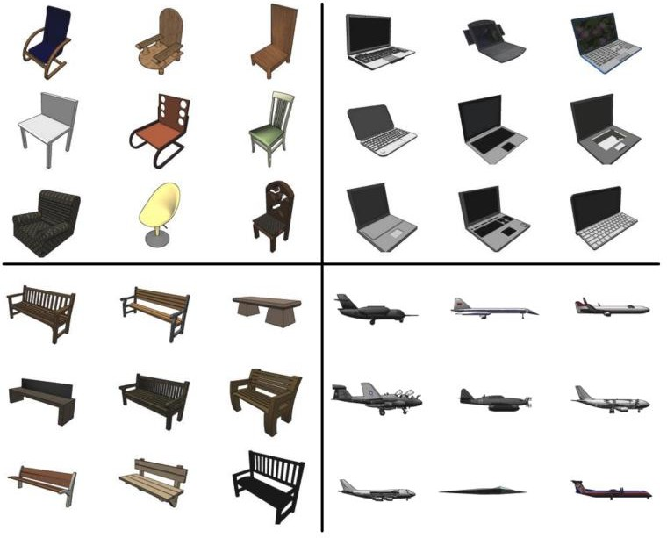
南京邮电大学硕士研究生学位论文 第二章 点云配准基本理论概述
以驱动数据的几何分析，并且能够给计算机视觉研究带来可参考的定量标准。ShapeNet 数据
集的部分可视化效果如下图 2.4 所示。
图 2.4 ShapeNet 数据集的部分可视化效果图
2.3.2 ModelNet
ModelNet 数据集由普林斯顿视觉与机器人实验室开发完成，该数据集共有 662 个对象类 别，127915 个三维模型，以及 10 类标记方向的数据，并且包含三个子集：（1）ModelNet10 包含 10 个类别的三维模型，类别分别为浴缸、床、椅子、服务台、梳妆台、监控、床头柜、 沙发、桌子和卫生间。（2）ModelNet40 包含 40 个类别的三维模型，其中像桌子、花瓶、飞机 这样具有规则对称结构的点云，可以利用对称信息来识别物体的关键信息，而对于吉他、花、 人这样具有复杂结构的点云，很难获得识别物体的关键信息，在点云处理任务中具有一定的 挑战性。（3）Aligned40 包含 40 个类别对齐的三维模型。ModelNet 数据集旨在为计算机视觉、 机器人自动化领域和认知科学领域的研究人员提供大规模的三维物体模型。ModelNet 数据集 的部分可视化效果如下图 2.5 所示。

Slide 29
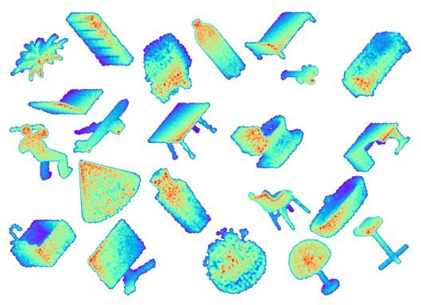
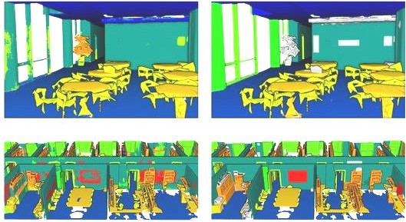
南京邮电大学硕士研究生学位论文
第二章 点云配准基本理论概述
图 2.5
ModelNet 据集的部分可视化效果图
2.3.3 S3DIS
S3DIS 数据集由斯坦福大学开发完成，包含 13 类带有像素级语义标注的室内场景对象， 它们包括具有结构元素的天花板、地板、墙壁、梁、柱子、窗户和门以及桌子、椅子、沙发和 书架这些常见的物品和家具。数据共有 9 个维度，分别为 XYZ 坐标、RGB 颜色和关于它所 属空间的归一化坐标。该数据集由来自三个不同建筑物的大型室内区域组成，场景包括会议 室、个人办公室、洗手间、开放空间、大堂、楼梯和走廊等。其中一个区域包括多个楼层，而 其余区域则只有一个楼层。S3DIS 数据集的部分可视化效果如下图 2.6 所示。
图 2.6 S3DIS 数据集的部分可视化效果图
点云配准评价指标
在点云信息处理任务中，前沿学者已经提出并总结了不同的评价指标用于性能测试。对 于三维形状分类任务，总体准确率（Overall Accuracy，OA）和平均类别准确率（Mean Class

Slide 30
南京邮电大学硕士研究生学位论文 第二章 点云配准基本理论概述
Accuracy，mAcc）是最常用的评价指标。OA 代表所有测试实例的平均精度，mAcc 代表所有
形状类别的平均精度。对于三维对象识别任务，平均精度（Average Precision，AP）是最常用 的评价指标。AP 计算的是精确召回曲线下的面积。对于三维多目标跟踪任务，平均多目标跟 踪精度（Average Multi-Object Tracking Accuracy，AMOTA）和平均多目标跟踪精度（Average Multi-Object Tracking PreciSion，AMOTP）是最常用的评价指标。对于三维点云分割任务，平 均交叉联合（Mean Intersection over Union，mIoU）、平均精度（Mean Average Precision，mAP） 是最常用的评价指标^{[55]}。
本节将介绍用于三维点云配准的评价指标，主要可以分为两类，第一类用于特征提取与 匹配，第二类用于刚体运动参数估计。
2.4.1 基于特征提取与匹配的评价指标
（1）特征匹配召回率（Feature-Match Recall）
特征匹配召回率是指正确提取出的匹配点对数量和所有点对数量的比率，衡量的是匹配 算法的查全率。从数学上来说，特征匹配召回率可以表示为：
𝑛
1 1
𝑅_{𝑓𝑎} = _{𝑛} ∑ 1 ([_{|𝛺|} ∑
(∥𝑇𝑝_{𝑖} − 𝑞_{𝑗}∥ < 𝑟₁)] > 𝑟₂)
(2.53)
𝑠=1
(𝑖，𝑗)∈𝗇
其中𝑛是所有点对的数量，𝛺是一组匹配点对(𝑝, 𝑞)之间的对应关系，𝑝 = (𝑥_{𝑝}, 𝑦_{𝑝}, 𝑧_{𝑝})，𝑞 =
(𝑥_{𝑞}, 𝑦_{𝑞}, 𝑧_{𝑞})，𝑇 ∈ 𝑆𝐸₃是地面真实姿态变换。此外，𝑟₁是局内距离阈值，𝑟₂是局内召回率阈值。
（2）配准召回率（Registration Recall）
配准召回率采用两组具有地面真实姿态变换且存在重叠部分的点云，衡量有多少存在重 叠部分的点云组可以通过匹配算法被正确恢复。具体地说，配准召回率使用如下误差矩阵来 定义真阳性：
𝐸 =
1
√_{𝛺}∗
∑
(𝑝∗,𝑞∗)∈𝗇∗
_{∥𝑇}̂
𝑝∗ − 𝑞^{∗ 2} < 𝑟
(2.54)
𝑖,𝑗
∥
3
其中𝛺∗ 是重叠部分一组匹配点对( 𝑝∗, 𝑞∗ ) 之间的对应关系， 𝑝∗ = (𝑥∗_{𝑝}, 𝑦∗ , 𝑧∗_{𝑝})， 𝑞∗ =
𝑝
(𝑥∗_{𝑞}, 𝑦∗ , 𝑧∗_{𝑞})，对于重叠部分，𝑟₃是用于判断匹配点对是否正确的阈值。
𝑞

Slide 31
南京邮电大学硕士研究生学位论文
第二章 点云配准基本理论概述
2.4.2 基于刚体运动参数估计的评价指标
旋转矩阵和平移向量是点云配准任务中最常用的目标参数。最常见的评价指标有均方误
差（MSE）、均方根误差（RMSE）以及平均绝对误差（MAE），其中 MSE(R)和 MSE(t)分别计
算的是旋转矩阵和平移向量的真实值和预测值平方误差的平均值，可以表示为：
𝑛
1
2
𝑀𝑆𝐸(𝑅) = ∑ (𝑅_{𝑝𝑟𝑒} − 𝑅_{𝑔𝑡})
𝑛
𝑖=1
𝑛
(2.55)
1
2
𝑀𝑆𝐸(𝑡) = ∑ (𝑡_{𝑝𝑟𝑒} − 𝑡_{𝑔𝑡}) (2.56)
𝑛
𝑖=1
RMSE(R)和 RMSE(t)分别计算的是旋转矩阵和平移向量的真实值和预测值平方根误差的
平均值，可以表示为：
1
𝑛
2
𝑅𝑀𝑆𝐸(𝑅) = √ ∑ (𝑅_{𝑝𝑟𝑒} − 𝑅_{𝑔𝑡})
𝑛
𝑖=1
(2.57)
1
𝑛
2
𝑅𝑀𝑆𝐸(𝑡) = √ ∑ (𝑡_{𝑝𝑟𝑒} − 𝑡_{𝑔𝑡})
𝑛
𝑖=1
(2.58)
MAE(R)和 MAE(t)分别计算的是旋转矩阵和平移向量的真实值和预测值绝对误差的平均
值，可以表示为：
𝑛
1
𝑀𝐴𝐸(𝑅) = ∑ |𝑅_{𝑝𝑟𝑒} − 𝑅_{𝑔𝑡}|
𝑛
𝑖=1
𝑛
1
𝑀𝐴𝐸(𝑡) = ∑ |𝑡_{𝑝𝑟𝑒} − 𝑡_{𝑔𝑡}|
𝑛
(2.59)
(2.60)
𝑖=1
这些误差值越小，表示配准的精度越高。理想情况下，如果刚性运动变换是完美的，则
上述所有误差度量都应该为 0。
本章小结
本章首先介绍了点云数据具有的无序性、局部相关性以及不变性这三大特点，其次介绍 了点云数据的两类特征描述方式，即局部特征描述和全局特征描述。然后分析了求解刚体运 动最优变换参数的两种方法，一是基于 SVD 的线性代数求解法，二是基于 Levenberg- Marquardt 的非线性优化法。接着阐述了点云配准任务中常用的标准数据集，包括 ShapeNet、

Slide 32
南京邮电大学硕士研究生学位论文 第二章 点云配准基本理论概述
ModelNet 以及 S3DIS，并阐述了用于衡量点云配准算法性能的两类评价指标，分别是基于特
征提取与匹配的评价指标和基于刚体运动参数估计的评价指标。

Slide 33
南京邮电大学硕士研究生学位论文 第三章 基于几何特征的点云数据预处理
第三章 基于几何特征的点云数据预处理
本章设计了一种基于几何特征的点云数据预处理方案，主要可以分为两个部分：点云滤 波和点云分割。其中点云滤波包括降采样和离群点去除，点云分割包括地面点数据过滤和无 关背景去除，如下图 3.1 所示。通过分析并对比不同的点云滤波方法以及不同的点云分割方 法处理点云的效果，本章确定了点云预处理的有效方案，为后续利用有效点云信息进行点云 配准奠定了基础。
点云滤波
点云分割
读取原始
点云数据
降采样
离群点 去除
地面点 数据过滤
无关背景
去除
图 3.1 点云预处理方案示意图
点云滤波
由于外部传感器采集的原始点云数据比较稠密，为避免较大数据量对后续的算法处理造 成一定的计算压力，需要对原始点云数据进行降采样，即在不损失点云重要特征的前提下对 点云进行删减，从而提高算法执行的效率。
由于设备测量误差的影响，外部传感器获得的数据不可避免地会受到环境噪声的干扰。 通常，点云数据的密度分布是不均匀的，并且会产生少量从固有数据中分离出来的离群点。 这些问题可能会增加曲面法向量或曲率等局部点云特征的计算复杂度，从而导致后续的算法
执行失败^{[56]}。因此，在点云分割之前，需要对点云数据进行去噪处理。
3.1.1 降采样
（1）随机降采样
随机降采样的思想比较简单，就是从点云数据中随机选择𝑘个点，每个点被选到的概率相 同，可以得到指定采样点数量的点云。如原始点云中有 10000 个点，若从中随机采样 5000 个
点，那么每个点被选择的概率为¹，这种随机性使得采样后的点云分布也具有随机性。如果原
2
始点云是不均匀的，比如有的区域密度大，有的区域密度小，虽然每个点被选到的概率一样，

Slide 34
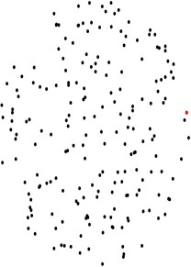
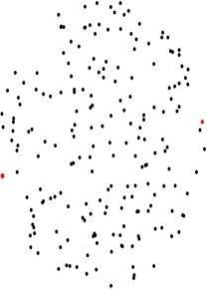
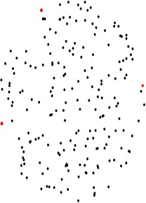
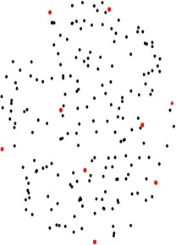
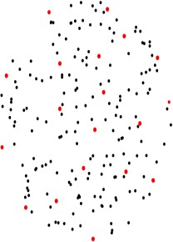
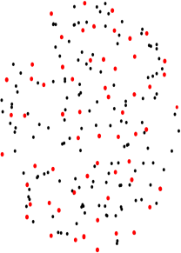
南京邮电大学硕士研究生学位论文 第三章 基于几何特征的点云数据预处理
但密度大的区域点比较多，这个区域中的点被采样的机会就更多，因此原来密度大的地方，
采样后密度还是大，这也就导致随机降采样后的点云同样也是不均匀的。不仅如此，随机降 采样由于其随机性可能会过滤掉一些包含重要信息的特征点，影响后续算法的精度。在实际 应用中，由于计算机的随机数都是伪随机数，这意味着它们有随机数的表现和属性，但实际 上并不是随机生成的，而是由算法生成的。该算法每生成一个随机数序列都有一个初始值， 即随机种子。算法可以通过固定随机种子生成固定的随机数序列，以此来保证随机降采样的 科学性。同时，随机降采样的时间复杂度很低，仅为𝑂(𝑘)，其中𝑘为指定采样点的数量，这使 得随机降采样在点云预处理中也得到了广泛应用。
（2）均匀降采样
均匀降采样（Uniform Sampling）有多种不同的采样方式，其中最远点采样^{[57]}（Farthest Point Sampling，FPS）是常用的一种。假设一组点云数据𝑃 = {𝑝_{𝑖}|𝑖 = 1,2, … , 𝑛} ⊂ 𝑅➪，FPS 首
先设置一个初始状态为空的内点集合𝑁 = ∅，并在点云中随机选取一个种子点𝑝_{k1} 作为起始点
并放入集合𝑁 = {𝑝_{𝑘1} }，其次分别计算剩余的𝑛 − 1个点到集合𝑁中的点𝑝_{k1} 的距离，选择距离最
大的点𝑝_{k2} 放入集合𝑁 = {𝑝_{k1} , 𝑝_{k2} }，然后计算𝑛 − 2个点到集合𝑁中𝑝_{k1} 的距离，保留距离最小的 点𝑝_{k} ，并记录此时的距离值𝑑，再计算𝑛 − 2个点到集合𝑁中𝑝_{k} 的距离，保留距离最小的点𝑝′ ，
3 2 𝑘₃
并记录此时的距离值𝑑′，假设𝑑 > 𝑑′，则将点𝑝_{k3} 放入集合𝑁 = {𝑝_{k1} , 𝑝_{k2} , 𝑝_{k3} }，以此类推，重复
上述步骤，直到选取出需要的采样点个数。这个过程如下图 3.2 所示，其中黑色为原始点云数 据，红色为内点集合。FPS 这种方式的降采样点云分布均匀，但是算法复杂度较高且效率低。
图 3.2 均匀降采样算法过程示意图

Slide 35
南京邮电大学硕士研究生学位论文 第三章 基于几何特征的点云数据预处理
（3）体素降采样
体素降采样（Voxel Sampling）的优势在于其能保持点云本身的几何结构。体素滤波器首 先根据输入的点云数据𝑃 = {𝑝_{𝑖}|𝑖 = 1,2, … , 𝑛} ⊂ 𝑅➪计算出该点云的最小外接立方体，其次根据 设定的分辨率𝛾 = (𝑟, 𝑟, 𝑟)建立最小三维体素栅格，并将最小外接立方体分割成数个三维体素 栅格，此时点云数据填充至对应的三维体素栅格中。然后分别计算每个三维体素栅格中的质 心𝑀，以此质心的坐标𝑀 = (𝑥_{𝑐𝑒𝑛𝑡𝑒𝑟}, 𝑦_{𝑐𝑒𝑛𝑡𝑒𝑟}, 𝑧_{𝑐𝑒𝑛𝑡𝑒𝑟})可以近似表示该三维体素栅格中的所有点。 每个三维体素栅格中，质心的计算公式为：
∑ℎ
𝑥_{𝑖}
^{ﻟ𝑥}center ^{= 𝑖=1}
I
∑ℎ
ℎ
𝑦_{𝑖}
❪ I
𝗅
^{𝑦}center ^{= 𝑖=1}
(3.1)
∑ℎ
ℎ
𝑧_{𝑖}
^{𝑧}center ^{= 𝑖=1}
ℎ
其中𝑥_{𝑖}、𝑦_{𝑖}、𝑧_{𝑖}分别表示三维体素栅格中任一点𝑝_{𝑖}的三维坐标信息，ℎ为三维体素栅格中点云
的数量。
由此可见，体素降采样无法指定采样后点云的数量，但是这种方法简洁高效，并不需要
建立复杂的拓扑结构。同时，体素降采样后的点云分布比较均匀，并且可以通过调整分辨率 来控制分割的体素栅格数量，从而控制采样后点云的规模大小。分辨率设置得越大，体素栅 格越大，体素栅格数量越小，降采样后点的个数则越少。
3.1.2 离群点去除
统计滤波器
统计滤波器的思想为对每一个点的邻域进行一个统计分析，计算它到近邻域内所有点的
平均距离。假设点云中任一点与其近邻域𝑘个点的平均距离满足高斯分布，根据全局距离平均 值和方差定义的标准范围确定距离阈值𝜎，当某个点与其近邻域𝑘个点的平均距离大于阈值𝜎 时，则判定该点为离群点并从数据中剔除。
半径滤波器
半径滤波器通过搜索以查询点为原点，半径为𝑟的邻域，并统计该邻域内点的数量，如果 数量大于给定阈值，则将其视为局内点保留，否则视为局外点剔除。此算法运行速度很快， 但是查询点邻域的半径以及判别是否为局内点的阈值标准都需要人工指定。

Slide 36
南京邮电大学硕士研究生学位论文
第三章 基于几何特征的点云数据预处理
点云分割
点云的有效分割是点云处理的关键环节，往往直接影响后续点云处理的质量，并为后续 的点云配准提供了重要的前提条件。目前比较常用的点云分割算法是鲁棒性较好的聚类分割 算法和基于随机采样一致性的分割算法。
在传感器采集的点云数据中，绝大部分数据属于地面点数据，这对后续点云分割算法会 带来干扰，因此需要先进行地面点数据过滤。同时，考虑到非理想状态，周围环境可能存在 非目标物体的杂物，需要通过点云分割算法对点云数据进行聚类，从而实现无关背景去除。
由于真实场景较小，采集的点云数据滤波之后数量较少，直接将地面作为一个分割的类别更 为高效。因此，本节并没有进行地面点数据过滤，而是直接使用了欧式聚类和区域生长这两 类点云分割算法对滤波后的点云进行分割，从而分离出目标物体点云。
3.2.1 欧式聚类算法
欧式聚类^{[58]}是一种简单的聚类方法。该算法首先在整个点云上构建𝑘-d tree，然后将近邻 域内的所有点组成一个实例。
𝑘-d 树（𝑘-dimensional tree，𝑘-d tree）是一种高效的数据结构，用于组织多维数据，可以 快速搜索最近邻，是点云配准任务中广泛需要的一种基本操作。𝑘-d tree 是一种轻量级的二叉 树，其原理是用一个垂直于坐标轴的超平面连续划分𝑘维空间，可以得到多个超矩形区域。𝑘- d tree 首先是一个包含所有𝑘维空间的根节点，然后通过垂直于坐标轴的超平面获得两个左右 节点。同时，将𝑘维空间划分为两个区域，重复上述过程，直到左、右节点不再有样本，即可 得到一个𝑘-d tree。
在整个𝑘-d tree 中，每个节点为𝑇_{𝑟}，左侧和右侧的子节点分别为𝑇_{𝑟𝑙}和𝑇_{𝑟𝑟}，可以得到：
𝑇_{𝑟} = 𝑇_{𝑟𝑙} 𝖴 𝑇_{𝑟𝑟}
𝑇_{𝑟𝑙} ∩ 𝑇_{𝑟𝑟} = ∅
当𝑇_{𝑟𝑙}和𝑇_{𝑟𝑟}都为空时，节点𝑇_{𝑟}为叶节点。 欧式聚类的算法步骤大致如下：
(3.2)
(3.3)
随机定义空间中任意一点𝑝₁₁为查询点，通过𝑘-d tree 算法找到𝑝₁₁的近邻域内的𝑘个
点，判断这𝑘个点到查询点𝑝₁₁ 的距离，并将距离小于阈值的点𝑝₁₂，𝑝₁₃， …放在点集𝐶 =
{𝑝₁₁, 𝑝₁₂, 𝑝₁₃, … }中。
以集合𝐶中除𝑝₁₁以外的任意一点作为查询点，假设为点𝑝₁₂，重复步骤 1，得到点 集

Slide 37
南京邮电大学硕士研究生学位论文 第三章 基于几何特征的点云数据预处理
𝐶 = {𝑝₁₁, 𝑝₁₂, 𝑝₁₃, … , 𝑝₂₂, 𝑝₂₃, 𝑝₂₄ … }。
当点集𝐶中所有的点都已被作为查询点，且没有满足条件的新点可以加入点集𝐶时 ，即完成类别Ⅰ点云的搜索与分割。
随机定义空间中除类别Ⅰ点云外的任意一点为查询点，重复步骤 1~3，完成类别 Ⅱ点云的搜索与分割。
以此类推，当原始点云中所有的点都被搜索与分割完毕时，算法终止。
3.2.2 区域生长算法
区域生长算法^{[59]}的基本思路是把具有相同特性的点结合在一起，首先对每一区域确定一 个种子点为生长的起点，然后将种子点周围邻域的点与种子点进行特征比较，并将与种子点 具备相同特性的点结合在一起不断地往外生长，直至没有满足条件的点便停止生长。区域生 长的过程中主要有以下三个要点，一是种子点的选取，二是区域生长的生长准则，三是生长 的停止条件。
（1）种子点的选取
种子点的选取是否合理直接影响分割结果，通常利用法线、曲率等三维几何特征作为选 取标准。通过计算点云中每个点的平均曲率和高斯曲率，并选择点云数据中曲率最小的点作 为初始种子点开始生长，即在最平坦的区域选择种子点，可以减少总线段数，避免重叠分割， 提高分割的稳定性。选择种子点的计算步骤如下：
将曲面𝑟(𝑢, 𝑣)的偏导数^{∂r} 、 ^{∂r} 、
∂r
、 ^{∂r} 、 ^{∂r} 记为𝑟 、𝑟 、𝑟 、𝑟 、𝑟 ，那么曲线
∂𝑢 ∂𝑣 ∂𝑢 ∂𝑢 𝜕𝑢𝜕𝑣 ∂𝑣 ∂𝑣
𝑢 𝑣 𝑢𝑢 𝑢𝑣 𝑣𝑣
的单位法向量𝑁̅可以表示为：
_{𝑁̅ =} r_{𝑢} × 𝑟_{𝑣}
(3.4)
∥r_{𝑢} × 𝑟_{𝑣}∥
平均曲率和高斯曲率是分析三维曲面的两个重要几何特征，将两者结合起来选取最小曲
率点，可以更好地提取点云曲面的局部特征。曲面上点𝑝的平均曲率𝑍和高斯曲率𝐻的计算公
式如下：
𝐿𝑁 − 𝑀²
𝑍 = (3.5)
𝐸𝐺 − 𝐹²
𝐻 =
𝐸𝑁 + 𝐺𝐿 − 2𝐹𝑀
(3.6)
2(𝐸𝐺 − 𝐹²)
其中各变量可以由以下公式得到：
𝐸 = r_{u} × 𝑟_{𝑢}
(3.7)
𝐹 = r_{u} × r_{v}
25
(3.8)

Slide 38
南京邮电大学硕士研究生学位论文 |  | 第三章 | 基于几何特征的点云数据预处理
 | 𝐺 = r_{v} × r_{v} |  | (3.9)
 | 𝐿 = r_{uu} × 𝑁 |  | (3.10)
 | 𝑀 = r_{uv} × 𝑁 |  | (3.11)
 | 𝑁 = r_{v} × 𝑁‾ |  | (3.12)
计算曲面上点的最大曲率和最小曲率：
_{𝐾1,2 = 𝐻 ±} ̅_{𝐻}̅̅2̅̅₋̅̅̅̅_{𝐾}̅
(3.13)
其中，𝐾₁表示该点所在曲面在所有方向上的最大曲率，𝐾₂表示该点所在曲面在所有方向上的
最小曲率，𝐾₁和𝐾₂可以为后续的曲率阈值设置提供参考。
（2）区域生长的生长准则
区域生长方法用最小二乘法拟合估计点的切平面法向量，即分析协方差矩阵的特征向量
和特征值。对于曲面上的一个点𝑝_{𝑖}，该点的法向量可以是协方差矩阵𝐶的最小特征值相对应的
特征向量。协方差矩阵𝐶的计算公式如下：
𝑘
1
𝑇
𝐶 = ∑ (𝑝 − 𝑝̅) ⋅ (𝑝 − 𝑝̅)
(3.14)
𝑘
𝑖=1
𝑖 𝑖
其中𝑘是点𝑝_{𝑖}邻域内点的个数，𝑝̅是𝑝_{𝑖}邻域内所有点的质心。计算当前种子点的法向量与其邻
域内所有点的法向量之间的夹角：
𝛼 = 𝑎𝑟𝑐𝑐𝑜𝑠
𝑛⃗→_{𝑝} ∙ 𝑛⃗→_{𝑖}
(3.15)
|𝑛⃗→_{𝑝} ∥ 𝑛⃗→_{𝑖} |
其中𝑛⃗→_{𝑝}表示当前种子点的法向量，𝑛⃗→_{𝑖} 表示其邻域内任一点的法向量。当夹角在阈值范围内时，
则将该点添加到种子点。
阈值的设置也是区域生长中一个非常重要的步骤，甚至直接影响分割结果。首先需要根 据点云数据设置点云聚类的最小聚类点数和最大聚类点数，最大聚类点数一般选择远大于点 云数量的值，这使得分割后的点数小于最小聚类点数。其次设置种子点的法向量与其邻域内 任一点法向量的夹角偏差允许范围，如果两条法向量之间的夹角在阈值范围内，则将这两个 点归为同一类。最后根据主曲率的最小值和最大值，调整点云的曲率阈值。如果曲面上点的 曲率小于阈值则也将该点加入种子点集。合理的曲率阈值设置可以在一定程度上避免点云数 据的欠分割和过分割。
（3）生长的停止条件。
通常，当没有点满足法向量和曲率两个几何特征属性的约束时，即没有点能够被加入某 个区域时，区域生长就会停止。
26

Slide 39
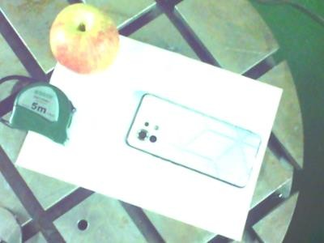
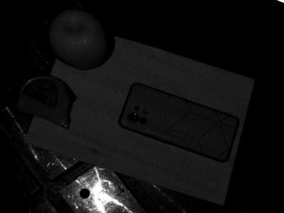
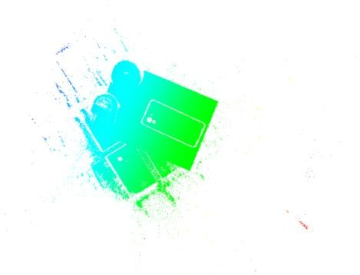
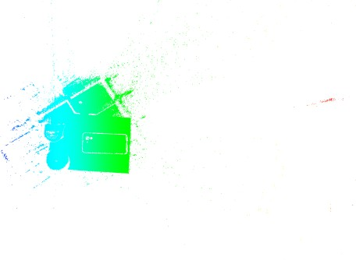
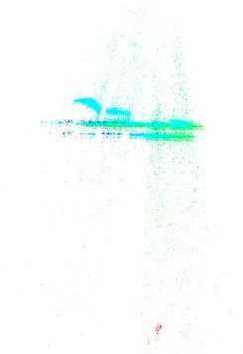
南京邮电大学硕士研究生学位论文
第三章 基于几何特征的点云数据预处理
实验结果与对比分析
本节主要在真实场景中测试了基于几何特征的点云数据预处理方案，首先使用外部传感 器采集稠密点云数据，其次分析并对比了随机降采样、均匀降采样以及体素降采样三类降采 样方法对原始点云的处理效果，然后分析并对比了使用不同参数的统计滤波器以及半径滤波 器对降采样后的点云数据进行离群点去除的效果，之后分析并对比了欧式聚类算法和区域生 长算法对点云进行分割的效果，最后确定了最优预处理方案。
3.3.1 实验环境与硬件配置
本节对真实场景进行点云数据采集与点云数据预处理。在真实场景中，本节将手机作为 目标物体放置于工作台，同时在手机周围放置了苹果、卷尺等杂物作为无关背景。通过手动 操控深度相机对真实场景进行扫描，获得了目标物体及其周围环境的点云数据，采集的原始 点云共有 271114 个点，可视化结果如下图所示。
(a) RGB 图像
(b) 灰度图像
图 3.3 真实场景二维图像
(a) 正面
(b) 背面
(c) 侧面
图 3.4 真实场景点云可视化效果图
硬件配置包括 Intel® Core™ i9-9900k CPU@3.60GHz 和两块 NVIDIA RTX 2080 Ti GPU， 内存为 32GB，总显存为 22GB。本节在 Ubuntu18.04 环境下运行，采用 PCL 1.8.0 三维点云处

Slide 40
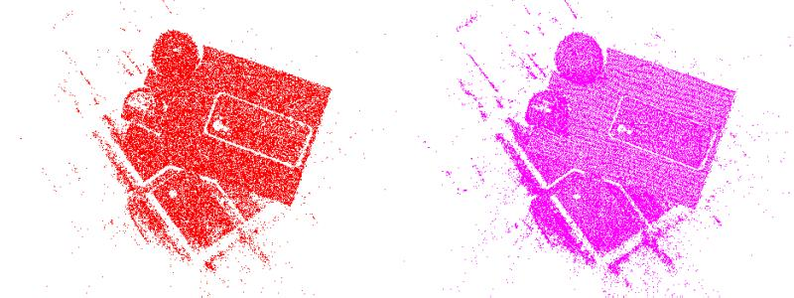
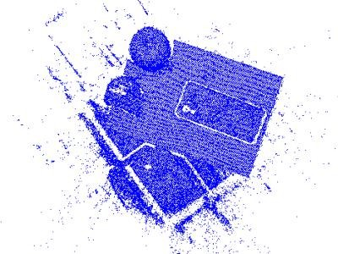
南京邮电大学硕士研究生学位论文 第三章 基于几何特征的点云数据预处理
理跨平台开源库对真实场景采集的点云数据进行预处理，并利用 CloudCompare 三维点云编
辑和处理软件可视化点云处理的效果。
3.3.2 对比实验分析
（1）降采样不同方法效果对比
为了比较不同降采样方法处理点云的效果，本节对原始点云数据分别进行了随机降采样、 均匀降采样和体素降采样。通过调整均匀降采样近邻搜索半径的大小以及体素降采样中栅格
的分辨率，保证均匀降采样和体素降采样后点云的个数一致，均为 48977。之后指定采样个数 为 48977 对原始点云进行随机降采样。实验效果与数据如下图 3.5 与下表 3.1 所示。
(a) 随机降采样
(b) 均匀降采样
(c) 体素降采样
图 3.5 三种降采样结果对比图
从可视化结果可以看出，均匀降采样和体素降采样基本保持了原始点云本身的几何结构， 随机降采样并不能保持原始点云本身的几何结构。在外部传感器采集过程，由于受到光照、 光强等外界环境的影响，原始点云数据中除了目标物体及其周围杂物外，还存在很多干扰噪 声。这些干扰噪声在进行降采样时也被认为是点云本身的几何结构，因此在对原始点云分别 进行均匀降采样和体素降采样之后仍保留了大量干扰噪声。在对原始点云进行随机降采样时， 对于目标物体及其周围杂物这样密度大的区域，其中的点被采样到的概率更大，而对于干扰 噪声这样密度小的区域，其中的点被采样到的概率更小，反而使得随机降采样后的点云数据 过滤了绝大多数干扰噪声，也能保证目标物体及其周围杂物的重要信息。
表 3.1 降采样实验结果对比表
方法 | 原始点云 数量（个） | 降采样后 点云数量（个） | 用时（s）
随机降采样 | 271114 | 48977 | 0.104379
均匀降采样 |  |  | 0.122201
体素降采样 |  |  | 0.155843

Slide 41
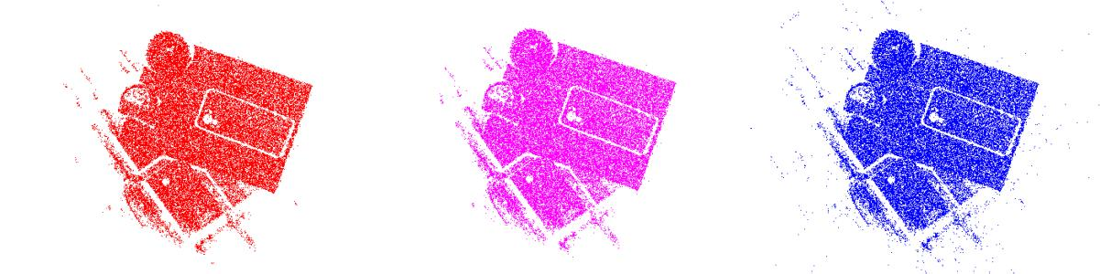
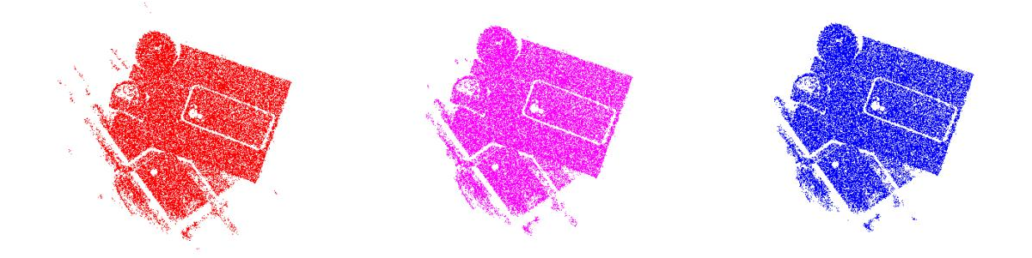
南京邮电大学硕士研究生学位论文 第三章 基于几何特征的点云数据预处理
从表格数据可以看出，同样从 271114 个点降采样到 48977 个点，随机降采样用时最短，
仅为 0.104379s，比均匀降采样和体素降采样分别快了 15%和 33%。
（2）离群点去除不同方法和参数效果对比
为了比较不同的离群点去除方法和不同的参数处理点云的效果，本节分别使用统计滤波 器和半径滤波器对降采样后的点云进行去噪。当使用统计滤波器时，通过调整近邻搜索点的 个数𝑘₁以寻求最优参数，获得最佳效果。当使用半径滤波器时，通过调整近邻搜索半径的大 小𝑟₁和近邻点集数阈值的大小𝑘₂以寻求最优参数，获得最佳效果。实验效果与数据如下图 3.6
和 3.7 以及下表 3.2 所示。
(a) 𝑘₁=10
(b) 𝑘₁=30
统计滤波器不同参数效果对比图
(c) 𝑘₁=100
图 3.6
(a) 𝑟₁=10, 𝑘₂=5
(b) 𝑟₁=10, 𝑘₂=20
半径滤波器不同参数效果对比图
(c) 𝑟₁=10, 𝑘₂=30
图 3.7
从可视化结果可以看出，在使用统计滤波器进行离群点去除时，当近邻搜素点的个数设
为 30 时，效果最好。当近邻搜索点的个数设为 10 时，近邻域太小，有一部分噪声密集区域 的查询点到近邻点集的平均距离恰好在标准范围内，故被认为是局内点，从而导致一部分噪 声没有从数据中剔除。当近邻搜索点的个数设为 100 时，近邻域内的噪声点和非噪声的分布 情况和原始点云类似，噪声区域查询点到近邻点集的平均距离恰好与全局平均距离相当，故 被认为是局内点，从而导致大量的噪声没有从数据中剔除。在使用半径滤波器进行离群点去 除时，当近邻搜索半径的大小设为 10，查询点的近邻点集数阈值设为 30 时，效果最好。当查 询点的近邻点集数阈值设为 5 时，阈值太小，噪声区域查询点的近邻域内点的个数远大于 5，

Slide 42
南京邮电大学硕士研究生学位论文 第三章 基于几何特征的点云数据预处理
故被认为是局内点，从而导致大部分噪声没有从数据中剔除。当查询点的近邻点集数阈值设
为 20 时，有一部分噪声区域查询点的近邻域内点的个数小于 20 被认为是离群点从数据中剔
除，但仍有一部分噪声区域查询点的近邻域内点的个数大于 20 被认为是局内点，无法从数据 中剔除。当使用半径滤波器进行离群点去除时，需要指定近邻搜索半径的大小以及近邻点集 数阈值的大小，且它们两者之间并不独立，相互影响，需要通过先验知识或反复调整来获得 最优参数。而统计滤波器根据全局距离平均值和方差来定义阈值标准，相较而言更为高效。
表 3.2 离群点去除实验结果对比表
方法 | 参数 | 降采样后 点云数量（个） | 离群点去除后 点云数量（个） | 用时（s）
统计滤波 | 𝑘₁=10 | 48977 | 48177 | 0.104379
 | 𝑘₁=30 |  | 48105 | 0.122201
 | 𝑘₁=100 |  | 48189 | 0.155843
半径滤波 | 𝑟₁=10, 𝑘₂=5 |  | 47994 | 0.099722
 | 𝑟₁=10, 𝑘₂=20 |  | 47362 | 0.135366
 | 𝑟₁=10, 𝑘₂=30 |  | 46889 | 0.161095
从表格数据可以看出，当使用统计滤波器进行离群点去除时，近邻搜索点的个数与去除
离群点后点的数量无线性关系，但与用时存在线性关系，即近邻搜索点的个数越大用时越久。
其中效果最好的实验，点云个数从 48977 减少为 48105，用时为 0.122201s。当使用半径滤波 器进行离群点去除时，近邻点集数阈值与去除离群点后点的数量以及用时都存在线性关系， 即近邻点集数阈值越大，去除离群点后点的数量越少，用时也越久。其中效果最好的实验， 点云个数从 48977 减少为 46889，用时为 0.161095s。
（3）背景去除不同方法效果对比
为了比较不同的背景去除效果，本节分别使用了欧式聚类算法和区域生长算法对点云进 行分割。当使用欧式聚类算法时，将近邻搜索半径的大小设为 5 可以获得较好的分割效果。
当使用区域生长算法时，将近邻搜索点的个数设为 50，法向量角度阈值设为 ⁵ 𝜋，曲率阈值
180
设为 1.0，可以获得较好的分割效果。实验效果与数据如下图 3.8 与下表 3.3 所示。

Slide 43
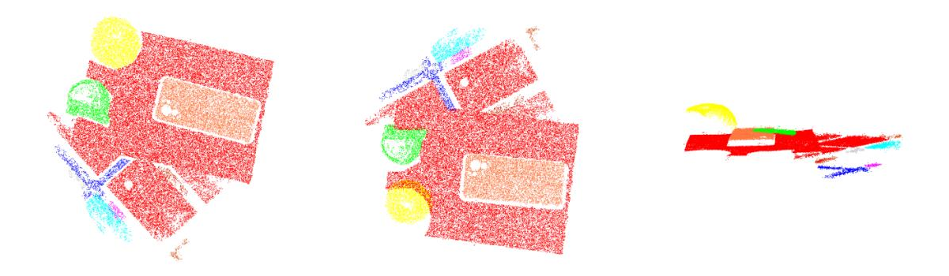
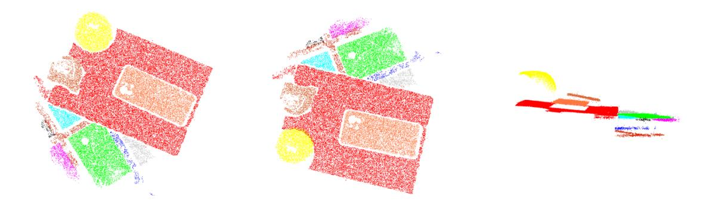
南京邮电大学硕士研究生学位论文
第三章 基于几何特征的点云数据预处理
(a) 欧式聚类，正面
(b) 欧式聚类，背面
(c) 欧式聚类，侧面
(d) 区域生长，正面
(e) 区域生长，背面
(f) 区域生长，侧面
图 3.8 点云分割效果对比图
从可视化结果可以看出，当使用欧式聚类算法对离群点去除后的点云做无关背景去除时， 大部分属于工作台类别的点云都能被认为是地面点聚为一类，且目标物体（手机）以及杂物
（苹果、卷尺）都能被聚类正确。当使用区域生长算法对离群点去除后的点云做无关背景去 除时，虽然有大部分属于工件台类别的点云被认为是地面点，但仍有一部分属于工件台类别 的点云被认为是其它类别。但目标物体（手机）以及杂物（苹果、卷尺）都能被聚类正确。这 是因为真实场景的工作台不是一个完整的平面，存在很多凹槽，区域生长算法中的法向量和
曲率通过最小二乘法对近邻域点集拟合平面求得，凹槽处在没有点云的情况下无法计算出精 确的法向量和曲率。而欧式聚类计算的是查询点与近邻域内所有点的平均距离，由于凹槽间 距并没有很大，取平均之后，这一部分带来的影响可以有所减少。
表 3.3 点云分割实验结果对比表
方法 | 离群点去除后 点云数量（个） | 点云分割 类别（类） | 无关背景去除后 点云数量（个） | 用时（s）
欧式聚类 | 48105 | 10 | 6067 | 0.295816
区域生长 |  | 12 | 6001 | 0.499993
从表格数据可以看出，当使用欧式聚类算法分割点云时，点云被分为 10 个类别，且无关
背景去除后点云数量为 6067，即目标物体（手机）的点云数量为 6067，用时 0.295816s。当 使用区域生长算法分割点云时，点云被分为 12 个类别，且无关背景去除后点云数量为 6001，

Slide 44
南京邮电大学硕士研究生学位论文 第三章 基于几何特征的点云数据预处理
即目标物体（手机）的点云数量为 6061，用时 0.499993s。从用时来看，由于欧式聚类算法以
邻域内点与点之间的距离作为判定标准，而区域生长算法利用了法向量和曲率这两种几何特 征作为判定标准，从算法复杂度来说欧式聚类远低于区域生长算法，因此处理时长也就更短。
（4）点云预处理方案
综上所述，本章确定了点云预处理的有效方案，实验数据如下表 3.4 所示。首先使用随机 降采样这种方法来降低原始点云的冗余性，并指定采样数量𝑚为 48977。然后使用统计滤波器 进行离群点去除，并取近邻搜索点的个数𝑘₁为 30。最后使用欧式聚类算法进行无关背景去除， 并取近邻搜索半径的大小𝑟₂为 5。测试下来，降采样后，点云数据从 271114 个点减少到 48977
个点，用时为 0.104379s，且在保证点云结构与重要特征的同时过滤掉了绝大多数干扰噪声。 离群点去除后，点云个数又从 48977 减少为 48105，用时为 0.122201s，且去除了绝大多数离 群点。在进行无关背景去除时，点云被分为 10 个类别，分离出目标物体（手机）后，点云个 数从 48105 减少为 6067，即目标物体（手机）的点云数量为 6067，用时为 0.295816s。总用 时 0.522397s。
表 3.4 点云预处理实验结果汇总表
方法 | 参数 | 处理前点云 数量（个） | 处理后点云 数量（个） | 用时（s）
随机降采样 | 𝑚=48977 | 271114 | 48977 | 0.104379
统计滤波器 | 𝑘₁=30 | 48977 | 48105 | 0.122201
欧式聚类 | 𝑟₂=30 | 48105 | 6067 | 0.295816
总用时（s） | 0.522397
本章小结
本章设计了一种基于几何特征的点云数据预处理方案，主要包括点云滤波和点云分割两 个部分。通过分析和对比不同方法以及不同参数的算法，本章确定了点云配准的有效方案， 即使用随机降采样对采集到的原始点云数据完成指定数量的采集，再使用统计滤波器对降采 样后的点云进行离群点去除，最后使用欧式聚类算法对离群点去除后的点云进行分割，可以 较好地分离出目标物体，为后续利用有效点云信息进行点云配准奠定基础。

Slide 45
南京邮电大学硕士研究生学位论文 第四章 基于位置自适应卷积提取特征的点云配准优化
第四章 基于位置自适应卷积提取特征的点云配准优化
本章基于 PCRNet 深度学习网络模型提出一种基于位置自适应卷积提取特征的点云配准 优化方法。首先阐述了 PCRNet 网络的工作机制，并分析了 PCRNet 网络在特征提取方面存 在的局限性。然后针对这些局限性对原网络提出了改进，构建了 PACNet 网络模型。最后通 过实验将本章提出的网络模型与当前主流的点云配准算法进行了多项测试对比，证明了 PCRNet 网络具有更高的精度。
基础网络 PCRNet
本节阐述了 PCRNet 网络中用于提取点云全局信息的 PointNet 框架，分析了搬土距离^{[60]}
（Earth Mover Distance，EMD）损失函数的原理，介绍了 PCRNet 网络模型的整体框架，并 对其存在的局限性做出了分析。
4.1.1 PointNet
在点云处理任务中，被广泛应用的共享权值的多层感知机^{[61}（] Multi-Layer Perceptron，MLP） 可以将输入点云的所有点映射到一个冗余的高维空间，目的是减少最大池化层带来的特征损 失。其本质是用 1×1 大小的卷积核来做卷积操作，可以减少大量的参数。MLP 的结构可以 简单看成：
𝑂𝑢𝑡𝑝𝑢𝑡 = 𝐼𝑛𝑝𝑢𝑡 × 𝑊𝑒𝑖𝑔ℎ𝑡 + 𝐵𝑖𝑎𝑠 (4.1)
其中𝐼𝑛𝑝𝑢𝑡、𝑊𝑒𝑖𝑔ℎ𝑡、𝐵𝑖𝑎𝑠、𝑂𝑢𝑡𝑝𝑢𝑡的尺寸分别为𝑁 × 𝐶₁、𝐶₁ × 𝐶₂、𝐶₂ × 1、𝑁 × 𝐶₂，其能够 将输入的𝐶₁维特征转换成𝐶₂维特征，这𝐶₂维中每一维都整合了原来𝐶₁维的全部信息。
PointNet 是首个可以直接处理点云数据的深度学习模型架构，输入对象是含有𝑛个点的三 维点云，并使用 T-Net 网络预测三维空间刚性运动变换矩阵，将其作用于原始点云以完成数 据的对齐。对齐后的数据以点为基本单元，采用 MLP 对每个点进行独立建模，从而完成特征 提取。然后使用对称函数聚合全局特征，即在特征空间的维度上进行最大池化(max pooling)， 提取出点云的全局特征向量。PointNet 的轻量级架构如图 4.1 所示，其中𝑛表示输入点的数量，
𝑀表示每个点学习特征的维度。

Slide 46
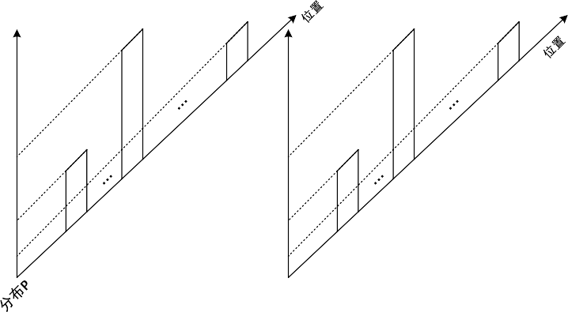

南京邮电大学硕士研究生学位论文
第四章 基于位置自适应卷积提取特征的点云配准优化
N×3
MLPs
N×M
最大池化
shared
1×M
图 4.1 PointNet 的轻量级架构示意图
4.1.2 EMD 损失函数
搬土距离（EMD）是一种距离度量的定义，可以用来评估某一特征空间中两个多维分布 之间的差异性^{[60]}。
EMD 实际上是线性规划中运输问题的最优解。假设有若干个大小不一且分布不同的土堆， 同样还有若干个大小不一且分布不同的土坑。每对土堆-土坑的运输成本用距离表示，EMD 度 量的就是用土堆填满土坑所消耗的最小总运输成本。
如下图 4.2 所示，土堆和土坑分别用两个直方图来表示，两个直方图分别被描述为𝑃 =
{(𝑝₁, 𝑤_{𝑝1}), (𝑝₂, 𝑤_{𝑝2}), … , (𝑝_{𝑚}, 𝑤_{𝑝𝑚})}和𝑄 = {(𝑞₁, 𝑤_{𝑞1}), (𝑞₂, 𝑤_{𝑞2}), … , (𝑞_{𝑚}, 𝑤_{𝑞𝑚})}，其中𝑝_{𝑖}和𝑞_{𝑗}表示 直方的位置，即土堆和土坑的分布位置，𝑤_{𝑝𝑖}和𝑤_{𝑞𝑗}表示相应直方的高度，即土堆和土坑的大
小。𝐹 = [𝑓_{𝑖𝑗}]表示从𝑝_{𝑖}到𝑞_{𝑗}的规划运输量。𝐷 = [𝑑_{𝑖𝑗}]表示𝑝_{𝑖}和𝑞_{𝑗}之间的运输距离。将土堆填满 土坑有很多种运输的方式，EMD 的目标是使得总运输成本最小化，这个过程可以表示为：
𝑊𝑂𝑅𝐾(𝑃, 𝑄, 𝐹) = 𝛴^{𝑚} 𝛴^{𝑛} 𝑓 𝑑 (4.2)
𝑖=1 𝑗=1 𝑖𝑗 𝑖𝑗
高度
高度
mn
f
q
p
n
m
mj
W_{p}
i
f
W
f
q _{j}
p
ij
q
i
i1
j
W_{p}
1 j
f
W_{q}
1
f
1
q
p
1
W_{p}
m
1
W_{q}
n
图 4.2 EMD 原理示意图
上式受以下约束：
𝑓_{𝑖𝑗} ≥ 0 1 ≤ 𝑖 ≤ 𝑚, 1 ≤ 𝑗 ≤ 𝑛
(4.3)

Slide 47
南京邮电大学硕士研究生学位论文
_{Σ}𝑛
第四章 基于位置自适应卷积提取特征的点云配准优化
𝑗=1
𝑓_{𝑖𝑗} ≤ 𝑤_{𝑝} 1 ≤ 𝑖 ≤ 𝑚
(4.4)
(4.5)
_{Σ}𝑚
𝑖
𝑖=1
𝑓_{𝑖𝑗} ≤ 𝑤_{𝑞} 1 ≤ 𝑗 ≤ 𝑛
_{Σ}𝑚 _{Σ}𝑛
(4.6)
𝑖=1 𝑗=1 ^{𝑓}𝑖𝑗
其中公式 4.3 表示从𝑝_{𝑖}到𝑞_{𝑗}的运输量大于零。公式 4.3 和公式 4.5 表示从𝑝_{𝑖}到𝑞_{𝑗}运输总量不能
大于土堆的总大小，也不能大于土坑的总大小。公式 4.5 表示总运输量不能大于土堆的总大 小，也不能大于土坑的总大小。当运输问题得到解决并求解得到使得总运输成本最小的调度 方式𝐹∗ = 𝑎𝑟𝑔𝑚𝑎𝑥_{𝐹} 𝑊𝑂𝑅𝐾(𝑃, 𝑄, 𝐹)时，EMD 可以定义为总运输成本归一化后的表达：
_{Σ}𝑚 _{Σ}𝑛
^{𝑓}𝑖𝑗^{𝑑}𝑖𝑗
EMD(𝑃, 𝑄) =
𝑖=1 𝑗=1
(4.7)
_{Σ}𝑚 _{Σ}𝑛
^{𝑓}𝑖𝑗
𝑖=1 𝑗=1
归一化的目的是为了消除在部分匹配的情况下受到奇异样本数据的影响。
当度量点云距离时，可以将𝑃 = {(𝑝₁, 1), (𝑝₂, 1), … , (𝑝_{𝑚}, 1)}表示一组点云数据，其中𝑝_{𝑖}表
示索引为 𝑖 的 点 云 坐 标 ， 𝑤_{𝑝𝑖} 表 示 每 个 点 的 权 重 ， 这 里 都 用 1 来表示。 𝑄 =
{(𝑞₁, 1), (𝑞₂, 1), … , (𝑞_{𝑚}, 1)}表示另一组点云数据，其中𝑞_{𝑗}表示索引为𝑗的点云坐标，同样𝑤_{𝑞𝑗}表
示每个点的权重，这里都用 1 来表示。𝐷 = [𝑑_{𝑖𝑗}]表示从𝑃第𝑖个点到𝑄第𝑗个点的距离，这里用 欧氏距离表示。𝐹 = [𝑓_{𝑖𝑗}]表示是否将𝑃第𝑖个点移动到𝑄第𝑗个点，因此𝑓_{𝑖𝑗}的值为 0 或 1。此时，
𝑊𝑂𝑅𝐾(𝑃, 𝑄, 𝐹) 就表示将𝑃 中所有点移动到𝑄 中所有点位置的总移动成本， 𝐹∗ =
𝑎𝑟𝑔𝑚𝑎𝑥_{𝐹} 𝑊𝑂𝑅𝐾(𝑃, 𝑄, 𝐹)就表示使得总移动成本最小的调度方式。
为了最小化模板点云和源点云对应点之间的距离，PCRNet 通过 EMD 损失函数在网络训 练过程中实现反向传播，这个过程可以表示为：
𝑒𝑠𝑡
1
EMD(𝑃_{𝑆} , 𝑃_{𝑇}) = 𝑚𝑖𝑛
𝑠₁
𝛴 ∥ 𝑥 − 𝜓(𝑥) ∥
(4.8)
𝜓:𝑃 →𝑃
𝑒𝑠𝑡
𝑥∈𝑃
𝑒
2
𝑆
𝑇
|𝑃 |
𝑆
𝑆
其中，𝑃_{𝑇}表示模板点云，𝑃^{𝑒𝑠𝑡}表示将网络预测得到的位姿变换作用于原始源点云后的变换源
𝑆
点云，𝜓(·)表示源点云到模板点云的映射关系。
4.1.3 PCRNet 网络设计
PCRNet 网络模型的整体框架如图 4.3 所示。该网络模型的总体结构由特征提取模块、特 征融合模块以及位姿回归模块组成。
在特征提取模块，该模型使用 PointNet 分别对输入的模板点云和源点云提取全局信息， 即使用 5 层 MLP 对输入的点云进行特征抽象与提取，然后经过 1 层最大池化对抽象到高维

Slide 48
南京邮电大学硕士研究生学位论文 第四章 基于位置自适应卷积提取特征的点云配准优化
空间后的点云特征进行降维操作，从而保证输入点云的顺序保持不变。在特征融合模块，将
两个全局信息以深度学习中的 concatenate^{[62]}数组拼接操作进行连接，即将 2 个 1×1024 维的
全局特征拼接成 1 个 1×2048 维的特征。在位姿回归模块，该模型使用不同维度的全连接层 预测相对位姿，获得旋转量和平移量。全连接层共有 5 个隐藏层，维度分别为 1024、1024、 512、512、256，输出层的维度为 7，即四元数和平移向量的组合。
特征提取模块
特征融合模块 位姿回归模块
(3,64,64,64,
128,1024)
最大池化
N×3
MLP
N×1024
1×1024
2048
(1024,1024,512,512,256,7)
(3,64,64,64,
128,1024)
Concatenate
全连接层
位姿 变换
N×3
MLP
N×1024
最大池化
1×1024
图 4.3 PCRNet 网络模型整体框架示意图
由此可见，PCRNet 的网络模型结构十分简单。由于并没有考虑到点云的局部特征，因此 相比于其他点云配准方法，PCRNet 的配准速度非常快，但同时精度上也有所妥协。为了提高 点云配准的精度，PCRNet 网络的作者 Sarode 又通过迭代方案改进了基础网络，从而提出了 迭代的 PCRNet。如图 4.4 所示，迭代的 PCRNet 将一次 PCRNet 预测得到的坐标变换𝑇(1)作 用于输入的源点云，再将原始模板点云和变换一次后的源点云作为下一次 PCRNet 的输入。 以此类推，在执行𝑛次迭代时，将原始模板点云和变换𝑛 − 1次后的源点云作为输入，通过 PCRNet 预测得到坐标变换𝑇(𝑛)。通过组合每次预测得到的坐标变换，获得原始模板点云和源 点云之间的整体变换。这个过程可以表示为：
𝑇 = 𝑇(𝑛) × 𝑇(𝑛 − 1) × ⋯ × 𝑇(1) (4.9)

Slide 49
南京邮电大学硕士研究生学位论文
第四章 基于位置自适应卷积提取特征的点云配准优化
T = 1
T=T(1)×T
T=T(2)×T
⋯
T=T(n)×T
T = 1
T(1)
T(2)
T(n)
PCRNet
PCRNet
PCRNet
源点云
源点云
坐标变换
对齐点云
坐标变换
⋯
对齐点云
图 4.4 PCRNet 网络预测坐标变换示意图
为了提高迭代的效率，迭代的 PCRNet 仅使用 3 层全连接网络预测相对位姿。与 PCRNet 相比，即使使用了更少数量的隐藏层，仍然能获得更稳健的性能。但由于 PCRNet 网络在特 征提取模块中仅关注了点云的全局信息，忽略了点云的局部特征，难以表征点云空间复杂的 变化关系，一定程度上限制了其对场景的理解能力，所以在配准精度上有所欠缺。
基于位置自适应卷积提取特征的 PACNet
为了解决上述问题，本节引入位置自适应卷积，基于 PCRNet 网络在特征提取模块提出 了改进，构建了 PACNet 点云配准网络模型，该网络可以灵活地对点云的局部区域进行建模。
4.2.1 位置自适应卷积
如图 4.5 所示，位置自适应卷积部分首先初始化了一个由𝐾个大小为𝐶_{𝑖𝑛} × 𝐶_{𝑜𝑢𝑡}的权重矩 阵组成的权重库𝑊 = {𝑊_{𝑘}|𝑘 = 1, 2, … , 𝐾}，其中𝐶_{𝑖𝑛}表示网络在当前层的输入维度，𝐶_{𝑜𝑢𝑡}表示 网络在当前层的输出维度。较大的𝐾可以保证卷积内核的多样性，但也会增加模型的负担。因
此，在本章的网络模型中，𝐾取值为 16^{[63]}。接下来计算输入点云中每一个点𝑝_{𝑖}与其邻域点𝑝_{𝑗}
的相对位置关系，并学习不同位置的权重系数𝐸_{𝑖𝑗} = {𝐸_{𝑘𝑖𝑗}|𝑘 = 1,2, … , 𝐾}，这个过程可以表示 为：
𝐸_{𝑖𝑗} = 𝑆𝑜𝑓𝑡𝑚𝑎𝑥 (𝜃(𝑝_{𝑖}, 𝑝_{𝑗})) (4.10)
其中𝜃是核大小为 1×1 的卷积实现的非线性函数。使用𝑆𝑜𝑓𝑡𝑚𝑎𝑥对其进行规范化操作可以确 保输出分数在范围(0,1)之间^{[64]}。较高的分数意味着对应的位置具有更重要的局部信息。
位置自适应卷积的内核是通过组合权重矩阵𝑊_{𝑚}和从点位置学习到的权重系数𝐸_{𝑘𝑖𝑗} 构成的， 可以表示为：

Slide 50
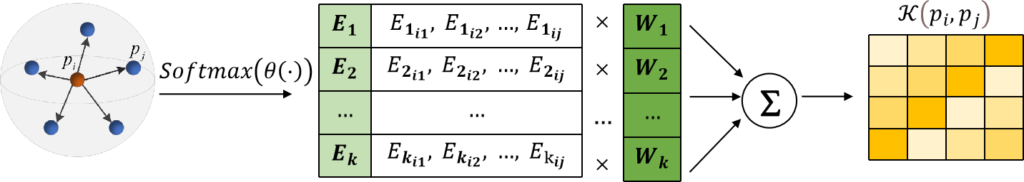
南京邮电大学硕士研究生学位论文
第四章 基于位置自适应卷积提取特征的点云配准优化
𝐾
𝒦(𝑝_{𝑖}, 𝑝_{𝑗}) = ∑ 𝐸_{𝑘𝑖𝑗} 𝑊_{𝑘}
𝑘
(4.11)
至此，位置自适应卷积完成了动态构建卷积内核的工作^{[65]}。它可以灵活地捕获输入特征
局部区域的信息，输出具有局部关联性的特征。
图 4.5 位置自适应卷积原理示意图
由于权重矩阵是随机初始化的并且可能会收敛的彼此非常相似，在其他网络学习任务中， 位置自适应卷积往往会对数据进行权重正则化^{[66]}来惩罚不同权重矩阵之间的相关性。但在点 云配准任务中，其目标是将源点云与模板点云对齐，当网络逐渐收敛，权重矩阵彼此之间也 将更相似，这是必然的也是必需的。因此本章取消了位置自适应卷积对权重的正则化，使其 能更好地适用于点云配准任务。
4.2.2 PACNet 网络设计
通过引入位置自适应卷积，本章基于 PCRNet 网络在特征提取模块提出了改进，构建了
PACNet 点云配准网络模型，网络模型整体框架如图 4.6 所示。使用𝑃_{𝑇} = {𝑃_{𝑇𝑖}|𝑖 = 1,2, … , 𝑛} ⊂
ℝ³来表示输入的模板点云，其中每个点𝑃_{𝑇} 都包含了坐标(𝑥, 𝑦, 𝑧)以及强度、颜色等信息，并初
𝑖
始化一个旋转矩阵𝑅₀ ∈ 𝑆𝑂(3)和平移向量𝑡₀ ∈ ℝ³ ，将其作用于模板点云𝑃_{𝑇} 生成源点云𝑃_{𝑆} =
{𝑃_{𝑠} |𝑗 = 1,2, … , 𝑛} ⊂ ℝ³，该过程可以由公式（4.12）表示：
𝑗
𝑃_{𝑆} = 𝑅₀𝑃_{𝑇} + 𝑡₀ (4.12)
至此得到了待配准的点云对。
在特征提取模块，首先通过 2 层 MLP 将𝑛个输入的点云由 3 维变为 64 维，再通过 2 层
位置自适应卷积对 64 维的高维全局特征进行特征学习，并输出 128 维的综合了关键点的局部
关联性和全局信息的高维特征，再通过 1 层 MLP 将 128 维的特征变为 1024 维，最后通过最
大池化，将𝑛个 1024 维的特征整合为一个 1 个 1024 维的特征，同时，这一步也可以消除点云 数据顺序的影响。
特征融合模块和 PCRNet 网络模型相同，直接将两个点云的特征合并为 1 个 2048 维的特

Slide 51


南京邮电大学硕士研究生学位论文 第四章 基于位置自适应卷积提取特征的点云配准优化
征。假设𝑃_{𝑇} 和𝑃_{𝑆}有𝑛对对应关系，配准的目标是找到最能将源点云𝑃_{𝑆}对齐到模板点云𝑃_{𝑇} 的刚性
变换矩阵，包括旋转矩阵𝑅 ∈ 𝑆𝑂(3)和平移向量𝑡 ∈ ℝ³。这个过程可以表示为：
𝑎𝑟𝑔𝑚𝑖𝑛 ∥ 𝑃_{𝑠} − (𝑅𝑃_{𝑇} + 𝑡) ∥² (4.13)
2
𝑅∈𝑆𝑂(3)，𝑡∈ℝ³
在位姿回归层模块，不再使用一个全连接层预测四元数和平移向量的组合，而是通过两
个不同通道数的全连接层分别回归旋转矩阵𝑅 ∈ 𝑆𝑂(3)和平移向量𝑡 ∈ ℝ³。在这个模块中，全
连接层共有 5 个隐藏层，分别为 1024、1024、512、512、256。在回归旋转矩阵时，输出层的 大小为 4，此时网络的输出为一个四元数，还需要将其进一步转化为旋转矩阵。在回归平移向
量时，输出层的大小为 3。将网络输出的旋转矩阵𝑅 ∈ 𝑆𝑂(3)和平移向量𝑡 ∈ ℝ³作用于源点云， 即可将源点云与模板点云对齐，从而完成点云配准。
特征提取模块
特征融合模块 位姿回归模块
N×3
(3,64,64)
(64,64,128)
(128,1024)
最大池化
MLP
N×64
位置自 适应卷 积层
N×128
MLP
N×1024
1×1024
(1024,1024,512,512,256,4)
2048
全连接层
位姿 变换
(3,64,64)
(64,64,128)
(128,1024)
最大池化
Concatenate
(1024,1024,512,512,256,3)
N×3
MLP
N×64
位置自 适应卷 积层
N×128
MLP
N×1024
全连接层
1×1024
图 4.6 PACNet 网络整体框架示意图
实验结果与分析
本节将本文提出的网络模型与当前比较主流的点云配准算法 ICP、Go-ICP、FGR、 PointNetLK、PCRNet 进行比较，使用均方误差、均方根误差以及平均绝对误差来评估真实值 和预测值之间的误差。其中 ICP、Go-ICP、FGR、PointNetLK 的各项测试性能指标本节参考 了文献^{[29]}中的数据，而 PCRNet 以及 PACNet 的各项测试性能指标均在实验室服务器上完成， 并保证了不同网络模型训练和测试采用的数据集相同以及方式相同。
4.3.1 数据集与硬件配置
本节采用 ModelNet40 标准数据集对本文提出的网络模型进行训练与测试。本节使用 9843
个模型作为训练集， 2468 个模型作为测试集。 硬件配置为 Intel®Xeon®Silver4210

Slide 52
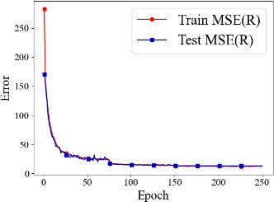
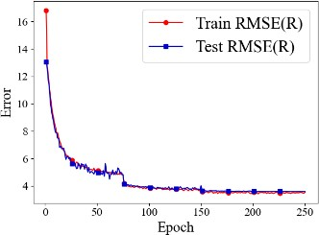
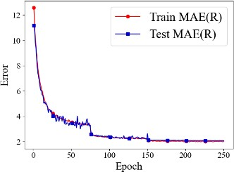
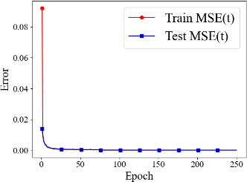
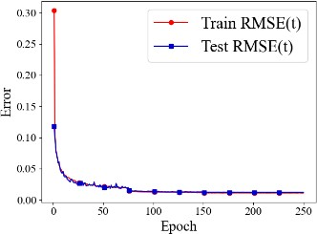
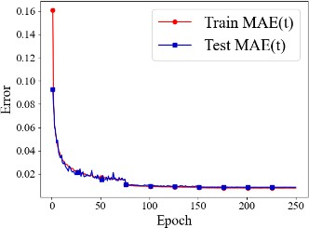
南京邮电大学硕士研究生学位论文 第四章 基于位置自适应卷积提取特征的点云配准优化
CPU@2.20GHz 和两块 TeslaP100-PCI-E GPU，内存为 12GB，总显存为 32GB。本章实验在
Ubuntu18.04 环境下运行，采用 PyTorch 1.9.0 作为深度学习框架。
4.3.2 训练参数设置
对于训练集和测试集中的每个样本随机选择 1024 个点，即为模板点云，并随机生成一个 旋转矩阵和平移向量作为初始变换矩阵。将初始变换矩阵作用于模板点云生成源点云，这样 就得到了待配准的点云对。为了保证实验的科学性，本节设置了随机种子，确保每次随机生 成的变换矩阵相同。本节采用 Adam^{[67]}（Adaptive Moment Estimation）梯度下降优化器训练网 络，初始学习率设置为 0.001，训练集和测试集的批量大小均设置为 16，共训练 250 步。
如图 4.7 所示分别为本章的模型在各项评价指标上的训练曲线和测试曲线。从图中可以
看出，训练曲线和测试曲线相似，误差指标在前 75 步下降剧烈，但当训练步数达到 75 时， 误差指标曲线趋于平缓，表明模型已经收敛并进入了全局最优。
(a) MSE(R)
(b) RMSE(R)
(c) MAE(R)
(d) MSE(t)
(e) RMSE(t) (f) MAE(t)
不同评价指标的训练曲线和测试曲线对比图
图 4.7
4.3.3 整体配准效果
本节将模型预测得到的旋转矩阵和平移向量作用到源点云上得到配准后的点云，并同时 可视化模板点云、源点云以及配准后的点云来查看配准的效果，如图 4.8 所示，其中蓝色为源 点云，绿色为模板点云，红色为配准后的点云。从可视化结果可以看出，本章的配准方法不 论是在像桌子、花瓶、飞机这样具有规则对称结构的点云中，还是在吉他、花束、人这样具 有复杂结构的点云中，均可以获得较好的配准效果。

Slide 53
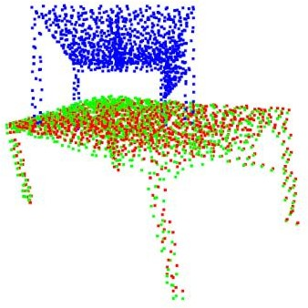
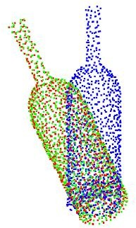
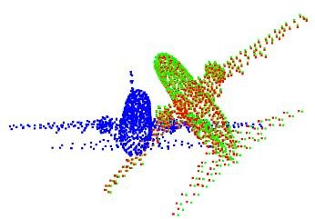
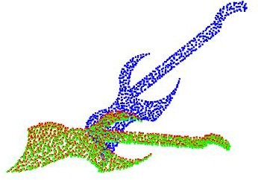
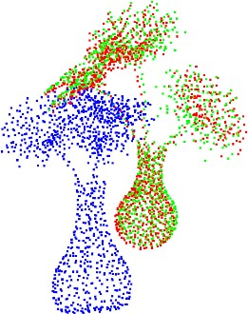
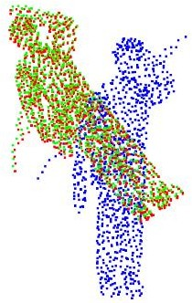
南京邮电大学硕士研究生学位论文
第四章 基于位置自适应卷积提取特征的点云配准优化
(a) 桌子
(b) 花瓶
(c) 飞机
(d) 吉他
(e) 花束
(f) 人
图 4.8 配准效果展示图
4.3.4 测试对比
（1）不同卷积层数对比
在实验的过程中，本节分别训练并测试了嵌入 1 到 3 层位置自适应卷积的模型，并对这 些模型在原始数据集上进行了性能评估，有趣地发现嵌入不同层数的位置自适应卷积会产生 不同的结果，实验结果如表 4.1 所示。
表 4.1 不同卷积层数测试结果对比表
卷积层数 | MSE(R) | RMSE(R) | MAE(R) | MSE(t) | RMSE(t) | MAE(t)
1 | 14.113483 | 3.756792 | 2.166226 | 0.000149 | 0.012212 | 0.008324
2 | 12.930086 | 3.595843 | 2.072818 | 0.000143 | 0.011957 | 0.008473
3 | 13.466946 | 3.669734 | 2.148391 | 0.000137 | 0.011701 | 0.008457
从表格数据可以看出，嵌入 2 层位置自适应卷积的模型具有最优性能。在旋转矩阵上的
性能评估上，嵌入 2 层位置自适应卷积的模型均优于嵌入其他数量的模型。在平移矩阵的性
能评估上，嵌入 2 层位置自适应卷积的模型没有明显的优势，但性能均衡。这说明过多的嵌 入位置自适应卷积并不会对模型带来更好的结果。这是因为过多的卷积层将导致提取出的

Slide 54
南京邮电大学硕士研究生学位论文 第四章 基于位置自适应卷积提取特征的点云配准优化
局部特征变得冗余，从而影响了重要信息的提取，反而降低配准精度^{[68]}。同时，冗余的数
据也加重了网络的负担，增加了算法的时间复杂度和空间复杂度。
（2）精度测试
表 4.2 评估了本章的方法及其同行的性能。在所有性能指标中，本章的方法在 MSE(R)、 RMSE(R)、MSE(t)和 RMSE(t)均最低。在 MAE(R)这个指标上，略高于 FGR。在 MAE(t)这个 指标上，本章的方法没有明显的优势。这是由于 MAE 计算的是真实值和预测值绝对误差的 平均值，大部分情况下梯度都相等，即使是较小的损失值其梯度也可能很大，因此不利于模 型参数的收敛与学习。对比 PCRNet，本章的方法嵌入了两层位置自适应卷积，分别带来了 25.6％、13.7%、21.6%、39.4%、22.1%、19.1%的提升。同时，本章的方法预测出的旋转矩阵 和平移向量与地面值的误差有四个指标最小，优于其他主流方法，具有更高的配准精度。
表 4.2 精度测试结果对比表
模型 | MSE(R) | RMSE(R) | MAE(R) | MSE(t) | RMSE(t) | MAE(t)
ICP | 894.897339 | 29.914835 | 23.544817 | 0.084643 | 0.290935 | 0.248755
Go-ICP | 140.477325 | 11.852313 | 2.588463 | 0.000659 | 0.025665 | 0.007092
FGR | 87.661491 | 9.362772 | 1.999290 | 0.000194 | 0.013939 | 0.002839
PointNetLK | 227.870331 | 15.095374 | 4.225304 | 0.000487 | 0.022065 | 0.005404
PCRNet | 17.447983 | 4.177078 | 2.628245 | 0.000241 | 0.015526 | 0.010579
本章方法 | 12.930086 | 3.595843 | 2.072818 | 0.000143 | 0.000143 | 0.008473
本章小结
综上所述，本章以 PCRNet 深度学习网络模型为基础进行了改进与优化，构建了一种使 用位置自适应卷积提取特征的 PACNet 点云配准网络模型。在特征提取模块，利用具有动态 内核组装的位置自适应卷积对输入的点云进行特征学习，可以灵活地对三维点云的复杂空间 变化和几何结构进行建模，从而提高对场景的理解能力。通过实验将 PACNet 网络模型在标 准数据集 ModelNet-40 上进行了各项测试对比。实验结果表明，与 ICP、Go-ICP、FGR、PCRNet 这些同类主流算法相比，本章提出的方法在点云配准任务中具有更高的精度

Slide 55
南京邮电大学硕士研究生学位论文
第五章 基于双重注意力机制融合特征的点云配准优化
第五章 基于双重注意力机制融合特征的点云配准优化
基于 PCRNet 深度学习网络模型，本章提出了一种基于双重注意力机制融合特征的点云
配准的点云配准优化方法。首先介绍了注意力机制相关的背景知识，并分析了 PCRNet 网络 在特征融合方面存在的局限性。然后针对这些局限性提出改进，结合上一章改进的网络构建 了 PACNet-Att 网络模型。最后通过实验将 PACNet-Att 网络模型与当前主流的点云配准算法 进行了测试对比以及消融实验，证明了此优化方法的先进性以及两个改进方法的有效性。
注意力机制
注意力是人类不可或缺的复杂认知功能，人类的视觉感知系统在处理大量信息时并不会 一次性处理全部信息，而是在需要的时间和地点选择性地专注于信息独特的部分，同时忽略 其他可感知的信息^{[69]}。这是人类利用有限的处理资源从海量信息中快速选择高价值信息的一 种手段。受此启发，研究学者们将注意力机制运用于计算机视觉领域，让其能根据具体的任 务处理关键信息。目前，注意力机制已经成为深度学习领域最重要的概念之一^{[70]}。由于注意 力机制可以学习特征之间的映射关系，并捕获特征之间的相互依赖性^{[71]}，因此本章通过引入 注意力机制学习不同层次特征的映射关系，实现点云局部特征和全局信息的有效融合。
基于双重注意力机制融合特征的 PACNet-Att
由于 PCRNet 网络在特征融合模块仅以数组拼接的方式将两组点云的特征在维度上进行 连接，不能充分利用不同层次特征的互补性，无法很好地融合点云的局部特征和全局信息。 为了解决上述问题，本章构建了一种结合空间注意力机制和通道注意力机制融合特征^{[72, 73]}的 点云配准网络模型，该网络可以捕获不同层次特征的长期语义依赖关系，有效融合局部特征 和全局信息，从而提高点云配准的精度。
5.2.1 空间注意力机制
空间注意力机制^{[74, 75]}可以实现空间维度上的特征聚焦，加深网络中深层信息的传递。设
𝐴^{𝐺×𝑁×𝑀}表示输入点云特征矩阵，其中𝐺表示通道数，𝑁和𝑀分别表示点云的数量和维度。将𝐴
分别输入三个通道数为 64 的卷积层进行降维处理，得到𝐵^{𝐺×𝑁×𝑀}、𝐶^{𝐺×𝑁×𝑀}和𝐷^{𝐺×𝑁×𝑀}。将𝐵和

Slide 56
南京邮电大学硕士研究生学位论文 第五章 基于双重注意力机制融合特征的点云配准优化
𝐶进行维度转换得到𝐵^{𝐺×𝐽}和𝐶^{𝐺×𝐽}，此时𝐽 = 𝑁 × 𝑀。对𝐵进行转置得到𝐵^{𝑇}，并与𝐶进行矩阵相乘，
经过𝑠𝑜𝑓𝑡𝑚𝑎𝑥归一化得到空间注意力系数矩阵𝑆_{𝑗𝑖}，如公式 5.1 所示：
𝑆 =
𝑒𝑥𝑝(𝐵_{𝑖}∗ 𝐶_{𝑖})
(5.1)
𝑗𝑖
𝐽 𝐽
∑_{𝑖} ∑_{𝑖} 𝑒𝑥𝑝(𝐵_{𝑖}∗ 𝐶𝑖)
其中𝑆_{𝑗𝑖}表示𝑖位置特征对𝑗位置特征的影响。相似位置的特征系数更高，点的依赖性关系更强。
同时，将特征𝐴输入到卷积层得到特征矩阵𝐷^{𝐺×𝑁×𝑀}，通过维度转换得到𝐷^{𝐺×𝐽}。加入一个 缩放因子𝑎，每个位置的特征𝐸^{𝐺×𝑁×𝑀}是所有位置的特征和原始特征的加权和，这个过程如公 式 5.2 所示：
𝐽
𝐸_{𝑗} = 𝑎 ∑ (𝑆_{𝑗𝑖}𝐷_{𝑖}) + 𝐴_{𝑗}
𝑖=1
(5.2)
𝑎初始化为 0，通过逐渐地学习并更新权重，最后输出加权后的每个位置的特征。空间注
意机制可以选择性地聚合特征，并提高语义一致性^{[76]}。
5.2.2 通道注意力机制
通道注意力机制^{[74, 75]}也通过类似空间注意力机制的方式来学习任意两个通道特征之间的 映射关系，利用通道之间的相互依赖性来更新某一个通道，并通过通道之间的关联，增强特 定语义的响应能力。为了避免打破通道之间的关系，通道注意力机制最开始不进行卷积运算， 而是直接将原始特征矩阵𝐴^{𝐺×𝑁×𝑀} 通过矩阵计算和𝑠𝑜𝑓𝑡𝑚𝑎𝑥 函数得到通道注意力系数矩阵
𝑋^{𝐺×𝐺}，如公式 5.3 所示：
ex p(𝐴∗𝐴 )
X =
∑𝐺
𝑖 𝑗
(5.3)
𝑗𝑖
ex p(𝐴∗𝐴 )
𝑖=1
𝑖 𝑗
其中X_{𝑗𝑖} 表示𝑖通道特征对𝑗通道特征的影响。
加入一个缩放因子𝑏，每个通道的输出特征是所有通道的特征和原始特征的加权和，这个 过程如公式 5.4 所示：
𝐺
𝐸_{𝑗} = 𝑏 ∑ (𝑋_{𝑗𝑖}𝐴_{𝑖}) + 𝐴_{𝑗}
𝑖=1
𝑏初始化为 0，通过逐渐地学习并更新权重，最后输出加权后的每个通道的特征，表明特
征映射之间的长期语义依赖关系，有助于提高特征的可分辨性。
(5.4)

Slide 57





南京邮电大学硕士研究生学位论文
第五章 基于双重注意力机制融合特征的点云配准优化
5.2.3 PACNet-Att 网络设计
本节引入空间注意力机制和通道注意力机制，基于 PCRNet 网络在特征融合模块提出了 改进，并结合上一章改进的网络 PACNet 构建了 PACNet-Att 点云配准网络模型，网络模型整 体框架如图 5.1 所示。该网络模型的整体结构同样是由特征提取模块、特征融合以及位姿回 归模块组成。
特征提取模块 特征融合模块 位姿回归模块
输入
N×3
(3,64,64) (64,64,128) (128,1024)
最大池化
MLP
N×64
位置自 适应卷 积层
N×128
MLP
N×1024
模板点云
1×1024
(1024,1024,512,512,256,4)
输出
2048
全连接层
(3,64,64)
(64,64,128)
(128,1024)
最大池化
双重注意力 机制
(1024,1024,512,512,256,3)
位姿 变换
N×3
MLP
N×64
位置自 适应卷 积层
N×128
MLP
N×1024
全连接层
源点云
1×1024
图 5.1 PACNet-Att 网络模型整体框架示意图
特征融合模块使用了结合空间注意力机制和通道注意力机制的双重注意力机制，结构如 图 5.2 所示。首先使用空间注意力机制学习综合了局部特征和全局信息的 1024 维抽象特征， 实现空间维度上的特征聚焦，输出加权后每个位置的特征。其次使用通道注意力机制学习综 合了的局部特征和全局信息的 1024 维抽象特征，捕获任意两个通道特征之间的映射关系，输 出加权后的每个通道的特征。最后以深度学习中的 concatenate 数组拼接操作将 1×1024 维的 抽象特征拼接成 1 个 1×2048 维的特征。至此，本章完成了基于双重注意力机制的特征融合。
空间注意力机制
1×1024
通道注意力机制
1×1024
模板点云
抽象特征
Concatenate
2048
融合后 抽象特征
空间注意力机制
1×1024
通道注意力机制
1×1024
源点云
抽象特征
图 5.2 双重注意力机制结构示意图

Slide 58
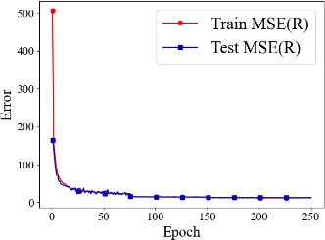
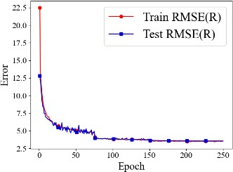
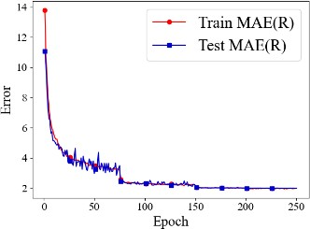
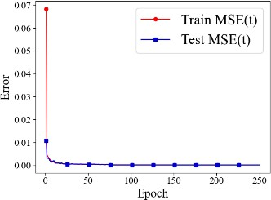
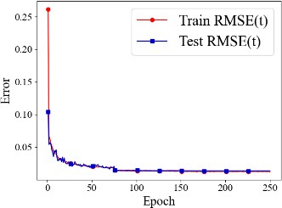
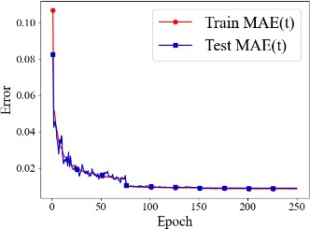
南京邮电大学硕士研究生学位论文
第五章 基于双重注意力机制融合特征的点云配准优化
实验结果与对比分析
本节将本章构建的网络模型 PACNet-Att 与当前比较主流的点云配准算法 ICP、Go-ICP、 FGR、PointNetLK、PCRNet 分别在精度、泛化性以及噪声鲁棒性三个方面进行了比较，并同 样使用均方误差、均方根误差以及平均绝对误差来评估真实值和预测值之间的误差。其中， PACNet-Att 的各项测试性能指标均在自己的电脑上完成。
5.3.1 实验环境和训练参数设置
本节实验环境和训练参数和第四章完全相同，因此不再赘述。如图 5.3 所示分别为本章 的模型在不同评价指标上的训练曲线和测试曲线。从图中可以看出，同样地，训练曲线和测 试曲线相似，但训练时的初始误差比测试时的初始误差大得多。误差曲线在前 75 步下降幅度 很大，尤其在 25~50 步之间抖动剧烈，之后趋于平缓，表明模型已经收敛并进入了全局最优。
(a) MSE(R)
(b) RMSE(R)
(c) MAE(R)
(d) MSE(t)
(e) RMSE(t) (f) MAE(t)
不同评价指标的训练曲线和测试曲线对比图
图 5.3
5.3.2 整体配准效果
同样地，本章将模型预测得到的旋转矩阵和平移向量作用到源点云上得到配准后的点云， 并同时可视化模板点云、源点云以及配准后的点云来查看配准的效果，如图 5.4 所示，其中蓝 色为源点云，绿色为模板点云，红色为配准后的点云。从可视化结果可以看出，本章配准方 法不论是在像门框、转椅、显示器这样具有规则对称结构的点云中，还是在沙发、树枝、钢 琴这样具有复杂结构的点云中均可以获得较好的配准效果。

Slide 59
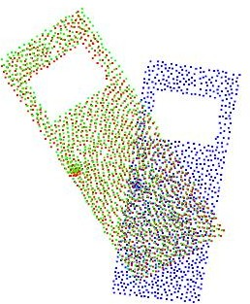
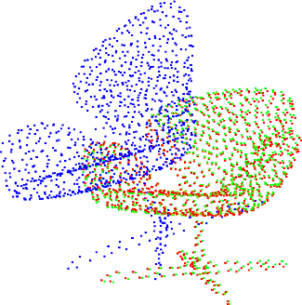
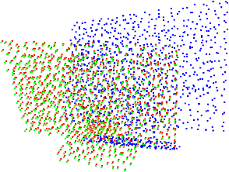
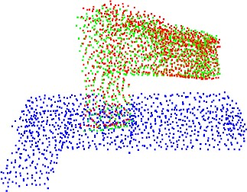
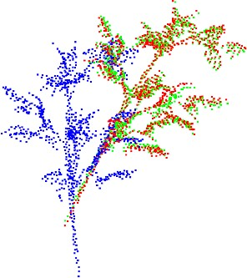
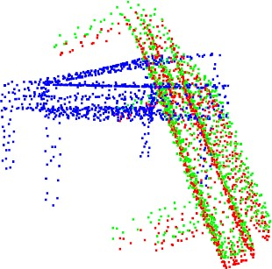
南京邮电大学硕士研究生学位论文
第五章 基于双重注意力机制融合特征的点云配准优化
(a) 门框
(b) 转椅
(c) 显示器
(d) 沙发
(e) 树枝
(f) 钢琴
图 5.4 配准效果展示图
5.3.3 测试对比
（1）精度测试
表 5.1 评估了本章的方法及其同行的性能。在所有性能指标中，同样地，本章的方法在 MSE(R)、RMSE(R)、MSE(t)和 RMSE(t)三个指标上均最低。在 MAE(R)这个指标上，仅次于 FGR。在 MAE(t)这个指标上，本章的方法没有明显的优势。对比 PCRNet，PACNet-Att 网络
模型在嵌入了两层位置自适应卷积和双重注意力机制后，在 6 个评价指标上分别带来了 30.3％、16.5%、23.4%、40.7%、22.9%、24%的提升。本章的方法预测出的旋转矩阵和平移向 量与地面值的误差有四个指标最小，其余两个指标表现均衡。总体来看，本章的方法性能优 于其他主流方法，具有更高的配准精度。

Slide 60
南京邮电大学硕士研究生学位论文
第五章 基于双重注意力机制融合特征的点云配准优化
表 5.1 各算法精度测试结果对比表
模型 | MSE(R) | RMSE(R) | MAE(R) | MSE(t) | RMSE(t) | MAE(t)
ICP | 894.897339 | 29.914835 | 23.544817 | 0.084643 | 0.290935 | 0.248755
Go-ICP | 140.477325 | 11.852313 | 2.588463 | 0.000659 | 0.025665 | 0.007092
FGR | 87.661491 | 9.362772 | 1.999290 | 0.000194 | 0.013939 | 0.002839
PointNetLK | 227.870331 | 15.095374 | 4.225304 | 0.000487 | 0.022065 | 0.005404
PCRNet | 17.447983 | 4.177078 | 2.628245 | 0.000241 | 0.015526 | 0.010579
本章方法 | 12.411096 | 3.522938 | 2.049789 | 0.000140 | 0.011842 | 0.008301
（2）泛化性对比
为了测试不同模型的泛化能力，本节在看不见的类别中对本章方法及其同行进行了测试， 结果如表 5.2 所示。同样地，本章的方法在 MSE(R)、RMSE(R)、MSE(t)和 RMSE(t)均最低。 在 MAE(R)这个指标上，略高于 FGR。在 MAE(t)这个指标上，本章的方法没有明显的优势。 本章的方法预测出的旋转矩阵和平移向量与地面值的误差有四个指标最小，其余两个指标表 现均衡。总体来看，本章的方法在看不见的类别中依然可以保持更高的配准精度，这也体现 了本章方法具有更好的泛化性能。
表 5.2 泛化性测试结果对比表
模型 | MSE(R) | RMSE(R) | MAE(R) | MSE(t) | RMSE(t) | MAE(t)
ICP | 892.601135 | 29.876431 | 23.626110 | 0.086005 | 0.293266 | 0.251916
Go-ICP | 192.258636 | 13.865736 | 2.914169 | 0.000491 | 0.022154 | 0.006219
FGR | 97.002747 | 9.848997 | 1.445460 | 0.000182 | 0.013503 | 0.002231
PointNetLK | 306.323975 | 17.502113 | 5.280545 | 0.000784 | 0.028007 | 0.007203
PCRNet | 18.333996 | 4.281822 | 2.693274 | 0.000194 | 0.013912 | 0.009988
本章方法 | 12.666718 | 3.559033 | 1.982284 | 0.000182 | 0.013489 | 0.008896
（3）噪声鲁棒性对比
为了测试噪声对不同模型的影响，本节在输入点云中添加期望值为 0、方差为 0.01 的高 斯噪声进行测试，结果如表 5.3 所示。本章的方法在 MSE(R)、RMSE(R)、MAE(R)、MSE(t) 和 RMSE(t)这五个指标上均优于其他所有方法。唯一不足的 MAE(t)指标，本章的方法同样仅 仅优于 ICP 和 PCRNet，没有明显的优势。但总体看来，本章方法对噪声的鲁棒性更强。

Slide 61
南京邮电大学硕士研究生学位论文
第五章 基于双重注意力机制融合特征的点云配准优化
表 5.3 噪声鲁棒性测试结果对比表
模型 | MSE(R) | RMSE(R) | MAE(R) | MSE(t) | RMSE(t) | MAE(t)
ICP | 882.564209 | 29.707983 | 23.557217 | 0.084537 | 0.290752 | 0.249092
Go-ICP | 131.182495 | 11.453493 | 2.534873 | 0.000531 | 0.023051 | 0.004192
FGR | 607.694885 | 24.651468 | 10.055918 | 0.011876 | 0.027393 | 0.002231
PointNetLK | 256.155548 | 16.004860 | 4.595617 | 0.000465 | 0.021558 | 0.005652
PCRNet | 17.806925 | 4.219825 | 2.675704 | 0.000236 | 0.015368 | 0.010528
本章方法 | 12.837771 | 3.582983 | 2.016258 | 0.000179 | 0.013361 | 0.008862
5.3.4 消融实验
为了验证位置自适应卷积和双重注意力机制在基础网络 PCRNet 中的有效性，本节又对 单独使用双重注意机制融合特征的网络进行了消融实验，并将其和基础网络 PCRNet、单独使 用位置自适应卷积提取特征的网络 PACNet、同时使用位置自适应卷积提取特征和双重注意力 机制融合特征的网络 PACNet-Att 进行了对比，结果如表 5.4 所示。
实验数据表明，在 PCRNet 中单独使用位置自适应卷积提取特征，6 项评价指标分别带来
了 25.6％、13.7%、21.6%、39.4%、22.1%、19.1%的提升。在 PCRNet 中单独使用双重注意力 机制融合特征，6 项评价指标分别带来了 27.3％、14.8%、23.3%、27.1%、14.6%、17.4%的提 升。在 PCRNet 中同时使用位置自适应卷积提取特征以及双重注意力机制融合特征，6 项评价 指标分别带来了 30.3％、16.5%、23.4%、40.7%、22.9%、24%的提升。综上所示，位置自适 应卷积和双重注意力机制各自都能对网络起到实质的作用，从而提高点云配准的精度。
表 5.4 消融实验测试结果对比表
模型 | MSE(R) | RMSE(R) | MAE(R) | MSE(t) | RMSE(t) | MAE(t)
PCRNet | 17.806925 | 4.219825 | 2.675704 | 0.000236 | 0.015368 | 0.010528
PACNet | 13.254151 | 3.640625 | 2.098704 | 0.000143 | 0.011975 | 0.008520
PCRNet-Att | 12.938107 | 3.596958 | 2.052865 | 0.000172 | 0.013123 | 0.008699
本章方法 | 12.411096 | 3.522938 | 2.049789 | 0.000140 | 0.011842 | 0.008301
本章小结
综上所示，本章以 PCRNet 深度学习网络模型为基础进行了改进与优化，并结合上一章 改进的网络，构建了一种基于双重注意力机制融合特征的 PACNet-Att 点云配准网络模型。在 特征融合模块，结合空间注意力机制和通道注意力捕获不同层次特征的长期语义依赖关系，

Slide 62
南京邮电大学硕士研究生学位论文 第五章 基于双重注意力机制融合特征的点云配准优化
可以有效融合点云的局部特征和全局信息。通过实验将 PACNet-Att 网络模型与当前主流的点
云配准方法进行了各项测试对比。实验结果表明，与 ICP、Go-ICP、FGR、PCRNet 这些同类 主流算法相比，本章提出的方法在点云配准任务中具有更高的精度、更高的泛化性能以及更 稳健的噪声鲁棒性。同时通过消融实验，验证了本文提出的两个改进点，即使用位置自适应 卷积提取特征，并使用双重注意力机制融合特征，各自都能对网络起到实质性的作用，从而 提高点云配准的精度。

Slide 63
南京邮电大学硕士研究生学位论文
总结与展望
第六章 总结与展望
本文总结
点云配准是三维计算机视觉领域的关键课题之一，探索点云配准对理论基础研究与实际 工程应用中都有重要意义。但外部传感器采集到的点云数据往往存在冗余性与质量缺陷，这 一方面使得配准过程占用大量的内存资源和处理时间，另一方面噪声干扰也会导致特征匹配 产生的对应关系出现异常值，从而影响点云配准的精度。在深度学习领域中，以点云配准经 典网络 PCRNet 为代表的点云配准方法在特征提取模块只关注点云的全局信息，并没有考虑 到点云的局部特征，难以表征点云空间复杂的变化关系，一定程度限制了其对场景的理解能 力，从而降低点云配准的精度。同时，PCRNet 在特征融合模块仅仅以数组拼接方式将两组点 云的特征在维度上进行连接，不能充分利用不同层次特征的互补性，无法很好地融合点云的 局部特征和全局信息，从而破坏点云配准的精度。本文针对以上点云配准任务中存在的问题， 主要对以下三个部分进行研究与改进：
第一部分，针对外部传感器采集到的点云数据存在冗余性与质量缺陷的问题，本文提出 一种基于几何特征的点云数据预处理方案，为后续利用有效点云信息进行点云配准奠定基础。 该方案首先使用随机降采样这种方法来降低原始点云的冗余性，并指定采样数量为 48977。 然后使用统计滤波器进行离群点去除，并取近邻搜索点的个数为 30。最后使用欧式聚类算法 进行无关背景去除，并取近邻搜索半径的大小为 5。测试下来，降采样后，点云数据从 271114 个点减少到 48977 个点，用时为 0.104379s，且在保证点云结构与重要特征的同时过滤掉了绝 大多数干扰噪声。离群点去除后，点云个数又从 48977 减少为 48105，用时为 0.122201s，且 去除了绝大多数离群点。在进行无关背景去除时，点云被分为 10 个类别，分离出目标物体（手 机）后，点云个数从 48105 减少为 6067，即目标物体（手机）的点云数量为 6067，用时为 0.295816s。总用时 0.522397s。
第二部分，针对以点云配准经典网络 PCRNet 为代表的点云配准方法在特征提取模块只 关注点云的全局信息而忽略局部特征的问题，本文在基础网络 PCRNet 的特征提取模块进行 了改进，提出了一种使用位置自适应卷积提取特征的点云配准网络模型 PACNet。在特征提取 模块，利用具有动态内核组装的位置自适应卷积层对输入的点云进行特征学习，根据每个点 与其邻域点的位置关系学习权重系数，并组合权重矩阵自适应地构建卷积内核，可以灵活地 捕获局部区域的信息，从而提高对场景的理解能力。本文通过实验将 PACNet 网络模型在标

Slide 64
南京邮电大学硕士研究生学位论文 总结与展望
准数据集ModelNet-40 上进行了各项测试对比。实验结果表明，PACNet 对比基础网络PCRNet，
在 6 个评价指标上分别带来了 25.6％、13.7%、21.6%、39.4%、22.1%、19.1%的提升。与 ICP、 Go-ICP、FGR、PCRNet 这些同类主流算法相比，本文提出的方法在点云配准任务中也具有更 高的精度。
第三部分，针对 PCRNet 在特征融合模块仅仅以数据拼接方式将两组点云的特征在维度 上进行连接而无法很好地融合不同层次特征的问题，本文在基础网络 PCRNet 的特征融合模 块进行了改进，并结合 PACNet 网络构建了一种基于双重注意力机制融合特征的点云配准网 络模型 PACNet-Att。在特征融合模块，双重注意力机制可以捕获不同层次特征的长期语义依
赖关系，有效融合点云的局部特征和全局信息。本文通过实验将 PACNet-Att 网络模型与当前 主流的点云配准算法进行了各项测试对比以及消融实验。实验结果表明，PACNet-Att 对比基 础网络 PCRNet，在 6 个评价指标上分别带来了 30.3％、16.5%、23.4%、40.7%、22.9%、24% 的提升。与 ICP、Go-ICP、FGR、PCRNet 这些同类主流算法相比，本文提出的方法在点云配 准任务中也具有更高的精度、更高的泛化性能以及更稳健的噪声鲁棒性。同时本文提出的两 个改进点，即使用位置自适应卷积提取特征，并使用双重注意力机制融合特征，各自都能对 网络起到实质的作用，从而提高点云配准的精度。
研究展望
本文对基于深度学习的点云配准算法研究取得了一定的成果，但仍存在可进一步探索的 空间，对此提出一些可行的改进思路与方向，并对今后的研究进行展望：
在使用外部传感器对真实场景进行点云数据采集时，目标物体（手机）与周围无 关背景（苹果、卷尺等杂物）的摆放比较理想，并没有重叠的部分，这使得本文可以很好地 分
离出目标物体。未来，具有重叠部分的点云分割将成为接下来的研究重点之一。
在对外部传感器采集到的稠密点云数据进行点云预处理时，本文采用的是基于几 何特征的方案，其中近邻搜索点的个数、近邻搜索半径的大小等参数都需要根据实际场景来 调整，这使得算法的自适应能力较差。未来可考虑使用点云的语义特征，实现更高层次特征 的点云预处理，更加智能化地处理点云数据。
在使用 PACNet-Att 网络对两片不对齐的点云进行配准时，以 MSE(R)这个指标为 例，误差仍有 12.411096，还有很大的提升空间。本文仅在特征提取模块与特征融合模块做出
了有效地改进，如何更好地解算位姿将成为接下来的研究内容之一。

Slide 65
南京邮电大学硕士研究生学位论文
参考文献
参考文献
Tian H, Wang T, Liu Y, et al. Computer Vision Technology in Agricultural Automation—A Review[J]. Information Processing in Agriculture, 2020, 7(1): 1-19.
赵跃东, 孙多润, 郭警中, et al. 基于 3D 视觉传感器边缘识别和追踪算法的研究[J]. 锻压装备与制造 技术, 2020, 55(02): 91-94.
Pawar P G, Devendran V. Scene Understanding: A Survey to See the World at a Single Glance[C]. 2019 2nd International Conference on Intelligent Communication and Computational Techniques, 2019: 182-186.
Mittal S, Vaishay S. A Survey of Techniques for Optimizing Deep Learning on GPUs[J]. Journal of Systems Architecture, 2019, 99: 101635.
[5] 徐锡磊. 数字城市的应用与展望[J]. 智能城市, 2020, 6(13): 42-43.
Yurtsever E, Lambert J, Carballo A, et al. A Survey of Autonomous Driving: Common Practices and Emerging Technologies[J]. IEEE Access, 2020, 8: 58443-58469.
张辉, 王盼, 肖军浩, et al. 一种基于三维建图和虚拟现实的人机交互系统[J]. 控制与决策, 2018, 33(11): 1975-1982.
Wang X, Chan T O, Liu K, et al. A Robust Segmentation Framework for Closely Packed Buildings from Airborne Lidar Point Clouds[J]. International Journal of Remote Sensing, 2020, 41(14): 5147-5165.
Phang J T S, Lim K H, Chiong R C W. A Review of Three Dimensional Reconstruction Techniques[J]. Multimedia Tools and Applications, 2021, 80(12): 17879-17891.
邹娟茹, 孙兴华. 多源数据融合构建精细三维模型的关键技术[J]. 地理空间信息, 2021, 19(12): 131- 134+137.
Campos C, Elvira R, Rodríguez J J G, et al. ORB-SLAM3: An Accurate Open-Source Library for Visual, Visual–Inertial, and Multimap Slam[J]. IEEE Transactions on Robotics, 2021, 37(6): 1874-1890.
Huang X, Mei G, Zhang J, et al. A Comprehensive Survey on Point Cloud Registration[J]. arXiv preprint arXiv: 210302690, 2021.
王珊, 王春阳. 基于特征点匹配的三维点云配准算法[J]. 国外电子测量技术, 2020, 39(12): 23-28.
Zhang Z, Dai Y, Sun J. Deep Learning Based Point Cloud Registration: An Overview[J]. Virtual Reality & Intelligent Hardware, 2020, 2(3): 222-246.
Huang X, Mei G, Zhang J. Feature-Metric Registration: A Fast Semi-Supervised Approach for Robust Point Cloud Registration without Correspondences[C]. Proceedings of the IEEE/CVF Conference on Computer
Vision and Pattern Recognition, 2020: 11366-11374.
Makovetskii A, Voronin S, Kober V, et al. An Algorithm for Rough Alignment of Point Clouds in Three- Dimensional Space[C]. 2020 International Conference on Information Technology and Nanotechnology, 2020: 1-4.
Lu H, Shi H. Deep Learning for 3D Point Cloud Understanding: A Survey[J]. arXiv preprint arXiv: 200908920, 2020.
Makay B P. A Method for Registration of 3D Shape[J]. IEEE Transactions on Pattern Analysis and Machine Intelligence, 1992, 14: 239-256.
Magnusson M. The Three-Dimensional Normal-Distributions Transform: An Efficient Representation for Registration, Surface Analysis, and Loop Detection[D]. Örebro universitet, 2009.
Yang J, Li H, Campbell D, et al. Go-Icp: A Globally Optimal Solution to 3D ICP Point-Set Registration[J]. IEEE Transactions on Pattern Analysis and Machine Intelligence, 2015, 38(11): 2241-2254.
Zhou Q-Y, Park J, Koltun V. Fast Global Registration[C]. European Conference On Computer Vision, 2016: 766-782.
祝瑞红, 黄昶. 基于快速点特征直方图的三维点云配准算法[J]. 长江信息通信, 2021, 34(02): 72-74.

Slide 66
南京邮电大学硕士研究生学位论文 参考文献
Shen Z, Ma X, Li Y. A Hybrid 3D Descriptor with Global Structural Frames and Local Signatures of Histograms[J]. IEEE Access, 2018, 6: 39261-39272.
Qi C R, Su H, Mo K, et al. Pointnet: Deep Learning on Point Sets for 3D Classification and Segmentation[C]. Proceedings of the IEEE Conference on Computer Vision and Pattern Recognition, 2017: 652-660.
Zeng A, Song S, Niessner M, et al. 3DMatch: Learning Local Geometric Descriptors from Rgb-D Reconstructions[M]. 30th IEEE Conference on Computer Vision and Pattern Recognition. 2017: 199-208.
Deng H, Birdal T, Ilic S. Ppfnet: Global Context Aware Local Features for Robust 3D Point Matching[C]. Proceedings of the IEEE Conference on Computer Vision and Pattern Recognition, 2018: 195-205.
Yew Z J, Lee G H. 3DFeat-Net: Weakly Supervised Local 3D Features for Point Cloud Registration[C]. Proceedings of the European Conference on Computer Vision, 2018: 607-623.
Aoki Y, Goforth H, Srivatsan R A, et al. Pointnetlk: Robust & Efficient Point Cloud Registration Using
Pointnet[C]. Proceedings of the IEEE/CVF Conference on Computer Vision and Pattern Recognition, 2019: 7163-7172.
Wang Y, Solomon J M. Deep Closest Point: Learning Representations for Point Cloud Registration[C]. Proceedings of the IEEE/CVF International Conference on Computer Vision, 2019: 3523-3532.
Lu W, Wan G, Zhou Y, et al. DeepVCP: An End-to-End Deep Neural Network for Point Cloud Registration[C]. Proceedings of the IEEE/CVF International Conference on Computer Vision, 2019: 12-21.
Sarode V, Li X, Goforth H, et al. PCRNet: Point Cloud Registration Network Using Pointnet Encoding[J]. arXiv preprint arXiv:190807906, 2019.
Pais G D, Ramalingam S, Govindu V M, et al. 3DRegNet: A Deep Neural Network for 3D Point Registration[C]. Proceedings of the IEEE/CVF Conference on Computer Vision and Pattern Recognition, 2020: 7193-7203.
Fu K, Liu S, Luo X, et al. Robust Point Cloud Registration Framework Based on Deep Graph Matching[C]. Proceedings of the IEEE/CVF Conference on Computer Vision and Pattern Recognition, 2021: 8893-8902.
Bustos A P, Chin T-J. Guaranteed Outlier Removal for Point Cloud Registration with Correspondences[J]. IEEE Transactions on Pattern Analysis and Machine Intelligence, 2017, 40(12): 2868-2882.
Guan B, Lin S, Wang R, et al. Voxel-Based Quadrilateral Mesh Generation from Point Cloud[J]. Multimedia Tools and Applications, 2020, 79(29), 20561-20578.
Jiang C, Sud A, Makadia A, et al. Local Implicit Grid Representations for 3D Scenes[C]. Proceedings of the IEEE/CVF Conference on Computer Vision and Pattern Recognition, 2020: 6001-6010.
Zhou Y, Tuzel O. VoxelNet: End-to-End Learning for Point Cloud Based 3D Object Detection[C]. Proceedings of the IEEE Conference on Computer Vision and Pattern Recognition, 2018: 4490-4499.
Thabet A, Alwassel H, Ghanem B. Self-Supervised Learning of Local Features in 3D Point Clouds[C]. Proceedings of the IEEE/CVF Conference on Computer Vision and Pattern Recognition Workshops, 2020: 938-939.
张学典, 方慧. BTDGCNN：面向三维点云拓扑结构的 BallTree 动态图卷积神经网络[J]. 小型微型计 算机系统, 2021: 1-8.
Sarabandi S, Thomas F. A Survey on the Computation of Quaternions from Rotation Matrices[J]. Journal of Mechanisms and Robotics, 2019, 11(2): 021006
野莹莹, 张艳珠, 邹心宇, et al. 欧拉角姿态解算的改进[J]. 装备制造技术, 2018, (03): 104-105+134.
Levinson J, Esteves C, Chen K, et al. An Analysis of SVD for Deep Rotation Estimation[J]. Advances in Neural Information Processing Systems, 2020, 33: 22554-22565.
Hu G, Zhou Z, Cao J, et al. Non-Linear Calibration Optimisation Based on the Levenberg–Marquardt Algorithm[J]. IET Image Processing, 2020, 14(7): 1402-1414.
马洁莹, 田暄, 翟庆, et al. 基于点到面度量的多视角点云配准方法[J]. 西安交通大学学报, 2022, (06): 1-12.

Slide 67
南京邮电大学硕士研究生学位论文 参考文献
Chen Y, Hosseini B, Owhadi H, et al. Solving and Learning Nonlinear PDEs with Gaussian Processes[J]. Journal of Computational Physics, 2021, 447: 110668.
纳文, 张世强, 曹越琦, et al. 雅可比矩阵在机器人运动中的应用[J]. 北京理工大学学报自然版, 2020, 40(5): 576-580.
兰林, 朱春钢. 基于Newton 迭代法的最小二乘渐进迭代逼近[J]. 数值计算与计算机应用, 2022, 43(1): 88-111.
Siddiqi K, Zhang J, Macrini D, et al. Retrieving Articulated 3D Models Using Medial Surfaces[J]. Machine Vision and Applications, 2008, 19(4): 261-275.
De Deuge M, Quadros A, Hung C, et al. Unsupervised Feature Learning for Classification of Outdoor 3D Scans[C]. Australasian Conference on Robitics and Automation, 2013, 2: 1-9.
Wu Z, Song S, Khosla A, et al. 3D Shapenets: A Deep Representation for Volumetric Shapes[C]. Proceedings of the IEEE Conference on Computer Vision and Pattern Recognition, 2015: 1912-1920.
Chang A X, Funkhouser T, Guibas L, et al. ShapeNet: An Information-Rich 3D Model Repository[J]. arXiv preprint arXiv: 151203012, 2015.
Dai A, Chang A X, Savva M, et al. ScanNet: Richly-Annotated 3D Reconstructions of Indoor Scenes[C]. Proceedings of the IEEE Conference on Computer Vision and Pattern Recognition, 2017: 5828-5839.
Uy M A, Pham Q-H, Hua B-S, et al. Revisiting Point Cloud Classification: A New Benchmark Dataset and Classification Model on Real-World Data[C]. Proceedings of the IEEE/CVF International Conference on Computer Vision, 2019: 1588-1597.
Armeni I, Sener O, Zamir A R, et al. 3D Semantic Parsing of Large-Scale Indoor Spaces[C]. Proceedings of the IEEE Conference on Computer Vision and Pattern Recognition, 2016: 1534-1543.
Guo Y, Wang H, Hu Q, et al. Deep Learning for 3D Point Clouds: A Survey[J]. IEEE Transactions on Pattern Analysis and Machine Intelligence, 2020, 43(12): 4338-4364.
Ruchay A, Dorofeev K, Kalschikov V. Accuracy Analysis of 3D Object Reconstruction Using Point Cloud Filtering Algorithms[J]. Proceedings of the 5th Information Technology and Nanotechnology, ITNT-2019, Samara, Russia, 2019: 21-24.
Chen C, Fragonara L Z, Tsourdos A. Fast Hierarchical Neural Network for Feature Learning on Point Cloud[J]. arXiv preprint arXiv: 190604117, 2019.
Liu H, Song R, Zhang X, et al. Point Cloud Segmentation Based on Euclidean Clustering and Multi-Plane Extraction in Rugged Field[J]. Measurement Science and Technology, 2021, 32(9): 095106.
Ge Y, Tang H, Xia D, et al. Automated Measurements of Discontinuity Geometric Properties from a 3D-Point Cloud Based on a Modified Region Growing Algorithm[J]. Engineering Geology, 2018, 242: 44-54.
Andoni A, Indyk P, Krauthgamer R. Earth Mover Distance over High-Dimensional Spaces[C]. SODA, 2008, 8: 343-352.
袁冰清, 陆悦斌, 张杰. 神经网络与深度学习基础[J]. 数字通信世界, 2018, 5: 59-62.
Ketkar N, Moolayil J. Introduction to Pytorch[M]. Deep Learning with Python. Springer. 2021: 27-91.
Chen Y, Dai X, Liu M, et al. Dynamic Convolution: Attention over Convolution Kernels[C]. Proceedings of the IEEE/CVF Conference on Computer Vision and Pattern Recognition, 2020: 11030-11039.
Mei J, Xiao C, Szepesvari C, et al. On the Global Convergence Rates of Softmax Policy Gradient Methods[C]. International Conference on Machine Learning, 2020: 6820-6829.
Xu M, Ding R, Zhao H, et al. Paconv: Position Adaptive Convolution with Dynamic Kernel Assembling on Point Clouds[C]. Proceedings of the IEEE/CVF Conference on Computer Vision and Pattern Recognition,
2021: 3173-3182.
Lubana E S, Dick R P, Tanaka H. Beyond Batchnorm: Towards a General Understanding of Normalization in Deep Learning[J]. arXiv preprint arXiv: 210605956, 2021.
Singarimbun R N, Nababan E B, Sitompul O S. Adaptive Moment Estimation to Minimize Square Error in

Slide 68
南京邮电大学硕士研究生学位论文 参考文献
Backpropagation Algorithm[C]. 2019 International Conference of Computer Science and Information Technology, 2019: 1-7.
张顺, 龚怡宏, 王进军. 深度卷积神经网络的发展及其在计算机视觉领域的应用[J]. 计算机学报, 2019, 42(3): 453-482.
Niu Z, Zhong G, Yu H. A Review on the Attention Mechanism of Deep Learning[J]. Neurocomputing, 2021, 452: 48-62.
Jian L, Jun L, Xiong L. Research Progress in Attention Mechanism in Deep Learning[J]. 工程科学学报, 2021, 43(11): 1499-1511.
Cai Z. Interflow: Aggregating Multi-Layer Feature Mappings with Attention Mechanism[J]. arXiv preprint arXiv:210614073, 2021.
Ju M, Luo J, Wang Z, et al. Adaptive Feature Fusion with Attention Mechanism for Multi-Scale Target Detection[J]. Neural Computing and Applications, 2021, 33(7): 2769-2781.
Zhou H, Fang Z, Gao Y, et al. Feature Fusion Network Based on Attention Mechanism for 3D Semantic Segmentation of Point Clouds[J]. Pattern Recognition Letters, 2020, 133: 327-333.
Fu J, Liu J, Tian H, et al. Dual Attention Network for Scene Segmentation[C]. Proceedings of the IEEE/CVF Conference on Computer Vision and Pattern Recognition, 2019: 3146-3154.
Wang X, Jiang B, Zhang Z, et al. DeepGCNs-Att for Point Cloud Semantic Segmentation[C]. Journal of Physics: Conference Series, 2021, 2025(1): 012059.
Lu H, Chen X, Zhang G, et al. SCAnet: Spatial-Channel Attention Network for 3D Object Detection[C]. ICASSP 2019-2019 IEEE International Conference on Acoustics, Speech and Signal Processing, 2019: 1992- 1996.

Slide 69
南京邮电大学硕士研究生学位论文 附录 1 攻读硕士学位期间撰写的论文
附录 1 攻读硕士学位期间撰写的论文
Mei Q, Wang F, Tong C, Zhang J, Jiang B, *Xiao J. PACNet: A High-precision Point Cloud Registration Network Based on Deep Learning[C]. 2021 13th International Conference on Wireless Communications and Signal Processing (WCSP). IEEE, 2021: 1-5.
Wang F, Mei Q, Liu X, Xiao Y. Optimized Spatial Matching for Visual Object Tracking[C] 2021 IEEE 31st International Workshop on Machine Learning for Signal Processing (MLSP). IEEE, 2021: 1-6.
Wang X, Jiang B, Zhang Z, Tong C, Mei Q, *Xiao J , *Tong, Y. DeepGCNs-Att for Point Cloud
Semantic Segmentation[C]. Journal of Physics: Conference Series. IOP Publishing, 2021, 2025(1): 012059.
许杰, 张子恒, 王新宇, 佟诚, 梅青, *肖建. 一种基于 Zynq 的 CNN 加速器设计与实现[J]. 计算机技术与发展, 2021, 31(11): 108-113+121.

Slide 70
南京邮电大学硕士研究生学位论文 附录 2 攻读硕士学位期间申请的专利
附录 2 攻读硕士学位期间申请的专利
肖建，梅青，佟诚，王新宇，张子恒，江斌. 一种手写成绩识别显示器，ZL202021317576.8，
2021.03，授权；
肖建，佟诚，梅青，王新宇，张子恒，江斌. 一种基于仿生图像增强算法和 FPGA 硬件加 速的手写成绩录入系统，CN111914683A，2020.01，公开；
肖建，王新宇，张子恒，梅青，佟诚，张雷，陈文勤. 一种基于 CNN 检测遵章率的路口 交通规划系统，CN111145551A，2020.05，公开；
肖建，张子恒，王新宇，佟诚，梅青，张雷，许杰. 一种基于 ANN 的路口交通警力资源 调度系统，CN111160537A，2020.05，公开。

Slide 71
南京邮电大学硕士研究生学位论文
附录 3 攻读硕士学位期间参加的科研项目
附录 3 攻读硕士学位期间参加的科研项目
（1）2020 年江苏省研究生科研创新计划，基于 GAAS 无人机的三维建模方法（KYCX20_0801），
主持人；
横向项目，基于 3D 扫描的高精度焊接路径规划方法研发（KH1060321192），南京欧睿 三维科技有限公司，主要参与人员；
横向项目，励磁 CPU 开发服务（KH1060321191），国电南瑞科技股份有限公司，主要 参与人员。

Slide 72
南京邮电大学硕士研究生学位论文 附录 4 攻读硕士学位期间参加的学科竞赛
附录 4 攻读硕士学位期间参加的学科竞赛
佟诚，梅青，张子恒. “兆易创新杯”第十五届中国研究生电子设计竞赛，TI 企业命题二 等奖，2020.08；
佟诚，梅青，张子恒. “兆易创新杯”第十五届中国研究生电子设计竞赛，全国总决赛团 队三等奖，2020.08；
佟诚，梅青，张子恒. “兆易创新杯”第十五届中国研究生电子设计竞赛，全国总决赛华 为专项赛三等奖，2020.08；
佟诚，梅青，张子恒，王新宇，张欣. 第六届 3S 杯全国大学生物联网技术与应用“三创” 大赛，全国一等奖，2020.12；
章佳琪，梅青，江斌. 第七届 3S 杯全国大学生物联网技术与应用“三创”大赛，全国二 等奖，2021.10；
江斌，章佳琪，梅青. “兆易创新杯”第十五届中国研究生电子设计竞赛，全国总决赛团 队二等奖，2021.08；
王新宇，张子恒，张雷，许杰，梅青. 第五届 3S 杯全国大学生物联网技术与应用“三创” 大赛，全国三等奖，2019.11。

Slide 73
南京邮电大学硕士研究生学位论文
致谢
致谢
两年半的研究生生活即将结束，在本论文完成之际，谨向两年多来给予我关爱的良师益
友和亲人们致以最崇高的敬意和衷心的感谢。
首先，我要感谢我的研究生导师肖建教授对我的指导与培养。在理论基础积累的阶段， 肖老师教会我高效的文献调研能力、科学的文献管理能力以及全面的综述评价能力。在完成 毕业课题阶段，从论文选题、实验方案确定、理论分析、数据处理直至论文撰写与定稿，每
一步肖老师都给予了指导性意见与建议，倾注了肖老师大量的心血。肖老师渊博的学术积累、 深邃的思想维度、严谨的治学态度、务实的工作作风，无一不深深地影响着我。
其次，我要感谢我的父母对我的付出与理解。感谢他们一直都是我最坚实的后盾，在我 的身后给予我支持与信任，给予我勇气和力量，祝愿他们身体健康，平安如意。
再次，我要感谢课题组的同学们对我的关心与帮助。在研究生学习期间，我们相互分享 学习心得体会，共同探讨学术研究问题，祝愿他们前程似锦，未来可期。
最后，我要向即将审阅本论文的专家们，以及评议和参与本论文答辩的老师们表示诚挚 的谢意。

