Slide 1
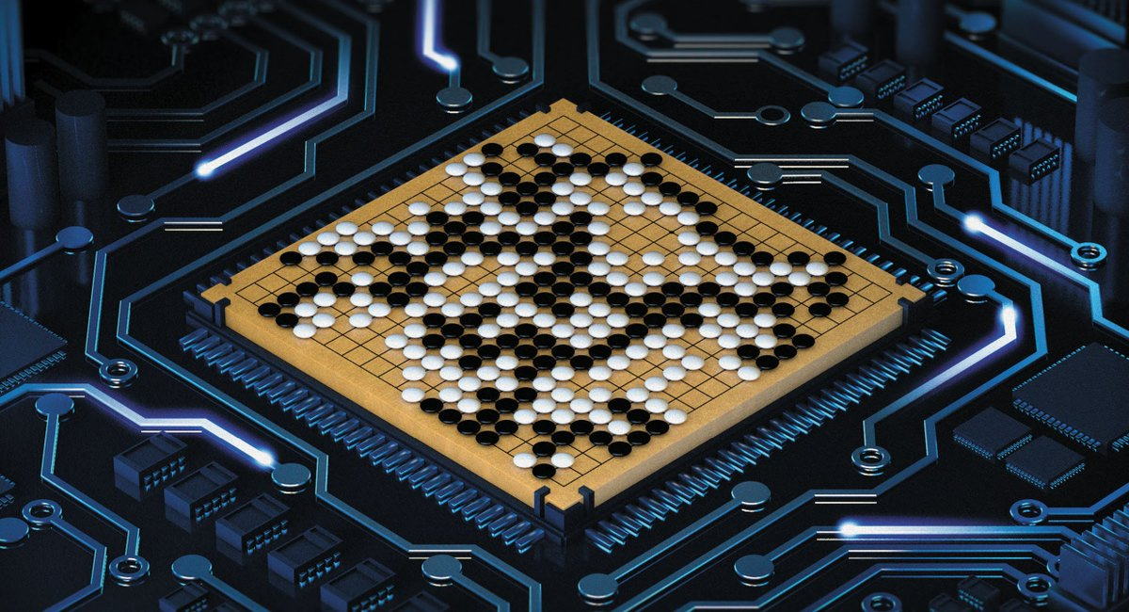
AlphaGo

Slide 2


AlphaGo
Mastering the Game of Go with
Deep Neural Networks and Tree Search
David Silver et al. Nature, 2016.

Slide 3
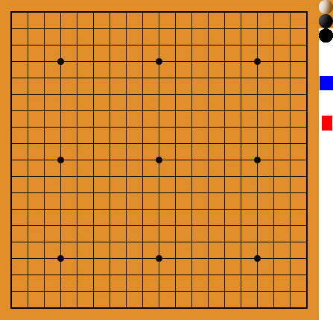
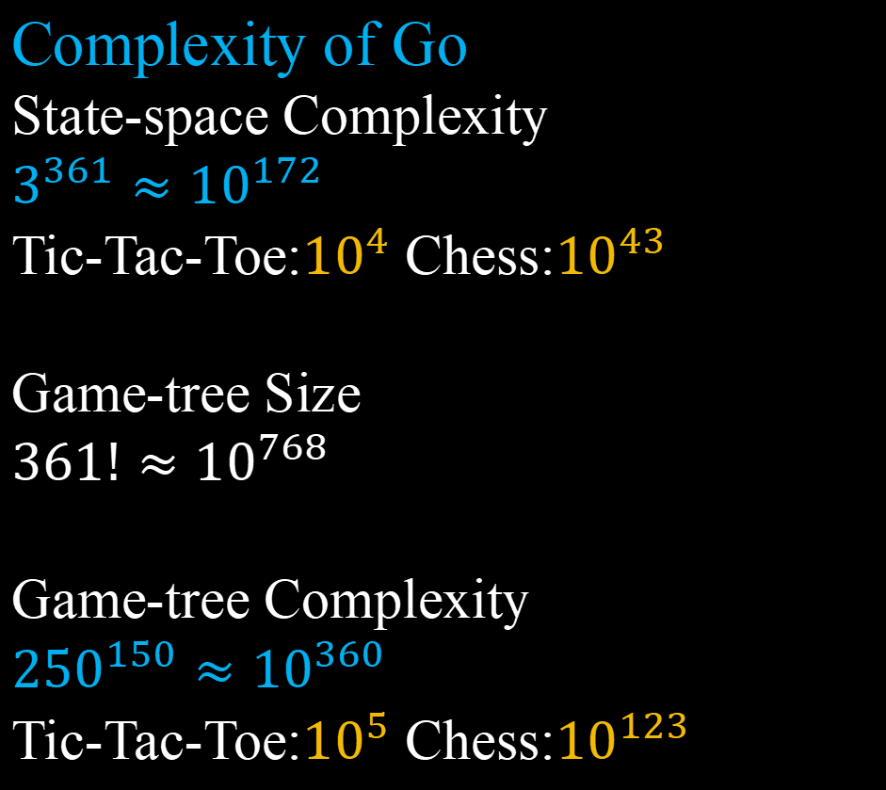
Complexity of Go
State-space Complexity
$3^{361}≈{10}^{172}$
Tic-Tac-Toe:${10}^{4}$ Chess:${10}^{43}$
Game-tree Size
$361!≈{10}^{768}$
Game-tree Complexity
${250}^{150}≈{10}^{360}$
Tic-Tac-Toe:${10}^{5}$ Chess:${10}^{123}$

Slide 4
Monte Carlo Tree Search

Slide 5
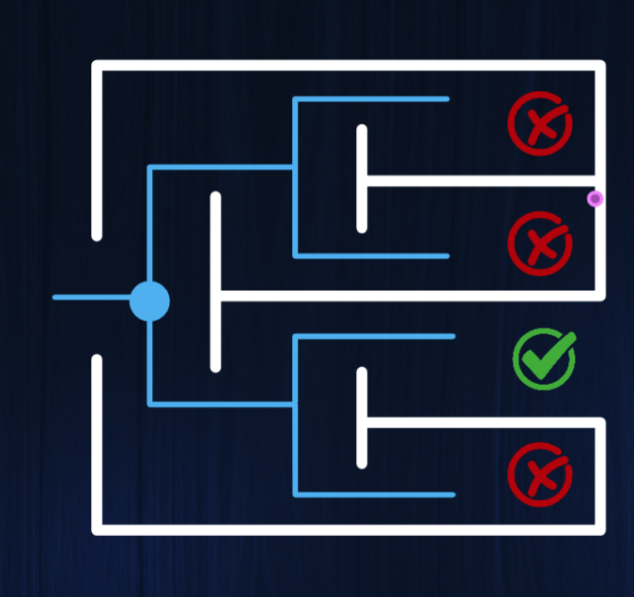
Monte Carlo Tree Search
A Naive Tree Search Algorithm
-1
-1
-1
S
1
1
State
Action
-1

Slide 6




Monte Carlo Tree Search
MiniMax Tree Search
State
State
State
Naive Value
Agent
State
Value
Rival
$$⋯$$
$$⋯$$
$$⋯$$
$$⋯$$
$$⋯$$
$$⋯$$
$$⋯$$
$$⋯$$
State
$$⋯$$
$$⋯$$
Value
$$⋯$$
$$⋯$$
$$⋯$$
$$⋯$$
$$⋯$$
$$⋯$$
$$⋯$$
$$⋯$$
$$⋯$$
$$⋯$$
Value
$$⋯$$
Edge
(Agent Action)
$$⋯$$
$$⋯$$
$$⋯$$
$$⋯$$
$$⋯$$
$$⋯$$
Value
(Rival Action)Edge
Root
Node
Leaf

Slide 7
Monte Carlo Tree Search
MiniMax Tree Search
State
State
Naive Value
Agent
Value
Rival
$$⋯$$
$$⋯$$
$$⋯$$
$$⋯$$
State
$$⋯$$
Value
Back Up
$$⋯$$
Back Up
$$⋯$$
$$⋯$$
$$⋯$$
$$⋯$$
Value
$$⋯$$
Edge
(Agent Action)
$$⋯$$
$$⋯$$
$$⋯$$
Value
Root
Node
Leaf

Slide 8
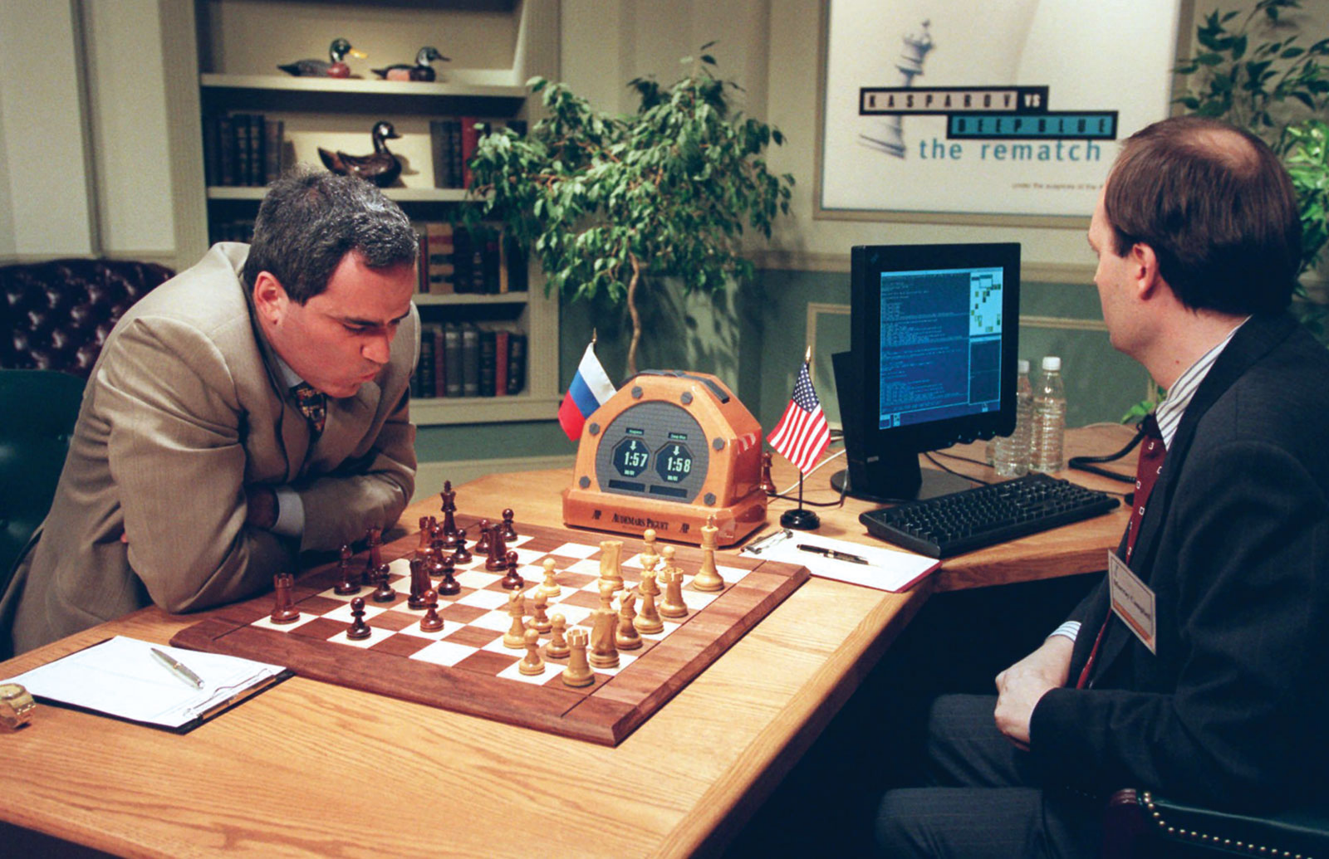
Monte Carlo Tree Search
MiniMax Tree Search
State
Agent
State
5
MiniMax
Rival
5
State
1
+
5
6
Alpha-Beta Pruning
State
6
4
=
Action
Action
Action
Deep Blue 1997
2
3
3
3
9
0
9
Root
Node
Leaf

Slide 9
Monte Carlo Tree Search
MiniMax Tree Search
State
State
Naive Value
Agent
Value
Rival
$$⋯$$
$$⋯$$
$$⋯$$
$$⋯$$
State
$$⋯$$
Value
Back Up
$$⋯$$
Back Up
$$⋯$$
$$⋯$$
$$⋯$$
$$⋯$$
Value
$$⋯$$
$$⋯$$
$$⋯$$
Edge
(Agent Action)
$$⋯$$
Value
Root
Node
Leaf

Slide 10
Monte Carlo Tree Search
MiniMax Tree Search
Agent
Rival
State
State
State
Root

Slide 11

Monte Carlo Tree Search
MiniMax Tree Search
Agent
Rival
$$⋯$$
$$⋯$$
$$⋯$$
$$⋯$$
$$⋯$$
$$⋯$$
State
State
State
$$⋯$$
$$⋯$$
$$⋯$$
$$⋯$$
$$⋯$$
$$⋯$$
$$⋯$$
$$⋯$$
$$⋯$$
$$⋯$$
$$⋯$$
$$⋯$$
Root
Node
Leaf

Slide 12
Monte Carlo Tree Search
MiniMax Tree Search Tree Policy
State
State
State
Forward
Agent
State
Rival
$$⋯$$
$$⋯$$
$$⋯$$
$$⋯$$
$$⋯$$
$$⋯$$
$$⋯$$
$$⋯$$
State
$$⋯$$
$$⋯$$
$$⋯$$
$$⋯$$
$$⋯$$
$$⋯$$
$$⋯$$
$$⋯$$
$$⋯$$
$$⋯$$
$$⋯$$
$$⋯$$
Edge
(Agent Action)
$$⋯$$
$$⋯$$
$$⋯$$
$$⋯$$
$$⋯$$
$$⋯$$
(Rival Action)Edge
Root
Node
Leaf

Slide 13
Monte Carlo Tree Search
MiniMax Tree Search Policy Tree
State
State
Backward
Agent
Value
Rival
$$⋯$$
$$⋯$$
$$⋯$$
$$⋯$$
State
$$⋯$$
Value
Back Up
$$⋯$$
Back Up
$$⋯$$
$$⋯$$
$$⋯$$
Naive Value
$$⋯$$
Value
$$⋯$$
Edge
(Agent Action)
$$⋯$$
$$⋯$$
$$⋯$$
Value
Root
Node
Leaf

Slide 14
Monte Carlo Tree Search
Monte Carlo Rollout
Agent
State
State
State
State
State
Rival
Win
State
$$⋯$$
$$⋯$$
Win
$$⋯$$
$$⋯$$
Edge
(Agent Action)
Lose
x N
Root
Leaf
Rollout

Slide 15
Monte Carlo Tree Search
Monte Carlo Rollout
Agent
State
Rival
Value 80% winning rate
State
$$⋯$$
$$⋯$$
Value 90% winning rate
$$⋯$$
$$⋯$$
Edge
(Agent Action)
x N
Value 50% winning rate
Root
Leaf
Rollout

Slide 16
Monte Carlo Tree Search
Monte Carlo Rollout
Agent
Rival
State
State
Value 90% winning rate
Root

Slide 17

Monte Carlo Tree Search
Monte Carlo Rollout
State
Agent
Rival
$$⋯$$
$$⋯$$
$$⋯$$
$$⋯$$
State
State
State
$$⋯$$
$$⋯$$
$$⋯$$
$$⋯$$
$$⋯$$
$$⋯$$
Root
Leaf
Rollout

Slide 18
Monte Carlo Tree Search
Monte Carlo Rollout Rollout Policy
Forward
Agent
State
State
State
State
State
Rival
Win
$$⋯$$
$$⋯$$
$$⋯$$
$$⋯$$
$$⋯$$
$$⋯$$
$$⋯$$
$$⋯$$
$$⋯$$
State
$$⋯$$
Win
$$⋯$$
$$⋯$$
$$⋯$$
$$⋯$$
$$⋯$$
$$⋯$$
$$⋯$$
$$⋯$$
$$⋯$$
Edge
(Agent Action)
Lose
x N
Root
Leaf
Rollout

Slide 19
Monte Carlo Tree Search
Monte Carlo Rollout Rollout Policy
Backward
Agent
State
Rival
Value 80% winning rate
State
$$⋯$$
Rollout Value
$$⋯$$
Value 90% winning rate
$$⋯$$
$$⋯$$
Edge
(Agent Action)
x N
Value 50% winning rate
Root
Leaf
Rollout

Slide 20
Monte Carlo Rollout
+
MiniMax Tree Search

Slide 21
Monte Carlo Tree Search
MiniMax Tree Search
Monte Carlo Rollout
Forwoard
Tree Policy
Rollout Policy
Agent
$$⋯$$
Rival
Win
$$⋯$$
$$⋯$$
$$⋯$$
$$⋯$$
$$⋯$$
$$⋯$$
$$⋯$$
$$⋯$$
$$⋯$$
State
$$⋯$$
Win
$$⋯$$
$$⋯$$
$$⋯$$
$$⋯$$
$$⋯$$
$$⋯$$
$$⋯$$
$$⋯$$
$$⋯$$
Lose
x N
$$⋯$$
Root
Node
Leaf
Rollout

Slide 22
Monte Carlo Tree Search
MiniMax Tree Search
Monte Carlo Rollout
Agent
$$⋯$$
No Update of Value
Rival
Back Up
Win
State
$$⋯$$
$$⋯$$
$$⋯$$
$$⋯$$
Back Up
Win
$$⋯$$
$$⋯$$
$$⋯$$
$$⋯$$
Back Up
Lose
$$⋯$$
Root
Node
Leaf
Rollout

Slide 23
Monte Carlo Tree Search
MiniMax Tree Search
Monte Carlo Rollout
Update Value
$$⋯$$
Backwoard
Agent
No Update of Value
Rival
Back Up
Win
State
$$⋯$$
$$⋯$$
Back Up
Win
$$⋯$$
$$⋯$$
Back Up
Lose
$$⋯$$
Root
Node
Leaf
Rollout

Slide 24

Monte Carlo Tree Search
MiniMax Tree Search
Monte Carlo Rollout
Agent
Rival
$$⋯$$
$$⋯$$
$$⋯$$
State
State
State
$$⋯$$
$$⋯$$
$$⋯$$
$$⋯$$
$$⋯$$
$$⋯$$
$$⋯$$
$$⋯$$
$$⋯$$
Root
Node
Leaf
Rollout

Slide 25
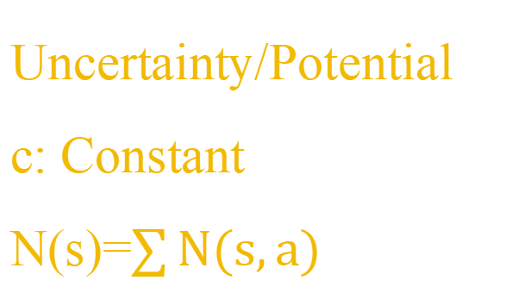
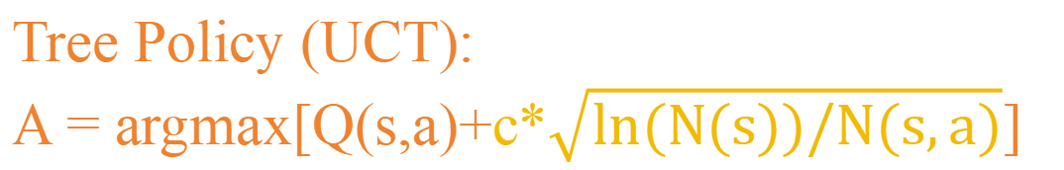
Monte Carlo Tree Search
MiniMax Tree Search
Monte Carlo Rollout
Agent
Rival
Tree Policy (UCT):
A = argmax[Q(s,a)+c*$\sqrt{ln(N(s))/N(s,a)}$]
State
$$⋯$$
$$⋯$$
Uncertainty/Potential
c: Constant
N(s)=$\sum{N(s,a)}$
$$⋯$$
$$⋯$$
Q(s,a)
N(s,a)
Root
Leaf

Slide 26
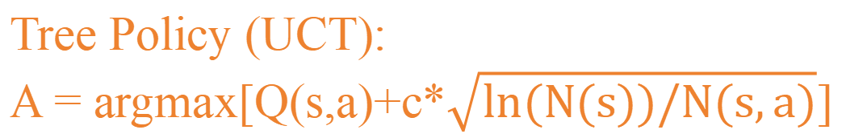
Monte Carlo Tree Search
MiniMax Tree Search
Monte Carlo Rollout
Tree Policy (UCT):
A = argmax[Q(s,a)+c*$\sqrt{ln(N(s))/N(s,a)}$]
Rollout Policy:
Random
Agent
Rival
Selection
Simulation
State
Q=0
Win
N=1
Root
Leaf
Rollout

Slide 27
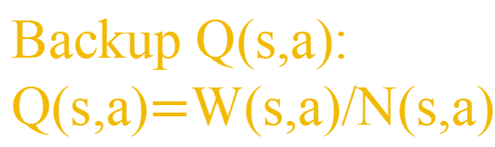
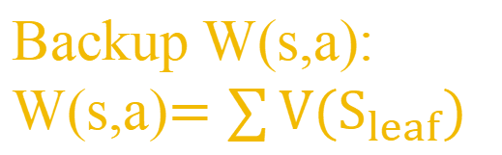
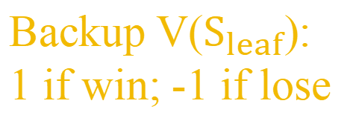
Monte Carlo Tree Search
MiniMax Tree Search
Monte Carlo Rollout
Tree Policy (UCT):
A = argmax[Q(s,a)+c*$\sqrt{ln(N(s))/N(s,a)}$]
Rollout Policy:
Random
Agent
Rival
Selection
Simulation
Backup
State
V=1
Q=0
Back Up
Win
N=1
W=1
Backup Q(s,a):
Q(s,a)$=$W(s,a)/N(s,a)
Backup W(s,a):
W(s,a)$=\sum{V(S_{leaf})}$
Backup V($S_{leaf}$):
1 if win; -1 if lose
Root
Leaf
Rollout

Slide 28
Monte Carlo Tree Search
MiniMax Tree Search
Monte Carlo Rollout
Tree Policy (UCT):
A = argmax[Q(s,a)+c*$\sqrt{ln(N(s))/N(s,a)}$]
Rollout Policy:
Random
Agent
Rival
Selection
Simulation
Backup
State
V=1
Q=1
Back Up
Win
N=1
W=1
Backup Q(s,a):
Q(s,a)$=$W(s,a)/N(s,a)
Backup W(s,a):
W(s,a)$=\sum{V(S_{leaf})}$
Backup V($S_{leaf}$):
1 if win; -1 if lose
Root
Leaf
Rollout

Slide 29
Monte Carlo Tree Search
MiniMax Tree Search
Monte Carlo Rollout
Tree Policy (UCT):
A = argmax[Q(s,a)+c*$\sqrt{ln(N(s))/N(s,a)}$]
Rollout Policy:
Random
Agent
Rival
Q=0
N=0
Selection
Simulation
Backup
State
Q=1
N=1
Q=0
N=0
Root
Leaf

Slide 30
Monte Carlo Tree Search
MiniMax Tree Search
Monte Carlo Rollout
Tree Policy (UCT):
A = argmax[Q(s,a)+c*$\sqrt{ln(N(s))/N(s,a)}$]
Rollout Policy:
Random
Agent
Rival
Selection
Simulation
Backup
State
Lose
Q=0
N=1
Root
Leaf
Rollout

Slide 31
Monte Carlo Tree Search
MiniMax Tree Search
Monte Carlo Rollout
Tree Policy (UCT):
A = argmax[Q(s,a)+c*$\sqrt{ln(N(s))/N(s,a)}$]
Rollout Policy:
Random
Agent
Rival
Selection
Simulation
Backup
State
V=-1
Back Up
Lose
Q=-1
W=-1
N=1
Root
Leaf
Rollout

Slide 32
Monte Carlo Tree Search
MiniMax Tree Search
Monte Carlo Rollout
Tree Policy (UCT):
A = argmax[Q(s,a)+c*$\sqrt{ln(N(s))/N(s,a)}$]
Rollout Policy:
Random
Agent
Rival
Q=0
N=1
Selection
Simulation
Backup
State
Q=1
N=1
Q=-1
N=1
Root
Leaf

Slide 33
Monte Carlo Tree Search
MiniMax Tree Search
Monte Carlo Rollout
Tree Policy (UCT):
A = argmax[Q(s,a)+c*$\sqrt{ln(N(s))/N(s,a)}$]
Rollout Policy:
Random
Agent
Rival
Q=.7
N=9
Selection
Simulation
Backup
State
if N=10
Expansion
Q=.8
N=9
Q=0
N=0
Q=.9
N=9
Root
Leaf

Slide 34
Monte Carlo Tree Search
MiniMax Tree Search
Monte Carlo Rollout
Tree Policy (UCT):
A = argmax[Q(s,a)+c*$\sqrt{ln(N(s))/N(s,a)}$]
Rollout Policy:
Random
Agent
Rival
Q=.7
N=9
Selection
Simulation
Backup
State
if N=10
Expansion
Q=.8
N=9
Q=0
Win
Q=.9
N=10
N=1
Root
Node
Leaf
Rollout

Slide 35
Monte Carlo Tree Search
MiniMax Tree Search
Monte Carlo Rollout
Tree Policy (UCT):
A = argmax[Q(s,a)+c*$\sqrt{ln(N(s))/N(s,a)}$]
Rollout Policy:
Random
Agent
Rival
Q=.7
N=9
Selection
Simulation
Backup
State
if N=10
Expansion
Q=.8
N=9
Q=0
Back Up
Win
Q=.9
N=10
N=1
Root
Node
Leaf
Rollout

Slide 36


Monte Carlo Tree Search
MiniMax Tree Search
Monte Carlo Rollout
State
State
State
Agent
State
After N
Iterations
Q(s,a)
N(s,a)
W(s,a)
Rival
$$⋯$$
$$⋯$$
$$⋯$$
$$⋯$$
$$⋯$$
$$⋯$$
$$⋯$$
$$⋯$$
State
$$⋯$$
$$⋯$$
$$⋯$$
$$⋯$$
$$⋯$$
$$⋯$$
$$⋯$$
$$⋯$$
$$⋯$$
$$⋯$$
$$⋯$$
$$⋯$$
$$⋯$$
$$⋯$$
$$⋯$$
$$⋯$$
$$⋯$$
$$⋯$$
$$⋯$$
$$⋯$$
$$⋯$$
Root
Node
Leaf

Slide 37
Monte Carlo Tree Search
MiniMax Tree Search
Monte Carlo Rollout
Agent
State
After N
Iterations
Q(s,a)
N(s,a)
W(s,a)
Take action:
Maximum Q(s,a)
Maximum N(s,a)
Rival
State
$$⋯$$
$$⋯$$
$$⋯$$
$$⋯$$
$$⋯$$
$$⋯$$
$$⋯$$
$$⋯$$
$$⋯$$
$$⋯$$
$$⋯$$
$$⋯$$
$$⋯$$
$$⋯$$
$$⋯$$
Root
Node
Leaf

Slide 38
Monte Carlo Tree Search
AlphaGo
Agent
Tree Policy
Rollout Policy
Rival
State
Back Up
Naive Value
Rollout Value
Root
Node
Leaf
Rollout

Slide 39
Monte Carlo Tree Search
AlphaGo
Deep Neural Networks

Slide 40
Reinforcement Learning Components
(1) Basic Element : Agent, Environment, Goal
(2) Main Element : State, Action, Reward
(3) Core Element : Policy, Value
Reinforcement Learning characteristic
(1) Trial and Error
(2) Delayed Reward
Reinforcement Learning contradiction
Exploration vs Exploitation

Slide 41
Monte Carlo Tree Search
AlphaGo
Agent
Tree Policy
Rollout Policy
Rival
State
Back Up
Naive Value
Rollout Value
Root
Node
Leaf
Rollout

Slide 42


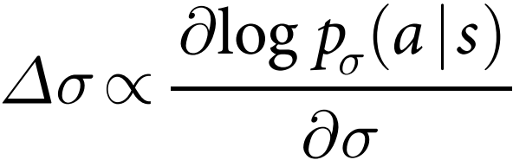
Supervised Learning of Policy Networks
Rollout of Policy Networks
Deep Convolutional Neural Network
Linear Softmax of small pattern feartures
SL Policy
Rollout Policy
Action time：3ms
Accuracy：57.0%
Action time：2μs
Accuracy：24.2%
30 million(s,a) of
Human Expert State-Action Pairs
8 million(s,a) of
Human Expert State-Action Pairs

Slide 43

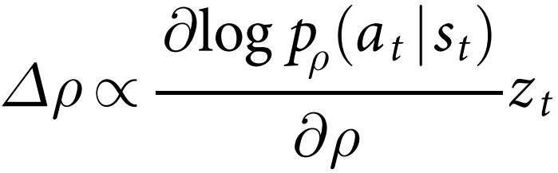
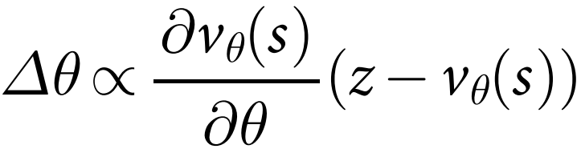
Reinforcement Learning of Policy Networks
Value Networks
Deep Convolutional Neural Network
Deep Convolutional Neural Network
RL Policy
Self Play of
Training Data
z = +1 or -1
ρ initialized as σ parameters

Slide 44

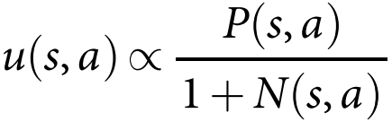



Tree Policy（with SL Policy):
（1）
State
（2）
（3）
（4）
Q(s, a)
（5）
N(s, a)

Slide 45
Tree Policy(with SL Policy)
A = argmax[Q(s, a) + u(s, a)]
①
②
Rollout Policy
State
Back Up
Vθ(sL)
Rollout Value
③

Slide 46


