Slide 1
Cryptography Engineering
Lecture 1 (Oct 23, 2024)
Today’s notes:
Main contents of this course
Symmetric Primitives
Diffie-Hellman Key Exchange, ElGamal Encryption
Signature
Slides and example code can be found on:
https://runzhizeng.github.io/CE-w2425

Slide 2
Contact Information
Lecturer: Runzhi Zeng
Email:
runzhi.zeng@uni-kassel.de
Office hours
Room 2628
3:15 pm – 3:45 pm, Wednesday
All information is available on:
https://runzhizeng.github.io/CE-w2425

Slide 3
Overall Goals
We focus on how to use cryptographic algorithms to ensure:
Confidentiality (“…learn nothing about your ciphertext…”)
Integrity (“…cannot modify your data…”)
Authentication (“…verify your identities…”)
Forward/Backward Secrecy (“…protect past/future communications…”)
Quantum Security (“…against attackers with quantum devices…”)
…in real-world applications.

Slide 4
Brief Overview
Main topics:
Symmetric primitives and necessary background (today)
Key exchange
Digital Signature
Secure Messaging
Password-based Authentication
Post-quantum Cryptography

Slide 5
Cryptography primitives – Hash, KDF
Hash function:
H( “…arbitrary-length string…” ) = a fixed length bit string
Security: collision resistance, (second) preimage resistance, …
SHA3 (Secure Hash Algorithm 3)
Do not use MD5 (which was broken)…
Key Derivation Function (KDF)
KDF( “…shared secret with randomness…” ) = a symmetric key
Used to derive a key for symmetric key encryption, e.g., K <-- KDF(g^xy)
HKDF (based on HMAC): https://en.wikipedia.org/wiki/HKDF

Slide 6







Cryptography primitives - SKE
Symmetric-key Encryption
ciphertext
Alice
Bob
Encrypt
Decrypt
$$key$$
$$key$$

Slide 7

Cryptography primitives - SKE
Symmetric-key Encryption (Confidentiality)
ciphertext
Alice
Bob
Encrypt
Decrypt
$$key$$
$$key$$
(without …)

Slide 8
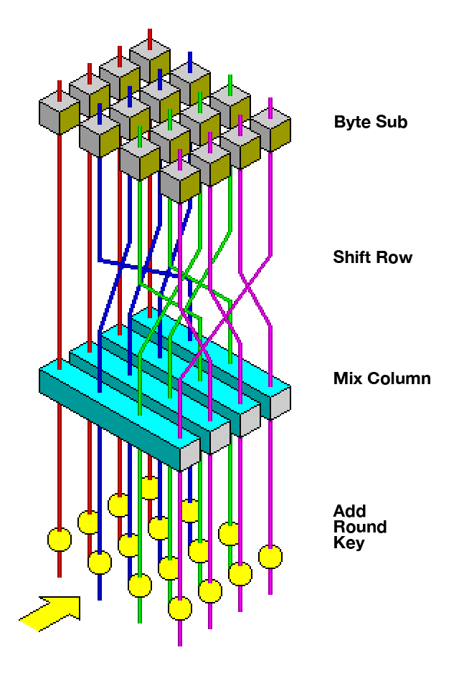
Cryptography primitives – SKE
Symmetric-key Encryption
AES (Advanced Encryption Standard)
Fixed-length encryption (block cipher)
Extend to arbitrary-length encryption via Mode of Operation
CBC, CTR, ...
(Image from Wikipedia)

Slide 9



Cryptography primitives - MAC
Message Authentication Code (MAC)
Integrity (...cannot forge a valid MAC tag without knowing the secret key...)
$m$ (message)
Signing algorithm
Verification algorithm
accept
/reject
$$τ$$
$$(m, τ)$$

Slide 10

Cryptography primitives - AE
Authenticated Encryption
Symmetric Encryption
Not only Confidentiality, but also Integrity
ciphertext
ciphertext
(without …)
(without …)

Slide 11
Cryptography primitives - AE
Authenticated Encryption
Symmetric Encryption
Not only Confidentiality, but also Integrity
Approaches to authenticated encryption:
Encrypt-then-MAC (EtM), ...
Authenticated Encryption with Associated Data (AEAD)
Ensure the message and additional data (like headers) are authenticated and encrypted securely.
AES-GCM mode (https://en.wikipedia.org/wiki/Galois/Counter_Mode), ChaCha20-Poly1305, ...

Slide 12
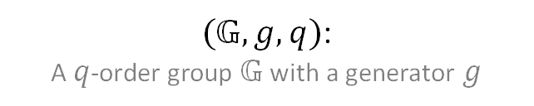
Cryptography primitives - DHKE
Diffie-Hellman Key Exchange
$(𝔾, g,q)$:
A $q$-order group $𝔾$with a generator $g$

Slide 13
Cryptography primitives - DHKE
Diffie-Hellman Key Exchange
$(𝔾, g,q)$:
A $q$-order group $𝔾$with a generator $g$
It can be an
elliptic curve group or
a group of integers modulo n.

Slide 14




Cryptography primitives - DHKE
Diffie-Hellman Key Exchange
$(𝔾, g,q)$:
A $q$-order group $𝔾$with a generator $g$
$$x←_{\$}ℤ_{q}$$
$$y←_{\$}ℤ_{q}$$
$$X=g^{x}$$
$${Y=g}^{y}$$

Slide 15



Cryptography primitives - DHKE
Diffie-Hellman Key Exchange
$(𝔾, g,q)$:
A $q$-order group $𝔾$with a generator $g$
$$x←_{\$}ℤ_{q}$$
$$y←_{\$}ℤ_{q}$$
$$X=g^{x}$$
$${Y=g}^{y}$$
$$K_{Alice}=Y^{x}$$
$$K_{Alice}=g^{xy}=K_{Bob}$$
$$K_{Bob}=X^{y}$$

Slide 16



Cryptography primitives - PKE
Public-key Encryption (PKE)
$$pk$$
$$(sk, pk)$$
$$pk$$

Slide 17



Cryptography primitives - PKE
Public-key Encryption (PKE)
$$(sk, pk)$$
$$pk$$
$$ct$$
Encryption algorithm
(message)
$$ct$$
$m$

Slide 18


Cryptography primitives - PKE
Public-key Encryption (PKE)
$$(sk, pk)$$
$$pk$$
Decryption algorithm
Encryption algorithm
$$m$$
$$ct$$
$$ct$$
$m$

Slide 19




Cryptography primitives - PKE
A PKE scheme: ElGamal Encryption
$(𝔾, g,q)$:
A $q$-order group $𝔾$with a generator $g$
$$sk: x←_{\$}ℤ_{q}$$
$$pk: X=g^{x}$$
$$pk$$
$$pk: X$$
message: $m∈𝔾$

Slide 20

Cryptography primitives - PKE
A PKE scheme: ElGamal Encryption
$(𝔾, g,q)$:
A $q$-order group $𝔾$with a generator $g$
$$sk: x←_{\$}ℤ_{q}$$
$$pk: X=g^{x}$$
$$pk: X$$
message: $m∈𝔾$
$$y←_{\$}ℤ_{q}$$
$$c_{0}=Y$$
$$K=X^{y}(=g^{xy})$$

Slide 21


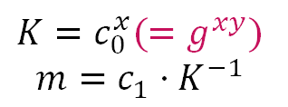
Cryptography primitives - PKE
A PKE scheme: ElGamal Encryption
$(𝔾, g,q)$:
A $q$-order group $𝔾$with a generator $g$
$$sk: x←_{\$}ℤ_{q}$$
$$pk: X=g^{x}$$
$$pk: X$$
message: $m∈𝔾$
$$y←_{\$}ℤ_{q}$$
$$c_{0}=Y$$
$$K=X^{y}(=g^{xy})$$
$$c_{1}=Y⋅m$$
$$c_{0}, c_{1}$$
$$K=c_{0}^{x}(=g^{xy})$$
$$m=c_{1}⋅K^{−1}$$

Slide 22



Cryptography primitives – Digital Signature
Signature scheme
$$pk$$
$$(pk,sk)$$
$$pk$$

Slide 23


Cryptography primitives – Digital Signature
Signature scheme
$$(pk,sk)$$
$m$ (message)
$$pk$$
$$m, σ$$
Signing algorithm
$$σ$$

Slide 24

Cryptography primitives – Digital Signature
Signature scheme
$$(pk,sk)$$
$m$ (message)
$$pk$$
Signing algorithm
Verification algorithm
accept
/reject
$$σ$$
$$(m, σ)$$

Slide 25
Cryptography primitives – Digital Signature
Signature scheme
Schnorr’s signature scheme
DSA (Digital signature algorithm)
Will be discussed in the next lecture

Slide 26
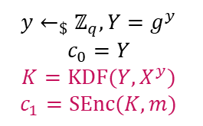





Coding Tasks
Find some useful cryptographic libraries (Python: PyNaCl, ecdsa, cryptography, PyCryptodomem, etc.), Google (Bing/ChatGPT/…) them!
Given the example code of DHKE, implement the hashed ElGamal encryption
Some example codes are available: DHKE+KDF+SKE, socket connection
$(𝔾, g,q)$:
A $q$-order group $𝔾$with a generator $g$
$$sk: x←_{\$}ℤ_{q}$$
$$pk: X=g^{x}$$
$$pk: X$$
message: $m∈{\left\{0,1\right\}}^{∗}$
KDF: Key Derivation Function
SKE = (Senc, SDec) is a symmetric-key encryption scheme
$$y←_{\$}ℤ_{q}, Y=g^{y}$$
$$c_{0}=Y$$
$$K={KDF(Y, X}^{y})$$
$$c_{1}=SEnc(K, m)$$
$$K=KDF\left(c_{0}, c_{0}^{x}\right)$$
$$m=SDec(K,c_{1})$$
$$c_{0}, c_{1}$$

Slide 27
Homework
Homework: Write a Python program that can sign a string (or a file) using the DSA (or Schnorr’s signature) algorithm, and also can verify the signature.
Homework: Consider implementing DHKE to enable two programs on your PC to perform a key exchange (using sockets, etc.)
Program Alice <-- (connection) --> Program Bob
Program Alice -- g^x --> Program Bob
Program Alice <-- g^y -- Program Bob
Homework: Add a trusted server to help the key exchange procedure (using sockets, etc.)
Program Alice <-- (connection) --> Server <-- (connection) --> Program Bob
Program Alice -- g^x --> Server -- g^x --> Program Bob
Program Alice <-- g^y -- Server <-- g^y -- Program Bob

