Slide 1
BLIND MAN’S BLUFF Group10
Ruocheng Shan
Guodong Xie
Kai Wang
Ruikai Zhou

Slide 2



OUTLINE
Go language introduction
Project vision
Demo

Slide 3
Go language introduction

Slide 4




Language design
Simple and easy
Object-oriented
Compiled – But makes you feel interpreted
Static – But makes you feel dynamic

Slide 5



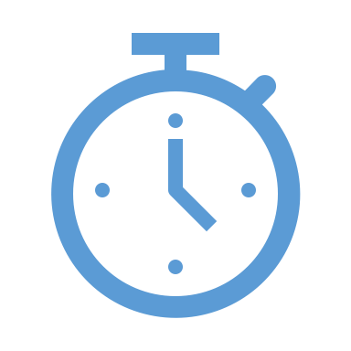



Advantages
Flexible- It is concise, simple and easy to read.
Concurrency- It allows multiple process
Running simultaneously and effectively.
Quick Outcome- Its compilation time is very fast.
Library- It provide a rich standard library.
Garbage collection
It validates for the interface and type embedding.

Slide 6
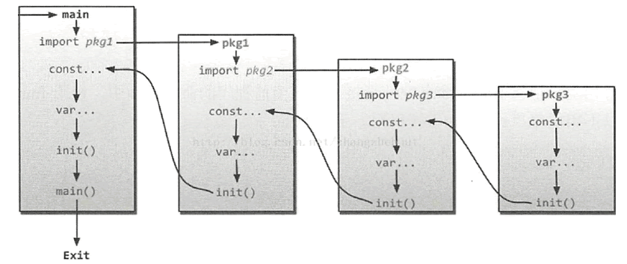
Packages/Modules
Large amount of packages(24000)
Index Tree
GOPATH - The GOPATH environment variable is used to specify directories outside of $GOROOT that contain the source for Go projects and their binaries.

Slide 7
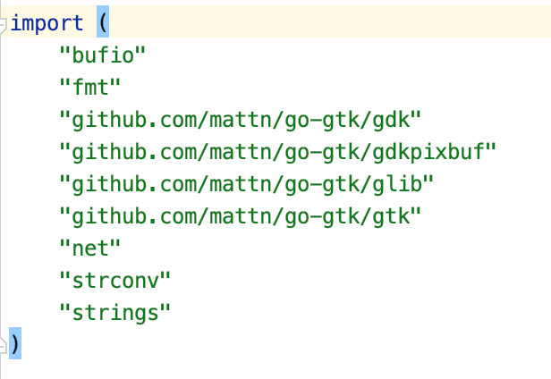
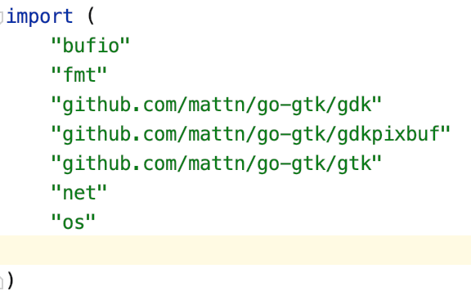
Packages
The packages we use in our project are downloaded from github
These packages are all written in Go
These packages are all open source and we can use the syntax import them from github directly

Slide 8
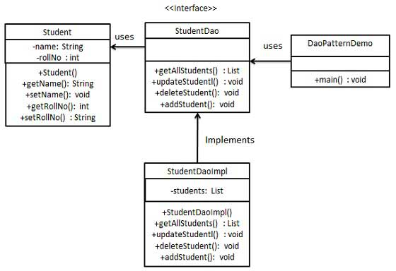
Structs
Go’s structs are typed collection of fields. They are useful for grouping data together to form records.
A struct is just like a set, we can do some operation to it. Its function is same as Data Access Object(DAO).

Slide 9



Go mod
Go mod is a new package management tool
Starting with Go1.11, golang officially supports the new dependency management tool Go mod
Instead of GOPATH

Slide 10
Public and private in Golang
Go language not like other languages uses public and private to declare variables, it uses uppercase letters and lowercase letters to control.
If the definition of constants, variables, type, interface, structure, function is the name of capital letter said it can be accessed by other packages (public).
If the definition of variables is the name of small letter said it can only be used in the package(private).

Slide 11



Three main compilation methods
Single file
Single package
Entire project, multiple packages

Slide 12



Gopher China
Most influential conference about Go in China
Has been held for four years
That means Go is very popular in China

Slide 13
Rules of Game and Design of Program

Slide 14
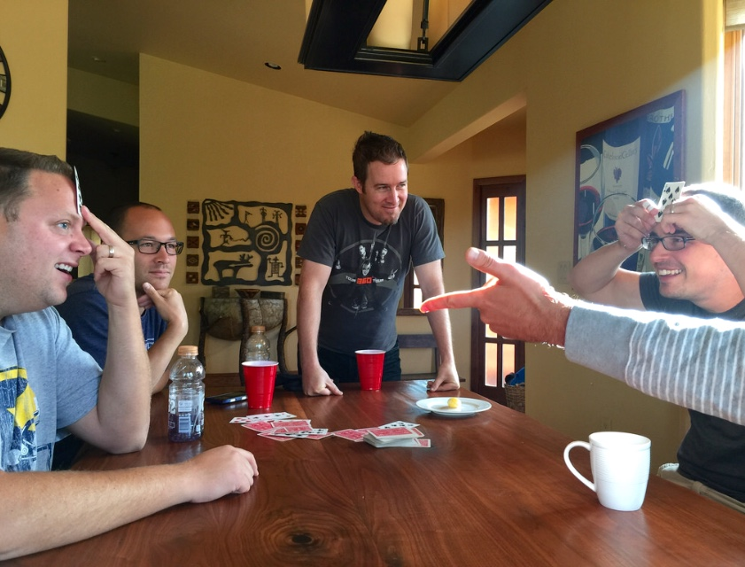
Rules for the Game
You get to see your opponent’s cards, but not your own.
Other than that one major difference, the rules for blind man’s bluff are the same as for Texas Hold’em. Each game begins with the blinds and then proceeds through four betting rounds and a final showdown.
After the betting rounds, players compare their cards with each other.
https://en.wikipedia.org/wiki/Blind_man%27s_bluff_(poker)

Slide 15
Design of the program
Player vs Computer.
Everyone is given cards starting from 1 to 10 ( 10>A).
In each round, everyone will be given a card from ten cards.
In each betting round, everyone must raise the money they put in the pool or fold.
Cards used will not be returned to the pool of cards.
During the game, if someone lose all the money, the game ends.
Otherwise, after ten rounds, the system will judge who is the winner by comparing the money players retains.

Slide 16
Project vision

Slide 17
Server
Multithreading
Socket Connection
Error Tolerant
Concise

Slide 18
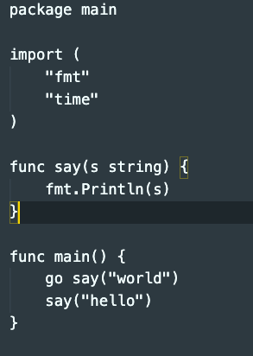
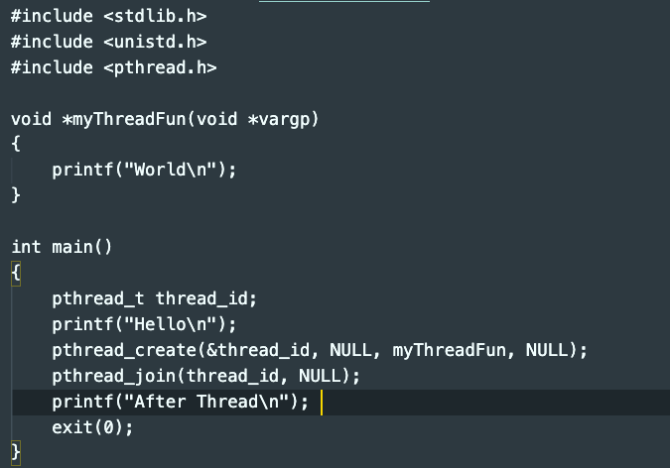
Multithreading

Slide 19
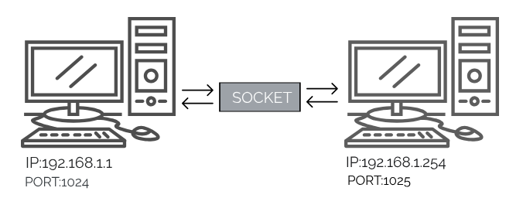
Socket
Notes:
A network socket is an internal endpoint for sending or receiving data within a node on a computer network.
why not HTTP

Slide 20
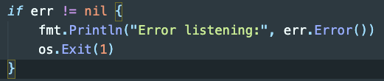
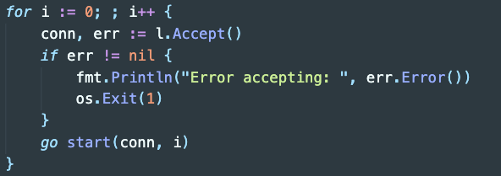
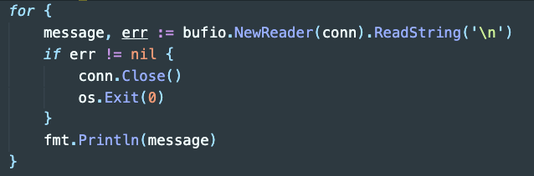
Error Tolerant
Notes:
We care correctness

Slide 21
Concise
Great Programming Language
Good Design
less than
100
Solid Community
Notes:
We care correctness

Slide 22
Client
Application
GTK Golang binding
Client - pass data to server
Controller
Multi-platform

Slide 23
GTK - Golang
· GTK is cross-platform and boasts an easy to use API for GUI development
· GTK is written in C but has been designed from the ground up to support a wide range of languages
· go-gtk is a open source golang package that gives golang api for accessing GTK

Slide 24
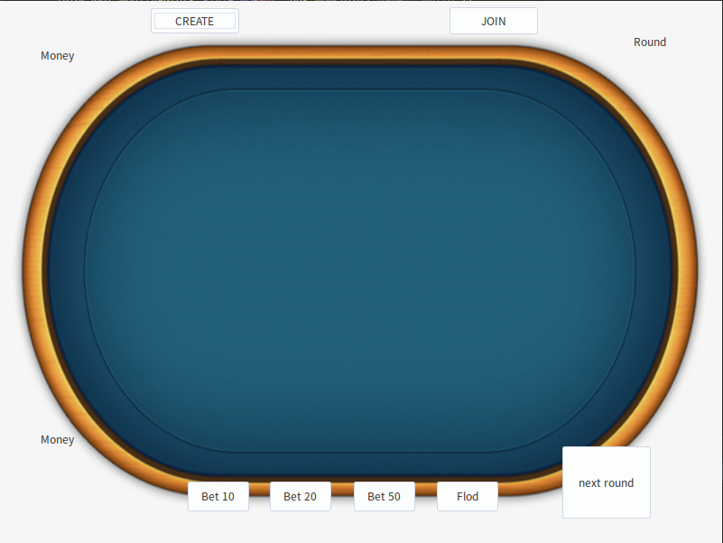
Design
Window
Socket Connection
Button Functions
Information

Slide 25
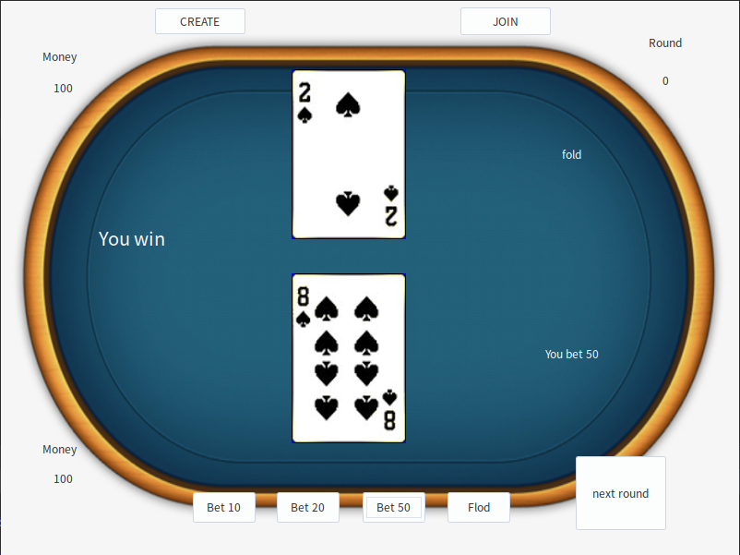
Design
Window
Socket Connection
Button-Functions
Information

Slide 26
Demo

Slide 27
References
https://gobyexample.com/structs
https://www.tutorialspoint.com/design_pattern/data_access_object_pattern.htm
https://blog.csdn.net/x356982611/article/details/80279124
http://www.gopherchina.org/
https://golang.org/
https://github.com/mattn/go-gtk
https://www.gtk.org/

Slide 28

Questions?

