Slide 1

NewsBoard Recommender System
TEAM MEMBER:
RUOFAN CHEN
SHANCHAO WU

Slide 2
Contents
1. Introduction of Newsboard Subscription Service
a. Recap Our Proposal
2. Go Through What We Did
a. User Side
a.1 Sign up
a.2 Receive Email
a.3 Submit the Survey
b. Data, Models and Methods
b.1 Crawl News
b.2 Latent Factor Models
b.3 word2vec cosine similarity
c. Generate Recommendation
(Check Recommendation History)
d. Generate News Websites, Send Emails
e. Collect and Refresh the Utility Matrix
f. Iterate this Process
3. Our Challenges
4. Future Work

Slide 3
1. Introduction - 1.a: recap our proposal
Type: news recommendation service for FREE
Our news subscription is FREE and personalized (based on user clicks)
What user can do: read news titles and abstracts, if interested, click the news link
Potential user: everyone who wants to know the news, some professionals, international students, price-sensitive users
Goal: Provide a personalized news board to users every day

Slide 4
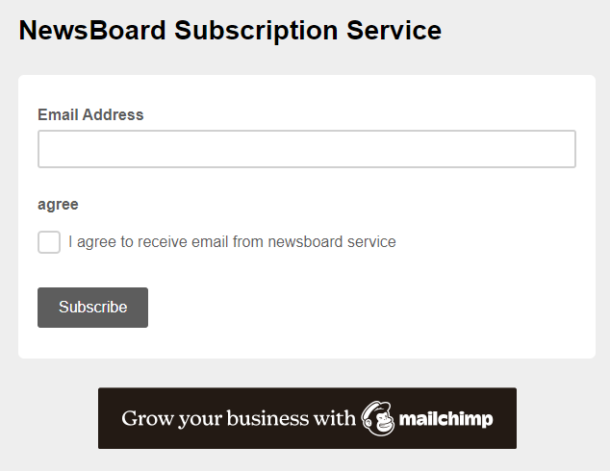
2. Implementation – a. user side 2.a.1: sign up
sign up link: http://eepurl.com/hYLLdz
Please note: after you clicked the Subscribe button, you will receive news recommendation emails from us. For better experiences, add newsboardnyt@163.com to your email contact, to prevent email from being blocked.

Slide 5
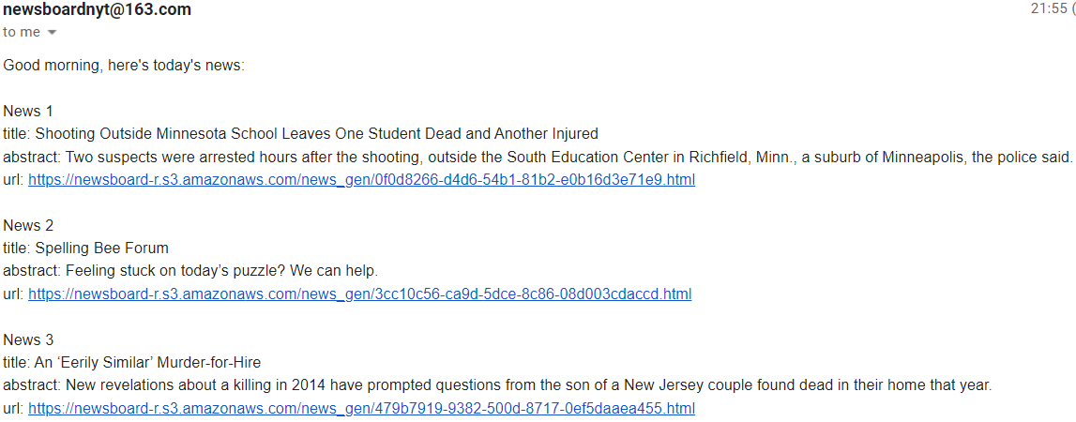
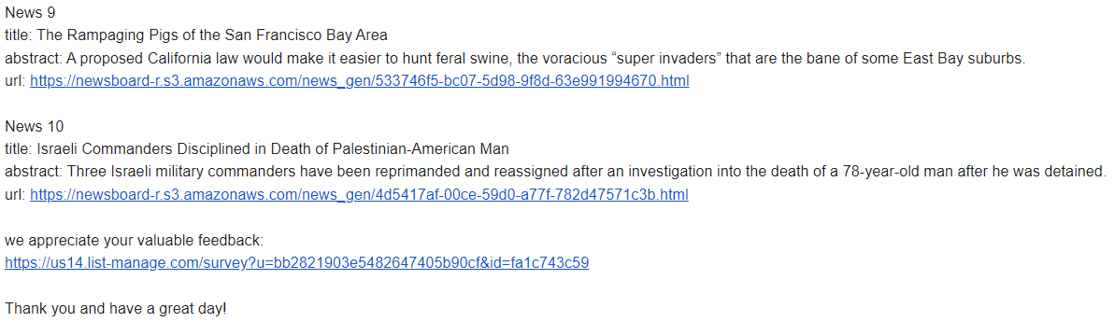
2. Implementation– 2.a.2: receive email

Slide 6
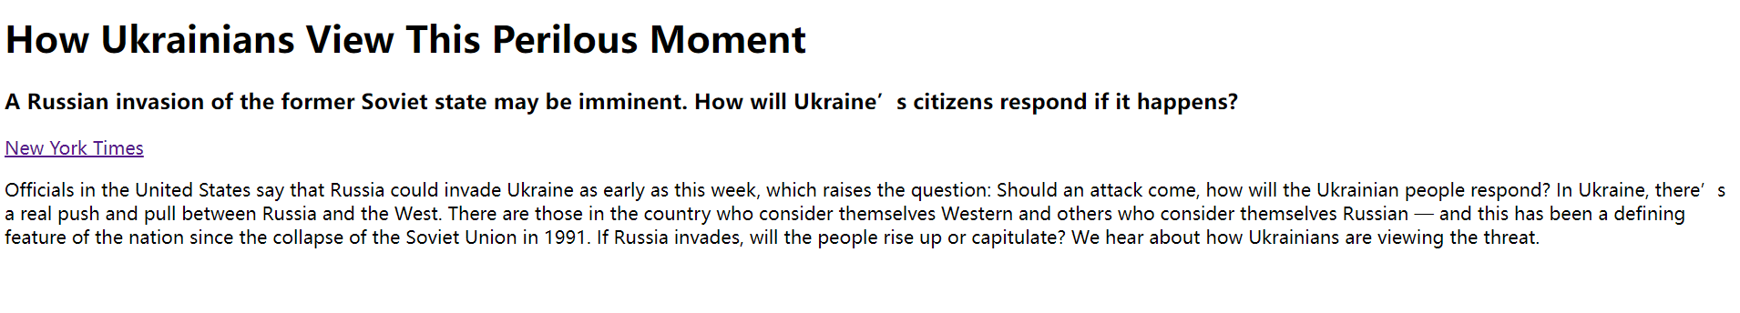
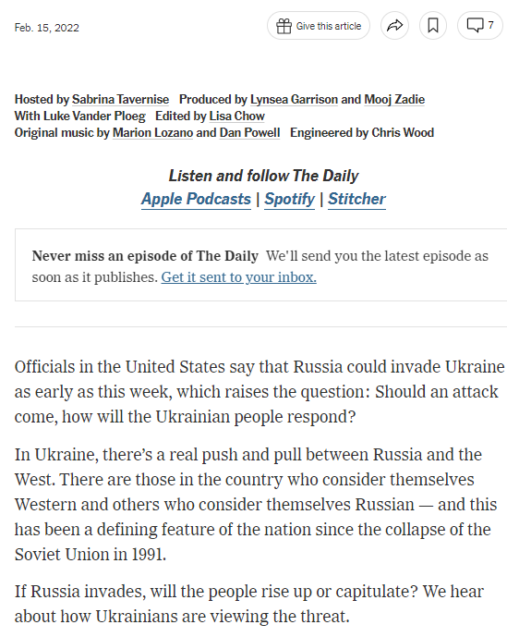
2. Implementation– 2.a.2: receive email
Generate news websites using the crawled news data from the New York Times API, hosting the websites using AWS S3.
A news website including:
News title, abstract, an original URL by the New York Times, and full text

Slide 7
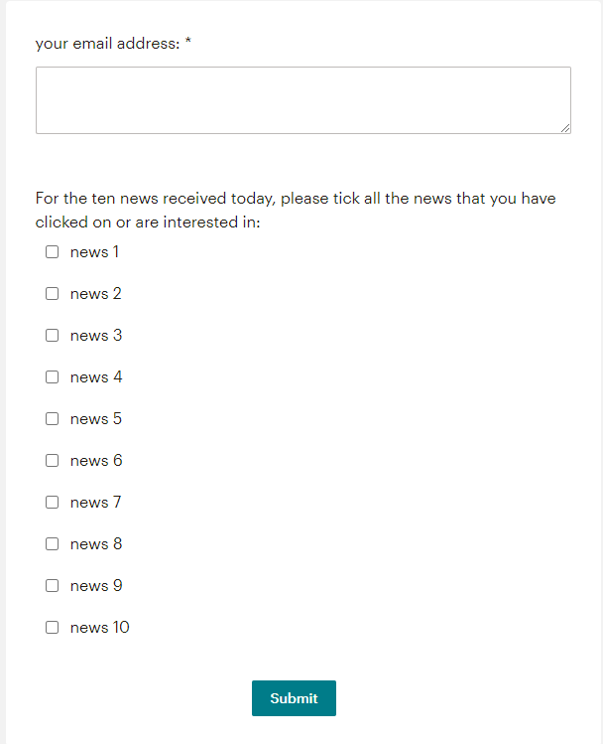
2. Implementation– 2.a.3: submit the survey
Survey link at the end of the email:
https://us14.list-manage.com/survey?u=bb2821903e5482647405b90cf&id=fa1c743c59

Slide 8
2. Implementation – 2.b: Data, Models and Methods 2.b.1: crawl news by date and save
New York Times API: https://developer.nytimes.com/apis
Crawl news (every day in February) and save as JSON file.
Structure:
[{"author": ["Paul Krugman"], "section": "Opinion", "abstract": "The push to make Americans\u2019 lives nasty, brutish and short.", "url": "https://www.nytimes.com/2022/01/31/opinion/republican-misinformation-coronavirus.html", "title": "Guns, Germs, Bitcoin and the Antisocial Right", "keywords": ["United States Politics and Government", "Bitcoin (Currency)", "Electric Light and Power", "Gun Control", "Coronavirus (2019-nCoV)", "Republican Party", "Abbott, Gregory W (1957- )", "DeSantis, Ron", "Florida", "Texas"], "publish_data": "2022-02-01", "id": "fe93a16a-33c1-5cee-a16d-0c957186afe7", "text": "In February 2021 a deep freeze caused widespread power outages in Texas, leaving about 10 million Texans without electricity…},{…},…]

Slide 9

2. Implementation– 2.b.2 Latent Factor models
Where to begin? We don’t have users and their behaviors data.
Use MIND as pretrain data. Download training set from https://msnews.github.io/
Assumption:
The users from MIND and our Newsboard are similar.
The news in Microsoft dataset and the crawled from the New York Times are (to some extent) similar (topic/ categories/…).

Slide 10
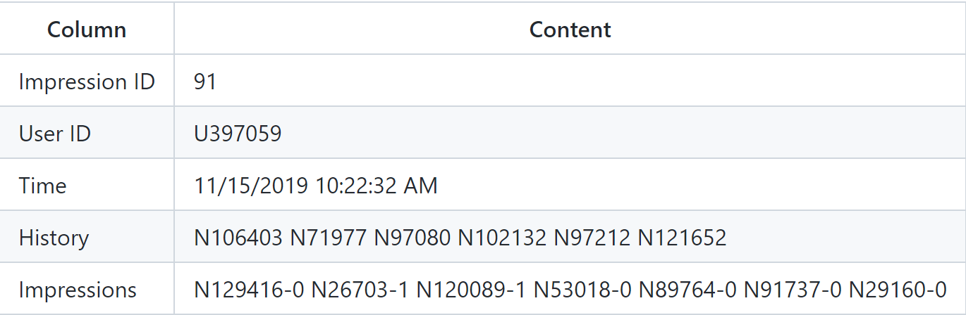
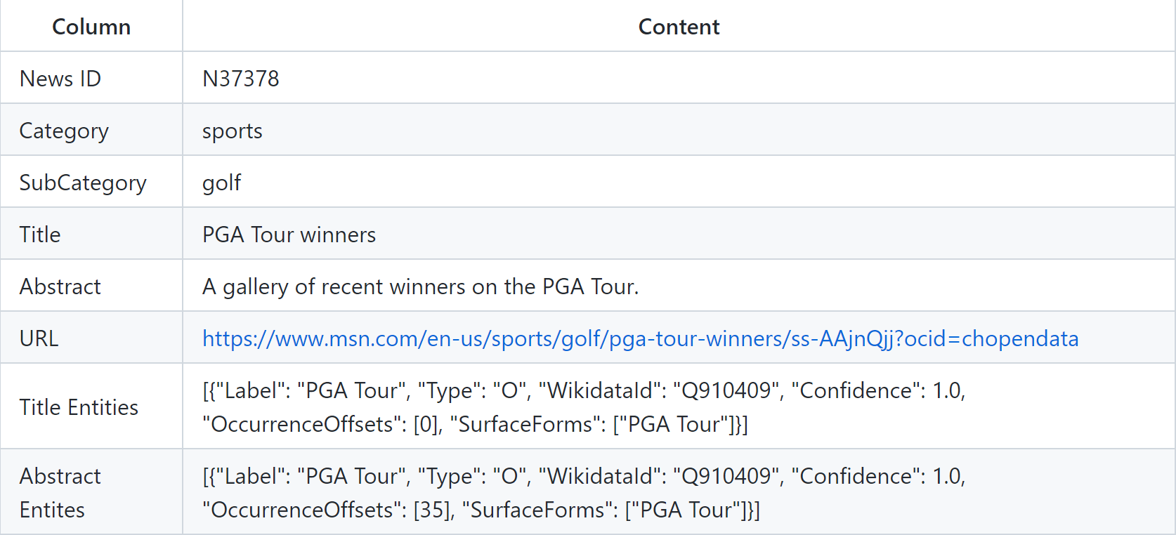
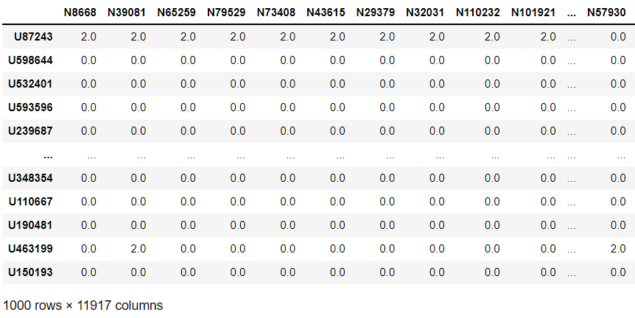
2. Implementation – 2.b.2 Latent Factor Models
behaviors.tsv
news.tsv
Utility matrix
Row: user
Col: news id (MIND)
percentage of user-items that have a rating: 0.57%

Slide 11
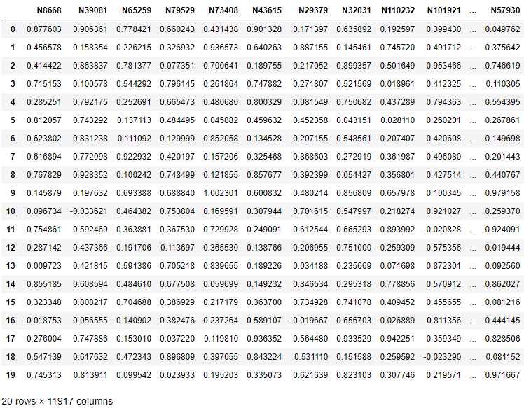
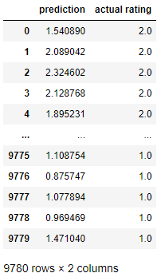
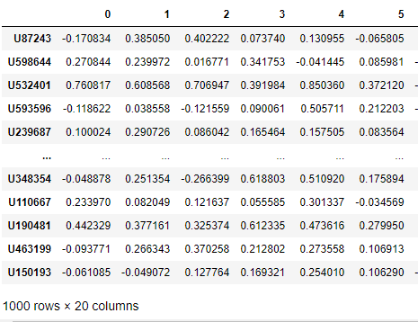
2. Implementation– 2.b.2 Latent Factor models
User matrix
Utility matrix (click: 2, recommended but not click:1, fill NA 0)
Item matrix
While doing SGD, we only care about those value is not 0

Slide 12
2. Implementation– 2.b.3 Update Item matrix
Now we got user matrix (row: user, col: factor) and item matrix (row: factor, col: news id) from MIND. How to update the item matrix after crawling the New York Times news?
Using word2vec model: pre-trained vectors trained on part of Google News dataset (about 100 billion words). The model contains 300-dimensional vectors for 3 million words and phrases.
Preprocessed crawled NYT news, get news id and news title. For each news title, generate sentences vector (using title), sum word vectors.
Using cosine similarity for each NYT news with all MIND news, calculate news-factor using weighted average of previous news, then append columns of NYT news

Slide 13
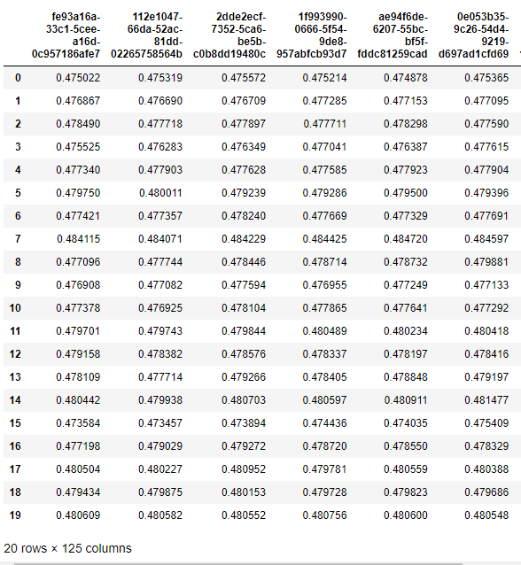
2. Implementation– 2.b.3 Update Item matrix

Slide 14
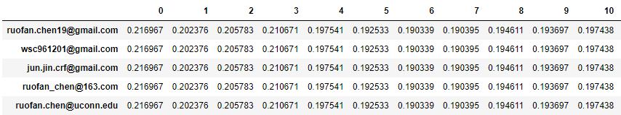
2. Implementation – 2.b.3 Update User matrix
export all subscribed user (signed up by link) by Mailchimp API
Then, simply add row to user matrix using column mean as initial value
get subscribed user matrix (5*20)

Slide 15
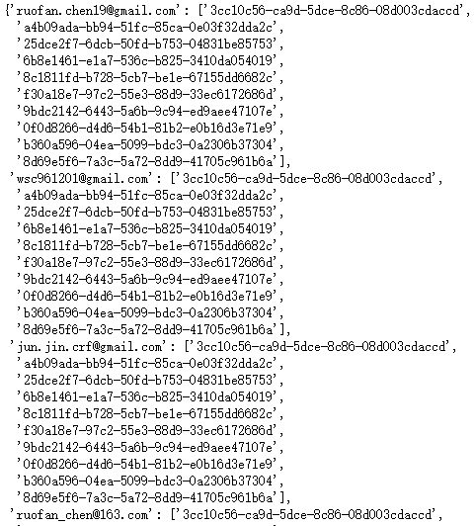
2. Implementation– 2.c. generate recommendation for the first day
Do matrix multiplication.
Choose news of top 10 score (ranked)
Save this file for:
Send email
As recommendation history , in the future day
Do not recommend the news that uses have seen

Slide 16
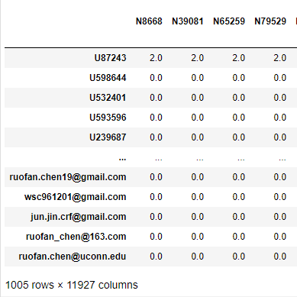
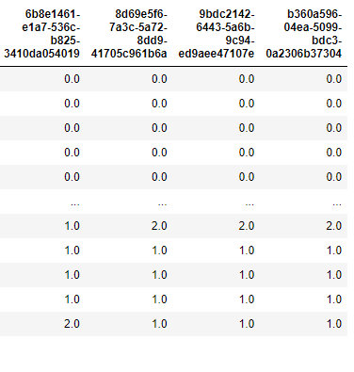
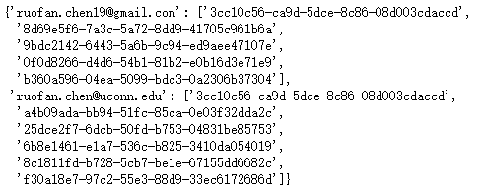
2. Implementation– 2.e. Collect feedback and refresh utility matrix
Download the feedback csv from Mailchimp account.
Save all the news id that has been recommended.

Slide 17
2. Implementation – 2.f. iterate
Matrix Factorization -> Crawl news -> update base news (= MIND + Day 1 news) -> generate sentence vector based on title -> calculate cosine similarity -> weighted average update item matrix -> check new user -> update User matrix -> matrix multiplication -> for subscribed user, calculate and sort recommendation score -> delete the recommendation list of the user already seen -> top 10 -> send email …
Candidate news window = 2, only recommend 2 days news
Eg:
News Day 1; Day 1 Day2, Day 2 Day 3
Date Day 1; Day 2; Day 3

Slide 18
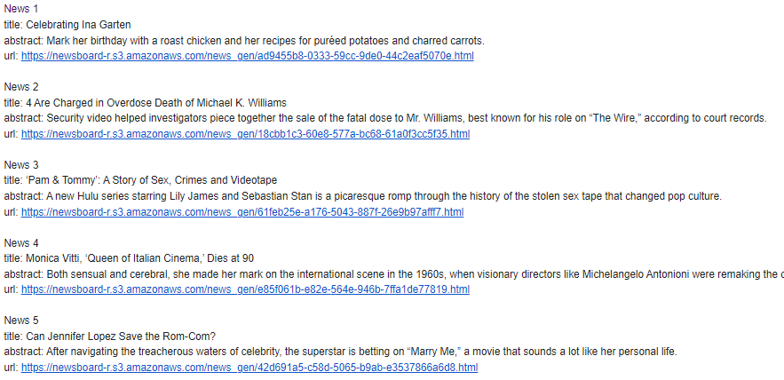
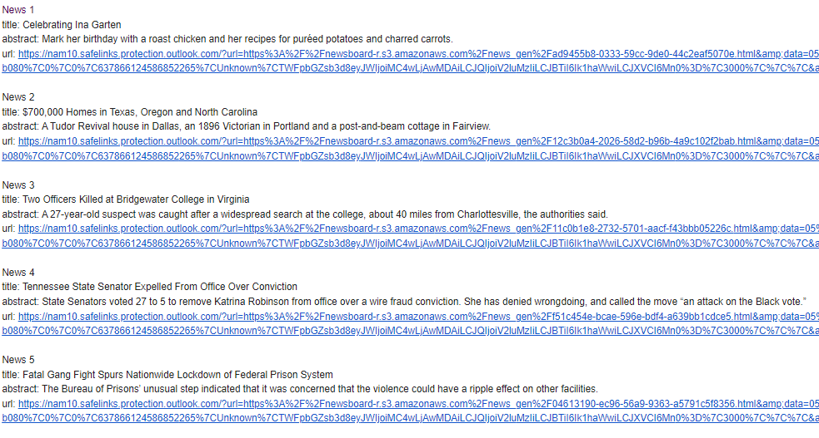

Slide 19
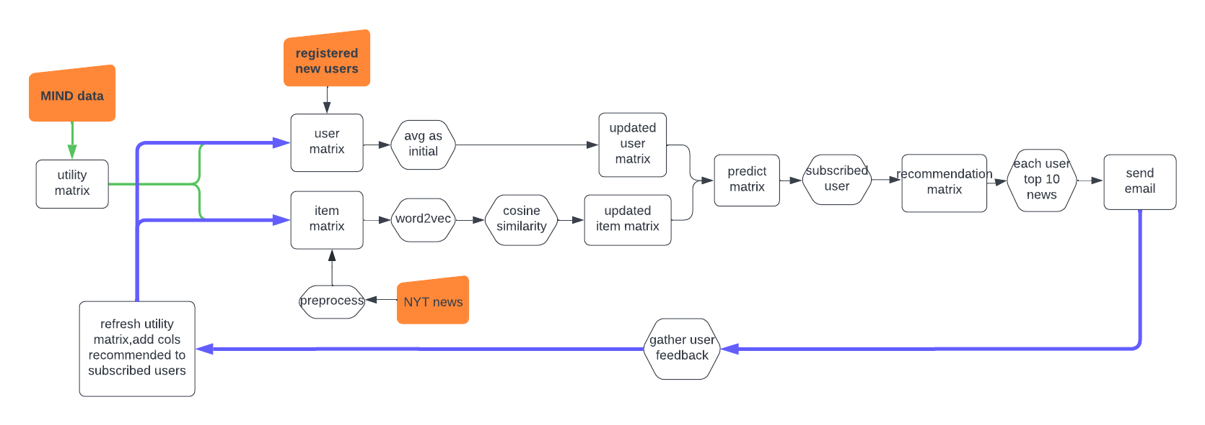
2. Implementation– 2.f. iterate framework

Slide 20
3. Our challenges
NYT News API: limitation
MIND: highly sparse.
How to track user clicks:
Implicit feedback: track clicks by developing a web application, that needs users to sign in to read the news (Apple News)
If directly using the URL, one problem is some NYT news is not free, needs a subscription fee
We host this news in AWS S3, not able to track clicks of each user
Explicit feedback: survey, a simple link embedded in the email (save time)

Slide 21
4. Future Work
Refine the URL of the news, now the full text is displayed in plain text.
Try other recommendation methods or other advanced methods to get recommendations and compare the result.
Add user unsubscribe function.
To different types of users:
Only want to see the news of their interests (professionals); wants to see all the hot news from different categories, maybe add a question when signing up to ask them
Make the recommendation process run automatically. Since we’re now using the survey provided by Mailchimp and the API does not allow us to get the survey report

Slide 22

Thank you

