Slide 1
Statistical Products Using FBI’s Crime US Data
Contributors: Ruofan Chen, Liquan Zhong, Sara Rahim Date: 4/22/21

Slide 2
Overview of Our Products
1. Interactive Map
2. Animated Bar Plot
Crime rates (rates are per 100,000 inhabitants) by state
Choose any of the 50 states, as well as Puerto Rico and District of Columbia
Covers 25 years (1995-2019)
Rank bar plot included – only includes the 50 states
Crime rates by area
Metro area, non-metro area, non-metro counties
Choose any state except District of Columbia, New Jersey, Rhode Island, Hawaii, and Puerto Rico
Covers 10 years (2010-2019)
Table showing top states with highest crime rates included
Notes:
This project is conducted in RShiny and FlexDashboard.
The interactive platform is built to help us to explore US crime data from 1995 to 2019. The original data is from the FBI’s website.

Slide 3
Overview of Our Products
3. State Trends Graph
4. Clustering Map
Crime rates (rates per 100,000 inhabitants) by crime type, state, and year
Choose any of the 50 states, as well as Puerto Rico and District of Columbia
Covers 25 years (1995-2019)
Violent crime and property crime boxplots included
Groups states that have comparable violent and property crime rates
k-means clustering analysis method used
Only displays the 50 states
Covers 15 years (2005-2019)
Bubble plot included, showing the actual rates – includes District of Columbia and Puerto Rico

Slide 4
Overview of Our Products
5. Regression Analysis
Variables that may affect crime rates are studied
Covers 24 years (1995-2018)
Includes 50 states and District of Columbia
Time series regression for each state
Panel data regression for each year
Conduct Granger causality test
Heat map displaying distance of coefficient
Will be explained more in detail

Slide 5
Modeling: regression

Slide 6
Variables affecting crime
• Population density and degree of urbanization.
• Variations in composition of the population
• Economic conditions, including median income, poverty level, and job availability.
• Administrative and investigative emphases of law enforcement.
• Policies of other components of the criminal justice system (i.e., prosecutorial, judicial, correctional, and probational).
Population density
Median age
Poverty rate
Unemployment rate
Police officer rate
Reference: https://ucr.fbi.gov/nibrs/2012/resources/variables-affecting-crime

Slide 7
Violent crime
year | region | crime_rate | pop_density | pol_officer_rate | pov_rate | unemp_rate
1995 | alabama | 632.4 | 83.80295567 | 2.13 | 20.1 | 5.6
1995 | alaska | 770.9 | 1.0589543 | 1.88 | 7.1 | 7.9
1995 | arizona | 713.5 | 37.11655902 | 2.05 | 16.1 | 4.4
1995 | arkansas | 553.2 | 47.70043207 | 1.87 | 14.9 | 4.5
1995 | california | 966 | 202.5286428 | 1.98 | 16.7 | 7.7
1995 | colorado | 440.2 | 36.12297429 | 2.24 | 8.8 | 3.9
1995 | connecticut | 405.9 | 675.9545924 | 2.21 | 9.7 | 5.1
1995 | delaware | 725 | 366.7519182 | 2.86 | 10.3 | 4.7
1995 | district of columbia | 2661.4 | 9081.967213 | 6.66 | 22.2 | 8.6
1995 | florida | 1071 | 262.3479082 | 2.56 | 16.2 | 6.2
File name: ‘Combine_vio.csv’

Slide 8
Property crime
year | region | crime_rate | pop_density | pol_officer_rate | pov_rate | unemp_rate
1995 | alabama | 4215.7 | 83.80295567 | 2.13 | 20.1 | 5.6
1995 | alaska | 4982.9 | 1.0589543 | 1.88 | 7.1 | 7.9
1995 | arizona | 7500.1 | 37.11655902 | 2.05 | 16.1 | 4.4
1995 | arkansas | 4137.7 | 47.70043207 | 1.87 | 14.9 | 4.5
1995 | california | 4865.1 | 202.5286428 | 1.98 | 16.7 | 7.7
1995 | colorado | 4956.1 | 36.12297429 | 2.24 | 8.8 | 3.9
1995 | connecticut | 4097.3 | 675.9545924 | 2.21 | 9.7 | 5.1
1995 | delaware | 4433.8 | 366.7519182 | 2.86 | 10.3 | 4.7
1995 | district of columbia | 9512.1 | 9081.967213 | 6.66 | 22.2 | 8.6
1995 | florida | 6630.6 | 262.3479082 | 2.56 | 16.2 | 6.2
File name: ‘Combine_prop.csv’

Slide 9
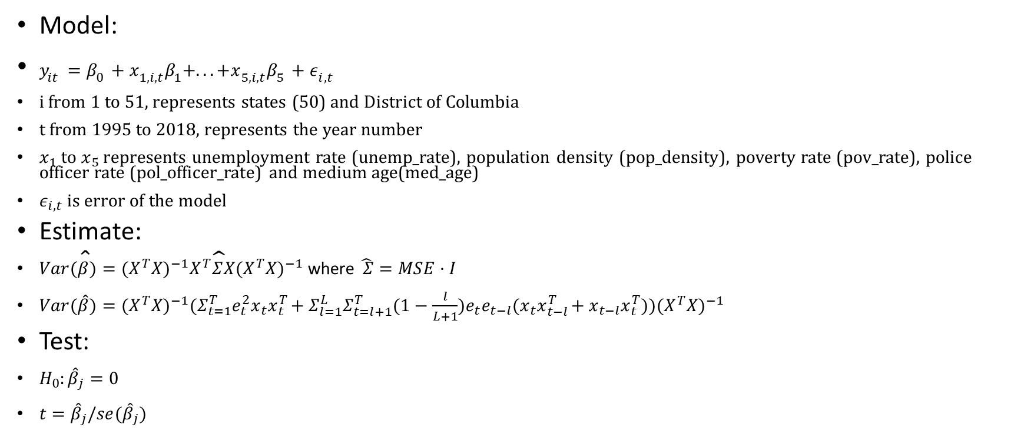
model 1: time series regression model
First function: plm_inferenct_state_level (line 6 ~ 72)
Model:
$y_{it}=β_{0}+x_{1,i,t}β_{1}+...+x_{5,i,t}β_{5}+ε_{i,t}$
i from 1 to 51, represents states (50) and District of Columbia
t from 1995 to 2018, represents the year number
$x_{1}$ to $x_{5}$ represents unemployment rate (unemp_rate), population density (pop_density), poverty rate (pov_rate), police officer rate (pol_officer_rate) and medium age(med_age)
$ε_{i,t}$ is error of the model
Estimate:
$Var(\hat{β})=(X^{T}X)^{−1}X^{T}\hat{Σ}X(X^{T}X)^{−1}$ where$\hat{ Σ}=MSE⋅I$
$Var(\hat{\hat{β}})=(X^{T}X)^{−1}(Σ_{t=1}^{T}e_{t}^{2}x_{t}x_{t}^{T}+Σ_{l=1}^{L}Σ_{t=l+1}^{T}(1−\frac{l}{L+1})e_{t}e_{t−l}(x_{t}x_{t−l}^{T}+x_{t−l}x_{t}^{T}))(X^{T}X)^{−1}$
Test:
$H_{0}:{\hat{β}}_{j}=0$
$t={\hat{β}}_{j}/se({\hat{β}}_{j})$
function code file name: ‘regression_func.R’ document: ‘method_documentation&summary.pdf’

Slide 10
model 1: time series regression result: violent crime
[1] “North Dakota”
 | point estimation | standard error | t-statistics | p-value | significant
pop_density | 1.13345803 | 0.08733724 | 12.977946 | 4.56E-12 | TRUE
pol_officer_rate | -0.39862001 | 0.11523657 | -3.459145 | 2.13E-03 | TRUE
pov_rate | 0.02127663 | 0.05412762 | 0.3930827 | 6.98E-01 | FALSE
unemp_rate | 0.13513875 | 0.03203674 | 4.2182433 | 3.27E-04 | TRUE
med_age | 0.38988672 | 0.04465431 | 8.731222 | 9.26E-09 | TRUE
Complete result is in ‘regression_output.xlsx’

Slide 11
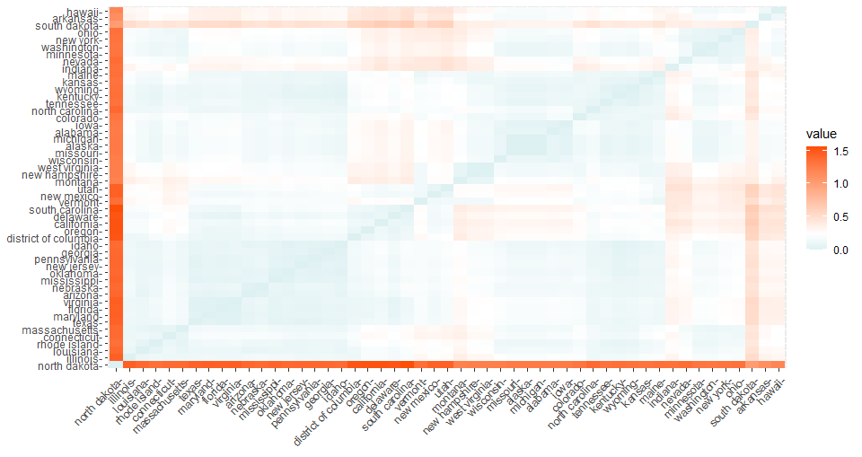
Result for violent crime

Slide 12
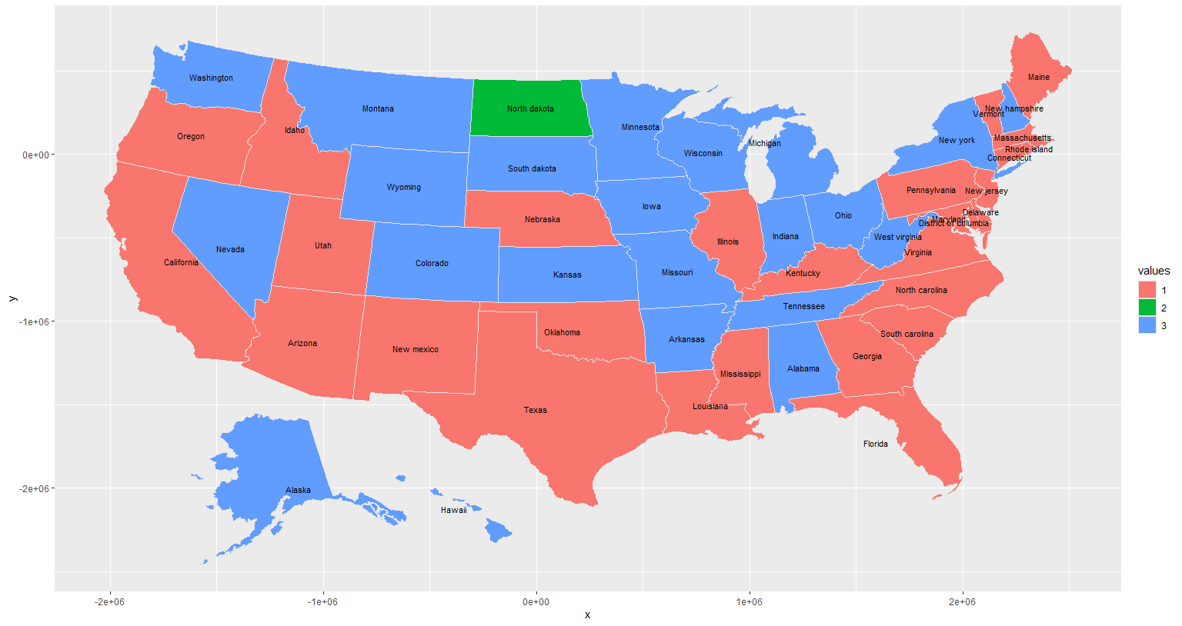
Coefficient of violent crime by states

Slide 13
model 1: time series regression result: violent crime
[1] "Nevada"
 | point estimation | standard error | t-statistics | p-value | significant
pop_density | 0.080525792 | 0.05682827 | 1.417002 | 0.16988622 | FALSE
pol_officer_rate | 0.058691616 | 0.02681616 | 2.188666 | 0.03903501 | TRUE
pov_rate | 0.09511433 | 0.04248761 | 2.238637 | 0.03514891 | TRUE
unemp_rate | -0.005115414 | 0.0275618 | -0.185598 | 0.85438711 | FALSE
med_age | -0.18622709 | 0.06681779 | -2.787089 | 0.01047601 | TRUE
[1] "Pennsylvania"
 | point estimation | standard error | t-statistics | p-value | significant
pop_density | -0.14280272 | 0.05305631 | -2.6915313 | 0.013026769 | TRUE
pol_officer_rate | 0.02339736 | 0.005712334 | 4.0959363 | 0.000443191 | TRUE
pov_rate | -0.01358206 | 0.006697943 | -2.0277954 | 0.054319601 | FALSE
unemp_rate | 0.01975757 | 0.009387052 | 2.1047687 | 0.046440901 | TRUE
med_age | 0.04219266 | 0.048981682 | 0.8613967 | 0.397911349 | FALSE

Slide 14
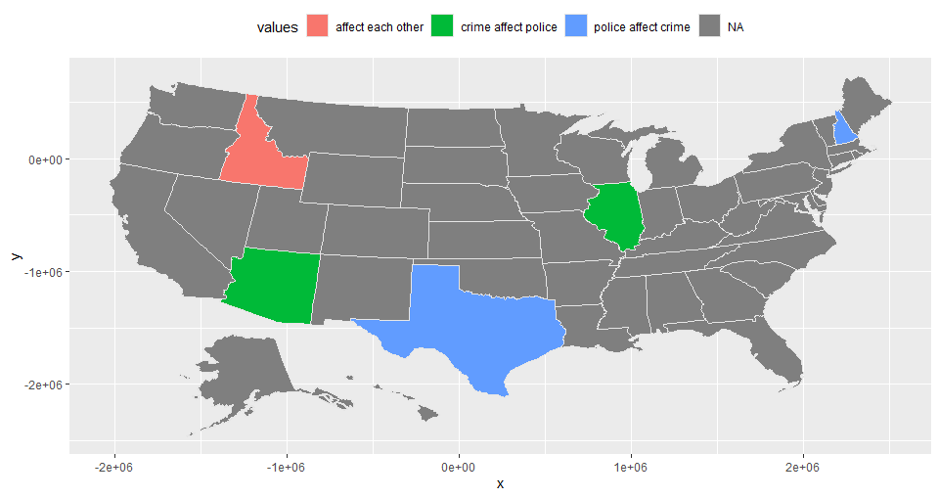
Granger causality test for police officer rate vs violent crime

Slide 15
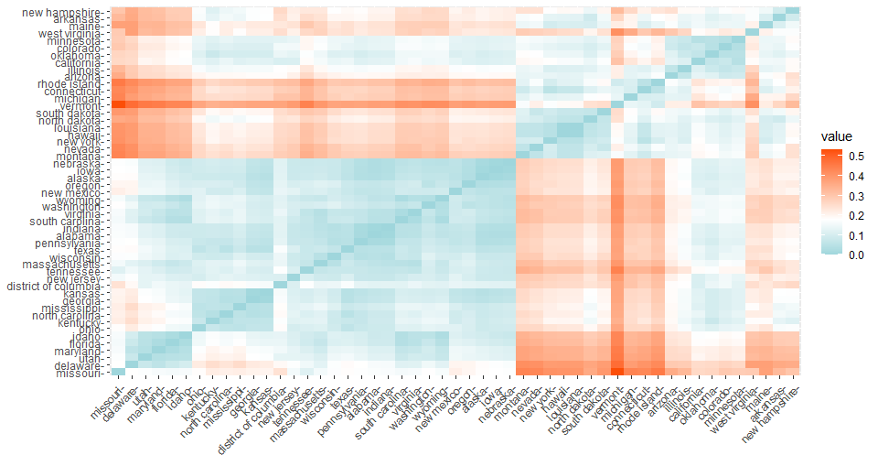
Result for property crime

Slide 16
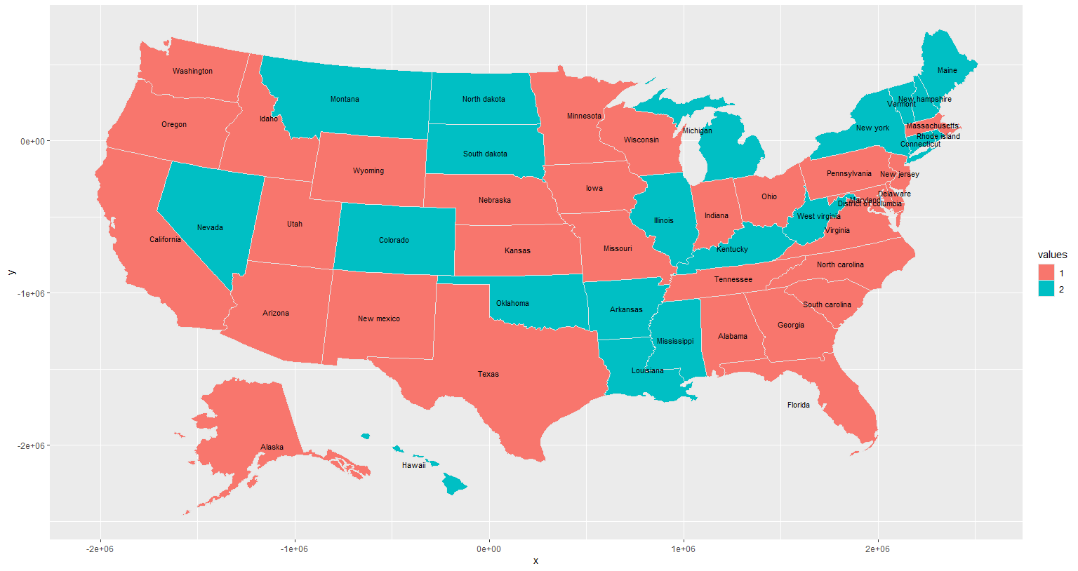
Coefficient of violent crime by states

Slide 17
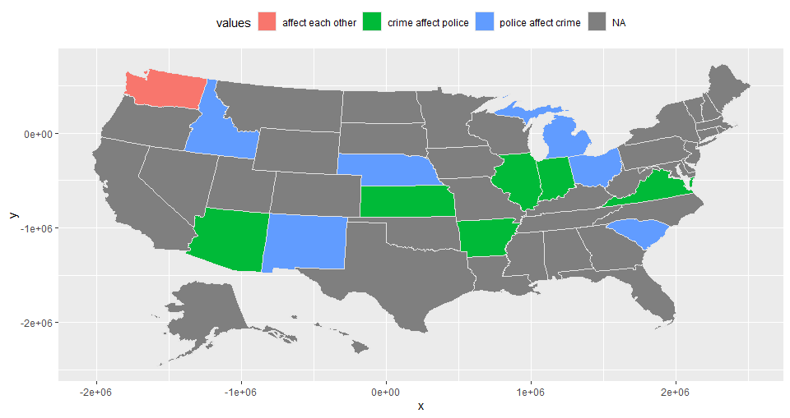
Granger causality test for police officer rate vs property crime

Slide 18

model 2: panel data regression model
First function: plm_inferenct_overall (line 76 ~ 129)
$y_{t}=x_{t}^{T}β_{t}+ε_{t}$
where $β_{t}=(β_{0,t},β_{1,t},...,β_{p,t})$, p is the number of predictors. Here, p=5.
$β_{p,t}=C_{p}+ε_{t}$
$Var(\hat{C_{p}})=(X^{T}X)^{−1}S(X^{T}X)^{−1} where S=(Σ_{t=1}^{T}e_{t}^{2}+Σ_{l=1}^{L}Σ_{t=l+1}^{T}2(1−\frac{l}{L+1})e_{t}e_{t−l}/T$
$se\left(\hat{C_{p}}\right)=\sqrt{\frac{MSE}{T}}$
$se\left(\hat{C_{p}}\right)=\sqrt{\frac{{(X}^{T}X)^{−1}S(X^{T}X)^{−1}}{T}}$
Test:
$t=\frac{C_{p}}{se(C_{p})}$
function code file name: ‘regression_func.R’ document: ‘method_documentation&summary.pdf’

Slide 19
model 2: panel data regression result: violent crime
 | point estimation | standard error | t-statistics | p-value | significant
intercept | -4.02129639 | 0.16975603 | -23.688681 | 0.00E+00 | TRUE
pop_density | -0.14133105 | 0.05091461 | -2.775845 | 1.07E-02 | TRUE
pol_officer_rate | 0.32779987 | 0.07426576 | 4.413876 | 2.01E-04 | TRUE
pov_rate | 0.06979036 | 0.009605421 | 7.265726 | 2.15E-07 | TRUE
unemp_rate | 0.14380091 | 0.009022827 | 15.937455 | 6.39E-14 | TRUE
med_age | -0.04334538 | 0.004604959 | -9.412762 | 2.36E-09 | TRUE

Slide 20
model 2: panel data regression result: property crime
 | point estimation | standard error | t-statistics | p-value | significant
intercept | -2.07738 | 0.22804722 | -9.1094291 | 4.31E-09 | TRUE
pop_density | -0.01485604 | 0.01787844 | -0.8309472 | 4.15E-01 | FALSE
pol_officer_rate | 0.06446643 | 0.021161613 | 3.0463852 | 5.73E-03 | TRUE
pov_rate | 0.06434089 | 0.015155689 | 4.2453291 | 3.06E-04 | TRUE
unemp_rate | 0.03425506 | 0.00475191 | 7.2086935 | 2.44E-07 | TRUE
med_age | -0.03866972 | 0.004723764 | -8.1862088 | 2.88E-08 | TRUE

Slide 21
Review of our products
1. Interactive Map
2. Animated Bar Plot
3. State Trends Graph
4. Clustering Map
5. Regression Analysis

Slide 22
Thank you!

