Slide 1

Zillow Scraping with Python
DS-GA-1007: Final Project Proposal
Lu Yin
Shenghui Zhou
Ruofan Wang

Slide 2
Problem Statement
DS-GA-1007: Final Project Proposal
Zillow’s top-rated real estate app opens the door to millions of homes for sale and for rent across the U.S.
Our project aims at collecting informative data and conducting relevant predictive analysis from Zillow’s website.
We can obtain a basic overview of the U.S. real estate market, as well as find differences between various areas.

Slide 3
Methodology
DS-GA-1007: Final Project Proposal
Beautiful Soup is a Python library for pulling data out of HTML and XML files effectively.
Various types of data visualization(heat map, trend line, etc) can be achieved using Matplotlib library in Python.
We can use Pandas to collect, clean and transform raw data to prepare for data analysis.
Scikit-learn helps us conduct some machine learning methods on our data.

Slide 4
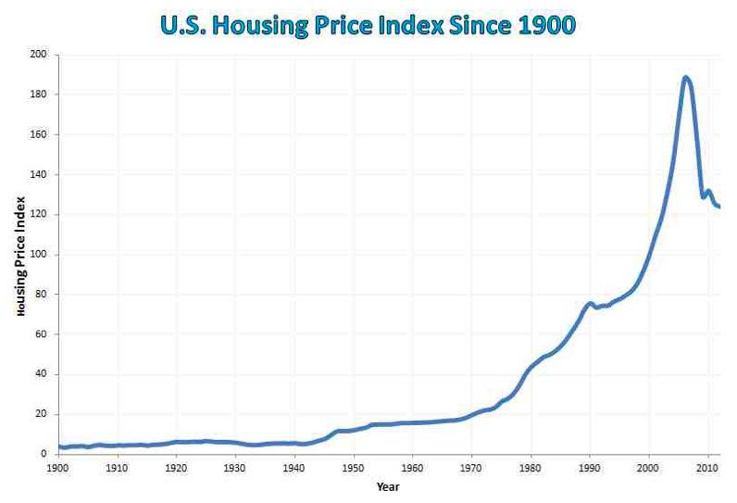
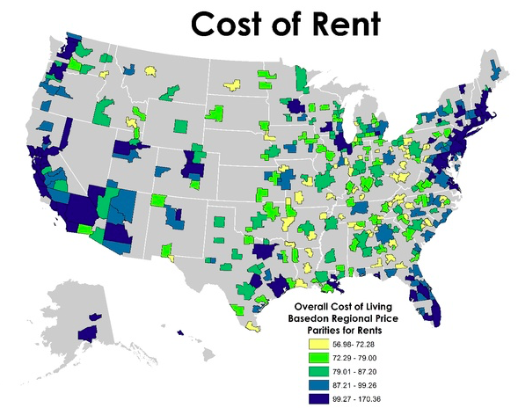
Expected Results: Data Visualization
DS-GA-1007: Final Project Proposal
Price trend lines can help grasp the developing trend of real estates in recent years.
Heat map is a useful figure to present data in the form of maps, which can help locate differences among multiple areas.

Slide 5
Expected Results: Predictive Analytics
DS-GA-1007: Final Project Proposal
Price of a certain house can be affected by many features, including location, area, the number of bedrooms, etc. Predicting house price precisely can be useful in real life.
We can conduct further predictive analysis using different methods, like linear regression, lasso, ridge regression, XGBoost, and compare model performances.

