Slide 1
Chapter 9
Matchings in bipartite graphs

Slide 2
Summary
Problem formulation
Matchings
Systems of distinct representatives
Stable marriages
Assignments

Slide 3
Problem formulation

Slide 4
Bipartite graph
Independent Set: a set of pairwise nonadjacent vertices in a graph
Bipartite Graph: A graph G = (X, △, Y) is bipartite if V is the union of two disjoint independent sets X and Y called partite sets of G, △ is the set of edges of G.
X,Y-bigraph: A bipartite graph with partite sets X and Y

Slide 5
Example
Let X = {x₁, x₂, x₃, x₄} and Y = {y₁, y₂, y₃} and let △ = {(x₁, y₁), (x₁, y₃), (x₂, y₁), (x₃, y₂), (x₃, y₃), (x₄, y₃)}. Then the bigrpah is as follows:
x₁
y₁
x₂
x₃
y₂
x₄
y₃

Slide 6
Association of chessboard and bipartite graph
Let X = {x₁, x₂, x₃, …, x_{m}} and Y ={y₁, y₂, …, y_{n}} be the rows and columns of the chessboard. Construct G = (X, △, Y) as follows: (x_{i}, y_{j}) is in △ iff the square at the intersection of row x_{i} and column y_{j} is allowed in the chessboard.
Each bipartite graph is the rook-bipartite graph of some board with forbidden positions.

Slide 7
Example
A chessboard and its corresponding bipartite graph:
y₁
y₂
y₃
y₄
y₅
x₁
y₁
x₁
×
x₂
y₂
x₂
×
×
x₃
y₃
x₃
×
×
×
y₄
x₄
x₄
×
y₅

Slide 8
Matchings
Matching: A matching in a graph G is a set of non-loop edges with no shared endpoints
x₁
y₁
x₁
y₁
x₂
y₂
x₂
y₂
x₃
y₃
x₃
y₃
y₄
y₄
x₄
x₄
y₅
y₅
A matching in G
G

Slide 9
Rooks placement and matchings
Let B be a board and G be its corresponding bipartite graph. Non-attacking rooks on the board B correspond to matchings in the bipartite graph G.
The number of non-attacking rooks that can be placed on B equals the number of edges in a matching of G.

Slide 10
Example
A rook placement and its corresponding matching
y₁
y₂
y₃
y₄
y₅
x₁
y₁
x₁
×
x₂
y₂
x₂
×
×
x₃
y₃
x₃
×
×
×
y₄
x₄
x₄
×
y₅
A matching in G

Slide 11
Domino cards placement and bipartite graphs
Consider a board B whose squares are alternatively colored black and white with some forbidden squares. Let X = {w₁, w₂, w₃,…, w₇} and Y ={b₁, b₂,…, b₆} be the squares colored white and black, respectively. Construct G = (X, △, Y) as follows: (w_{i}, b_{j}) is in △ iff the squares w_{i} and b_{j} has a common side.
w₁
×
w₂
b₁
w₃
b₁
b₂
b₃
b₄
b₅
b₆
b₂
w₄
×
w₅
×
×
b₃
×
b₄
×
w₁
w₂
w₃
w₄
w₅
w₆
w₇
×
w₆
b₅
w₇
b₆
G

Slide 12
Domino card Coverings and matchings
Consider a matching M in G, each of the edges of M corresponds to a domino, and because no two edges in M have a common vertex, no two of these dominos overlap.
B can be covered with k domino cards iff G has a matching with k edges.

Slide 13
Job assignment and matchings
Four people x_{i}, (i=1,2, 3, 4) apply for five jobs y_{j}, (j = 1, 2, 3, 4, 5). Suppose that x₁ is qualified for jobs y₁, y₃, y₄, y₅; x₂→{y₁, y₂, y₄}, x₃ → {y₂, y₄} and x₄→{y₂, y₃, y₄, y₅}. How to assign the job such that it will be assigned to a qualified person?

Slide 14
Solution
x₁
y₁
x₁
y₁
x₂
y₂
x₂
y₂
x₃
y₃
y₃
x₃
y₄
y₄
x₄
x₄
y₅
y₅
G
A job assignment strategy

Slide 15
Matching

Slide 16
Max-matching
Maximal Matching: A maximal matching in a graph is a matching that cannot enlarged by adding an edge
Max-Matching: A max-matching is a matching of maximum size among all matchings in the graph (in some books, it is called maximum matching)

Slide 17
Example
Consider the following bipartite graph G. the edges (x₁, y₂) and (x₂,y₁) form a matching with size 2, it is a max-matching. While the matching (x₁, y₁) cannot be enlarged by adding edges, it is a maximal matching but not a max-matching.
x₁
y₁
x₂
y₂

Slide 18
Path and cycle
Let u and v be two vertices in the bipartite graph G = (X, △, Y). A path joining u and v is a sequence of distinct vertices
such that any two consecutive vertices are joined by an edge.
The vertices in a path must be alternately left and right vertices.
If u = v, the path is called a cycle. A cycle in a bipartite graph necessarily has even length.

Slide 19
Example
x₁
y₁
x₂
y₂
y₃
x₃
y₄
x₄
y₅

Slide 20
M-saturated
M-saturated Vertices: The vertices incident to the edges of a matching M
M-unsaturated Vertices: The vertices which are not saturated by M

Slide 21
M-augmenting Path
M-alternating path: Given a matching M, and an M-alternating path is a path that alternates between edges in M and edges not in M
M-augmenting path: An M-alternating path whose endpoints are unsaturated by M

Slide 22
Another definition of M-augmenting path
A path joining u and v is an M-augmenting path provided that the following properties hold:
  The fist ,third, fifth,…and the last edges of the path do not belong to the matching M;
  The second, fourth, sixth,…edges of the path belong to the matching M
  Neither u nor v meets an edge of the matching M.

Slide 23
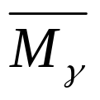
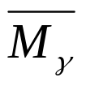
Comments
The length of an M-augmenting path is an odd number 2k+1 with k ≥ 0. k+1 edges of the path are edges of G-M while k of the edges of the path are edges of M.
M_{r}: the set of edges of the path that belong to M
: the set of edges of the path that do not belong to M
| | = |M_{r}| + 1

Slide 24
Example
Consider the right bigraph G. M ={(x₁, y₁), (x₂, y₂), (x₃, y₄)}is a matching, r = x₄y₂x₂y₁x₁y₃ is a M-augmenting path. M_{r} = {(x₁, y₁), (x₂, y₂)} and is the red edges. Let M’ = (M – M_{r}) ∪ . Then M’ is a matching larger than M.
y₁
x₁
x₂
y₂
y₃
x₃
y₄
x₄
y₅

Slide 25
Maximum Bipartite Matching
A matching M is a max-matching in G iff G has no M-augmenting path
(⇒) Suppose G has an M-augmenting path. Then, we can produce a matching larger than M. (see the above example)
(⇐) Let M’ be a matching in G larger than M. Then, we can construct an M-augmenting path. (read text book page 525-527.)

Slide 26

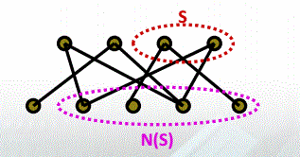
Hall’s theorem
An X,Y-bigraph G has a matching that saturates X iff |N(S)|>=|S| for all S⊆X.

Slide 27
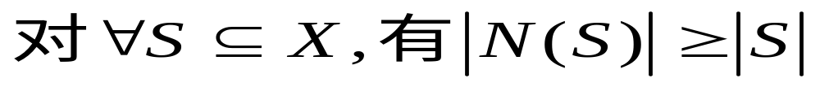
证明：“必要性”
如果G存在饱和X每个顶点的匹配，由匹配的定义，X的每个顶点在Y中至少有一个邻接点，所以:
“充分性”
如果G是满足条件(*)的二部图,但是不存在饱和X每个顶点的匹配。
令M*是G的一个最大匹配，但是不饱和X的顶点u.
u
示意图G

Slide 28
又令Z是通过M*与点u相连形成的所有M*交错路上的点集。
S
因M*是最大匹配，所以u是所有交错路上唯一的一个未饱和点。
u
令S=X∩Z , T=Z∩Y
T
显然，S-｛u｝中点与T中点在M*下配对，即：
|T| = |S| -1< |S|
即： |N(S)| = |T| = |S| -1< |S| ，与条件矛盾。
注: (1) G=(X,Y)存在饱和X每个顶点的匹配也常说成存在由X到Y的匹配。

Slide 29
The Marriage Theorem
A X,Y-bigraph G with |X|=|Y| has a perfect matching iff |N(S)|>=|S| for all S⊆X.
Perfect matching is a matching M such that all the vertices in G are saturated.
在一个由r个女人和s个男人构成的人群中，1≦r≦s。在熟识的男女之间可能出现r对婚姻的充分必要条件是，对每个整数k(1≦k≦r),任意k个女人共认识至少k个男人。

Slide 30
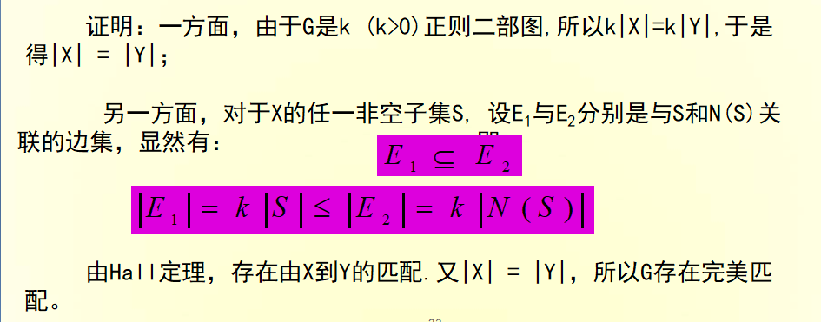
Corollary
For k>0, any k-regular bipartite graph has a perfect matching.
k-regular graph is a graph G which vertices have the same degree k.

Slide 31
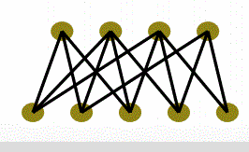
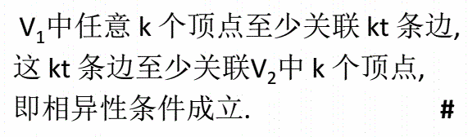
t - 条件
设二部图G=<V₁,V₂,E>中，V₁中每个顶点至少关联t（t≥1）条边，而V₂中每个顶点至多关联t条边，则G 中存在V₁到V₂的完备匹配.

Slide 32
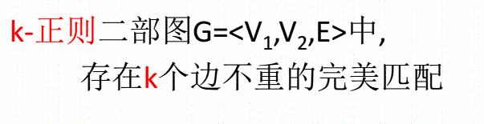
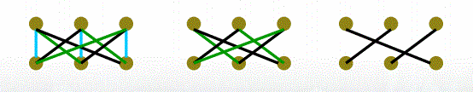
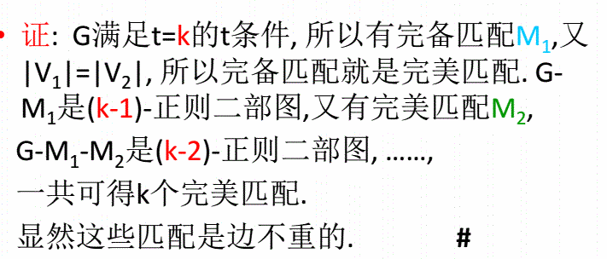

Slide 33
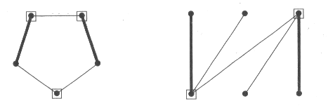
Vertex Cover
Vertex Cover: A vertex cover of a graph G is a set S⊆V(G) that contains at least one endpoint of every edge.

Slide 34
Min-cover
c(G) = min{|S|: S is a vertex cover of G}
We call a cover S of G which satisfies
|S| = c(G),
that is, a cover with the smallest number of vertices, a min-cover.

Slide 35
Example
The following bigraph has a cover S = {x₁, x₃, y₂}. c(G) = 3 and S is a min-cover: if we do not include x₁, then each of the three vertices y₁, y₂ and y₄ would have to be in the cover. If we do not include y₂ in the cover, we would have to include each of the three vertices x₁, x₂ and x₄ in the cover. Since {x₁, y₂} is not in a cover, each cover has to contain at least three vertices.
x₁
y₁
x₂
y₂
x₃
y₃
x₄
y₄

Slide 36
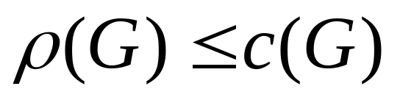
Max-matching and min-cover
If G is a bigraph, then
That is, the largest number of edges in a matching of G does not exceed the smallest number of vertices in a cover of G.
Proof: Each vertex of a cover S can incident with at most one edge in a matching M, S can “cover” M provided that |S| ≥ |M|.

Slide 37
Konig Theorem
If G is a bipartite graph, then the maximum size of a matching in G equals to the minimum size of a vertex cover in G

Slide 38

Example
Consider the bigraph G, M = {(x₁, y₁,), (x₂, y₂), (x₃, y₃)} is a matching of three edges. S = {x₁, x₃, y₂} is a cover of three vertices. Thus, 3 = |M| ≤ (G) ≤ c(G) ≤ |S| = 3. We have equality throughout, and hence M is a max-matching and S is a min-cover, and (G)= c(G) = 3.
x₁
y₁
x₂
y₂
x₃
y₃
x₄
y₄

Slide 39
Matching Algorithm
Input: An X,Y-bigraph G, a matching M in G, and the set U of M-unsaturated vertices in X.
Output: an M-augmenting path or a vertex cover of size |M|.

Slide 40
(0) begin by labeling with (*) all vertices in U call all vertices in U unscanned. Go to (1)
(1) if in the previous step, no new label has been given to a vertex of X, then stop. Otherwise go to (2).
(2) while there exists a labeled but unscanned vertex of X, select a labeled but unscanned vertex of X, say x_{i}, and label with (x_{i}) all vertices in Y which are joined to x_{i} by an edge not belonging to M and which have not been previously labeled. The vertex x_{i} is now scanned. If there are no labeled but unscanned vertices go to (3)

Slide 41
(3) If in step (2), no new label has been given to a vertex of Y, then stop. Otherwise go to (4)
(4) While there exists a labeled, but unscanned vertex of Y, select a labeled but unscanned vertex of Y, say y_{i}, and label with (y_{i}) any vertex of X which is joined to y_{i} by an edge belonging to M and which has not been previously labeled. The vertex y_{i} is now scanned. If there are no labeled but unscanned vertices, go to (1).

Slide 42
Breakthrough and non-breakthrough
Breakthrough: there is a labeled vertex of Y which does not meet an edge of M
In the case of breakthrough occurring in the algorithm, an M-augmenting path can be find and a matching with one more edge than M can be constructed.
Non-breakthrough: each vertex of Y which is labeled also meets some edge of M.
In the case of non-breakthrough, we conclude that M is the max-matching.

Slide 43
Matching Theorem
Repeatedly applying matching Algorithm to a bipartite graph produces a matching and a vertex cover of equal size

Slide 44
Example
(*) x₁
y₁
Determine a max-matching in the bigraph G by applying the matching algorithm. We input the matching M¹ = {(x₂, y₂), (x₃, y₃), (x₄, y₄)} of size 3 and U = {x₁, x₅, x₆}.
x₂
y₂
y₃
x₃
y₄
x₄
y₅
(*) x₅
(*) x₆
y₆

Slide 45
(i) (0) The vertices x₁, x₅ and x₆ are labeled (*).
(ii) (2) scan the vertices in U in turn, and label y₃ with (x₁) and y₄ with (x₅). Since all vertices incident to x₆ already have a label, no vertex of Y get label (x₆).
(iii) (4) scan the vertices y₃ and y₄ labeled in (ii), and label x₃ with (y₃) and x₄ with (y₄).
(*) x₁
y₁
x₂
y₂
y₃ (x₁)
(y₃) x₃
y₄ (x₅)
(y₄) x₄
y₅
(*) x₅
(*) x₆
y₆

Slide 46
(iv) (2) we scan the vertices x₃ and x₄ labeled in (iii), and label y₂ with (x₃)
(v) (4) scan the vertex y₂ labeled in (iv), and label x₂ with (y₂)
(vi)(2) scan the vertex x₂ labeled in (v), and label y₁, y₅ and y₆ with (x₂)
(4) scan the vertices y₁, y₅ y₆ labeled in (vi), and find that no new labels are possible.
(*) x₁
y₁ (x₂)
(y₂) x₂
y₂ (x₃)
y₃ (x₁)
(y₃) x₃
y₄ (x₅)
(y₄) x₄
y₅ (x₂)
(*) x₅
(*) x₆
y₆(x₂)

Slide 47
We have achieved breakthrough. We find the M¹-augmenting path r = y₁x₂y₂x₃y₃x₁ using the labels as a guide. Then
M² = {(x₄, y₄), (y₁, x₂), (y₂, x₃), (y₃, x₁)} is a matching of four edges.
(*) x₁
y₁ (x₂)
(y₂) x₂
y₂ (x₃)
y₃ (x₁)
(y₃) x₃
y₄ (x₅)
(y₄) x₄
y₅ (x₂)
(*) x₅
(*) x₆
y₆(x₂)

Slide 48
Continue to apply the algorithm to M². The resulting labeling of the vertices is as shown. In this case breakthrough has not occurred. Hence, M² is a max-matching of size 4, and the set
S = {x₂, x₃, y₃, y₄} of size 4, consisting of unlabeled vertices of X and labeled vertices of Y is a min-cover.
(y₃) x₁
y₁
x₂
y₂
y₃ (x₄)
x₃
y₄ (x₅)
(y₄) x₄
y₅
(*) x₅
(*) x₆
y₆

Slide 49
Exercise
Determine the max-matching of the right graph by applying the matching algorithm. We choose the red edges and obtain a matching M¹.
y₁
x₁
x₂
y₂
y₃
x₃
y₄
x₄
y₅

Slide 50
Time Complexity of the matching Algorithm
Let G be an X,Y-bigraph with n vertices and m edges.
1. The matching algorithm executes at most n/2 times since c(G)<=n/2.
2. Each execution of the algorithm considers each edge at most once.
⇒ The execution time of the algorithm is O(mn).

Slide 51
Systems of distinct representatives

Slide 52
System of representatives
Let Y be a finite set and let A = (A₁, A₂, …, A_{n}) be a family of n subsets of Y. A family (e₁, e₂,…,e_{n}) of elements of Y is called a system representatives of A, provided e₁ ∈ A₁, e₂∈ A₂, …, e_{n} ∈ A_{n}.
If the elements e₁, e₂,…, e_{n} are different, then (e₁, e₂,…,e_{n}) is called a system of distinct representatives, abbreviated SDR.

Slide 53
Example
Let A = (A₁, A₂, A₃, A₄) be the family of subsets of the set Y = {a, b, c, d, e} defined by A₁ = {a, b, c}, A₂ = {b, d}, A₃ = {a, b, d}, A₄＝{b, d}. Then {a, b, b, d} is a system representatives, and {c, b, a ,d} is an SDR.

Slide 54
Comments
A family of non-empty sets always has a system of representatives. We need only to pick one element from each of the sets to obtain a system of representatives.
However, the family does not always have an SDR even though all the sets in the family are non-empty. E.g., the family (A₁ ={x}, A₂ = {x}, A₃, A₄…) has no SDR.

Slide 55
Example
Let the family A = (A₁, A₂, A₃, A₄) be defined by A₁ = {a, b}, A₂ = {a, b}, A₃ = {a, b}, A₄＝{a, b, c, d}. Then A does not have an SDR.
Why?

Slide 56
Marriage condition
In order for the family A = (A₁, A₂, …, A_{n}) of sets to have an SDR if and only if the following condition hold:
(MC): For each k = 1, 2, …, n and each choice of k distinct indices i₁, i₂,…i_{k} from {1,2, 3,..,n}, |A_{i1} ∪ A_{i2} ∪ … A_{ik}| ≥ k.

Slide 57
Bipartite graph and representative system
A = (A₁, A₂, …, A_{n}) is the set of subsets of Y = {y₁, y₂,…,y_{m}}. Let G = (X, △, Y) be defined as follows:
X = {1, 2, …, n} is the set that index the members of the family A, Y = {y₁, y₂,…,y_{m}}, △ = { {i, y_{j}}: y_{j} is in A_{i}}.

Slide 58
Exercise
Let A = (A₁, A₂, A₃, A₄) be the family of subsets of the set Y = {a, b, c, d, e} defined by A₁ = {a, b, c}, A₂ = {b, d}, A₃ = {a, b, d}, A₄＝{b, d}.
Draw its bipartite graph?

Slide 59
Comments
The family of sets A has an SDR iff the associated bipartite graph G has a matching M of n edges.
A has a SDR iff (G) = n.
a
1
2
b
c
3
d
4
e

Slide 60
Theorem 9.3.3
Let A = (A₁, A₂, …, A_{n}) be a family of subsets of a set Y. Then the largest number of sets of A which can be chosen such that they have an SDR equals the smallest value taken on by the expression |A_{i1} ∪ A_{i2} ∪ … A_{ik}| + n - k over all choices of k = 1, 2, 3, …, n and all choices of k distinct indices i₁, i₂,…i_{k} from {1,2, 3,..,n}.

Slide 61
Example
We define a family A = (A₁, A₂, A₄, A₅, A₆) of subsets of {a, b, c, d, e, f} by A₁ = {a, b, c}, A₂ = {b, c}, A₃ = {b, c}, A₄ = {b, c}, A₅ = {c}, A₆ = {a, b, c, d}.
Then with n = 6, k = 1 , min_{i=1, 2, …, 6} |A_{i}|+6-1 = 6; with k = 2, min _{i1, i2=1, 2, …, 6}|A_{i1} ∪ A_{i2}| + 6 – 2 = 6; with k = 3, min_{i1, i2, i3 =1, 2, …,6} |A_{i1} ∪ A_{i2} ∪ A_{i3}| + 6 – 3 = 5, with k = 4, min_{i1, i2, i3, i4 =1, 2, …,6} |A_{i1} ∪ A_{i2} ∪ A_{i3} ∪ A_{i4} | + 6 – 4 = 4, …….
Hence, 4 is the largest number of sets with an SDR.

Slide 62
Stable marriages

Slide 63
Definition
A complete marriage is called unstable, if for two partners, both would regard the partner more preferable than their current spouse. A complete marriage is called stable provided it is not unstable.
E.g., if “A and a get married; B and b get married; A prefers b to a and b prefers A to B”, then it is an unstable marriage.
A
a
B
b

Slide 64
Preferential ranking matrix
This matrix is an n-by-n array of n rows, one corresponding to each of the women w₁, w₂, …, w_{n}, and n columns, one corresponding to each of the n men m₁, m₂, .., m_{n}. In the position at the intersection of row i and column j we place the pair (p, q) of numbers representing, respectively, the ranking of m_{j} by w_{i} and the ranking of w_{i} by m_{j}. A complete marriage corresponds to a set of n positions of the matrix which includes exactly one position from each row and one position from each column.

Slide 65
Example
Let n = 2 and let the preferential ranking matrix be
Thus, for instance, the entry 1,2 in the first row and first column means that w₁ has put m₁ first on her list and m₁ has put w₁ second on his list. There are two possible complete marriages:
(1) (w₁, m₁) , (w₂, m₂)
(2) (w₂, m₁) , (w₁, m₂) (unstable! Since w₂ and m₂ prefer each other to their current spouses.
m
m
1
2
w
⎡
⎤
1
,
2
2
,
2
1
⎢
⎥
w
2
1
,
1
1
⎣
,
⎦
2

Slide 66
Example
Let n = 3, and let the preferential ranking matrix be
There are 3!=6 possible marriages. One is (w₁, m₁), (w₂, m₂), (w₃, m₃). Since each woman gets her first choice, the complete marriage is stable, even though each man gets his last choice.
Another stable complete marriage is obtained by giving each man his first choice.
⎡
⎤
1
,
3
2
,
2
3
,
1
⎢
⎥
3
,
1
1
,
⎢
3
2
,
2
⎥
⎢
2
,
2
3
,
1
1
,
⎥
⎣
3
⎦

Slide 67
Theorem 9.4.1
For each preferential ranking matrix there is a stable complete marriage.

Slide 68
Deferred acceptance algorithm
Begin with every woman marked as rejected. While there exists a rejected woman, do:
(1) each woman marked as rejected choose the man whom she ranks highest among all those men who have not yet rejected her.
(2) each man picks out the woman he ranks highest among all those women who have chosen him and who he has not yet rejected, defer decision on her, and now rejects the others.

Slide 69
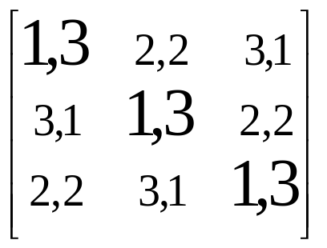
Example
We apply the deferred acceptance algorithm to the right matrix
designating the women as A, B, C and the men as a, b, c respectively. In (1), A chooses a, B chooses b and C chooses c. There are no rejections, the algorithm halts, and A marries a, B marries b, C marries c.

Slide 70
Example
We apply the algorithm to the following preferential ranking matrix, the result of the algorithm are:
A -> a, B->b, C->d, D->a; a rejects D.
D->d, d reject C
C->a, a rejects A
A ->b, b rejects B
B->a, a rejects B
B->c. there are no rejections. Hence, (A, b),(B, c), (C,a), (D, d).
a
b
c
d
A
1,2
2,1
3,2
4,1
B
2,4
1,2
3,1
4,2
C
2,1
3,3
4,3
1,4
D
1,3
4,4
3,4
2,3

Slide 71
Exercise
Apply the algorithm to the matrix where the men choose the women.
a
b
c
d
A
1,2
2,1
3,2
4,1
B
2,4
1,2
3,1
4,2
C
2,1
3,3
4,3
1,4
D
1,3
4,4
3,4
2,3

Slide 72
Women optimal
A stable complete marriage is called optimal for a woman, provided that a woman gets as a spouse a man whom she ranks at least as high as the spouse she obtains in every other stable complete marriage.
A stable complete marriage is called women-optimal (resp., men-optimal) provided it is optimal for each woman (resp., man).

Slide 73
Theorem 9.4.2
The stable complete marriage obtained from the deferred acceptance algorithm, with the women choosing the men, is women-optimal. If the men choose the women in the algorithm, the resulting complete marriage is men-optimal.

Slide 74
Corollary 9.4.3
In the women-optimal stable complete marriage, each man is paired with the woman he ranks lowest among all the partners that are possible for him in a stable complete marriage.

Slide 75
Matching in the weighted graphs

Slide 76
Maximum Weighted Bipartite Matching and Minimum Weighted Cover (Dual Problems)
A farming company owns n farms and n processing plants. The profit that results from sending the output of farm i to plant j is w_{i,j}. The company wants to select edges forming a matching to maximize total profit.
The government will pay u_{i} if the company agrees not to use farm i and v_{j} if it agrees not to use plant j. The government must offer amounts such that u_{i}+v_{j}>=w_{i,j} for all i, j. Otherwise, the company makes more by using edge x_{i}y_{j} than taking the government payments for those vertices. The government wants to minimize Σu_{i}+Σv_{j}.

Slide 77
farm
plant
i
w_{ij}
j

Slide 78
Lemma
For a perfect matching M and weighted cover (u,v) in a weighted bipartite graph G, (1) c(u,v)>=w(M), and (2) c(u,v) =w(M) iff M consists of edges x_{i}y_{j} such that u_{i}+v_{j}=w_{i,j}. In (2), M and (u,v) are optimal.
(1) c(u,v)>=w(M) since u_{i}+v_{j}>=w_{i,j} for all i, j.
(2) Trivial.

Slide 79
Equality Subgraph
Equality Subgraph: The equality subgraph G_{u,v} for a weighted cover (u,v) is the spanning subgraph of K_{n,n} whose edges are the pairs x_{i}y_{j} such that u_{i}+v_{j}=w_{i,j}. In the cover, the excess for i,j is u_{i}+v_{j}-w_{i,j}.

Slide 80
Max-weighted-matching Algorithm
Input: A matrix of weights on the edges of K_{n,n} with bipartition X,Y.
Output: A maximum weighted matching.
Idea: Iteratively adjusting the cover (u,v) until the equality subgraph G_{u,v} has a perfect matching.
Initialization: Let (u,v) be a cover, such that u_{i}=max_{j} w_{i,j} and v_{j}=0.

Slide 81
Algorithm
1. Find a maximum matching M in G_{u,v}. If M is perfect matching, stop and report M as a maximum weighted matching.
2. Let Q be a vertex cover of size |M| in G_{u,v}. Let R=X∩Q and T=Y∩Q. Let ε=min{u_{i}+v_{j}- w_{i,j} : x_{i}∈X-R, y_{j}∈Y-T}.
3. Decreases u_{i} by ε for x_{i} ∈X-R, and increases v_{j} by ε for y_{j} ∈T.
4. Form the new equality graph and Goto Step 1.

Slide 82
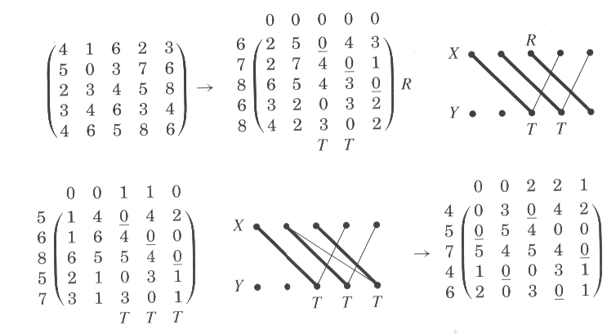

Slide 83
Comments
The previous Algorithm finds a maximum weight matching and a minimum cost cover

Slide 84
Edge Cover
Edge Cover: An edge cover of G is a set L of edges such that every vertex of G is incident to some edge of L
α(G): maximum size of independent set
p(G): maximum size of matching
c(G): minimum size of vertex cover
β(G): minimum size of edge cover

Slide 85
Lemma 2
In a graph G, S⊆V(G) is an independent set iff V(G)-S is a vertex cover, and hence α(G)+ c(G)=n(G)
(⇒)1. No edge joins two nodes in S. ⇒ Every edge has an endpoint in V(G)-S. ⇒ V(G)-S is a vertex cover.
(⇐) Every edge has an endpoint in V(G)-S. ⇒ No edge joins two nodes in S. ⇒ S is an independent set

Slide 86
Theorem 1
If G is a graph without isolated vertices, then p(G)+β(G)=n(G).

Slide 87
Corollary 1
If G is a bipartite graph with no isolated vertices, then α(G)=β(G).

Slide 88
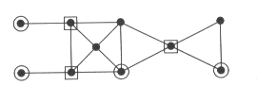
Dominating Set
Dominating Set: In a graph G, a set S⊆V(G) is a dominating set if every vertex not in S has a neighbor in S.
Dominating Number γ(G): the minimum size of a dominating set in G.

Slide 89
Theorem 2
For any graph G, γ(G)<=α(G).

Slide 90
Factor
Factor: a spanning subgraph of graph G
k-Factor: a spanning k-regular subgraph
Odd component: a component of odd order
o(H): the number of odd components of H

Slide 91
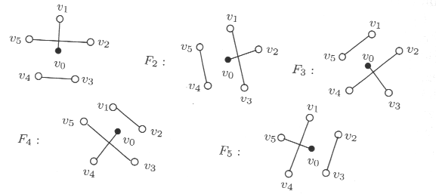
1-Factor of K₆

Slide 92
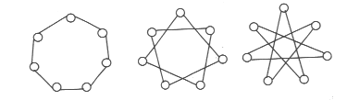
2-Factor of K₇

Slide 93
Theorem 3
A graph G has 1-factor if and only if o(G-S)<=|S| for every S⊆V(G).

Slide 94
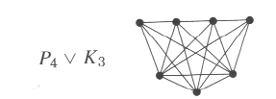
Join
Join: The join of simple graphs G and H, written G∨H, is the graph obtained from the disjoint union G+H by adding the edges {xy: x∈V(G), y∈V(H)}

Slide 95
Corollary 2.
The largest number of vertices saturated by a matching in G is min_{S⊆V(G)}{n(G)-d(S)}, where d(S)=o(G-S)-|S|.

Slide 96
Corollary 3
Every 3-regular graph with no cut-edge has a 1-factor.

Slide 97
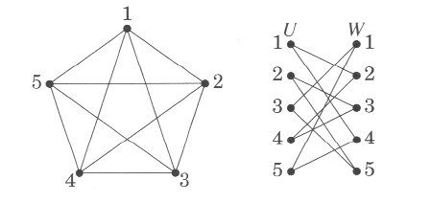
Example
Consider the Eulerian circuit in G=K₅ that successively visits 1231425435. The corresponding bipartite graph H is on the right. For the 1-factor in H whose u,w-pairs are 12,43,25,31,54, the resulting 2-factor in G is the cycle (1,2,5,4,3). The remaining edges forms another 1-factor in H, which corresponds to the 2-factor (1,4,2,3,5) in G.

Slide 98
Theorem 4
Every regular graph with positive even degree has a 2-factor.

Slide 99
Assignments
7
12
19
Read the following paper:
  Takeaki UNO, “Algorithms for Enumerating All Perfect, Maximum and Maximal Matchings in Bipartite Graphs”, Lecture Notes in Computer Science.
Learn the “matching in the weighted graphs” section in this .ppt by yourself.

Slide 100
Assignments (cont’d)
Determine the max-matching and the min-cover of the right graph by applying the matching algorithm. We choose the red edges and obtain a matching M¹.
Find a minimum edge cover for the right graph.
y₁
x₁
x₂
y₂
y₃
x₃
y₄
x₄
y₅

