Slide 1
Predict Body Fat by Abdomen Body Fat Project
Group 3
Ruofeng Tang, Xiaoyang Wang, Xingyu Tang
October 16, 2023

Slide 2
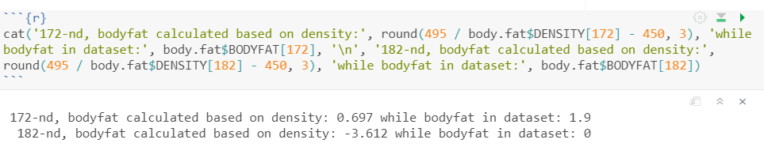
Data Cleaning
We cross-examined body fat percentage with density, and adiposity with height and weight. Based on given formulas, these measurements should align relatively well.
We deleted two individuals (172-nd and 182-nd) based on given formula Body Fat = 495/Density – 450
Reason:
Index 172’s body fat 1.9 while calculated body fat is 0.697. Applying the formula could probably recover it, but 0.697 still does not belongs to normal body fat range.
Index 182 had body fat 0.0, and applying the formula cannot recover it.
IDNO <dbl> | BODYFAT <dbl> | DENSITY <dbl> | AGE <dbl> | WEIGHT <dbl> | HEIGHT <dbl> | ADIPOSITY <dbl> | NECK <dbl> | CHEST <dbl> | ABDOMEN <dbl>
172 | 1.9 | 1.0983 | 35 | 125.75 | 65.5 | 20.6 | 34.0 | 90.8 | 75.0
182 | 0.0 | 1.1089 | 40 | 118.50 | 68.0 | 18.1 | 33.8 | 79.3 | 69.4

Slide 3
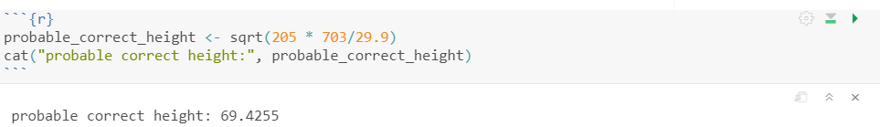
We modified one individual (42-nd) based on given formula Adiposity = 703 * Weight / Height^2
Reason:
Index 42’s adiposity in dataset is 29.9, while calculate adiposity is 703*205/29.5^2=165.60. We indicate height should have error.
Final Cleaned Data: n=250 (from n=252) with p=14 possible predictors
Possible predictors: Age, Weight, Height, Adiposity, Neck, Chest, Abdomen, Hip, Thigh, Knee, Ankle, Biceps, Forearm, Wrist
IDNO <dbl> | BODYFAT <dbl> | DENSITY <dbl> | AGE <dbl> | WEIGHT <dbl> | HEIGHT <dbl> | ADIPOSITY <dbl> | NECK <dbl> | CHEST <dbl> | ABDOMEN <dbl>
42 | 31.7 | 1.025 | 44 | 205 | 29.5 | 29.9 | 36.6 | 106 | 104.3

Slide 4
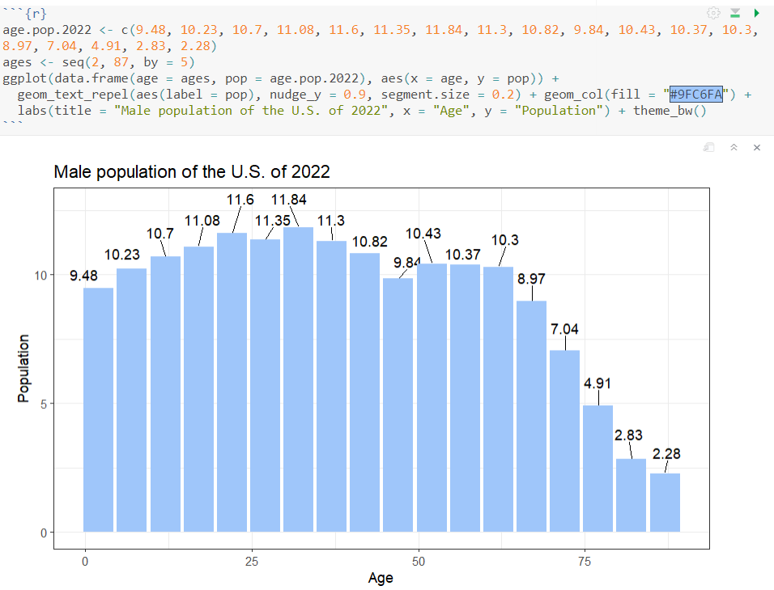
Finding the Best Model for Body Fat
Potential Problem
The data set is from 1970s, decades ago. To accurately predict body fat percentage today, we want to somehow manipulate the age distribution to imitate modern American society. Thus, we searched online and used population of U.S. by age of 2022 [origin: https://www.statista.com/statistics/241488/population-of-the-us-by-sex-and-age/]
Candidate Models
Linear Regression with bootstrapping (restricted)
Bodyfat ~ Age + Weight, Height + Adiposity + Neck + Chest + Abdomen + Hip + Thigh + Knee + Ankle + Biceps + Forearm + Wrist
Bodyfat ~ Abdomen
Weighted Linear regression
Bodyfat ~ Abdomen
Metric for Model Performance:
We’ll define the “best” model based on R squared, Prediction Range, Residual Plot and Whether residuals follow normal distribution

Slide 5
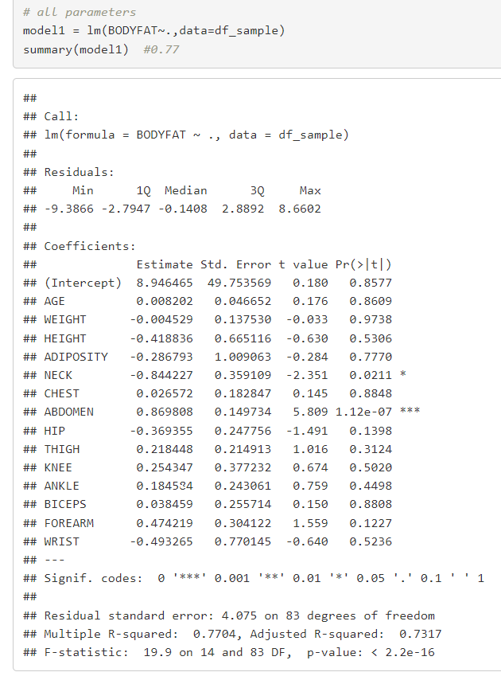
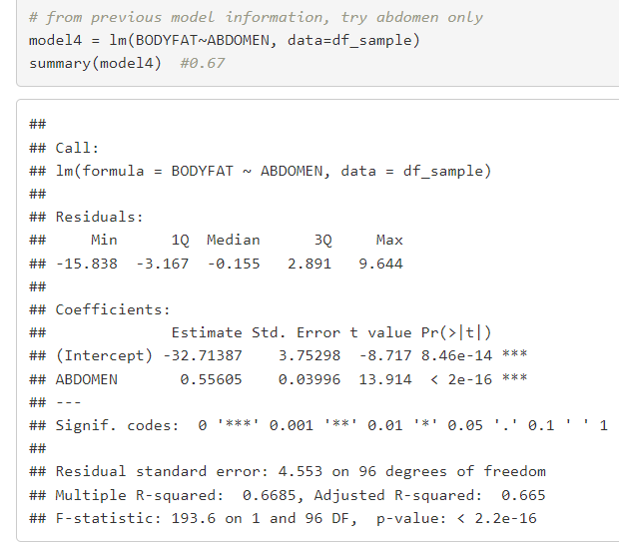
Linear Regression with Bootstrapping (Restricted)
Choose the best predictor(s)
The R-squared values (0.77/0.67) did not have enough difference to guarantee the more complicated model.
Bodyfat ~ abdomen
Bodyfat ~ .

Slide 6
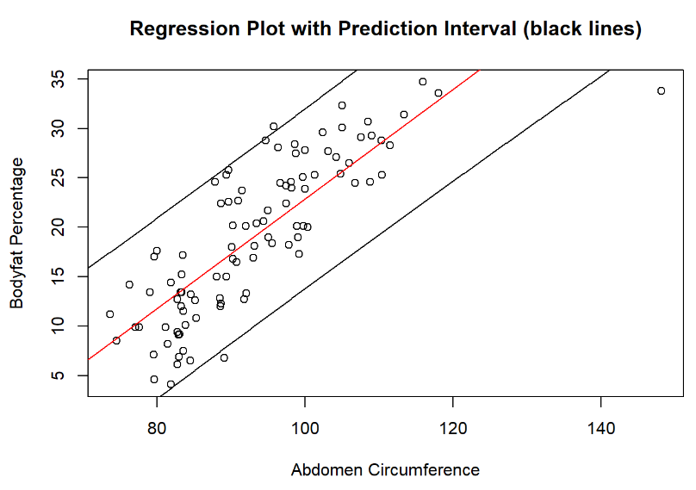
Linear Regression with Bootstrapping (Restricted)
Build New Dataset
Bootstrap each age group separately. (Ideally bootstrap together, but computationally impossible)
For 1970 age groups with percentages higher than 2022 distribution, we want to randomly select fewer samples; for age groups with lower percentages, we want to randomly select more samples.
At the same time, we want to pick the maximum sample size such that we can pick enough people to satisfy 2022 percentage for each age group.
Final sample size: 98
R-squared value: 0.67
Points: (abdomen, bodyfat)
Red line: prediction line
Black lines: prediction interval

Slide 7
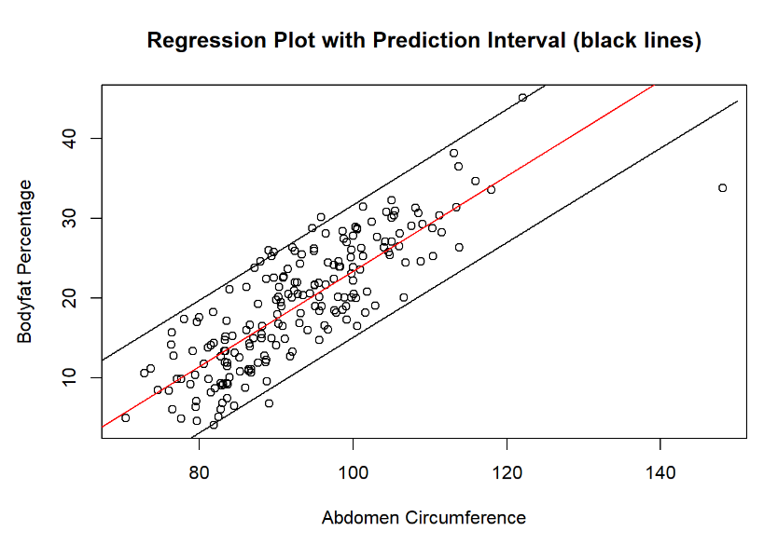
Linear Regression with Bootstrapping (Restricted)
Potential Problem
Although the new dataset we built had 2022 age distribution, there was information loss because of the random selection process and the reduced sample size.
Resample
To mitigate that, we sampled 4 more times and combined them to a larger data set. It risked repeating several data entries, but it was more beneficial by preventing information loss.
R-squared value: 0.69
Points: (abdomen, bodyfat)
Red line: prediction line
Black lines: prediction interval

Slide 8
Linear Regression with Bootstrapping (Restricted)
Model Analysis
There are two main limitations of this model.
It was most accurate with age group 20-74 because of the original data set’s limitation. But we believed that predictions for people outside that age group would be accurate to a large extent: the regression model trained on all parameters suggested that age did not significantly influence body fat percentage.
The bootstrapping process counted some data entries repeatedly. For example, every sample in age group 20-24 was counted 5 times by design, since we wanted the sample size to be as large as possible. We considered this a necessary trade-off, since this method brought in much-needed randomness when simulating a new 2022 age distribution.

Slide 9
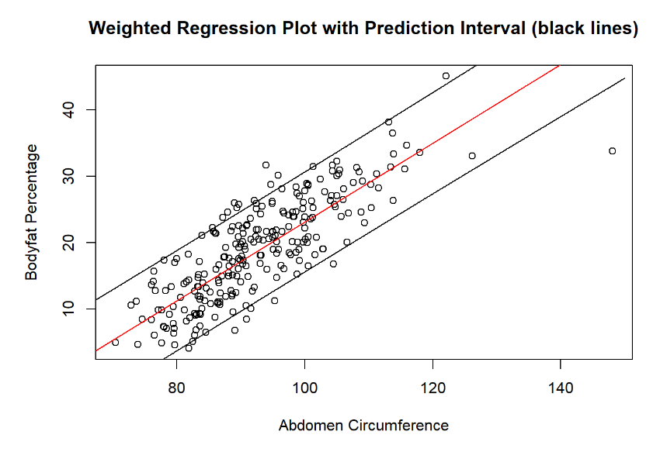
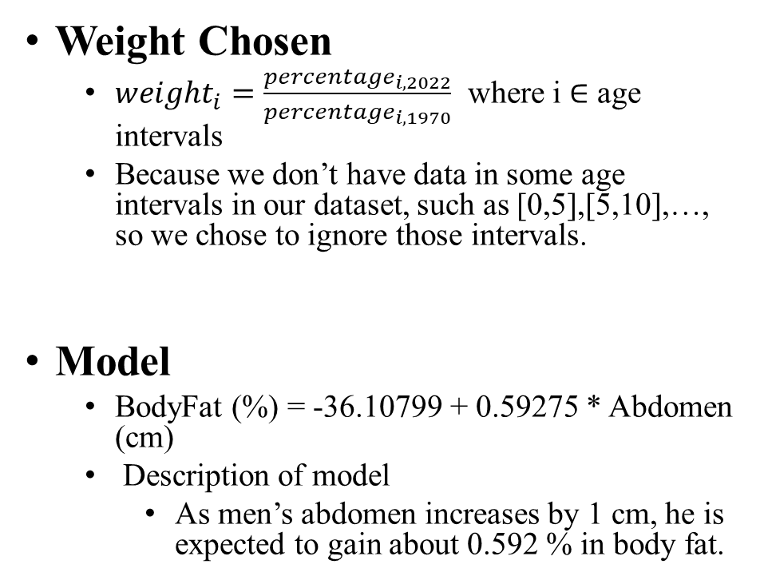
Weighted Linear Regression
Points: (abdomen, bodyfat)
Red line: prediction line
Black lines: prediction interval

Slide 10
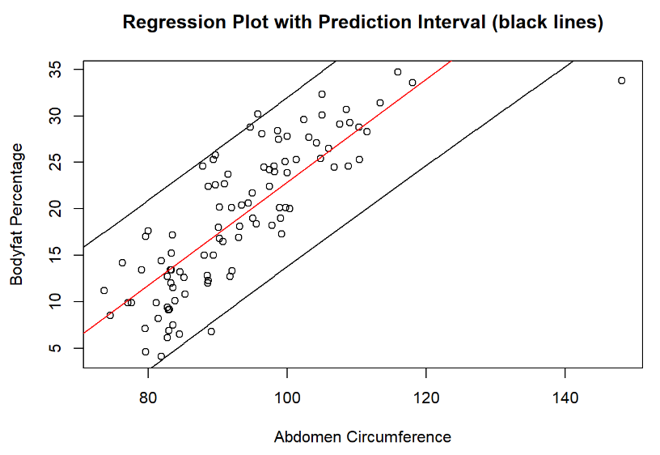
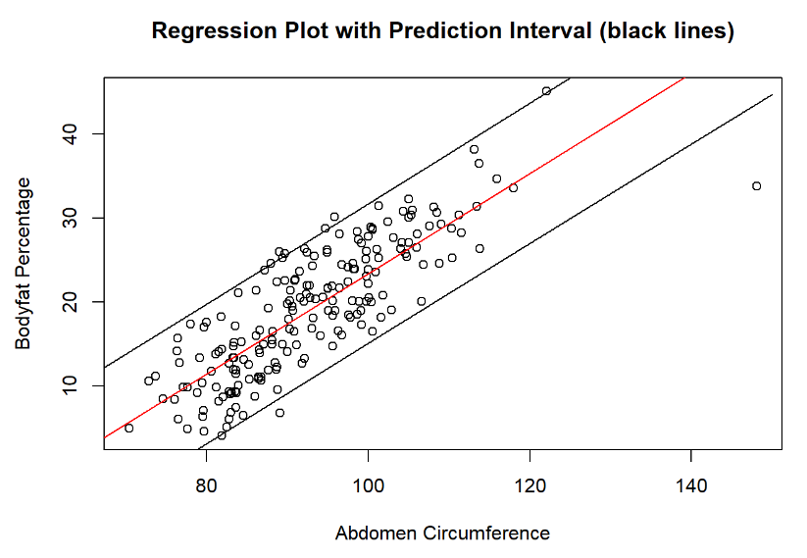
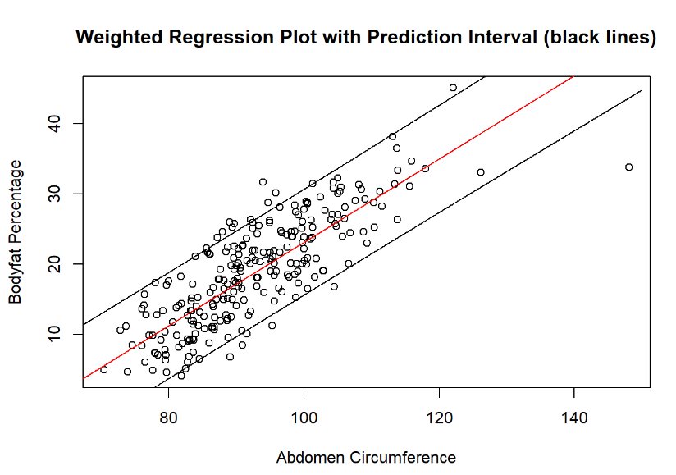
Metric for Model Performance (Model Diagnostics)
 | Linear Regression with Bootstrapping Without Resampling Bodyfat ~ Abdomen | Linear Regression with Bootstrapping With Resampling Bodyfat ~ Abdomen | Weighted linear regression model Bodyfat ~ Abdomen
R^2 | 0.6685 | 0.6914 | 0.7003
Prediction Interval | 18.91686 | 16.748 | 15.3984

Slide 11
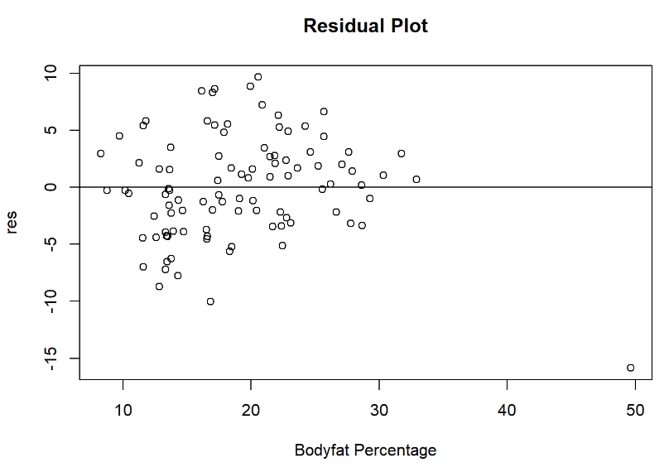
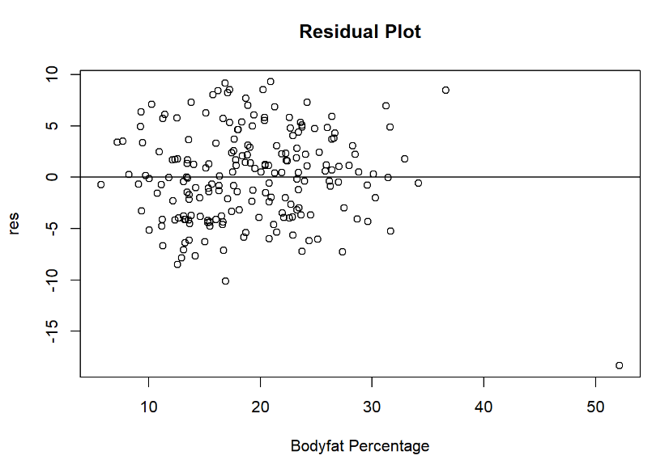
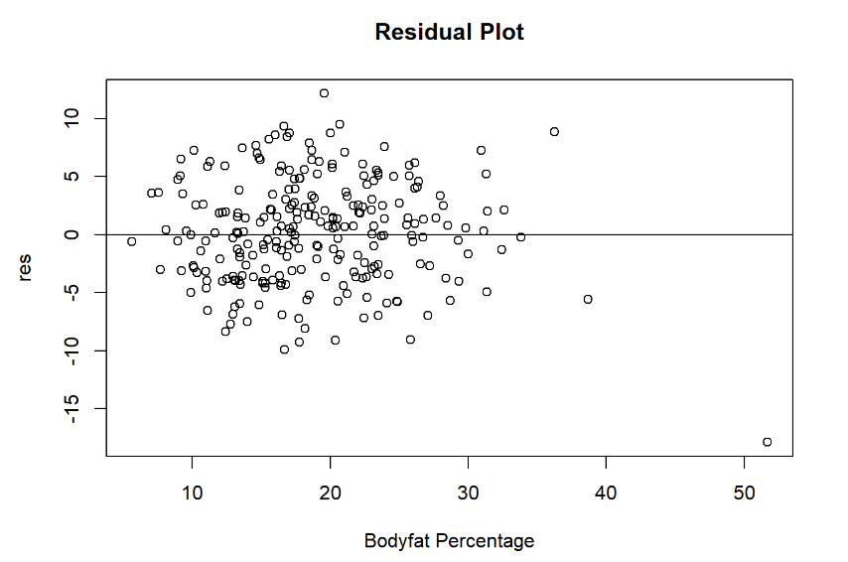
 | Linear Regression with Bootstrapping Without Resampling Bodyfat ~ Abdomen | Linear Regression with Bootstrapping With Resampling Bodyfat ~ Abdomen | Weighted linear regression model Bodyfat ~ Abdomen
Residual Plot

Slide 12
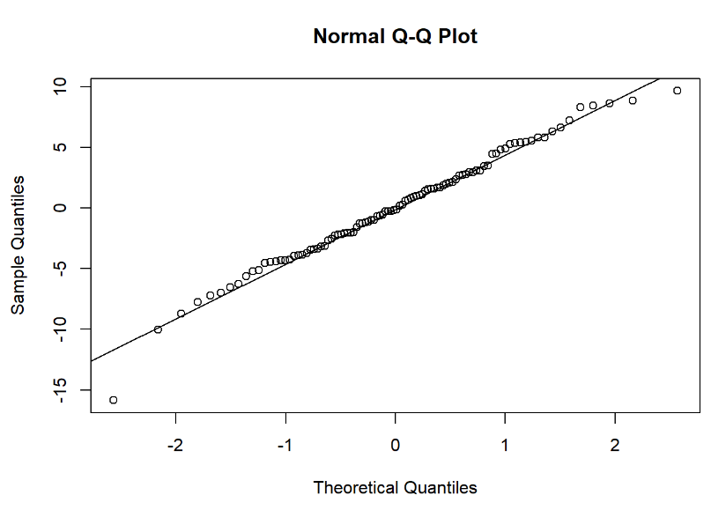
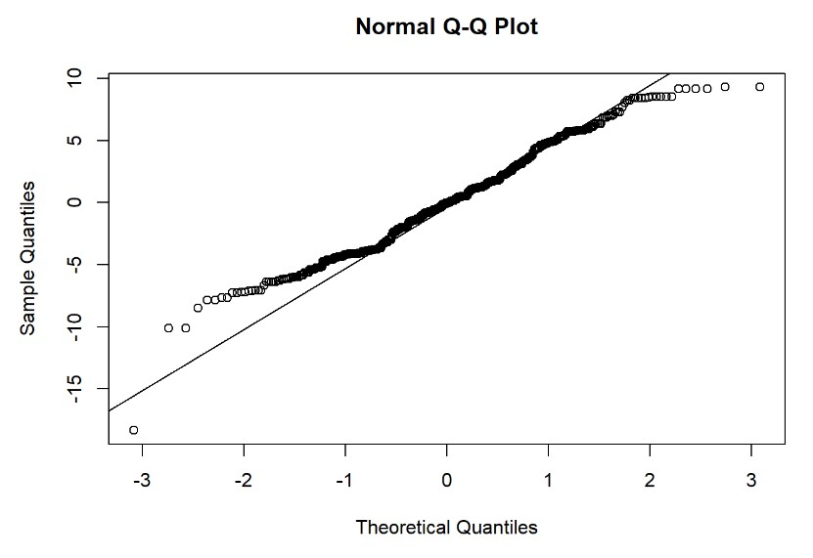
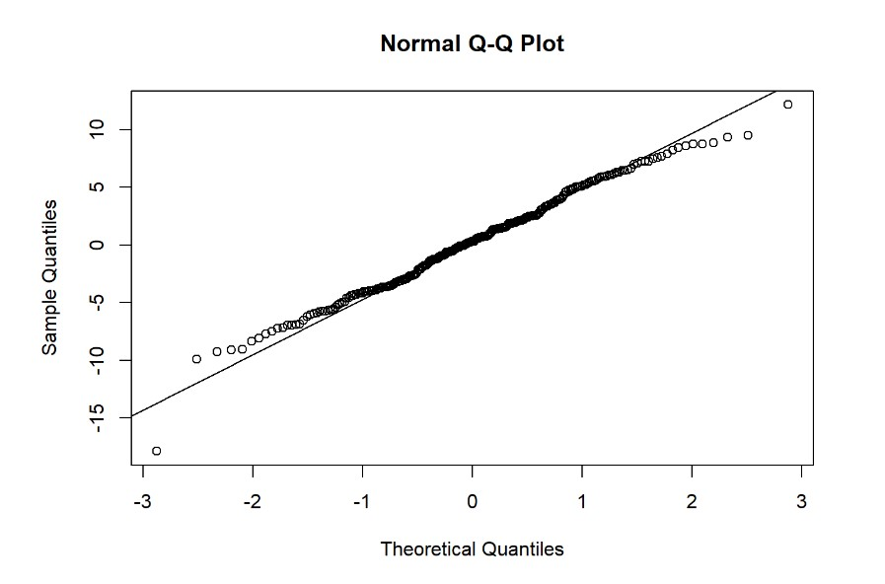
 | Linear Regression with Bootstrapping Without Resampling Bodyfat ~ Abdomen | Linear Regression with Bootstrapping With Resampling Bodyfat ~ Abdomen | Weighted linear regression model Bodyfat ~ Abdomen
Whether Residuals Follow Normal Distribution (using QQplot) |  | This plot does not perform as well

Slide 13
Conclusions (Final Model)
We considered the weighted regression model below to be the best model overall
BodyFat (%) = -36.10799 + 0.59275 * Abdomen (cm)
Reason
Highest R-squared value 0.7
Produced the smallest prediction range 15.4, meaning the highest accuracy among our models
the QQ-plot displayed a higher degree of normality than the bootstrapping model
Limitations of Linear Regression with Bootstrapping model
Usage
Regarding user experience, the input of our model would be abdomen circumference, and the output would be average bodyfat percentage and a prediction range

Slide 14
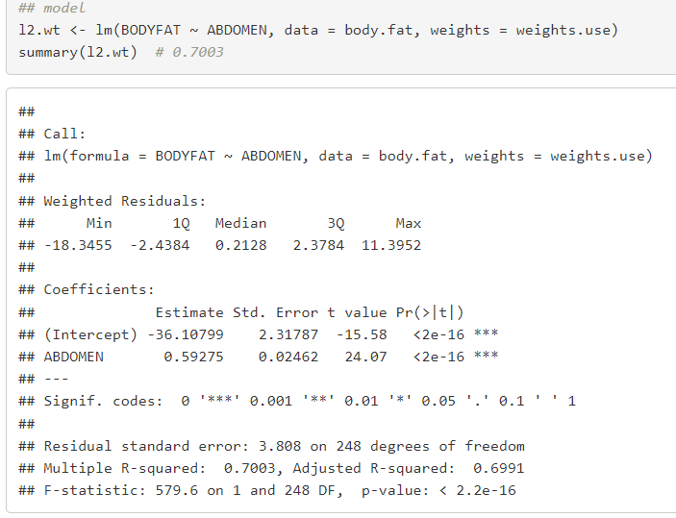
Statistical Properties
Coef are both significant at 0.05 based on two-sided t-test with p-values 2.2e-16
Overall model is significant at 0.05 based on F-test with p-value
Coef is significant and positive, suggesting bodyfat has positive linear relationship with abdomen
R^2 =0.7003

Slide 15
Strengths and Weaknesses
Final Model:
BodyFat (%) = -36.10799 + 0.59275 * Abdomen (cm)
Strengths
Very simple (only need data of abdomen circumference)
Explains abdomen circumference of variation in body fat
Weaknesses
We could not check the model’s performance against a 2022 age distribution. We could only check the performance against 1970 age distribution, as opposed to simulated 2022 age distribution with bootstrapping.
Prediction model was most accurate with age group 20-74
Requires units (cms) – but we can change units by changing coefficients

Slide 16
THANKS

