Slide 1


MINT: Multiplier-less INTeger Quantization for Energy Efficient Spiking Neural Networks
Ruokai Yin, Yuhang Li, Abhishek Moitra, Priyadarshini Panda
Department of Electrical Engineering, Yale University, USA
Email: ruokai.yin@yale.edu

Slide 2
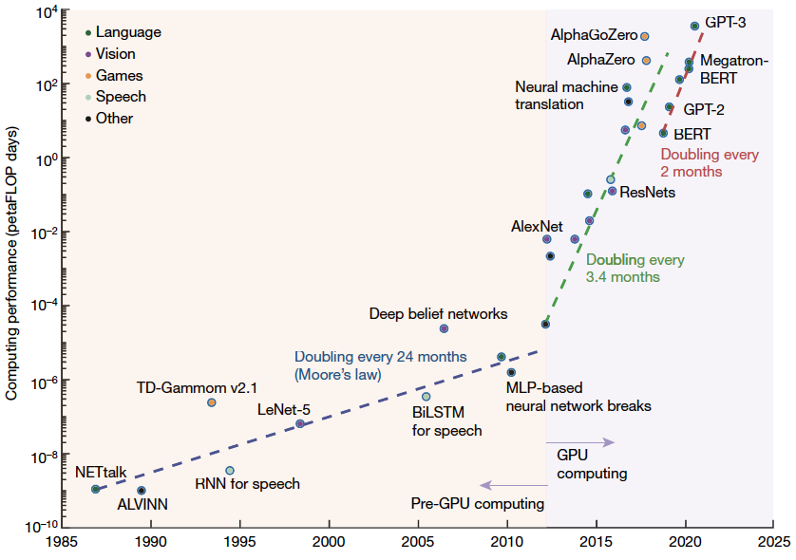
Neural Networks at GPU era
AlphaGoZero
GPT-3
Language
Games
Vision
AlphaZero
Neural machine
translation
GPT-2
Doubling every
3.5 months
BERT
Doubling every
2 months
ResNets
AlexNet
2010
2015
2020
2025
Notes:
We are in an era where the GPUs are really boosting the performance and the computation cost of the neural network models. Since the release of AlexNet (2012), the computing cost of neural networks roughly doubling every 3 and a half month.
And in the time where LLM are prevailing, this number doubling every 2 months.

Slide 3


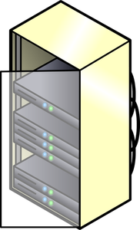







Two Ways of Processing Neural Networks
Speed ↑
Cost ↑
Speed ↓
Cost ↓
Notes:
When we look at the ways of processing of neural networks, they can be categorized into 2 classes.
Here is a very classic analogy:
We can think of the first group of class of processing nn as a truck, it is more powerful, process the large nn faster but requires more cost. This type of processing is usually seen in the server or cloud, where those large models are run. For example, chatgpt, midjourney, and google's gemini.
The other group is like a bike, it is not as powerful as the truck, but its cost is much smaller. This kind of processing is popular on the edge or personal devices. Nowadays, also many apllications can run locally on those edge devices such as siri, google cam, and small model like llama.

Slide 4
Two Ways of Processing Neural Networks
What Spiking Neural Networks (SNNs) are targeting at.
Speed ↓
Cost ↓
Notes:
The main topic we gonna discuss today, the spiking neural networks, can be categorized under this second category.

Slide 5
Two Ways of Processing Neural Networks
What Spiking Neural Networks (SNNs) are targeting.
Speed ↓
Cost ↓
Notes:
Lets have a closer look at the spiking neural netowkrs

Slide 6




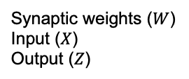


Preliminary of Spiking Neural Networks
Artificial Neural Networks (ANNs)
Synaptic weights ($W$)
Input ($X$)
Output ($Z$)
0.6
$$Z_{l}={ReLU(W}_{l}X_{l−1})$$
Output
Input
0.6
Spiking Neural Networks (SNNs)
Step 1: update
$$H_{l}^{t}={τU}_{l}^{t−1}+W_{l}S_{l−1}^{t}$$
$$v_{th}$$
Step 2: firing
$$H_{l}^{t}>v_{th}$$
Membrane Potential
T1
T2
T3
T4
Step 3: reset
$$U_{l}^{t}=H_{l}^{t}(1−S_{l}^{t})$$
T1
T2
T3
T4
Timesteps
Membrane potentials before reset: ${ H}_{l}^{t}$
Membrane potentials after reset: ${ U}_{l}^{t}$
Leaky Integrate-and-Fire (LIF)
Notes:
I would like to introduce the SNN from a perspective of showing the differences between the neurons in ANNs and SNNs.
We gonna first very quickly go through the neurons in ANNs. Assume that the weights, inputs and outputs are denoted as following. The relation ship between the output and input of an ANN neuron is shown as here: the weight matrices will multiplied with the inputs and the result will go through a ReLU function.
The ReLU function, as the non-linear activation function in ANNs, works as shown in the fig here. It act like a negative-filter for the outputs.
On the other hand, the neuron in SNN has a slightly more steps in its input-output relationship. It involves three steps as shown here. The input is multiplied with the weights, similar to the ANNs. However, one big difference here is the input of the SNNs are now in the form of binary spikes (either 1 / 0). We will soon have a look at what benefit this forms of spike will give us. But let's first continue on looking at the behavior of SNN's neuron.
All the other parts of those equations can be viewed as the non-linear activation function of the SNN neuron. This non-linear behavior we are introducing today is one of the most popular SNN neuron model called Leaky Integrate-and-Fire (abbreviated as LIF neuron).
Not like ANN, where the input for each neuron is processed one time at once, the inputs for a SNN neuron is processed across multiple uniform and discrete ticks, we called them timesteps.
let's look at an example here, in the first timestep, we receive some inputs, those inputs are accumulated to a value called membrane potential. Between the timesteps, the membrane potential will have some leakage as shown here. Then we move to the next timestep, and accumulated the inputs again. Once the membrane potential surpass a pre-set threshold, an output spike will be generated at that timestep. And the membrane potential after the spike will be reset to 0. And we repeat the process untill all timesteps are processed.
To clarrify some terminologies we used in the work, the membrane potentials before the reset is called H and the membrane potential after the reset is called U. We will focus on the U in this work.

Slide 7

Preliminary of Spiking Neural Networks
Artificial Neural Networks (ANNs)
Synaptic weights ($W$)
Input ($X$)
Output ($Z$)
0.6
$$Z_{l}={ReLU(W}_{l}X_{l−1})$$
Output
Input
0.6
Spiking Neural Networks (SNNs)
Step 1: update
$$H_{l}^{t}={τU}_{l}^{t−1}+W_{l}S_{l−1}^{t}$$
$$v_{th}$$
Step 2: firing
$$H_{l}^{t}>v_{th}$$
Membrane Potential
T1
T2
T3
T4
Step 3: reset
$$U_{l}^{t}=H_{l}^{t}(1−S_{l}^{t})$$
T1
T2
T3
T4
Timesteps
Membrane potentials before reset: ${ H}_{l}^{t}$
Membrane potentials after reset: ${ U}_{l}^{t}$
Leaky Integrate-and-Fire (LIF)

Slide 8








Benefits of SNNs (Hardware)
Artificial Neural Networks (ANNs)
$$W_{l}$$
$$X_{l−1}$$
x
+
$$Z_{l}={ReLU(W}_{l}X_{l−1})$$
Require multipliers
(~32x power compared to adder)
Spiking Neural Networks (SNNs)
$$H_{l}^{t}={τU}_{l}^{t−1}+W_{l}S_{l−1}^{t}$$
$$W_{l}$$
$$S_{l−1}^{t}$$
+
$$H_{l}^{t}>v_{th}$$
Does not require multipliers
$$U_{l}^{t}=H_{l}^{t}(1−S_{l}^{t})$$
Notes:
Next, we gonna have a quick look at the benfits of SNNs from a harware perspective.
For ANN, the mm between weights and inputs require MACs, which reflect as the multipliers on the circuit.
On the other hand, for SNNs, the mm between weights and the binary spikes can simplified the MACs to a simple accumulation, which holds a huge potential to reduce the computation cost.

Slide 9
Benefits of SNNs (Hardware)
Artificial Neural Networks (ANNs)
$$W_{l}$$
$$X_{l−1}$$
x
+
$$Z_{l}={ReLU(W}_{l}X_{l−1})$$
Require multipliers
Multi-bits value
Higher storage
Spiking Neural Networks (SNNs)
$$H_{l}^{t}={τU}_{l}^{t−1}+W_{l}S_{l−1}^{t}$$
$$W_{l}$$
$$S_{l−1}^{t}$$
+
$$H_{l}^{t}>v_{th}$$
Does not require multipliers
$$U_{l}^{t}=H_{l}^{t}(1−S_{l}^{t})$$
Notes:
Another benefit is lie on the storage side. The activation in ANN are multi bits value, which requires higher storage.

Slide 10
Benefits of SNNs (Hardware)
Artificial Neural Networks (ANNs)
$$W_{l}$$
$$X_{l−1}$$
x
+
$$Z_{l}={ReLU(W}_{l}X_{l−1})$$
Require multipliers
Multi-bits value
Higher storage
Spiking Neural Networks (SNNs)
$$H_{l}^{t}={τU}_{l}^{t−1}+W_{l}S_{l−1}^{t}$$
$$W_{l}$$
$$S_{l−1}^{t}$$
+
$$H_{l}^{t}>v_{th}$$
Does not require multipliers
$$U_{l}^{t}=H_{l}^{t}(1−S_{l}^{t})$$
Single-bit spike
Lower storage
Notes:
For SNN, the binary spike only takes 1 bit for the storage. So the SNN also holds huge potential to simply the storage requirement.
Ok, so we finished our briefly introduction to the SNNs. Then, let’s have a look at the SNNs from a bigger picture.

Slide 11
Model Size of SNNs
Notes:
Here is a trend plot for some recent state-of-the-art SNN algorithm works.

Slide 12
Model Size of SNNs
BNTT
Event BP
Direct SNN
TDBN
TSSL
LTH
CIFAR-10
References for those works are in the appendix.
.
Notes:
Here is a trend plot for some recent state-of-the-art SNN algorithm works.
Those recent works have a clear trend of achieving higher accuracy with smaller timesteps.

Slide 13
Model Size of SNNs
BNTT
Weight Size (MB)
6
45
200
Event BP
Direct SNN
TDBN
TSSL
LTH
References for those works are in the appendix.
.
Notes:
When we look at the size of weights, it also have a trend of getting smaller while retaining the accuracy.

Slide 14
Model Size of SNNs
Membrane Potential Size (MB)
BNTT
1000
3000
5000
Weight Size (MB)
2000
4000
6000
6
45
200
Event BP
Direct SNN
TDBN
TSSL
LTH
References for those works are in the appendix.
.
Notes:
However, if we look at the size of membrane potential, the concept we disccused shortly before, which determines the output spikes, their size are insanely higher than the weight size.
What are the causes? Let’s have a closer look at it.

Slide 15


Size of Membrane Potential ($U$) in SNNs
Network Arch: VGG-9
# of Timesteps: 4
Precision of $U$: 32-bit
Yin R, et al. MINT: Multiplier-less Integer Quantization for Spiking Neural Networks[J]. arXiv preprint arXiv:2305.09850, 2023.
Notes:
We analyze the size of membrane potential in vgg-9, with a timestep of 4. The membrane potential’s precision is left as 32-bit full precision.

Slide 16


Size of Membrane Potential ($U$) in SNNs
Network Arch: VGG-9
# of Timesteps: 4
17.4%
Precision of $U$: 32-bit
82.6%
Batch-1
Yin R, et al. MINT: Multiplier-less Integer Quantization for Spiking Neural Networks[J]. arXiv preprint arXiv:2305.09850, 2023.
Notes:
At the case where the weights are also left full precision, with mini batch size of 1, we see that membrane potential does not take too much memory space for the snn model.

Slide 17
Size of Membrane Potential ($U$) in SNNs
Network Arch: VGG-9
# of Timesteps: 4
17.4%
Precision of $U$: 32-bit
62.8%
82.6%
37.2%
Batch-1
Batch-1
Yin R, et al. MINT: Multiplier-less Integer Quantization for Spiking Neural Networks[J]. arXiv preprint arXiv:2305.09850, 2023.
Notes:
When we quantize the weight to 4bit, we see that the membrane potential starts to take a much larger portion of the total memory footprint.

Slide 18


Size of Membrane Potential ($U$) in SNNs
Network Arch: VGG-9
# of Timesteps: 4
17.4%
Precision of $U$: 32-bit
62.8%
98.2%
Key Observations:
82.6%
1. size of weight ↓ portion of $U$ ↑
2. batch size ↑ size of $U$ ↑
37.2%
Batch-1
Batch-1
Batch-32
Yin R, et al. MINT: Multiplier-less Integer Quantization for Spiking Neural Networks[J]. arXiv preprint arXiv:2305.09850, 2023.
Notes:
Moreover, when we have a larger batch size, which is very common in the recent SNN works, the membrane potential really dominates the total memory footprint.
Here’s our key observations:
First,
Second

Slide 19
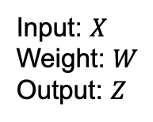


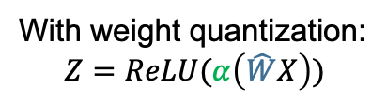

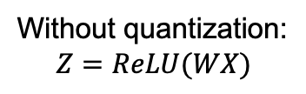
Naïve Solution: Quantization!
Uniform Quantization:
An affine mapping between low-precision integer vectors $\hat{q}$and high-precision floating point vectors $r$.
An example for a layer in ANN:
Low-precision integer
$$r=α (\hat{q} −Z)$$
simplify
$$r=α⋅\hat{q}$$
Scaling factor: 32-bit floating point
Input: $X$
Weight: $W$
Output: $Z$
Without quantization:
$$Z=ReLU(WX)$$
With weight quantization:
$$Z=ReLU(α\left(\hat{W}X\right))$$
Notes:
To overcome the large size of membrane potential, one intuitive solution is to quantize the membrane potential. We will consider the uniform quantization in this work.
Uniform quant can be viewed as an afiine mapping between low precision integers and high precision floating point values.
Here is the formal description, two important quantities here, one is the q hat, which is , the other one is the alpha. Here Z is … Fortunately, we find it is enough to use the following sijmplifed version for SNNs.
An example of ANN, without quantiation. With quantization of weights, we can leverage the low precision weights in computation and storage, after the full matrix multiplication, we then multiply the alpha for 1 time to scale the quantized results to ensure the accuracy.
The next question to ask is that, what happen when we naively apply the uniform quantization to SNNs.

Slide 20



Apply Quantization to SNNs
Let’s review the equations for SNNs again:
The goal is to quantize both the weights and membrane potentials.
Step 1: update
$$H_{l}^{t}={τU}_{l}^{t−1}+W_{l}S_{l−1}^{t}$$
Step 2: firing
$$H_{l}^{t}>v_{th}$$
Step 3: reset
$$U_{l}^{t}=H_{l}^{t}(1−S_{l}^{t})$$
Notes:
Let’s start from the equations of SNNs again. Again, one complete SNN update cycle includes three steps. And we will repeat this three steps for every timesteps.

Slide 21






Apply Quantization to SNNs
Let’s review the equations for SNNs again:
The goal is to quantize both the weights and membrane potentials.
Step 1: update
$$H_{l}^{t}={τU}_{l}^{t−1}+W_{l}S_{l−1}^{t}$$
Step 2: firing
$$H_{l}^{t}>v_{th}$$
Step 3: reset
$$U_{l}^{t}=H_{l}^{t}(1−S_{l}^{t})$$
Step 1: update
$$H_{l}^{t}={τU}_{l}^{t−1}+W_{l}S_{l−1}^{t}$$
$$H_{l}^{t}=α_{2}{τ\hat{U}}_{l}^{t−1}+α_{1}\hat{W_{l}}S_{l−1}^{t}$$
Step 2: firing
$$H_{l}^{t}>v_{th}$$
$$H_{l}^{t}>v_{th}$$
Step 3: reset
$$U_{l}^{t}=H_{l}^{t}(1−S_{l}^{t})$$
$$α_{3}{\hat{U}}_{l}^{t}=H_{l}^{t}(1−S_{l}^{t})$$
Notes:
When we naively apply the uniform quantization to those steps, the equatinos transform to the left hand side form.
Be more concise. Too much.

Slide 22
Apply Quantization to SNNs
Let’s review the equations for SNNs again:
The goal is to quantize both the weights and membrane potentials.
Step 1: update
$$H_{l}^{t}={τU}_{l}^{t−1}+W_{l}S_{l−1}^{t}$$
Step 2: firing
$$H_{l}^{t}>v_{th}$$
Step 3: reset
$$U_{l}^{t}=H_{l}^{t}(1−S_{l}^{t})$$
Step 1: update
$$H_{l}^{t}={τU}_{l}^{t−1}+W_{l}S_{l−1}^{t}$$
$$H_{l}^{t}=α_{2}{τ\hat{U}}_{l}^{t−1}+α_{1}\hat{W_{l}}S_{l−1}^{t}$$
Step 2: firing
$$H_{l}^{t}>v_{th}$$
$$H_{l}^{t}>v_{th}$$
Step 3: reset
$$U_{l}^{t}=H_{l}^{t}(1−S_{l}^{t})$$
$$α_{3}{\hat{U}}_{l}^{t}=H_{l}^{t}(1−S_{l}^{t})$$
Scaling factors need multiplications!
Notes:
We can see here that, those 3 different scaling factors are inserted to the equations, which force us to have high precision multiplications during the inference.

Slide 23
Cost of Scaling Factors
To support the scaling factors, we physically need a 32-bit multiplier.
Output-stationary systolic array is usually adopted for accelerating SNNs. For the quantization scaling, each processing element (PE) requires a 32-bit multiplier.
others
5.0%
The operations involved in each PE.
global buffer
48.7%
fire
scale-related
46.3%
Area breakdown of a 4-bit SpinalFlow
Narayanan, S, et al. "SpinalFlow: An architecture and dataflow tailored for spiking neural networks." (ISCA). IEEE, 2020.
.
Notes:
Though one may argue that, the number of high precision multiplications is not too bad, the number is fairly small compare to the operations in matrix multiplications. The problem for the scaling factor is that we physically need a 32-bit multiplier inside the hardware.
Usually, we have os systolic array adopted for SNNs, where
This is the operations that involed in each PE, we can see that though the SNNs do not require multiplications in the convolution (or mm), but the scaling factor will bring the multipliers back. Here the blue denotes the low precision operation, while the green denotes the operation for 32-bit operands.
More specifically, on the exisiting SNN systems, those high precision multipliers will take a very large portion of the hardware resources. This is the breakdown of the area on spinalflow, a popular SNN inference accelerator. We can see that.

Slide 24




Our methods: Review of LIF Equations
We first look at the LIF equations for updating the membrane potential after reset.
Step 1: update
$$H_{l}^{t}=α_{2}{τ\hat{U}}_{l}^{t−1}+α_{1}\hat{W_{l}}S_{l−1}^{t}$$
Step 2: firing
$$H_{l}^{t}>v_{th}$$
$$α_{3}{\hat{U}}_{l}^{t}=α_{2}{τ\hat{U}}_{l}^{t−1}+α_{1}\hat{W_{l}}S_{l−1}^{t}$$
Step 3: reset
$$α_{3}{\hat{U}}_{l}^{t}=H_{l}^{t}(1−S_{l}^{t})$$
Assume no output spikes
Notes:
Here we start to introduce our methods. We start from review those quantized LIF equations again.
So we first look at the equations for updating the membrane potential
step 1 and 3 could be combine together, this is the main equation we are targeting at.

Slide 25
Our methods: Review of LIF Equations
We first look at the LIF equations for updating the membrane potential after reset.
Step 1: update
$$H_{l}^{t}=α_{2}{τ\hat{U}}_{l}^{t−1}+α_{1}\hat{W_{l}}S_{l−1}^{t}$$
Step 2: firing
$$H_{l}^{t}>v_{th}$$
$$α_{3}{\hat{U}}_{l}^{t}=α_{2}{τ\hat{U}}_{l}^{t−1}+α_{1}\hat{W_{l}}S_{l−1}^{t}$$
Step 3: reset
$$α_{3}{\hat{U}}_{l}^{t}=H_{l}^{t}(1−S_{l}^{t})$$
Assume no output spikes
Notes:
here we show the scaling factors agagin.

Slide 26


Our methods: Review of LIF Equations
We first look at the LIF equations for updating the membrane potential after reset.
Step 1: update
$$H_{l}^{t}=α_{2}{τ\hat{U}}_{l}^{t−1}+α_{1}\hat{W_{l}}S_{l−1}^{t}$$
Step 2: firing
$$H_{l}^{t}>v_{th}$$
$$α_{3}{\hat{U}}_{l}^{t}=α_{2}{τ\hat{U}}_{l}^{t−1}+α_{1}\hat{W_{l}}S_{l−1}^{t}$$
Step 3: reset
$$α_{3}{\hat{U}}_{l}^{t}=H_{l}^{t}(1−S_{l}^{t})$$
Assume no output spikes
$${\hat{U}}_{l}^{t}=\frac{α_{2}}{α_{3}}{τ\hat{U}}_{l}^{t−1}+\frac{α_{1}}{α_{3}}\hat{W_{l}}S_{l−1}^{t}$$
How to get rid of those two multiplications?
How about adding the following constraints to the scaling factors?
$$α_{1}=α_{2}=α_{3}$$
Notes:
we first divide alpha3 to the rhs. which reduce the high precision mulitplications of the scaling factors into two.

Slide 27
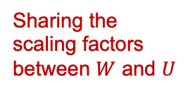

Our methods: Review of LIF Equations
We first look at the LIF equations for updating the membrane potential after reset.
Step 1: update
$$H_{l}^{t}=α_{2}{τ\hat{U}}_{l}^{t−1}+α_{1}\hat{W_{l}}S_{l−1}^{t}$$
Step 2: firing
$$H_{l}^{t}>v_{th}$$
$$α_{3}{\hat{U}}_{l}^{t}=α_{2}{τ\hat{U}}_{l}^{t−1}+α_{1}\hat{W_{l}}S_{l−1}^{t}$$
Step 3: reset
$$α_{3}{\hat{U}}_{l}^{t}=H_{l}^{t}(1−S_{l}^{t})$$
Assume no output spikes
$${\hat{U}}_{l}^{t}=\frac{α_{2}}{α_{3}}{τ\hat{U}}_{l}^{t−1}+\frac{α_{1}}{α_{3}}\hat{W_{l}}S_{l−1}^{t}$$
$${\hat{U}}_{l}^{t}={τ\hat{U}}_{l}^{t−1}+\hat{W_{l}}S_{l−1}^{t}$$
Sharing the scaling factors between $W$ and $U$
How to get rid of those two multiplications?
How about adding the following constraints to the scaling factors?
$$α_{1}=α_{2}=α_{3}$$
Notes:
result in the equations on the rhs. this equation does not have any multiplications left.
// please note that, there is a leaking operation, tau there. but in practices, setting tau to 0.5 is very common and will not affect the performance, 0.5 can be accomplished by shifter.

Slide 28





Our methods: Review of LIF Equations
We then look at the LIF equations for firing output spikes.
Step 1: update
$$H_{l}^{t}=α_{2}{τ\hat{U}}_{l}^{t−1}+α_{1}\hat{W_{l}}S_{l−1}^{t}$$
Step 2: firing
$$H_{l}^{t}>v_{th}$$
$$α_{2}{τ\hat{U}}_{l}^{t−1}+α_{1}\hat{W_{l}}S_{l−1}^{t}>v_{th}$$
Step 3: reset
$$α_{3}{\hat{U}}_{l}^{t}=H_{l}^{t}(1−S_{l}^{t})$$
Firing condition
Remember the shared scaling factors we just discussed.
$$α_{1}=α_{2}=α_{3}=α$$
Notes:
then lets look at the equations for firing the output spikes. if we satisfy this condition, an output spike will be generated.

Slide 29


Our methods: Review of LIF Equations
We then look at the LIF equations for firing output spikes.
Step 1: update
$$H_{l}^{t}=α_{2}{τ\hat{U}}_{l}^{t−1}+α_{1}\hat{W_{l}}S_{l−1}^{t}$$
Step 2: firing
$$H_{l}^{t}>v_{th}$$
$$α_{2}{τ\hat{U}}_{l}^{t−1}+α_{1}\hat{W_{l}}S_{l−1}^{t}>v_{th}$$
Step 3: reset
$$α_{3}{\hat{U}}_{l}^{t}=H_{l}^{t}(1−S_{l}^{t})$$
Firing condition
Remember the shared scaling factors we just discussed.
$$α_{1}=α_{2}=α_{3}=α$$
$$α_{2}{τ\hat{U}}_{l}^{t−1}+α_{1}\hat{W_{l}}S_{l−1}^{t}>v_{th}$$
$${τ\hat{U}}_{l}^{t−1}+\hat{W_{l}}S_{l−1}^{t}>\frac{v_{th}}{α}$$
Notes:
I am going to start with introduction
1:30

Slide 30
Our methods: Review of LIF Equations
We then look at the LIF equations for firing output spikes.
Step 1: update
$$H_{l}^{t}=α_{2}{τ\hat{U}}_{l}^{t−1}+α_{1}\hat{W_{l}}S_{l−1}^{t}$$
Step 2: firing
$$H_{l}^{t}>v_{th}$$
$$α_{2}{τ\hat{U}}_{l}^{t−1}+α_{1}\hat{W_{l}}S_{l−1}^{t}>v_{th}$$
Step 3: reset
$$α_{3}{\hat{U}}_{l}^{t}=H_{l}^{t}(1−S_{l}^{t})$$
Firing condition
Remember the shared scaling factors we just discussed.
$$α_{1}=α_{2}=α_{3}=α$$
integers
$$α_{2}{τ\hat{U}}_{l}^{t−1}+α_{1}\hat{W_{l}}S_{l−1}^{t}>v_{th}$$
$${τ\hat{U}}_{l}^{t−1}+\hat{W_{l}}S_{l−1}^{t}>\frac{v_{th}}{α}$$
Notes:
I am going to start with introduction
1:30

Slide 31

Our methods: Review of LIF Equations
We then look at the LIF equations for firing output spikes.
Step 1: update
$$H_{l}^{t}=α_{2}{τ\hat{U}}_{l}^{t−1}+α_{1}\hat{W_{l}}S_{l−1}^{t}$$
Step 2: firing
$$H_{l}^{t}>v_{th}$$
$$α_{2}{τ\hat{U}}_{l}^{t−1}+α_{1}\hat{W_{l}}S_{l−1}^{t}>v_{th}$$
Step 3: reset
$$α_{3}{\hat{U}}_{l}^{t}=H_{l}^{t}(1−S_{l}^{t})$$
Firing condition
Remember the shared scaling factors we just discussed.
$$α_{1}=α_{2}=α_{3}=α$$
integers
$$α_{2}{τ\hat{U}}_{l}^{t−1}+α_{1}\hat{W_{l}}S_{l−1}^{t}>v_{th}$$
$${τ\hat{U}}_{l}^{t−1}+\hat{W_{l}}S_{l−1}^{t}>\frac{v_{th}}{α}$$
$${τ\hat{U}}_{l}^{t−1}+\hat{W_{l}}S_{l−1}^{t}≥[\frac{v_{th}}{α}]$$
Notes:
we play a trick here, since the left hand side are all integers, the equation can be transformed to this form without losing generality.

Slide 32
Our methods: Review of LIF Equations
We then look at the LIF equations for firing output spikes.
Step 1: update
$$H_{l}^{t}=α_{2}{τ\hat{U}}_{l}^{t−1}+α_{1}\hat{W_{l}}S_{l−1}^{t}$$
Step 2: firing
$$H_{l}^{t}>v_{th}$$
$$α_{2}{τ\hat{U}}_{l}^{t−1}+α_{1}\hat{W_{l}}S_{l−1}^{t}>v_{th}$$
Step 3: reset
$$α_{3}{\hat{U}}_{l}^{t}=H_{l}^{t}(1−S_{l}^{t})$$
Firing condition
Remember the shared scaling factors we just discussed.
$$α_{1}=α_{2}=α_{3}=α$$
integers
$$α_{2}{τ\hat{U}}_{l}^{t−1}+α_{1}\hat{W_{l}}S_{l−1}^{t}>v_{th}$$
$${τ\hat{U}}_{l}^{t−1}+\hat{W_{l}}S_{l−1}^{t}>\frac{v_{th}}{α}$$
integers
$${τ\hat{U}}_{l}^{t−1}+\hat{W_{l}}S_{l−1}^{t}≥[\frac{v_{th}}{α}]$$
integer
Equivalent of scaling the firing threshold!
Notes:
we only need to caluclate this value offline. emprically, we need no more than 6bits for this value.

Slide 33








MINT Quantization
The forward algorithm for our proposed MINT (Multiplierless INTeger) quantization is formalized as below:
$$H_{l}^{t}← \hat{W_{l}}S_{l−1}^{t}+{\hat{U}}_{l}^{t−1}≫1$$
$${if H}_{l}^{t}≥\left[\frac{v_{th}}{α}\right]then$$
$$S_{l}^{t}←1$$
Low Storage of weights
Low Storage of potentials
No Multipliers
Fully Integer
$${\hat{U}}_{l}^{t}←0$$
$$else$$
$$S_{l}^{t}←0$$
${\hat{U}}_{l}^{t}←$ $H_{l}^{t}$
$$endif$$
Yin R, et al. MINT: Multiplier-less Integer Quantization for Spiking Neural Networks[J]. arXiv preprint arXiv:2305.09850, 2023.
Notes:
with all those discussions, we formalized our method.

Slide 34
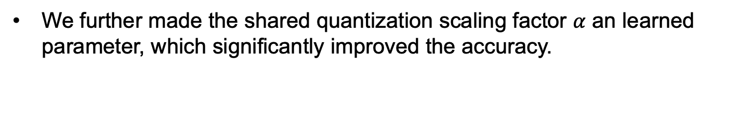
Training of MINT Quantized SNNs
We utilized Quantization Aware Training (QAT) to train our SNNs based on Backpropagation-through-Time (BPTT).
We further made the shared quantization scaling factor $α$ an learned parameter, which significantly improved the accuracy.
Yin R, et al. MINT: Multiplier-less Integer Quantization for Spiking Neural Networks[J]. arXiv preprint arXiv:2305.09850, 2023.
Notes:
during the training time, we do need to insert several quantization fucntions and using the fp gradients to do the standatrd bptt training of snns

Slide 35
Projection on SNN Accelerators
Processing element (PE) differences between MINT and vanilla Uniform Quantization (UQ) inside the SNN accelerator systems.
Notes:
finally lets look at the projection of mint on pe design of snn accelerators.
we envision an stnadard os-systolic array with three memory hierarchies. the hardware parameters are shown in the table here.

Slide 36















Projection on SNN Accelerators
Processing element (PE) differences between MINT and vanilla Uniform Quantization (UQ) inside the SNN accelerator systems.
PE unit for vanilla UQ
$$U_{in}^{t}$$
$$W$$
spad
AC unit
scale unit
LIF unit
$$S_{in}^{t}$$
$$α$$
$$v_{th}$$
$$S_{out}^{t}$$
x
<<
+
<<
0
$$U_{out}^{t}$$
+
LIF unit UQ
LIF unit MINT
$$W$$
LIF unit
$$θ$$
$$S_{out}^{t}$$
spad
AC unit
+
$$S_{in}^{t}$$
$$U_{in}^{t}$$
<<
0
$$U_{out}^{t}$$
PE unit for MINT
$$\left[\frac{v_{th}}{α}\right]$$
$$θ=$$
Yin R, et al. MINT: Multiplier-less Integer Quantization for Spiking Neural Networks[J]. arXiv preprint arXiv:2305.09850, 2023.
Notes:
lets zoom into the pe design.

Slide 37
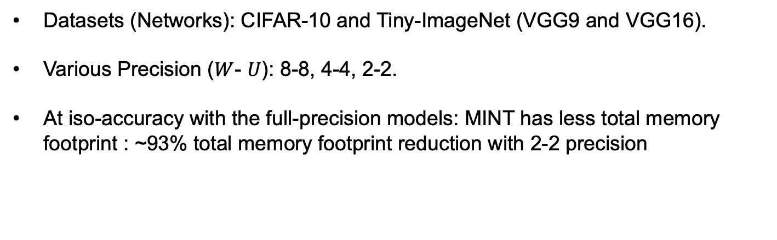
Experimental Results
Datasets (Networks): CIFAR-10 and Tiny-ImageNet (VGG9 and VGG16).
Various Precision ($W$- $U$): 8-8, 4-4, 2-2.
At iso-accuracy with the full-precision models: MINT has less total memory footprint : ~93% total memory footprint reduction with 2-2 precision
Yin R, et al. MINT: Multiplier-less Integer Quantization for Spiking Neural Networks[J]. arXiv preprint arXiv:2305.09850, 2023.
Notes:
Emphize,

Slide 38
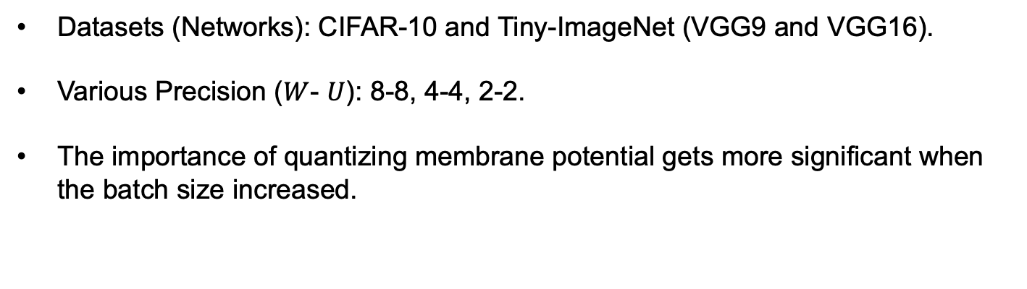
Experimental Results
Datasets (Networks): CIFAR-10 and Tiny-ImageNet (VGG9 and VGG16).
Various Precision ($W$- $U$): 8-8, 4-4, 2-2.
The importance of quantizing membrane potential gets more significant when the batch size increased.
Yin R, et al. MINT: Multiplier-less Integer Quantization for Spiking Neural Networks[J]. arXiv preprint arXiv:2305.09850, 2023.
Notes:
Emphaize the importance of quantizing the membrane potentials. That has largely been ignored by previous SNN quantization works. When we quantize the weights we do have some reasonable benefits, but …

Slide 39
Experimental Results
Simulated energy comparison between the MINT and vanilla UQ across different precision.
Simulated memory movement energy cost of MINT across different precision.
87.3% reduction
Yin, Ruokai, et al. "Sata: Sparsity-aware training accelerator for spiking neural networks." IEEE Transactions on Computer-Aided Design of Integrated Circuits and Systems (2022). https://github.com/RuokaiYin/SATA_Sim
Notes:
we can see that across different precisions, mint constatnly cost much less computation energy than the standard UQ.
the results are got in the open-source snn energy simulator below.
quickly

Slide 40
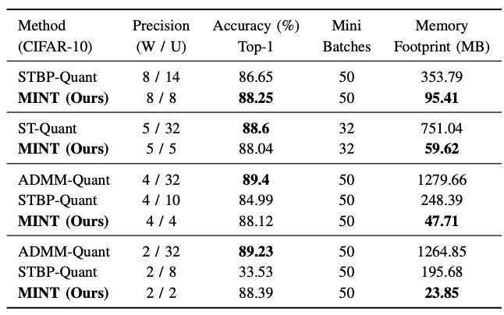
Experimental Results
Compare with other SOTA SNN quantization work, MINT achieves much smaller total memory footprint at iso-accuracy.
Deng, Lei, et al. "Comprehensive snn compression using admm optimization and activity regularization.” (TNNLS). IEEE, 2021.
Tan, Pai-Yu, and Cheng-Wen Wu. "A Low-Bitwidth Integer-STBP Algorithm for Efficient Training and Inference of Spiking Neural Networks." Proceedings of the 28th Asia and South Pacific Design Automation Conference. 2023.
Chowdhury, Sayeed Shafayet, Isha Garg, and Kaushik Roy. "Spatio-temporal pruning and quantization for low-latency spiking neural networks." 2021 International Joint Conference on Neural Networks (IJCNN). IEEE, 2021.

Slide 41
Experimental Results
MINT is agnostic to the underlying hardware used for deployment.
Compared to other SOTA SNN quantization work that requires scaling factors, MINT achieves a much smaller circuit area on other existing SNN accelerator systems.
76%
93%
86%
95%
Narayanan, S, et al. "SpinalFlow: An architecture and dataflow tailored for spiking neural networks." (ISCA). IEEE, 2020.
Lee, J, et al. "Parallel time batching: Systolic-array acceleration of sparse spiking neural computation." (HPCA). IEEE, 2022.
Deng, Lei, et al. "Comprehensive snn compression using admm optimization and activity regularization.” (TNNLS). IEEE, 2021.

Slide 42
Thank you!
Code is available at: https://github.com/RuokaiYin/MINT_Quantization/
Please cite this work if found interesting:
Yin R, et al. MINT: Multiplier-less Integer Quantization for Spiking Neural Networks[J]. arXiv preprint arXiv:2305.09850, 2023.
Q & A?

Slide 43
References
Appendix
BNTT :
Kim, Youngeun, and Priyadarshini Panda. "Revisiting batch normalization for training low-latency deep spiking neural networks from scratch." Frontiers in neuroscience 15 (2021): 773954.
Direct SNN:
Wu, Yujie, et al. "Direct training for spiking neural networks: Faster, larger, better." Proceedings of the AAAI conference on artificial intelligence. Vol. 33. No. 01. 2019.
Event BP:
Zhu, Yaoyu, et al. "Training spiking neural networks with event-driven backpropagation." Advances in Neural Information Processing Systems 35 (2022): 30528-30541.
TSSL:
Zhang, Wenrui, and Peng Li. "Temporal spike sequence learning via backpropagation for deep spiking neural networks." Advances in Neural Information Processing Systems 33 (2020): 12022-12033.
TDBN:
Zheng, Hanle, et al. "Going deeper with directly-trained larger spiking neural networks." Proceedings of the AAAI conference on artificial intelligence. Vol. 35. No. 12. 2021.
LTH:
Kim, Youngeun, et al. "Exploring lottery ticket hypothesis in spiking neural networks." European Conference on Computer Vision. Cham: Springer Nature Switzerland, 2022.

