Slide 1
Quora Insincere Questions Classification
Group members:
Ujjwal Siddharth (uxs170430)
Akash Chand (axc173730)
HaoLun Lo (hxl173830)
Ruolan Zeng (rxz171630)

Slide 2
Introduction
This project aims at creating an algorithm to predict whether a question asked on Quora is sincere or not.
An insincere question is defined as a question intended to make a statement rather than look for helpful answers.
Some characteristics that can signify that a question is insincere:
Has a non-neutral tone
Is disparaging or inflammatory
Isn't grounded in reality
Uses sexual content (incest, bestiality, pedophilia) for shock value, and not to seek genuine answers

Slide 3
Training & Test Data - Source
Source: Kaggle Code Competition
Title: Quora Insincere Question Classification

Slide 4
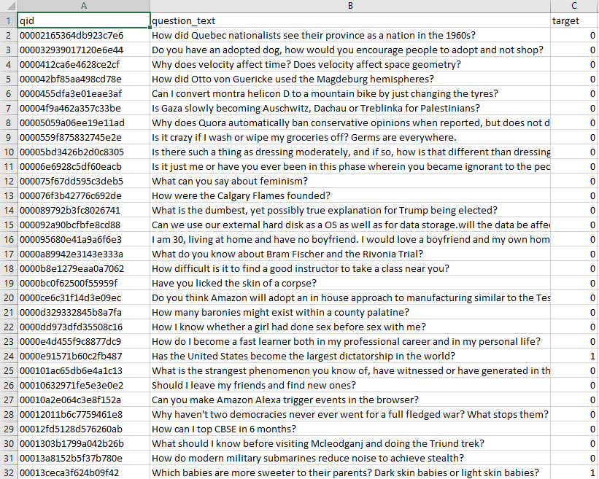
Training & Test Data – Data Set
Data source: Kaggle code competition
Question ID
Question text (Input)
Target (Output)
0 = sincere question
1 = insincere question

Slide 5
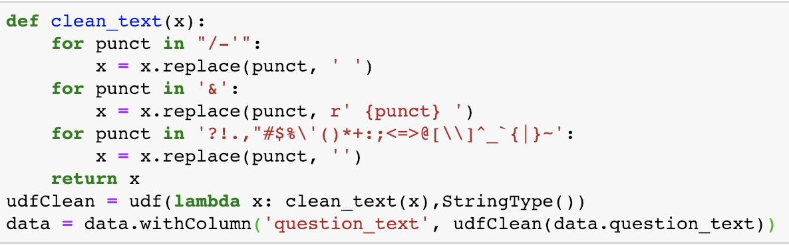
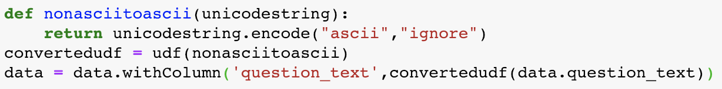
Pre-processing
1.Remove Punctuation
2. Remove Non-ascii Characters

Slide 6
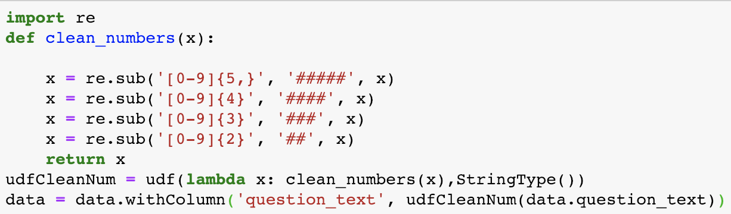
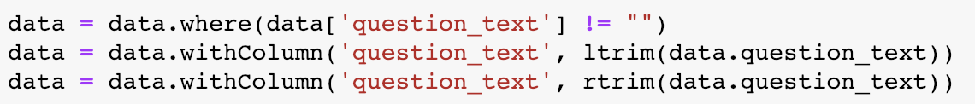
Pre-processing
3.Remove Numbers
4. Remove empty strings and whitespaces

Slide 7
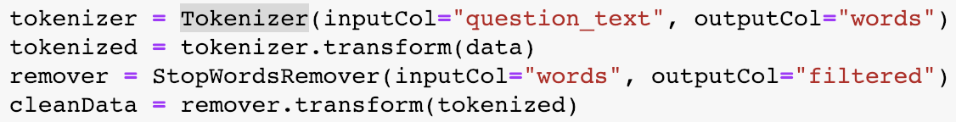
Pre-processing
5.Tokenizer and Remove Stopwords
6.Embedding(word2vec)
Word2Vec computes distributed vector representation of words.
Main advantage: similar words are close in the vector space, which makes generalization to novel patterns easier and model estimation more robust.

Slide 8
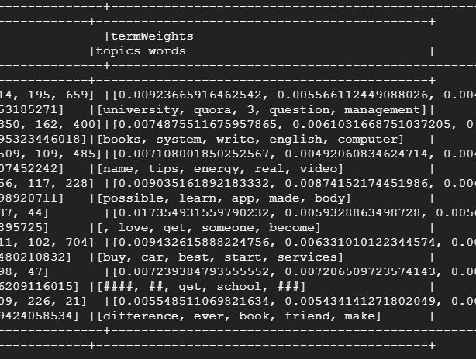
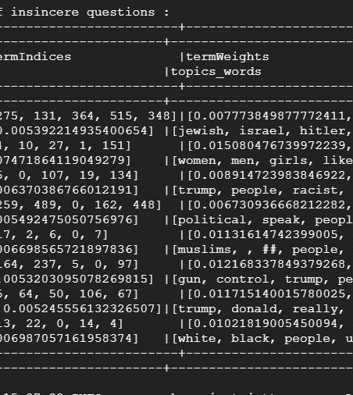
Topic Modelling
On fitting the sincere and insincere data to an LDA model, we found out that sincere questions dealt with topics related to education, career and books while insincere questions dealt with topics related to Donald Trump, racism and politics.

Slide 9
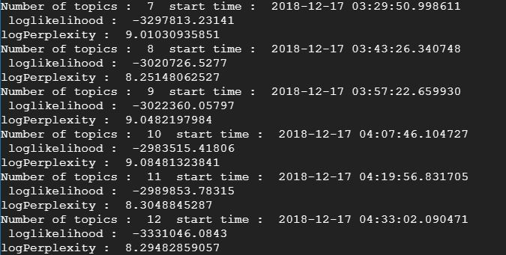
Topic Modelling
The most common way to evaluate a probabilistic model is to measure the log-likelihood of a held-out test set.
Perplexity is a decreasing function of the log-likelihood, L(w) of the unseen documents. The lower the perplexity, the better the model.
We found the lowest perplexity for k=20 topics for our dataset.

Slide 10
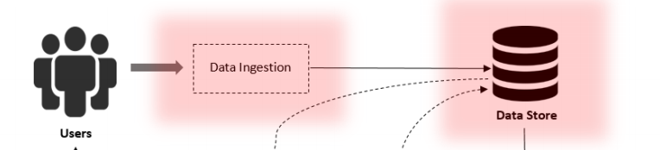
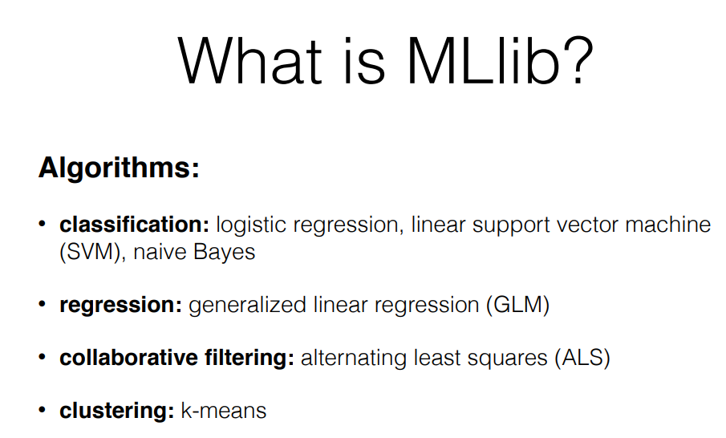
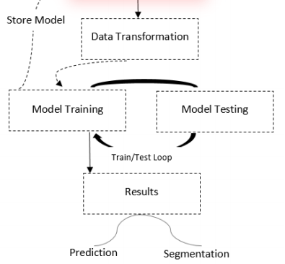
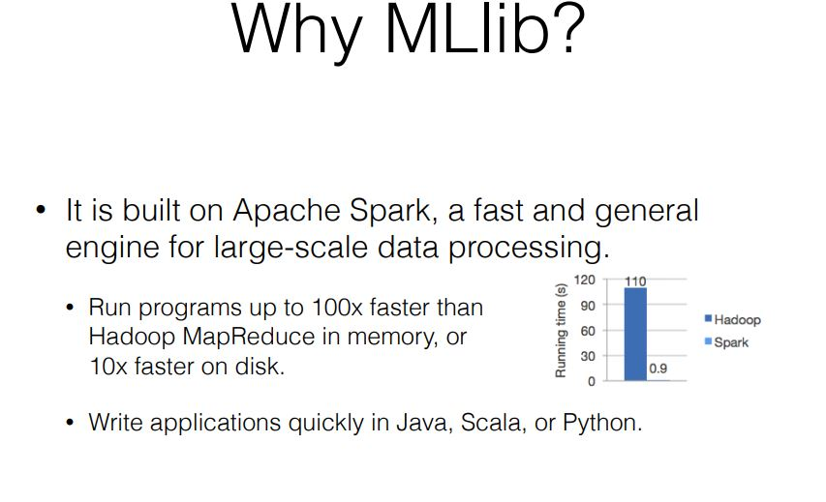
Supervised Learning Using Spark MLlib

Slide 11
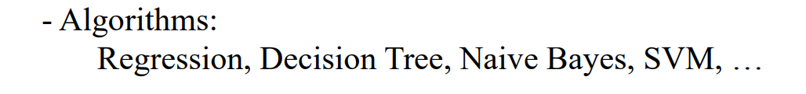
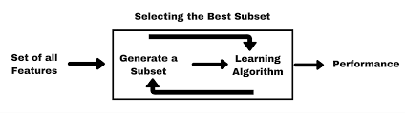

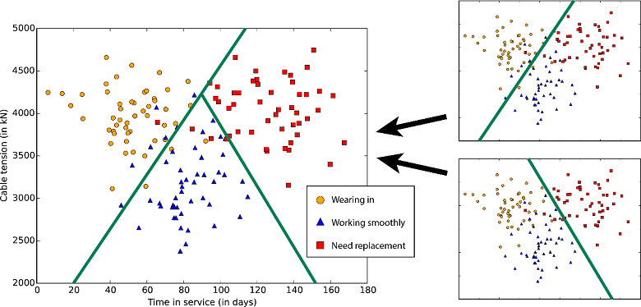
Features selected
We selected two features :
WordVectors and Topics after the previous stage.
Both these features are converted to vector form before being fed into the model.
Traget Column is the class/label for the data

Slide 12
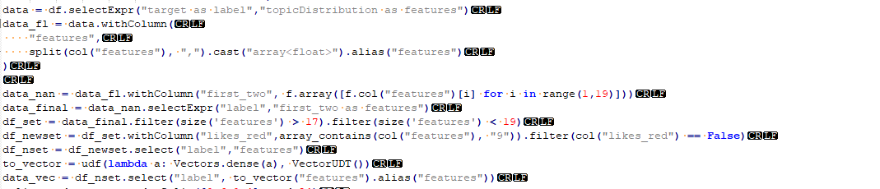
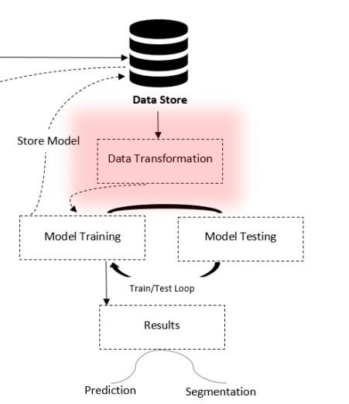
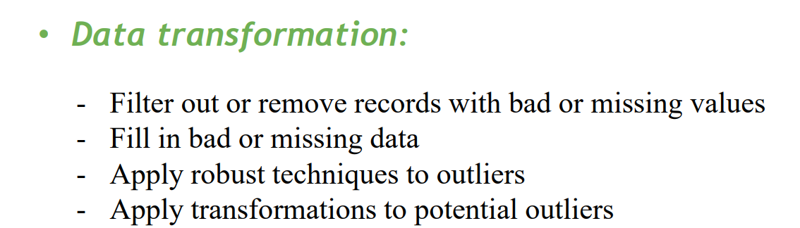
Data Transformation

Slide 13

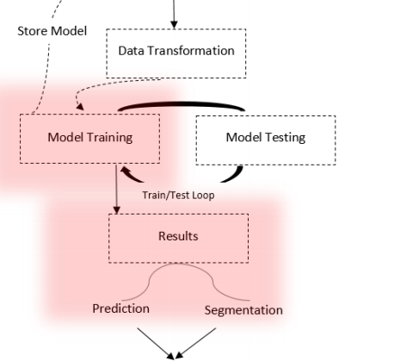

Training Classifier
Splitting data and creating layers (incase of NN)
Applying Classifier and making the model

Slide 14
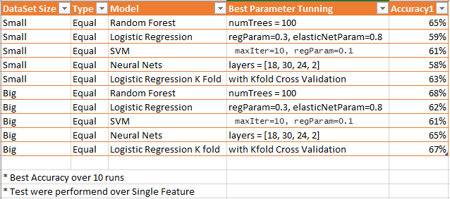
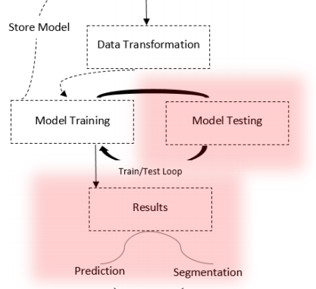
Evaluating performance

Slide 15
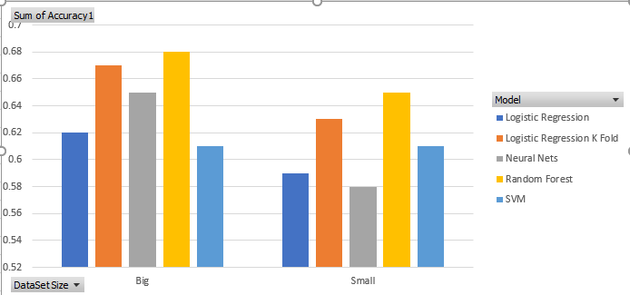
Evaluating Performance
Based on multiple runs across various classifiers we selected Random Forest Model

Slide 16
Working Environment
Linux / OSX with Jupyter → coding
Google Cloud Platform (GCP) → training & verification

Slide 17
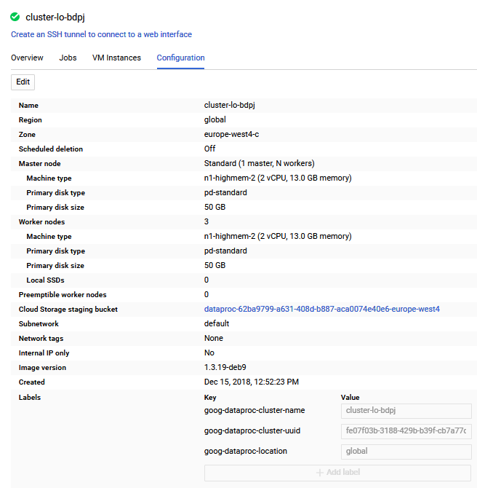
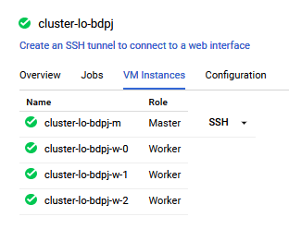
Google Cloud Platform

Slide 18
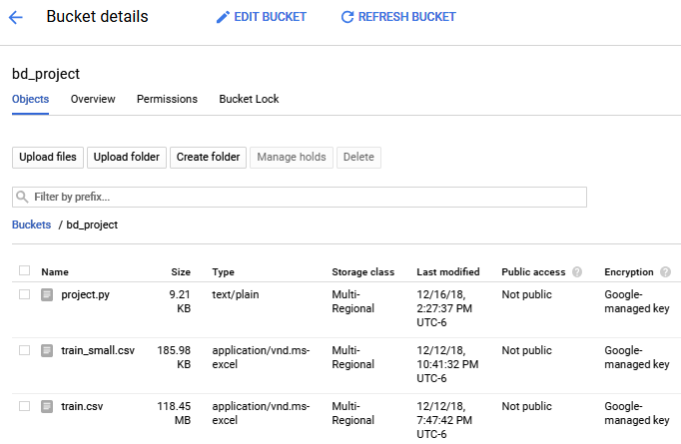
Google Cloud Platform

Slide 19
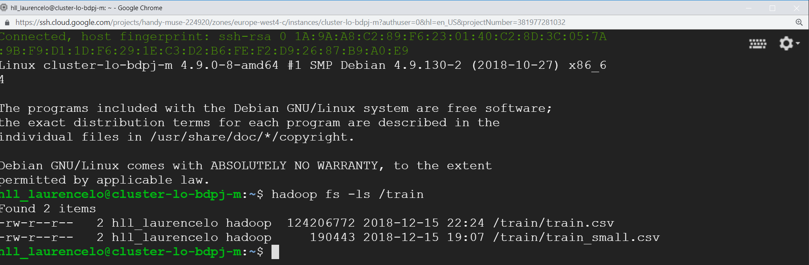
Google Cloud Platform

Slide 20
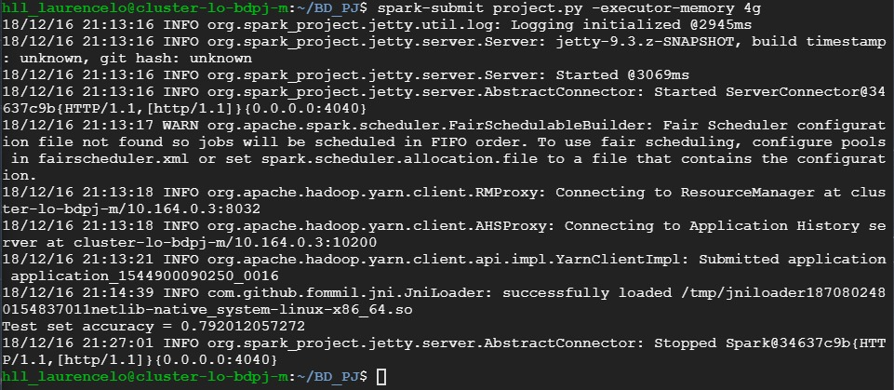
Google Cloud Platform

