Slide 1
FOODCO NIGERIA
"The Secret Ingredient"
Campaign Performance Report — 4-Week Digital Launch Results
Prepared by The Analyst's Desk — Independent Practice Project
Campaign Window: August 3 – August 30, 2026
Note: This is a self-initiated simulation project built to demonstrate the campaign-to-dashboard analyst workflow. FoodCo Nigeria, all data, and all figures are fictional.

Slide 2
EXECUTIVE SUMMARY
The Campaign Beat Target on 5 of 6 KPIs
3.87x
₦19.35M
7,402
+95%
Final ROAS
Total Revenue
Total Conversions
Optimization Lift
vs 3.5x target
on ₦5M spend
trial purchases
ROAS Wk1-2 → Wk3-4
Over a 4-week rollout across Meta Ads, Google Search, Google Display, and two influencer partners, "The Secret Ingredient" generated 7,402 trial conversions on a ₦5,000,000 budget — a 3.87x return, above the 3.5x target. A deliberate Week 1–2 learning phase, followed by data-driven optimization from Week 3 onward, nearly doubled ROAS by the campaign's close.
Headline Takeaways
Meta Ads was the standout channel: lowest CPA (₦610) and highest ROAS (4.27x)
Google Display underperformed: CPA ₦1,235 vs ₦800 target — recommended for pause
CPC ran above target (₦53.51 vs ₦45), offset by strong conversion efficiency
Google Search converted clicks at the highest rate (≈18%) of any channel
FoodCo Nigeria — "The Secret Ingredient"
2 / 10

Slide 3
CAMPAIGN OVERVIEW
Campaign Setup at a Glance
Product
FoodCo Seasoning Cubes — new flavour launch
Budget Allocation by Channel
Objective
Drive awareness and trial purchases
Audience
Women 25–45, Lagos / Abuja / Port Harcourt
Budget
₦5,000,000 over 4 weeks
Channels
Meta Ads, Google Search, Google Display, 2 Influencers
4-Week Phased Rollout
Wk 1-2
Wk 3
Wk 4
Learning Phase
Optimization
Strong Close
Broad targeting, creative testing
Reallocate to top performers
Scale winners, retarget engaged users
FoodCo Nigeria — "The Secret Ingredient"
3 / 10

Slide 4
KPI SCORECARD
Targets vs. Actual Results
Impressions
Reach
CTR
CPC
CPA
ROAS
2.42M
1.18M
3.86%
₦53.51
₦675.49
3.87x
Target: 2.0M
Target: 0.8M
Target: 2.5%
Target: ≤45 max
Target: ≤₦800 max
Target: ≥3.5x min
Beat Target
Beat Target
Beat Target
Above Target
Beat Target
Beat Target
Reading the One Red Card
CPC landed at ₦53.51 against a ₦45 target — roughly 19% above goal — driven by competitive FMCG keyword and CPM costs in the Nigerian digital market. This did not translate into a weaker outcome: strong click-to-conversion rates across channels meant CPA (₦675) and ROAS (3.87x) both cleared their targets comfortably. The efficiency lever that mattered was conversion quality, not click cost — a distinction worth flagging rather than smoothing over.
FoodCo Nigeria — "The Secret Ingredient"
4 / 10

Slide 5
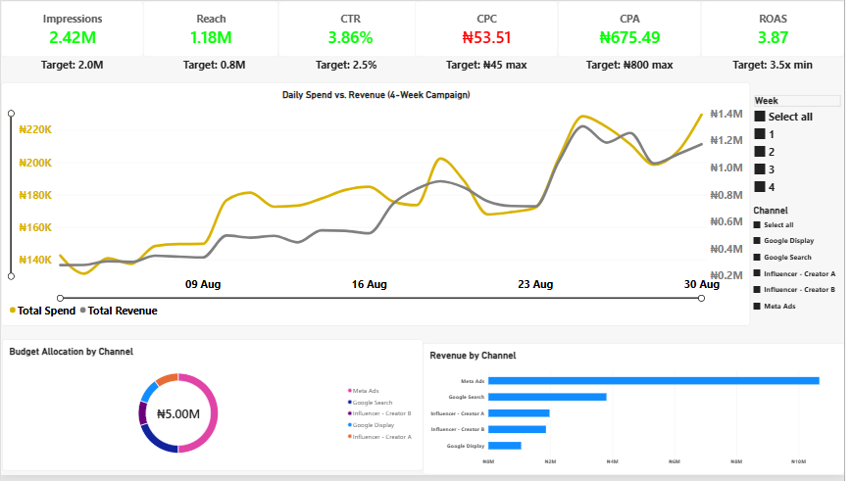
PERFORMANCE TREND
Spend and Revenue Diverge After Week 3
What the Chart Shows
Spend and Revenue track closely through early-to-mid August (Weeks 1–2) — the learning phase
Revenue begins pulling ahead of Spend heading into Week 3, as optimization takes effect
Both lines peak in the final stretch (Aug 23–30), reflecting the Week 4 strong close
Budget allocation (right) shows Meta Ads absorbing half of total spend — and Revenue by Channel confirms it returned the most
FoodCo Nigeria — "The Secret Ingredient"
5 / 10

Slide 6
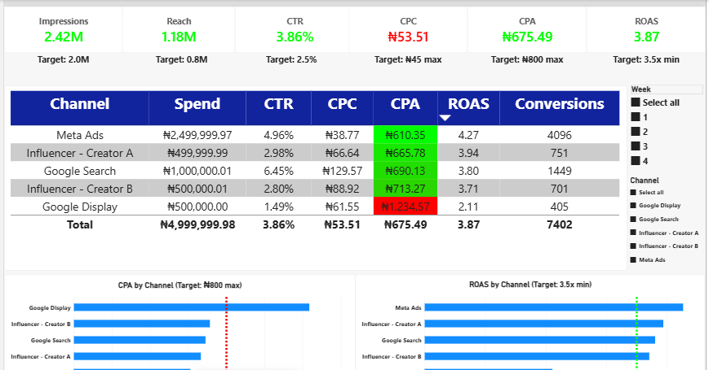
CHANNEL PERFORMANCE
Meta Ads Leads; Google Display Lags
BEST: Meta Ads
CPA ₦610 • ROAS 4.27x
50% of budget, highest revenue return of any channel.
WEAKEST: Google Display
CPA ₦1,235 • ROAS 2.11x
Missed the ₦800 CPA target by over 50% — recommended for pause (see Slide 9).
FoodCo Nigeria — "The Secret Ingredient"
6 / 10

Slide 7
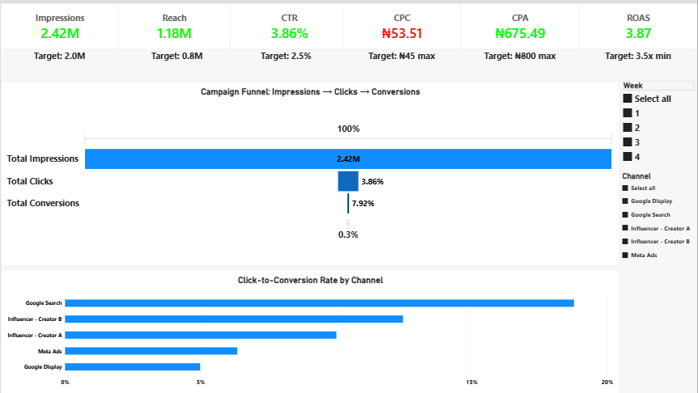
CONVERSION FUNNEL
Volume vs. Intent: Two Different Wins
Why This Matters
Google Search converts clicks at ~18% — the highest of any channel — because these are users actively searching for seasoning solutions. Meta Ads converts closer to ~6%, but its massive reach means that lower rate still produces the best overall CPA and ROAS. These are two different kinds of wins: Meta wins on scale, Search wins on intent quality. Search's budget share stays modest only because search volume itself is limited — not because the channel underperforms.
FoodCo Nigeria — "The Secret Ingredient"
7 / 10

Slide 8
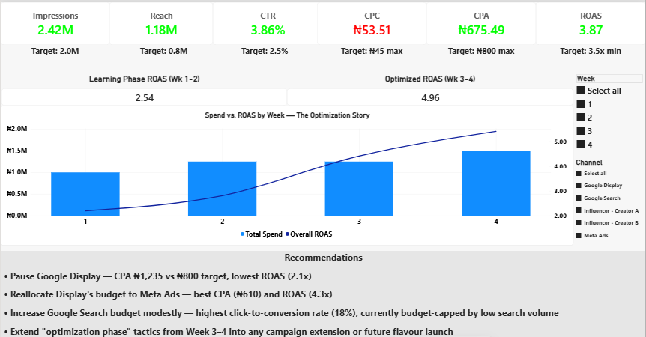
OPTIMIZATION STORY
Optimization Nearly Doubled ROAS
Learning Phase (Wk 1-2)
2.54x
↓ optimized to
Optimized Phase (Wk 3-4)
4.96x
+95% ROAS improvement
Reallocating budget toward top performers and pausing weak creative from Week 3 turned a below-target start into a well-above-target finish.
FoodCo Nigeria — "The Secret Ingredient"
8 / 10

Slide 9
RECOMMENDATIONS
Where We Go From Here
1
Pause Google Display
2
Reallocate to Meta Ads
CPA ₦1,235 vs ₦800 target; lowest ROAS (2.11x) of all channels.
Best CPA (₦610) and ROAS (4.27x) — the highest-return home for freed-up budget.
3
Grow Google Search modestly
4
Extend optimization tactics
Highest click-to-conversion rate (~18%), currently capped by limited search volume, not performance.
Apply Week 3–4 targeting and creative learnings to any extension or future flavour launch.
FoodCo Nigeria — "The Secret Ingredient"
9 / 10

Slide 10
Next Steps
1. Finalize budget reallocation from Google Display into Meta Ads for any campaign extension
2. Apply the Week 3–4 optimization playbook as the default approach for future FoodCo launches
3. Explore a modest Search budget increase to capture more high-intent, high-conversion traffic
Thank you.
Prepared by The Analyst's Desk — Independent Practice Project
Note: This is a self-initiated simulation project built to demonstrate the campaign-to-dashboard analyst workflow. FoodCo Nigeria, all data, and all figures are fictional.

