Slide 1

What Determines the Length of Stay in Animal Shelters？
A Generalized Linear Model Approach Based on Dallas Shelter Data
Group 19 Ce Zha, Fanzhen Pei, Hongxiang Huang, Ruoning Hou, Shaoran Xu

Slide 2
目 录
CONTENTS
PART 01
Analysis Objective
PART 04
Conclusion
PART 02
Exploratory Data Analysis
PART 05
Future Research
PART 03
Statistical Modeling
and Results

Slide 3
1
Analysis Objective

Slide 4
Analysis Objective
02
Investigate factors influencing Time at Shelter
01
03
Method:
Generalized Linear Model (GLM)
Key variables:
02
Goal:
Animal Type
Intake Type
Chip Status
Outcome Type
04
Identify variables significantly associated with shelter stay
Which variable has the greatest impact on shelter stay time, and how strong is this impact?

Slide 5
2
Exploratory Data Analysis

Slide 6
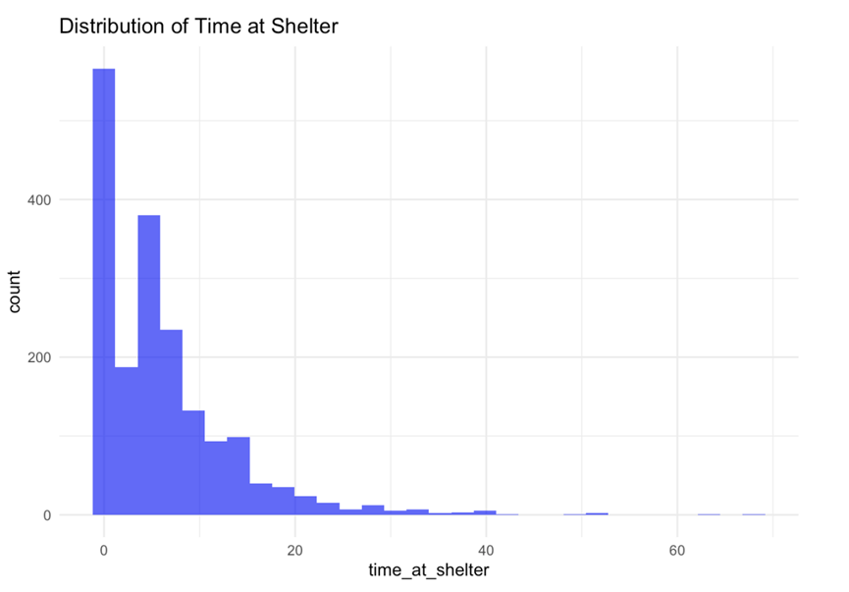
Exploratory Data Analysis
04
单击此处添加名称
• Right-skewed distribution
• Most animals stay for a short time
• Fewer animals stay for a long time

Slide 7
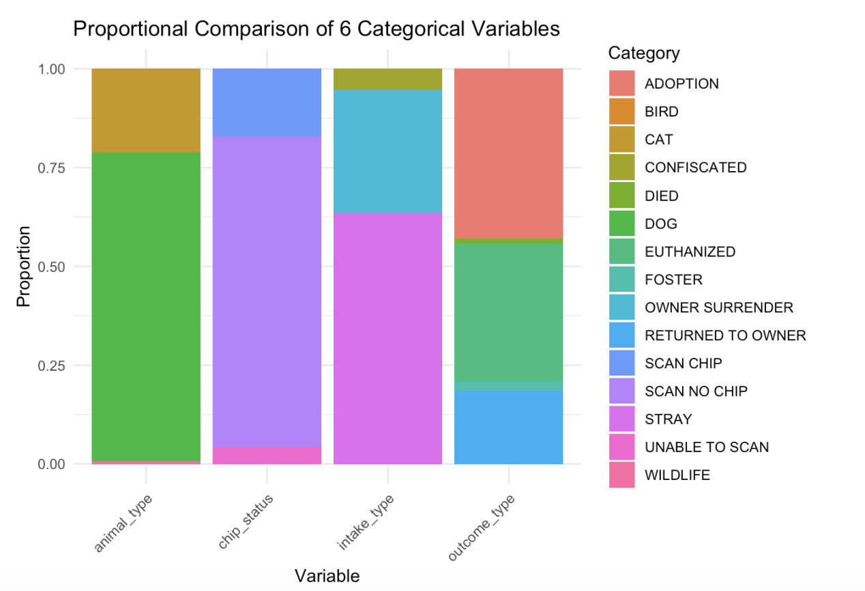

Exploratory Data Analysis
05
Proportional Distribution of Key Variables
• Animal Type: Dogs are the majority, followed by cats
• Chip Status: Most animals do not have a chip
• Intake Type: Stray animals make up the largest portion
• Outcome Type: Adoption is the most common, followed by euthanasia
Key Takeaway:
• Dogs & strays dominate the dataset
• Adoption is the most frequent outcome

Slide 8
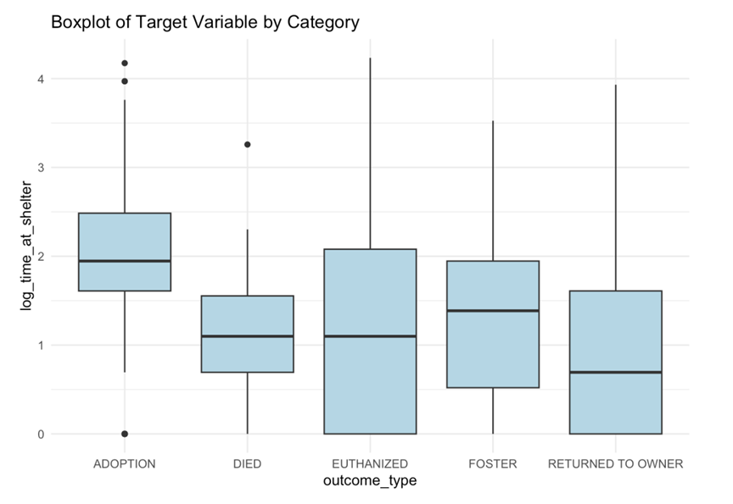
Exploratory Data Analysis
06
Log-Transformed Time at Shelter by Outcome Type
• Adoption: Longest stay, several outliers
• Died: Very short stay, median near 0
• Euthanized: Longer stay, wide spread
• Foster: Short stay, tight distribution
• Returned to Owner: Also short, similar to Foster
Insight:
Adoption & Euthanized ⬆/ Died, Foster, Returned ⬇

Slide 9
3
Statistical Modeling and Results

Slide 10
Statistical Modeling and Results
08
Model Overview
•Dependent variable: time_at_shelter
•Transformation: Log transformation applied to reduce skewness
•Model type: Poisson GLM
•Independent variables:
•animal_type
•intake_type
•outcome_type
•chip_status
Justification
•Variables selected based on prior EDA
•Poisson model is suitable for non-negative count data
•Log transformation improves model stability and reduces outlier impact

Slide 11
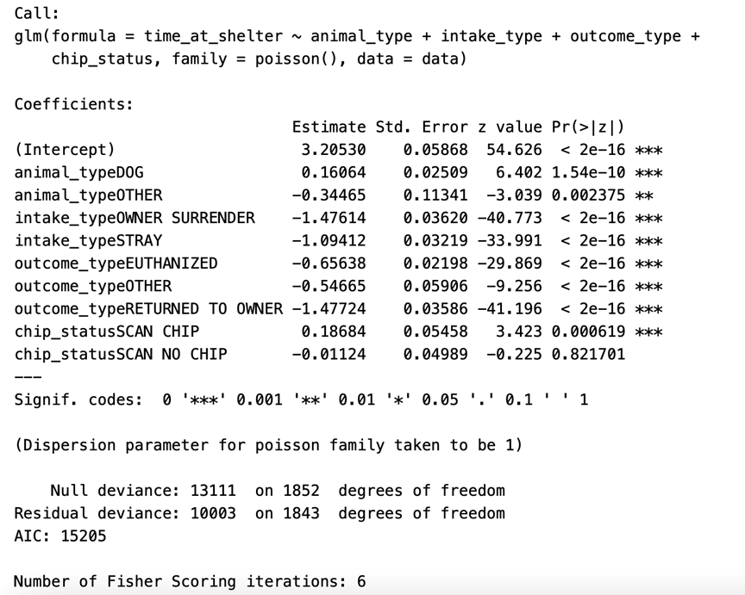
Statistical Modeling and Results
09
Poisson GLM Results: Factors Influencing Time at Shelter
• DOG: +0.16 → Dogs stay longer (p < 0.001)
• Owner Surrender: −1.48 → Much shorter stay (p < 0.001)
• Stray: −1.09 → Shorter stay (p < 0.001)
• Euthanized: −0.66 → Short stay (p < 0.001)
• Returned to Owner: −1.48 → Shortest stay (p < 0.001)
• Scan Chip: +0.19 → Slightly longer stay (p < 0.001)
• Scan No Chip: Not significant (p = 0.82)
Insight:
Dogs and chipped animals stay longer; owner-surrendered and returned animals stay least.

Slide 12
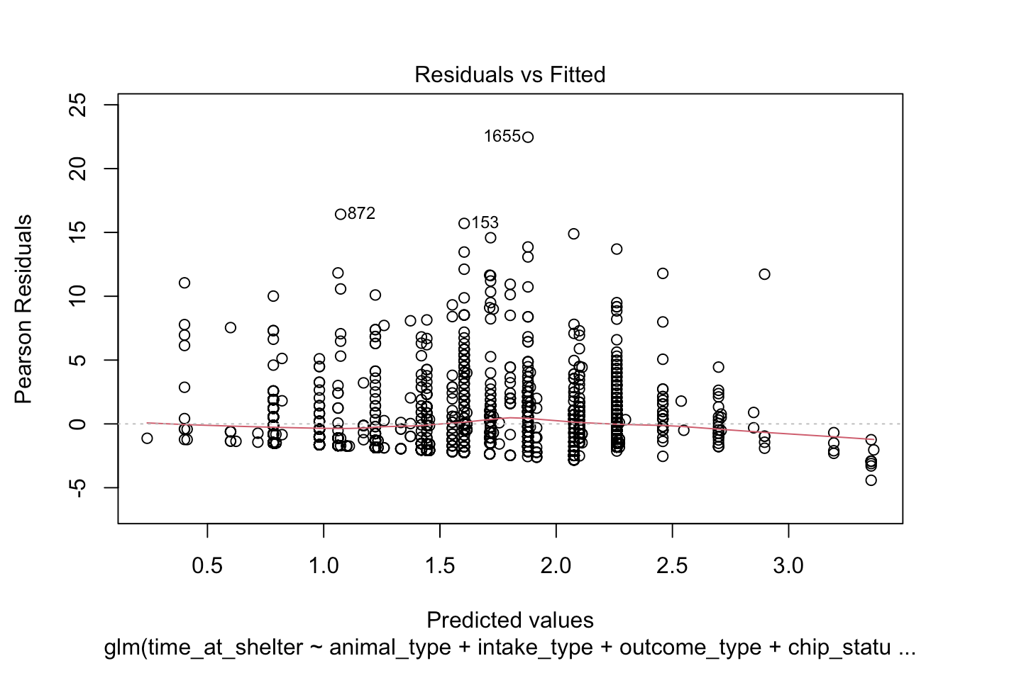
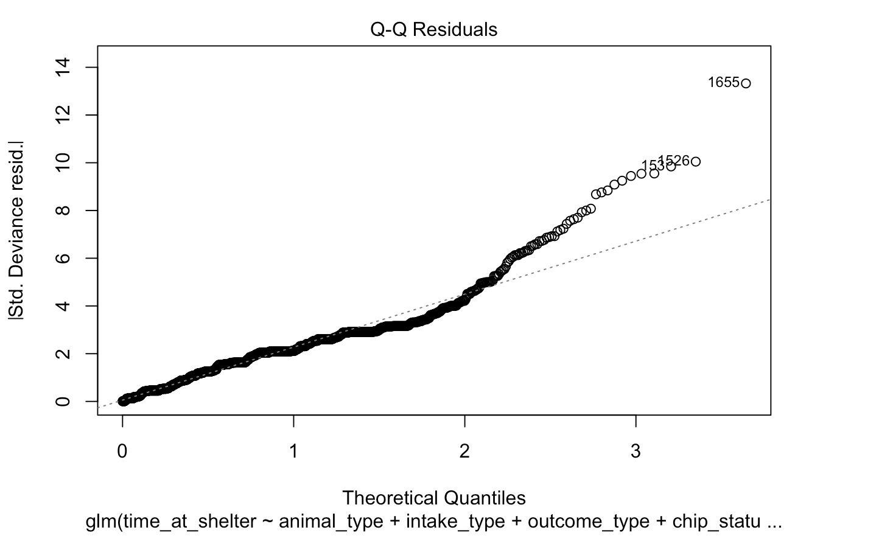
Statistical Modeling and Results
10
Residual Diagnostics: Model Fit
Residuals vs. Fitted → No strong pattern, model fits well ✅
Q-Q Plot → Some high residuals, indicating outliers

Slide 13
4
Conclusion

Slide 14
Conclusion
12
01
Animal type affects shelter time: dogs stay longer
02
Intake type is critical: owner surrender & stray = shortest stays
03
Outcome type matters: adoption & euthanasia = longer stays
04
Microchip scan slightly increases shelter time
05
Poisson GLM fits well, key variables are statistically significant

Slide 15
Conclusion
13
Strongest negative effects found in:
• Variable: intake_type = OWNER SURRENDER
• Intake Type = Owner Surrender
• Outcome Type = Returned to Owner
Coefficients:
• Owner Surrender → −1.4761
• Returned to Owner → −1.4772
Impact:
• Both reduce shelter time by ~77%
• Only 23% of baseline stay duration
Observation:
These two variables are the strongest predictors affecting shelter stay

Slide 16
5
Future Research

Slide 17
Future Research
15
Limitations
• Some data points with “unknown” values were excluded
• Small sample size for birds → merged into “others” → may affect interpretation
Future Work
• Try Negative Binomial regression to handle overdispersion
• Improve data quality by addressing missing or ambiguous values
• Collect more data on minority animal types (e.g., birds)

Slide 18
Thank you!

