Slide 1
.YADL

Slide 2
1.
Repetitive-Strain-Injury

Slide 3
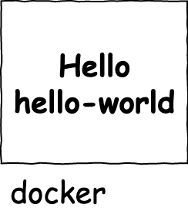
.YADL
version: "3.7"
services:
Hello:
images: hello-world

Slide 4
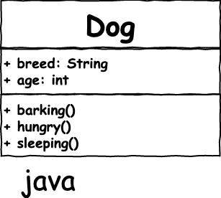
.YADL
public class Dog {
String breed;
int age;
String color;
void barking() {
}
void hungry() {
}
void sleeping() {
}
}

Slide 5
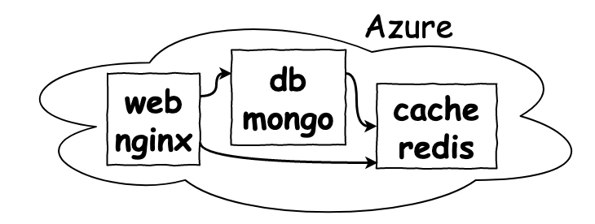

.YADL

