Slide 1
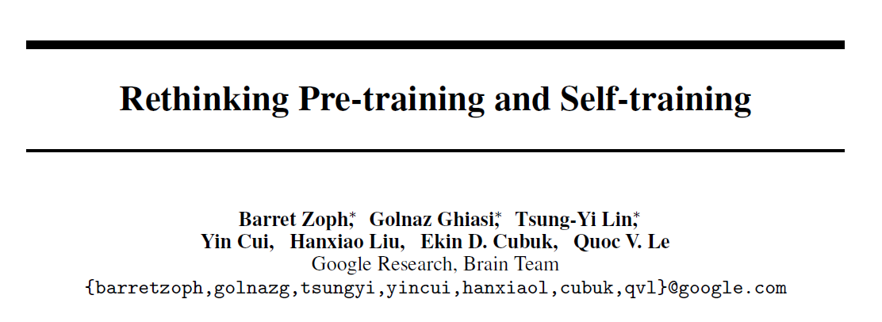

Slide 2
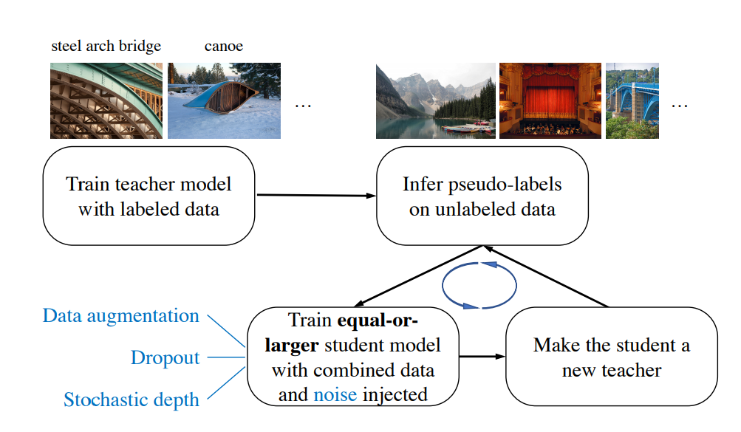
Self Training

Slide 3
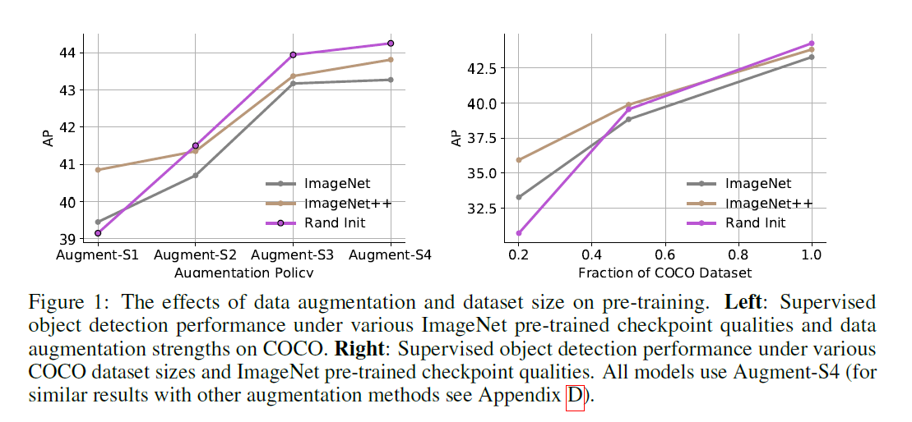
Rethinking imagenet pre-training

Slide 4
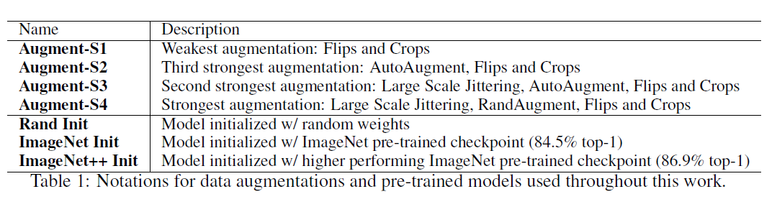
Setting

Slide 5
Setting
Object Detection
COCO for supervised learning
ImageNet and OpenImages as unlabeled data
RetinaNet with EfficientNet-B7 backbone
Segmentation
PASCAL VOC 2012 for supervised learning
Augmented PASCAL, COCO and ImageNet as unlabeled data
NAS-FPN with EfficientNet-B7 backbone

Slide 6
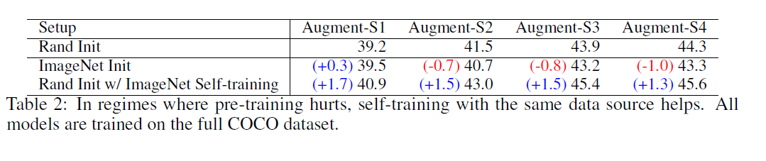
Experiment

Slide 7
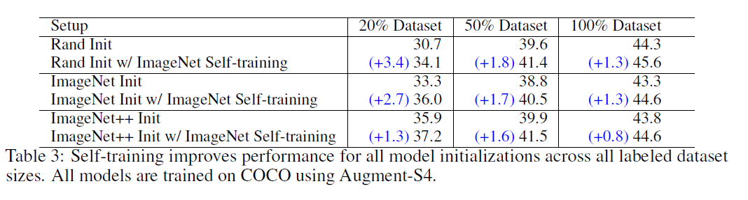
Experiment
Notes:
s4

Slide 8
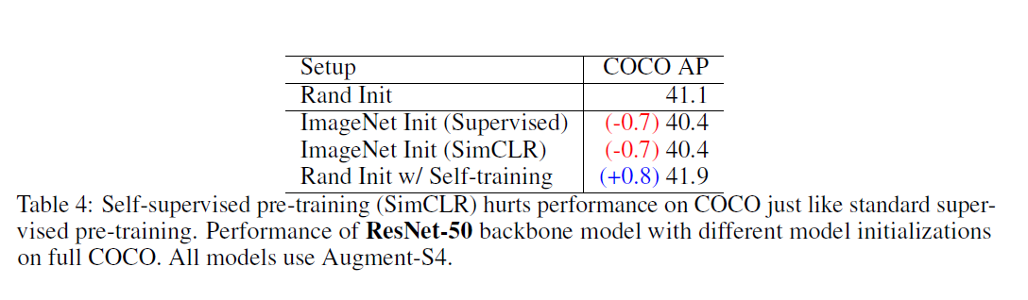
Experiment
Notes:
s4

Slide 9
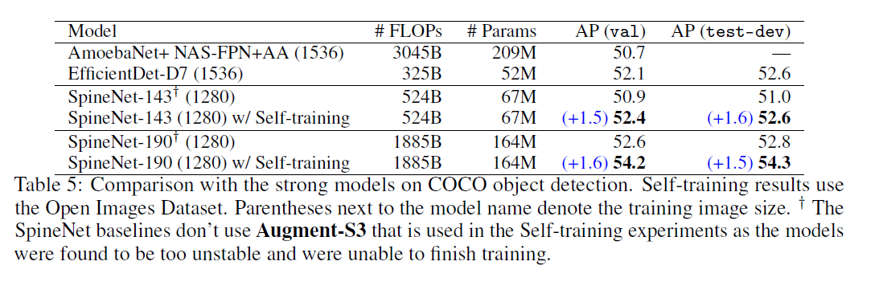
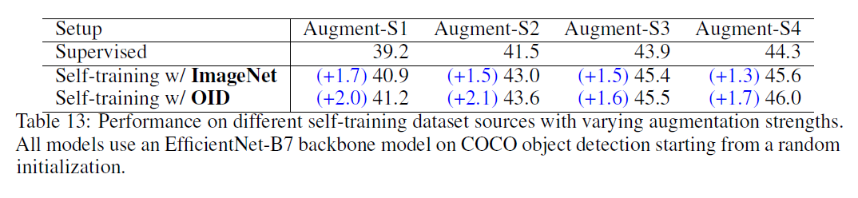
Experiment
Notes:
S3 oid预训练对coco没用

Slide 10
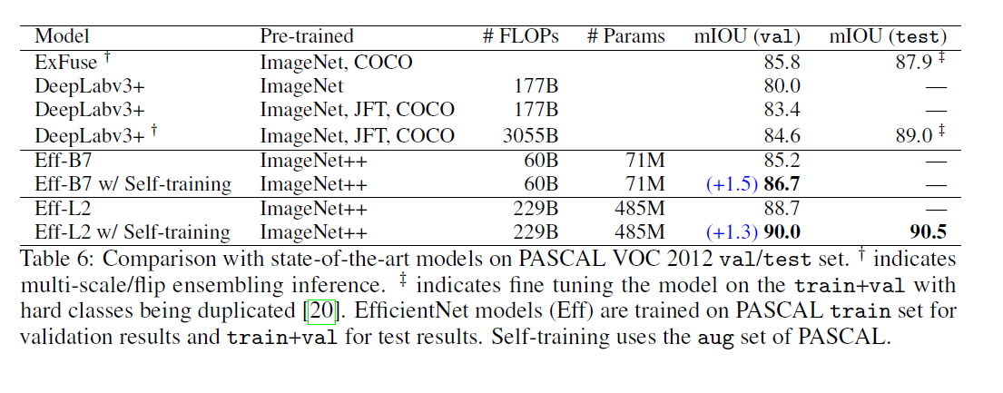
Experiment
Notes:
S4 aug pascal self training

Slide 11
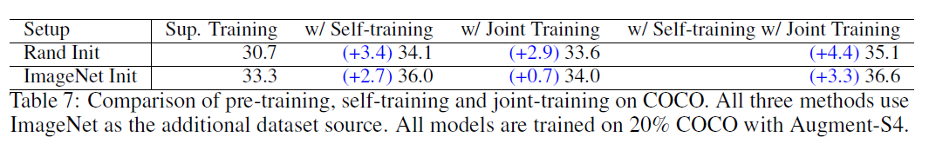
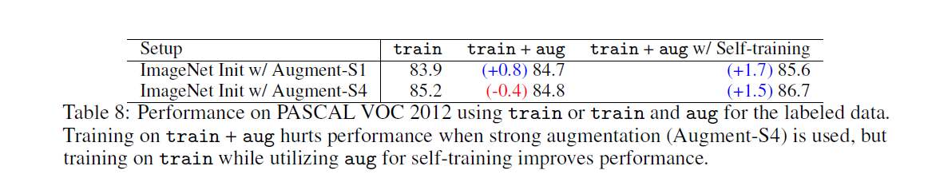
Experiment

Slide 12
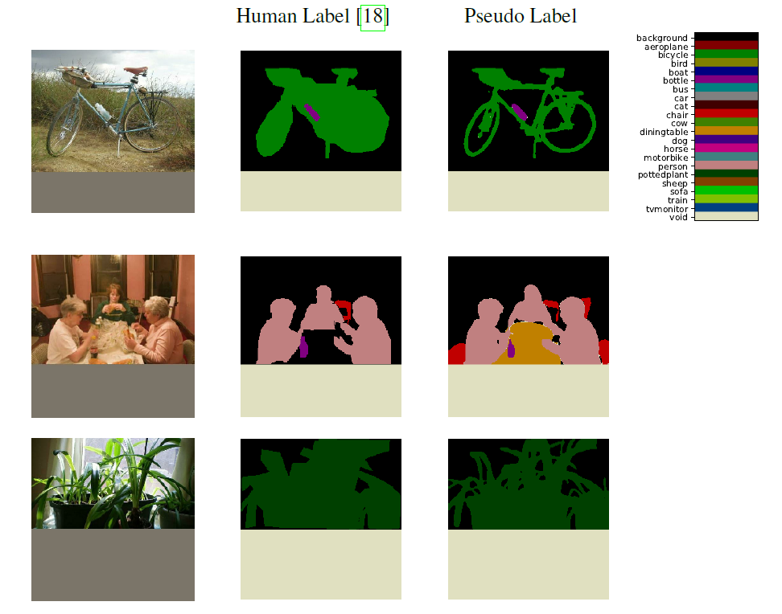
Experiment

