Slide 1
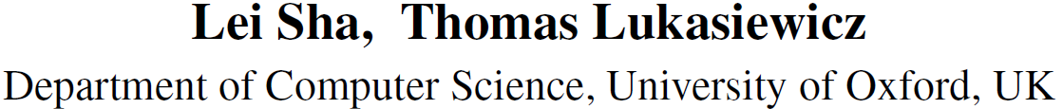
Multi-type Disentanglement without Adversarial Training
AAAI 2021

Slide 2
Task
Changing some specific features (such as sentiment, tense, or human face pose) of a given text or image.
We define a style type as a style class that represents a specific feature of text or an image, e.g., sentiment, tense, or face direction
We define a style value as one of the different values within a style, e.g., sentiment (positive/negative), or tense (past/now/future)

Slide 3
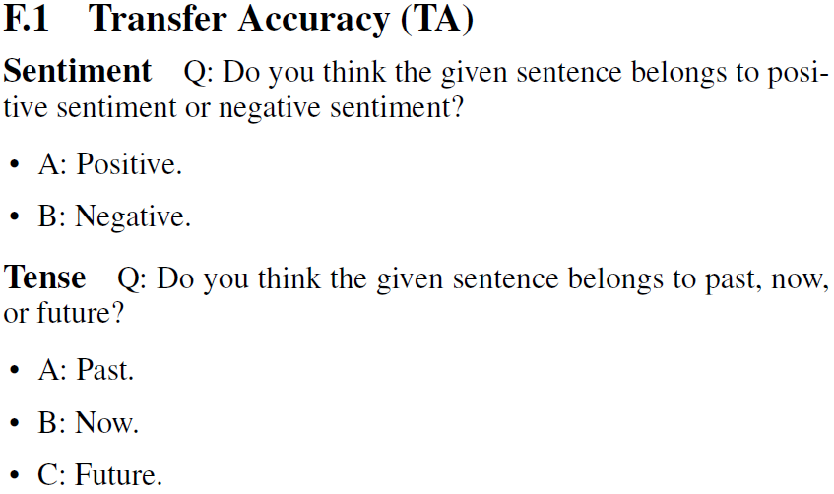
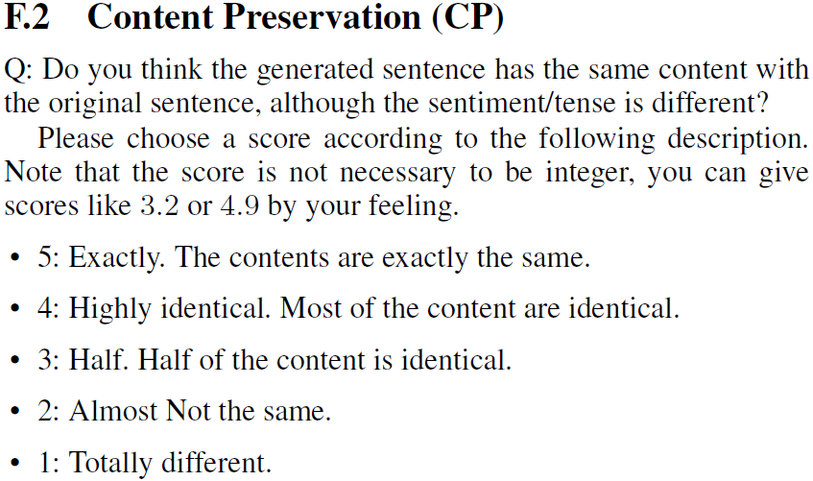
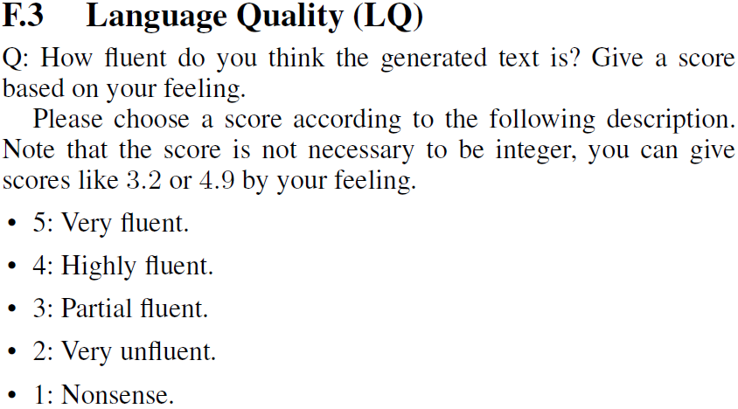
Human Evaluation Question Marks
We conducted a human evaluation on the Yelp dataset and the Amazon dataset.
1
Style transfer accuracy (TA)
2
Content preservation (CP)
3
Language quality (LQ)

Slide 4
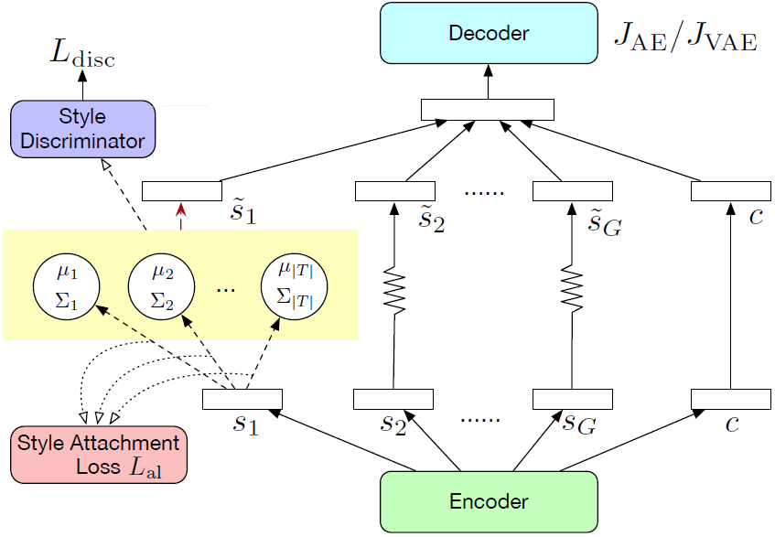

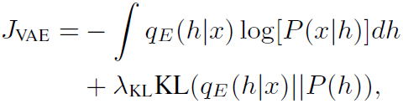

Methods
unified distribution assumption:
We require that all the vectors that belong to one specific style value follow a unified distribution. We use a Gaussian distribution with different mean and variance for each style value.
• Disentangled vectors that belong to the same style value should obey the same Gaussian distribution.
• The Gaussian distributions corresponding to any two different style values should be independent from each other.
Autoencoder:
Notes:
where h is the latent vector, P(x|h) is the decoder part, P(h) is the prior distribution of h (usually, N(0, 1)), and \lambda_KL is a hyperparameter.

Slide 5
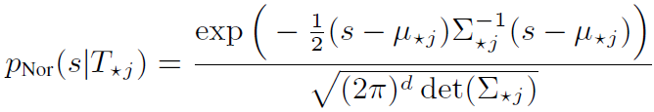





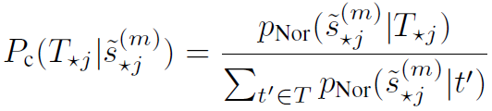
Methods
Style Attachment Loss on Latent Style Space:
Style Classification Loss:
The PDF of the j-th style value $T_{∗j}$ is a Normal distribution (Nor):
Bayes’ theorem
We define the style attachment loss (al) as the negative log-likelihood (NLL) loss
Then, we define the classification loss as an NLL loss:
Notes:
use s for style vector, and t for style value
Al: 对于每个风格样式(style type)，我们希望风格向量vector看起来像采样自特定的分布（风格值(style value)的）。希望style vector服从假设的分布。T from dataset
Cl: 希望每个分布都与相应的风格值对应。所以我们对每个风格值采样向量约束其分类结果为对应的风格值。 Random sample s

Slide 6
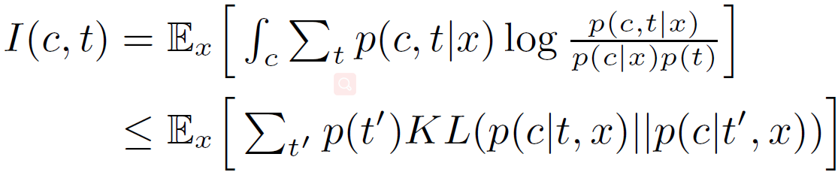
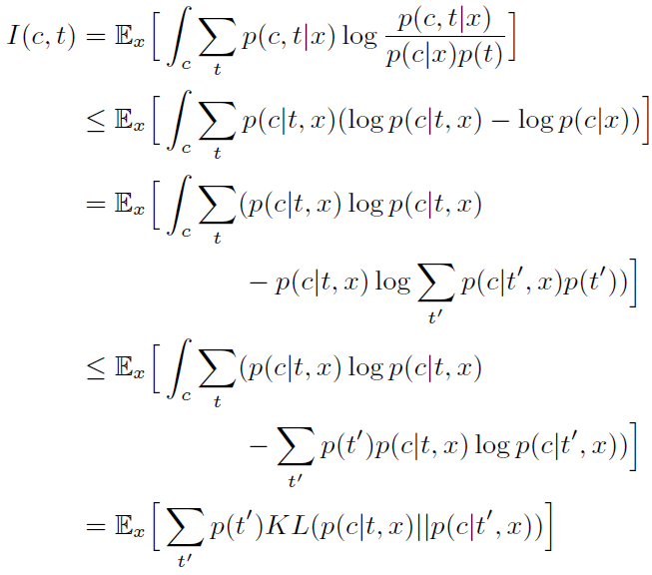
Methods
Style-Content Disentanglement
mutual information I(c, t) between the content vector c and the style labels t

Slide 7
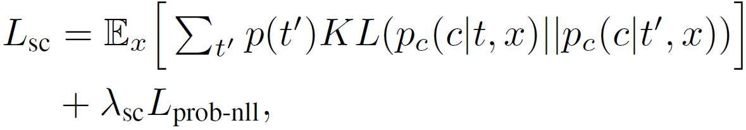
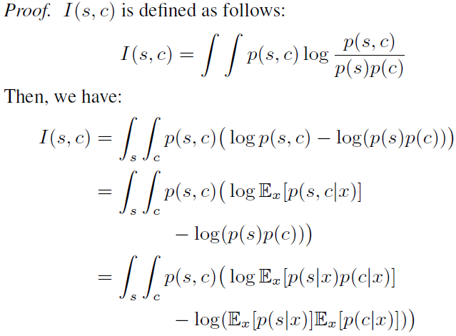
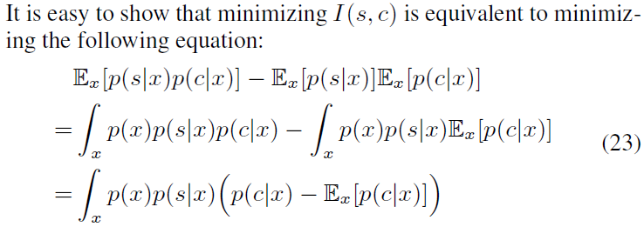
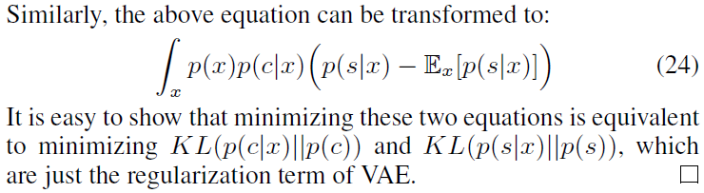
Methods
Style-Content Disentanglement
mutual information I(c, t) between the content vector c and the style labels t
mutual information I(c, s) between the content vector c and the style vectors s

Slide 8


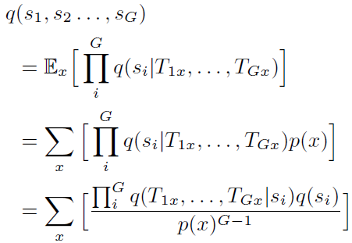
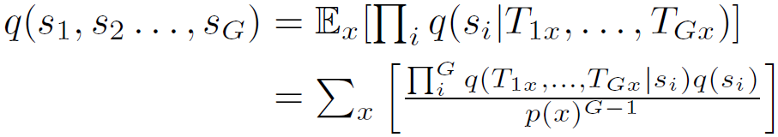

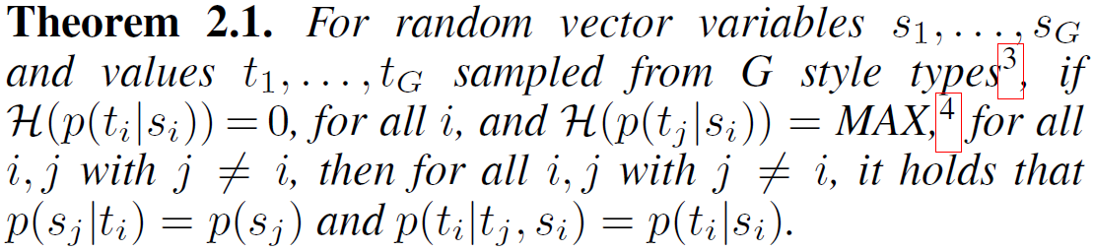


Methods
Multi-type Disentanglement
(1) make the style vectors $s_{1}, …, s_{G}$(G is the number of style types) for different style types independent to each other
$β$-TC-VAE: multi-type vector disentanglement can also be done by minimizing the total correlation term
(2) when the training set has labels of multiple types, there will be a training bias that makes different types affect each other.
we have the loss function for multi-type disentanglement

Slide 9
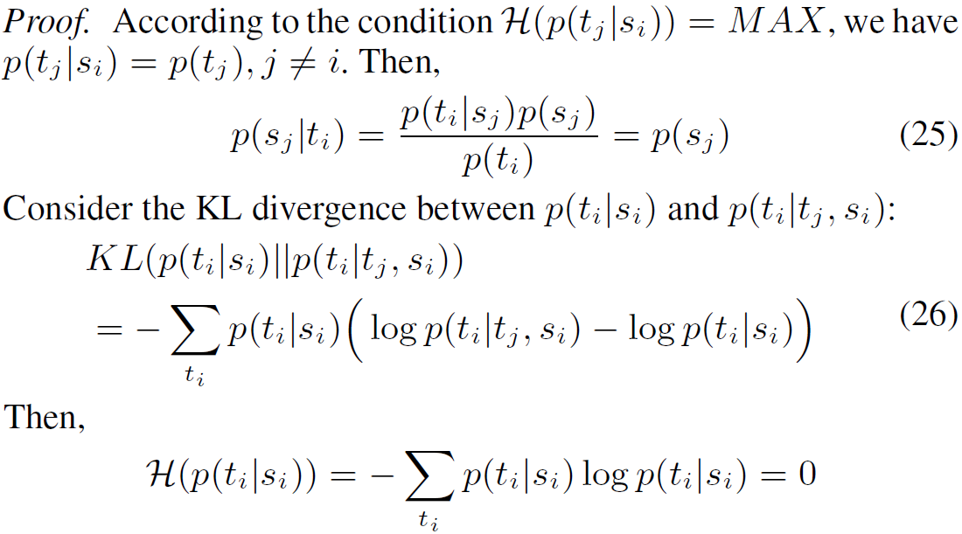
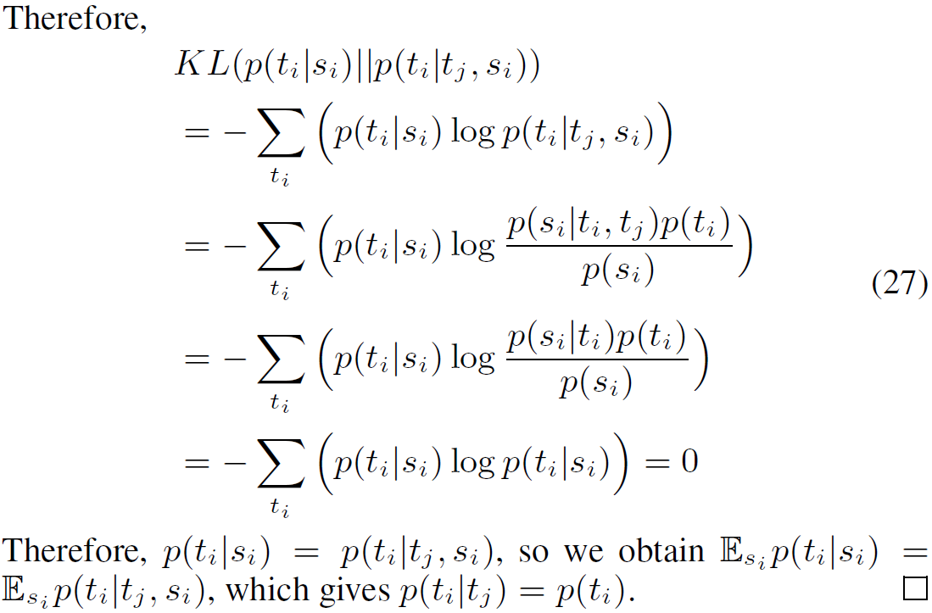
Methods

Slide 10
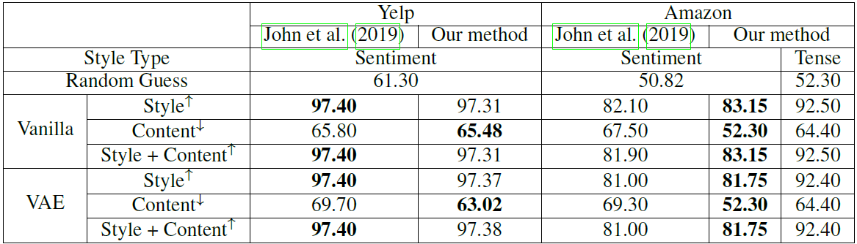
Experiments
Disentanglement Effect

Slide 11
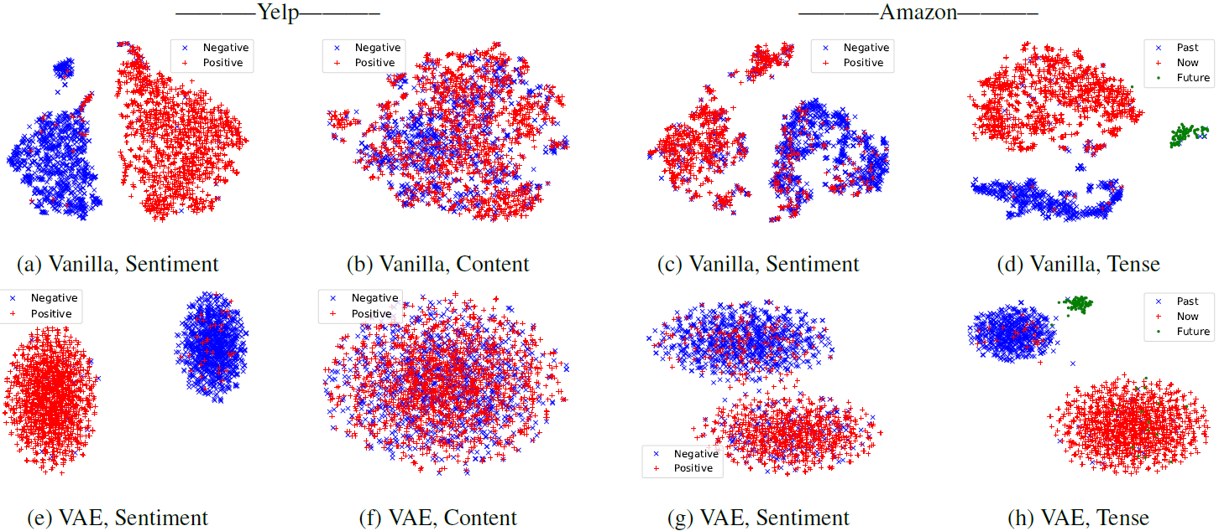
Experiments
Disentanglement Effect

Slide 12
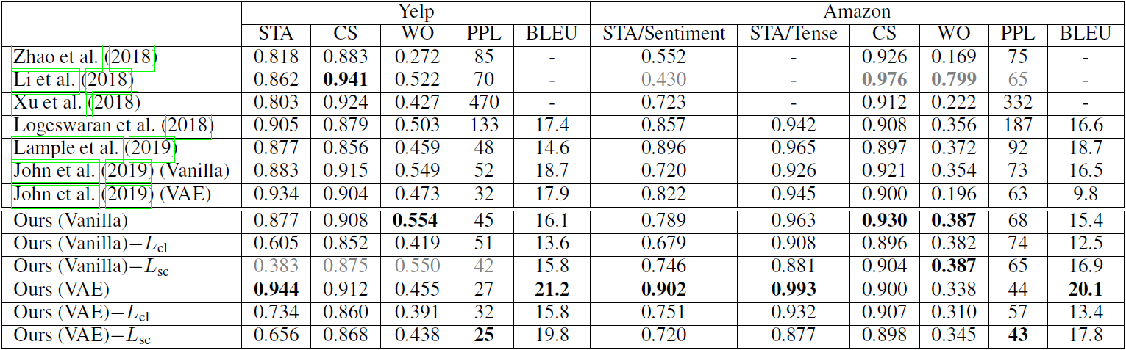
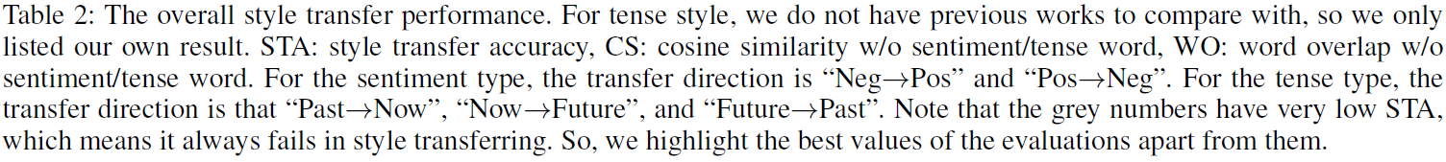
Experiments
Style-Transfer Performance

Slide 13
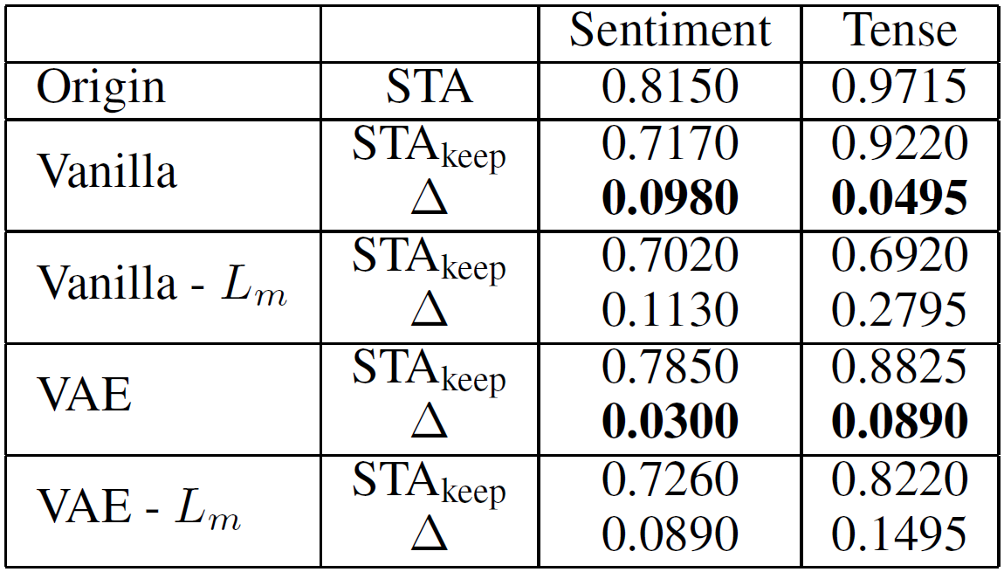
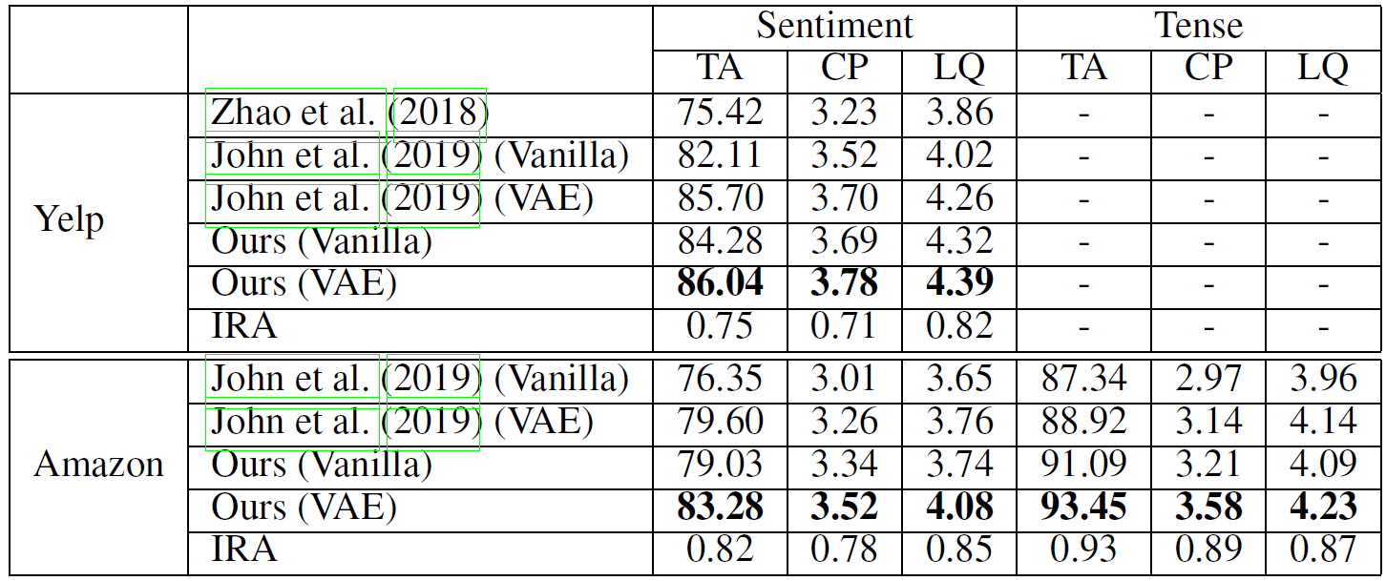
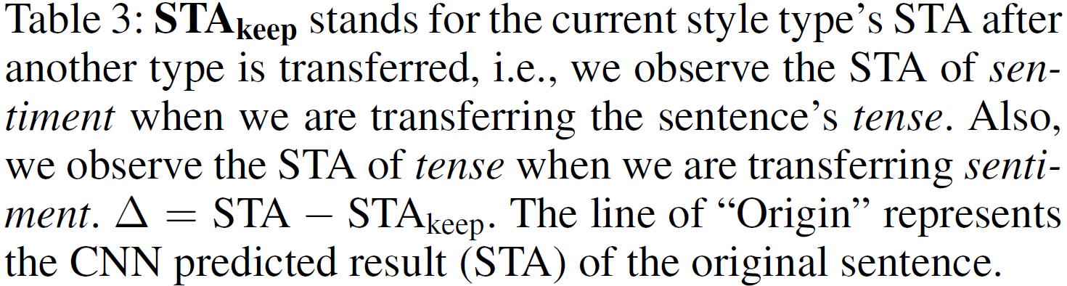
Experiments
Alleviation of Training Bias (style disentangle)
Human evaluation results
give each case a sentiment label or tense label (for transfer accuracy (TA))
content preservation (CP)
language quality(LQ)

Slide 14
Thank you
Thank you
Notes:
在“幻灯片放映”模式下，选择箭头访问相应链接。

