Slide 1
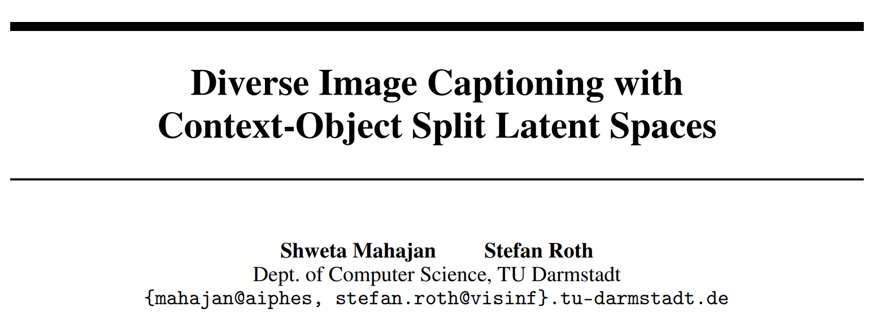
Nips2020

Slide 2
Introduction
Task: Diverse image captioning models aim to learn one-to-many mappings that are innate to cross-domain datasets
Motivation :
one-to-many relationships are innate to cross-domain tasks
prior work is limited to that of the paired training data

Slide 3
Related work
Diverse image captioning
Hamming distance
generative models (GANs)(VAEs)
Novel object captioning
require class labels of novel objects at test time

Slide 4
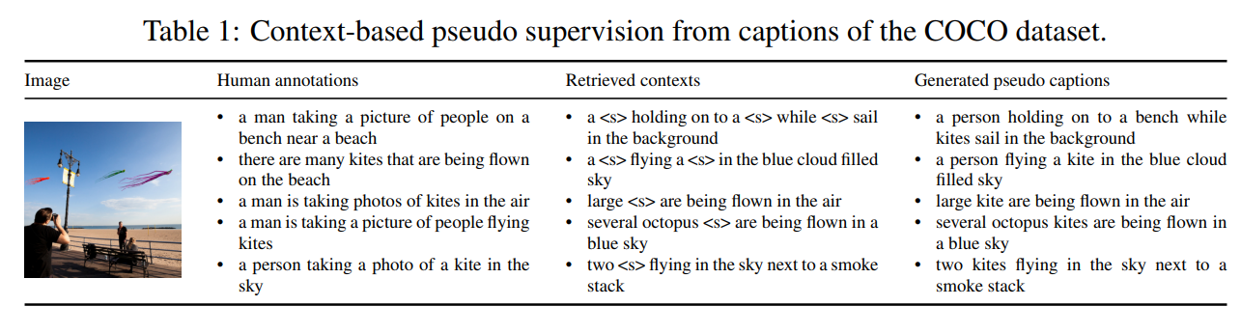
COS-CVAE Approach
There are multiple possible contextual descriptions in the dataset that can describe the image similarly well.
Our novel COS-CVAE framework is able to better capture diversity through generated context-based pseudo supervision (4th column).

Slide 5


COS-CVAE Approach: Preliminaries
Split each ground-truth caption from the paired data as
xº represents the objects in the visual scene
x^{m} is the contextual description in the caption
Use VSE++ to learn a joint embedding of the paired data {x^{m}, I} on the training set

Slide 6





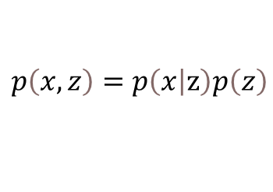
COS-CVAE Approach
Problem formulation
For the caption sequence x = (x1, . . . , xT ),
maximize the conditional likelihood of the conditional distribution pφ(x | I), parameterized by φ
Introduce explicit sequential latent variables z = (z1, . . . , zT )
$$p\left(x,z\right)=p\left(\left.x\right|z\right)p\left(z\right)$$
factorize the latent variable
is encoded independently of

Slide 7
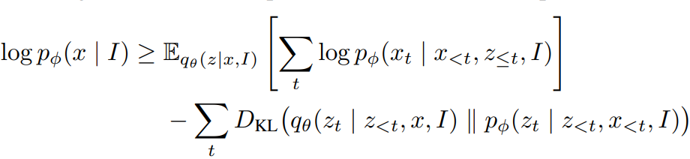


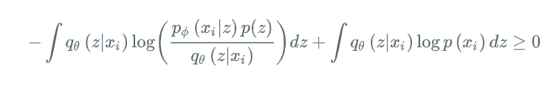
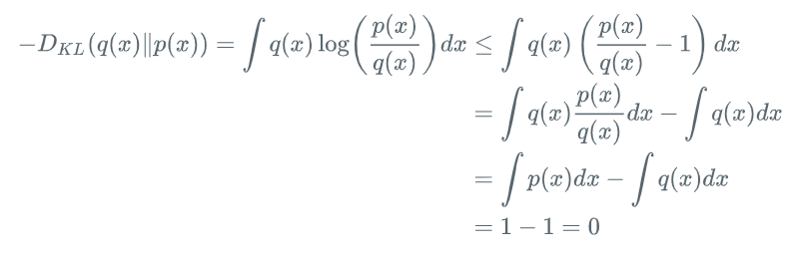
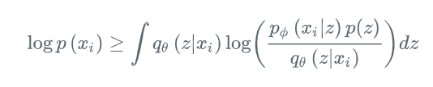
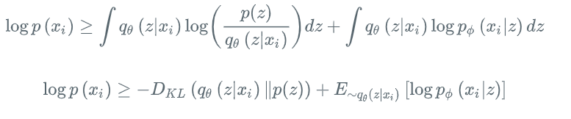

COS-CVAE Approach
The log-evidence lower bound
Proving：
Notes:
ELBO包含2项，第一个KL散度项起到正则化的作用，它约束了近似后验分布的形式；第二项被称为重建项(reconstruction term)，因为它度量的是decoder重建的数据的似然值。

Slide 8

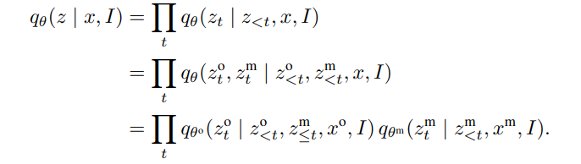
COS-CVAE Approach
The context-object split posterior
is factorized into
Notes:
allowing to encode the contexts of the scene xm directly in the latent space
网络生成

Slide 9
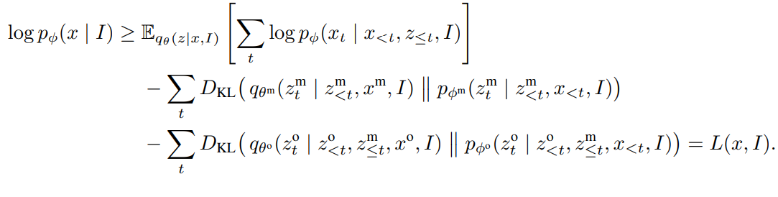
COS-CVAE Approach
The context-object split prior

Slide 10


COS-CVAE Approach
Context-based pseudo supervision
Show how COS-CVAE leverages annotations of captions N(I)

Slide 11
COS-CVAE Approach
Context-based pseudo supervision
Show how COS-CVAE leverages annotations of captions N(I)
Notes:
Extension to novel objects.

Slide 12
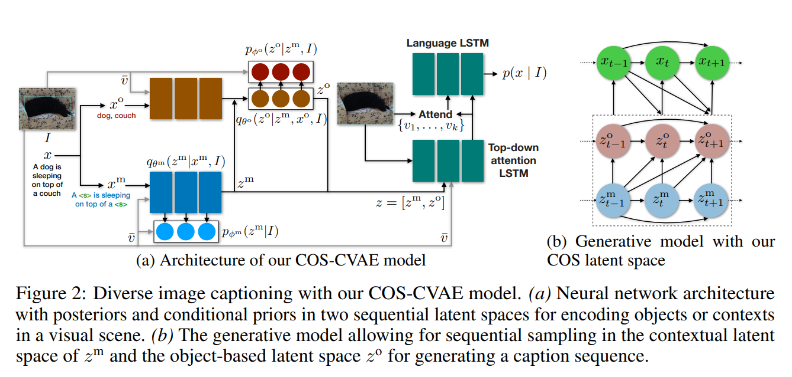
COS-CVAE Approach
Network architecture
Notes:
Extension to novel objects.

Slide 13
Experiments
dataset
COCO dataset
novel objects
A subset of the COCO dataset and excludes all the image-text pairs containing at least one of the eight specific objects in COCO: “bottle”, “bus”, “couch”, “microwave”, “pizza”, “racket”, “suitcase”, and “zebra”
Notes:
Extension to novel objects.

Slide 14
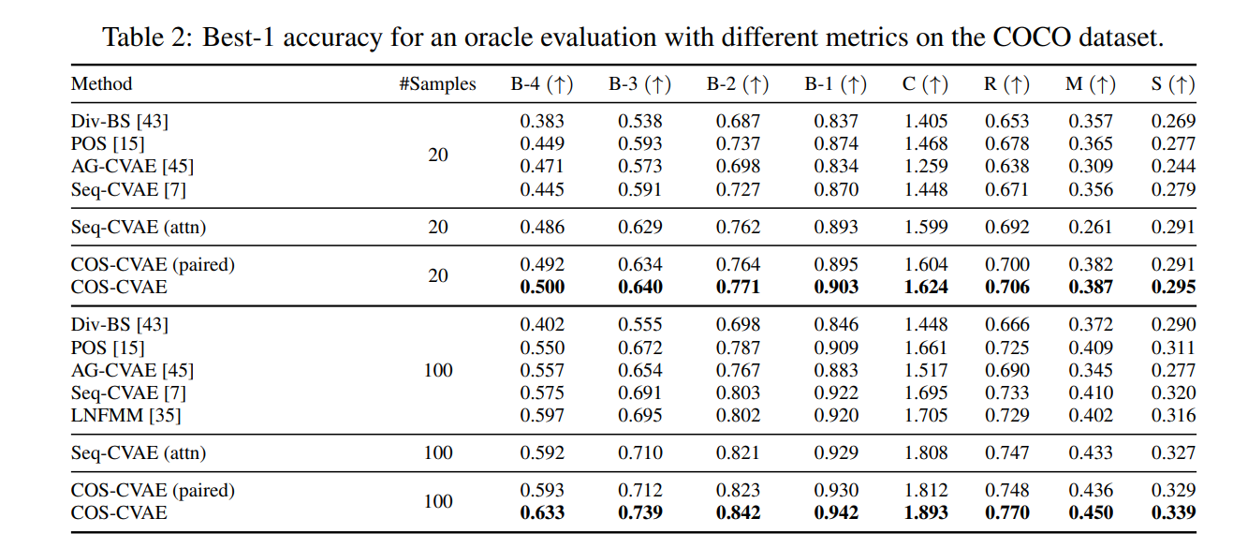
Experiments
Notes:
Extension to novel objects.

Slide 15
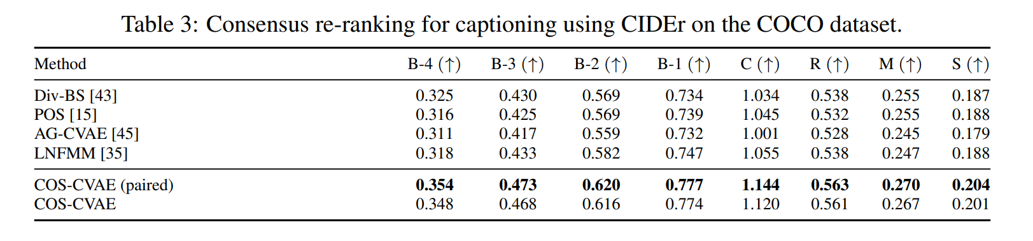
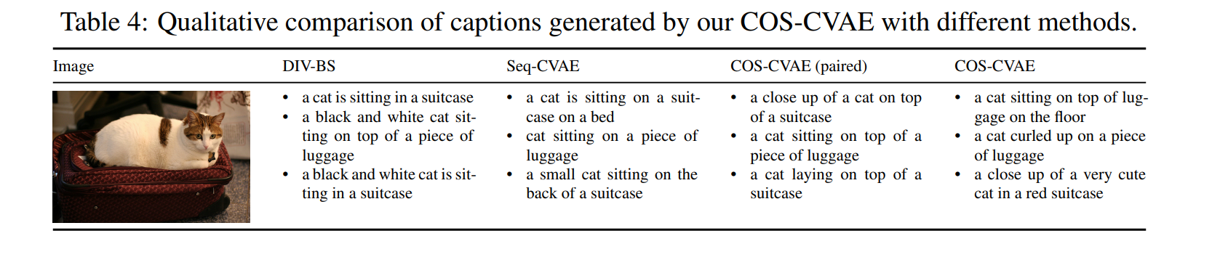
Experiments
Notes:
Extension to novel objects.

Slide 16
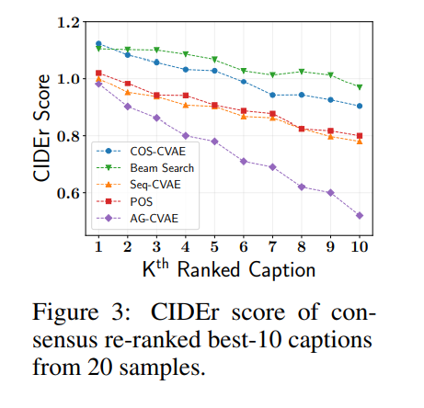
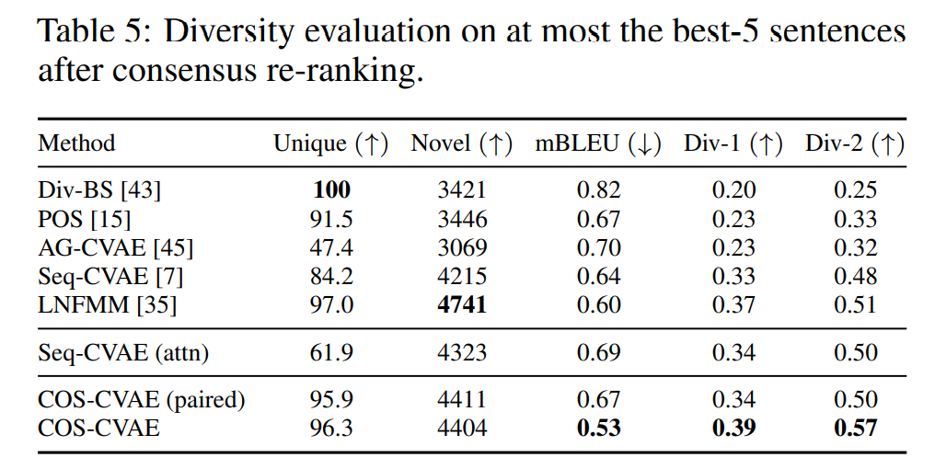
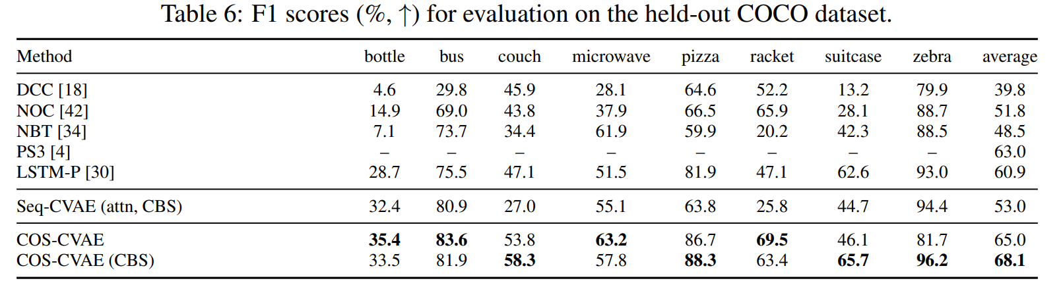
Experiments
Notes:
Extension to novel objects.

Slide 17
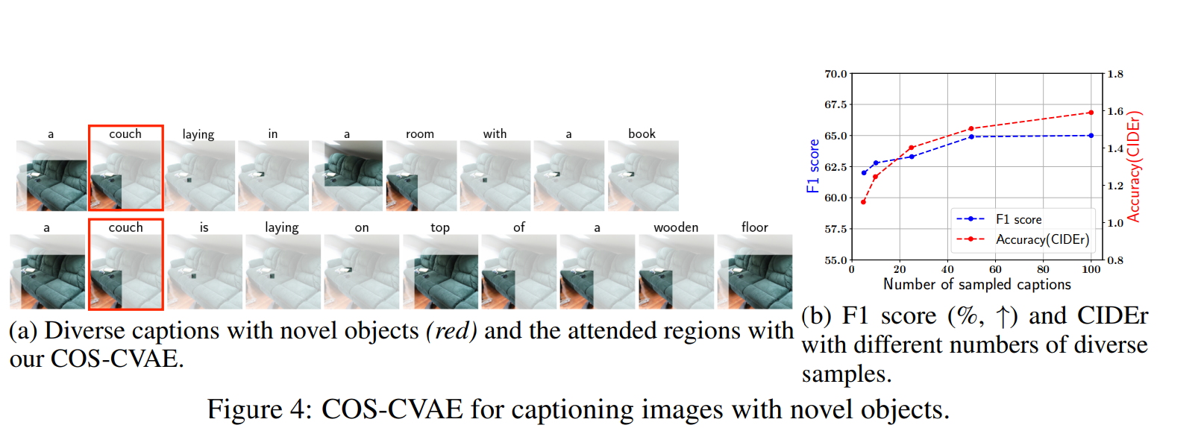
Experiments
Notes:
Extension to novel objects.

