Slide 1
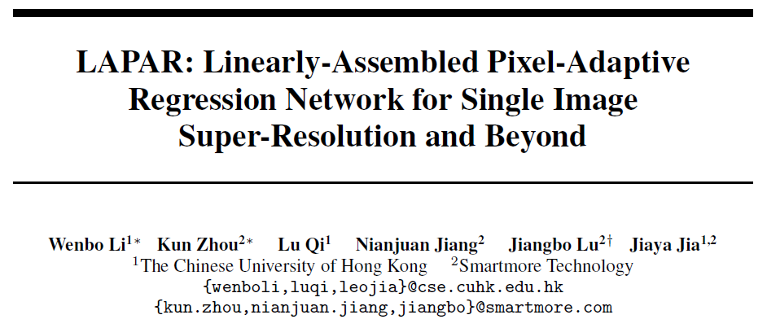

Slide 2
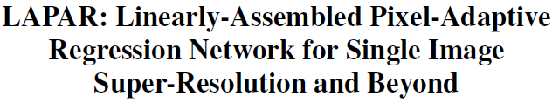

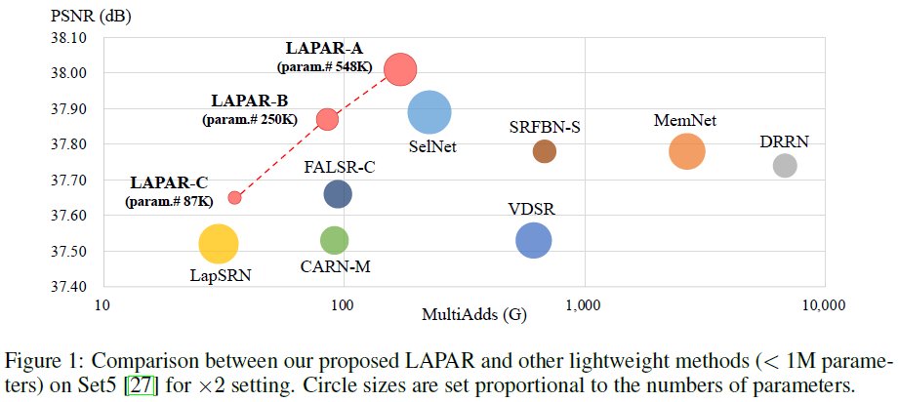


问题描述：
SISR
贡献：
-propose LAPAR for SISR. achieves SOTA results
(least model parameters and MultiAdds among all existing lightweight networks)
-pre-define a set of meaningful filter bases and optimize assembly coefficients in a pixel-wise manner. (extensive experiments)
-the same framework other image restoration tasks,

Slide 3
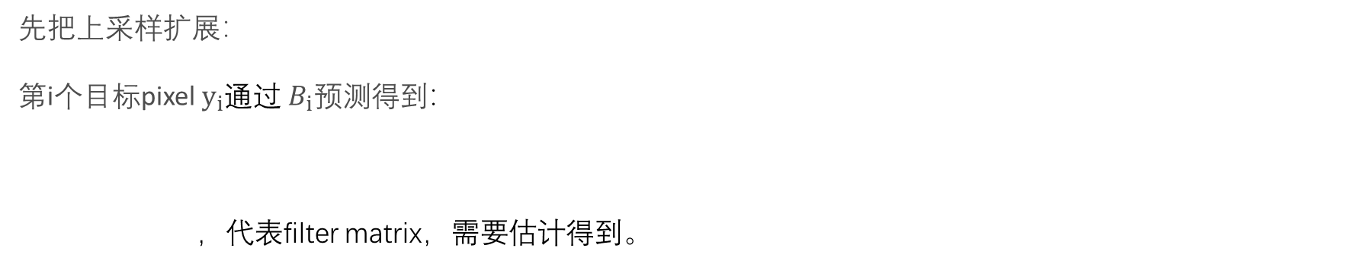
原理：
先把上采样扩展：
第i个目标pixel${ y}_{i}$通过${ B}_{i}预测得到$：
，代表filter matrix，需要估计得到。
-optimized efficiently
-general enough for different tasks
introduce a linear space constraint to facilitate the optimization：

Slide 4
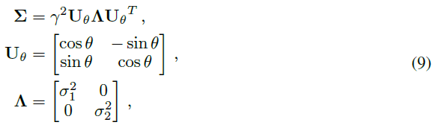
字典：
-Gaussian filters：
-difference of Gaussians (DoG) filters：

Slide 5
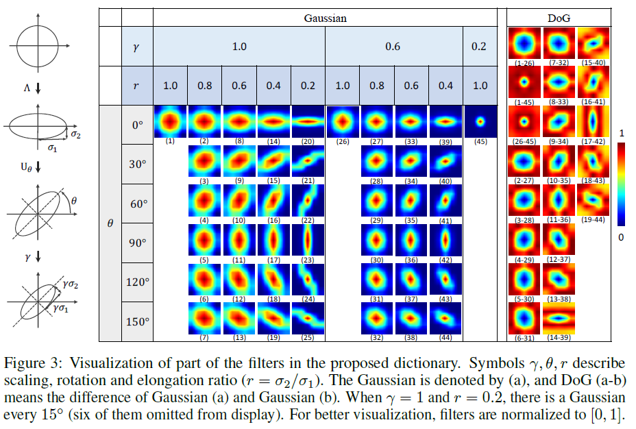
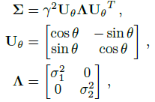
字典：

Slide 6
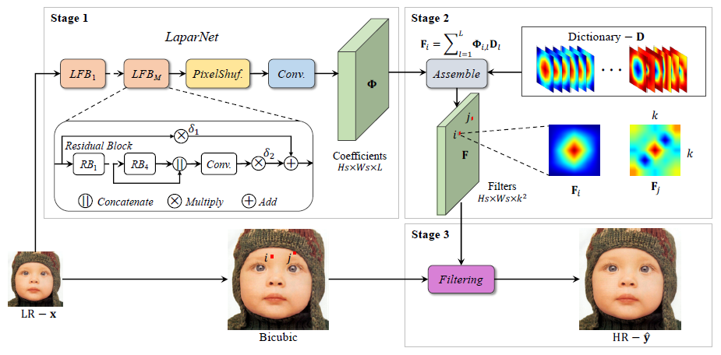
网络：
number of feature channels (C) and local fusion modules（M）：

Slide 7
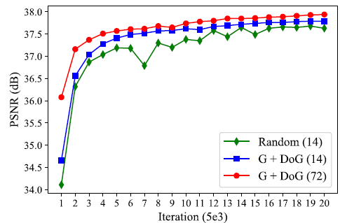
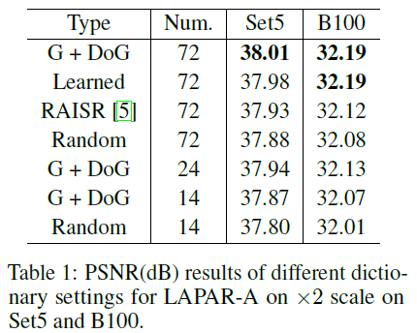
实验：
Study of The Filter Dictionary：

Slide 8
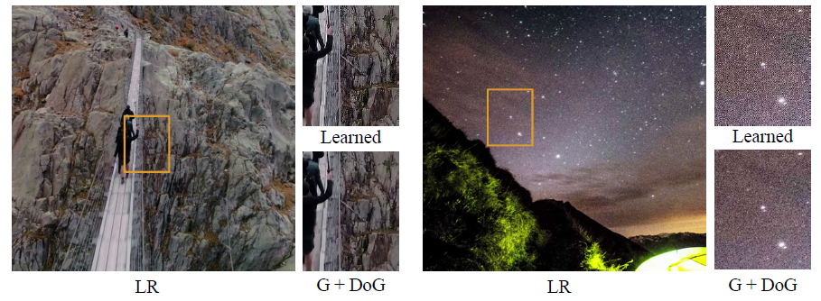
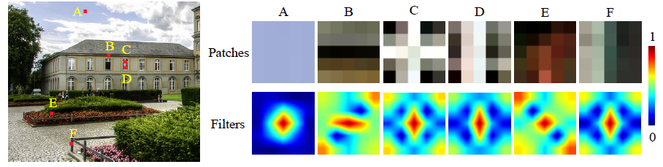
may sometimes generate artifacts along edges or amplify noise due to overfitting in natural images
generates adaptive filters to process the structural information differently for each pixel location

Slide 9
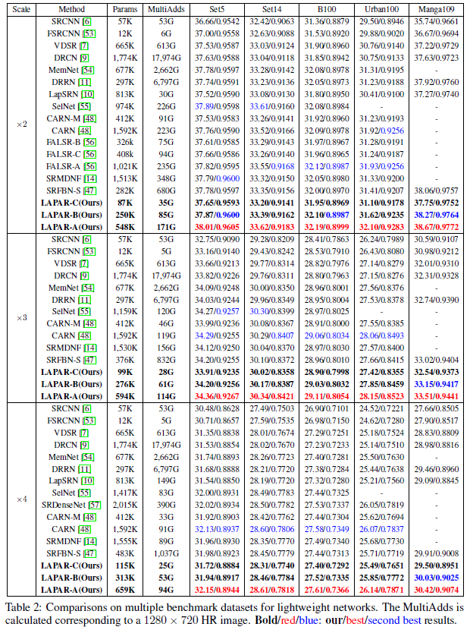
实验：

Slide 10
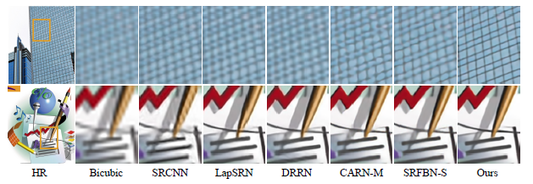
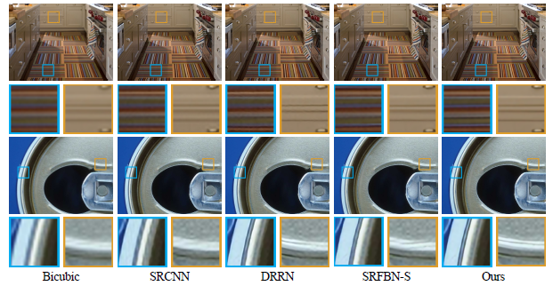
实验：

Slide 11
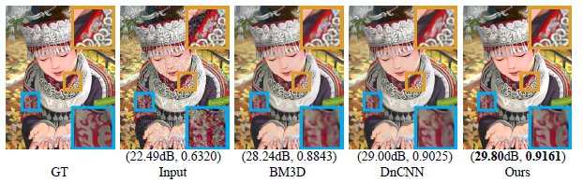
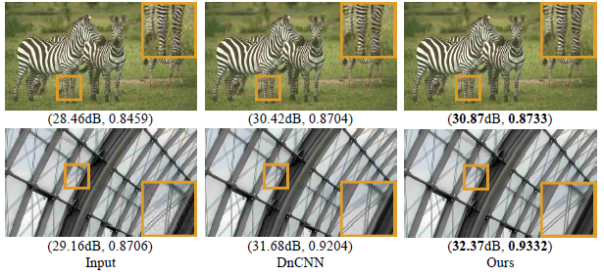
Image Denoising：
JPEG Image Deblocking：

Slide 12
谢谢！

