Slide 1

DYNAMIC LEARNING CHESS AI WITH ADAPTIVE BEHAVIOUR

Slide 2
GOAL OF THE PROJECT
Build a Chess AI that:
Understands board positions numerically (feature extraction)
Evaluates positions using a learned function
Adapts its play style dynamically based on game outcomes
Uses Minimax search to choose moves strategically
Learns continuously from new self-play experiences

Slide 3
BOARD EVALUATION
Board State s : E(s) (numeric score)
This score tells the engine:
How good the position is for white or black
Whether the position is winning, losing or equal

Slide 4
FEATURE VECTOR F(S)
Material Balance (white - black)
Mobility (number of legal moves)
Center Control (occupation of D4, D5, E4, E5)
King Safety (threat evaluation near king)
Pawn Structure (isolated/doubled pawn penalties)
Therefore, f(s)=[f₁(s), f₂(s), f₃(s), f₄(s), f₅(s)]^{T}
And, weight vector : W=(w₁, w₂, w₃, w₄, w₅)^{T}

Slide 5
EVALUATION FUNCTION
E_{W}(s, x) = Wᵀ· (f(s) × x)
where, W = weight vector to learn
x = meta-parameter controlling aggression or depth
f(s) = extracted feature vector
Here,
x>1 : AI becomes more aggressive
x<1 : AI becomes defensive (plays safely)

Slide 6
WHY META-PARAMETER X?
Allows dynamic adjustment of engine style.
High x → more aggressive (material sacrifices allowed).
Low x → positional/safe play.

Slide 7
DATASET REPRESENTATION
Let X be feature matrix (N × d).
Let y be evaluation target scores from expert data.
Goal: Learn W such that E(W, x) ≈ y.

Slide 8
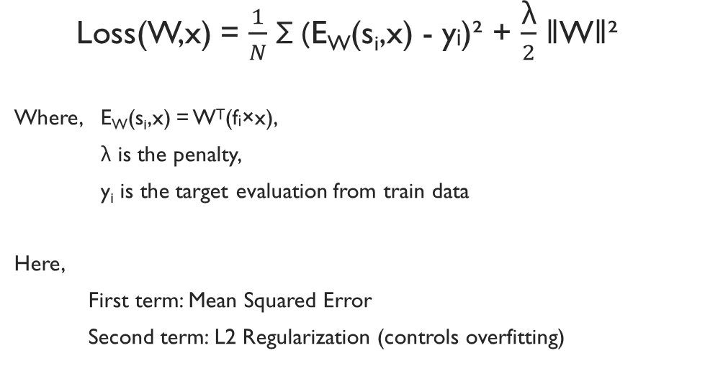
LOSS FUNCTION

Slide 9
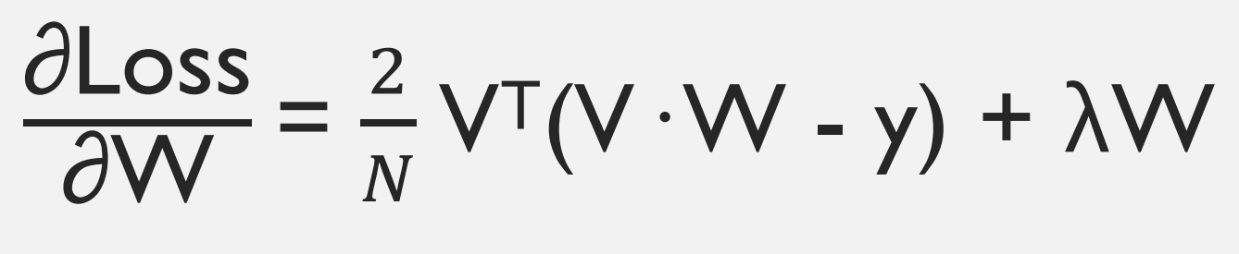
GRADIENT OF LOSS
Where, V is a matrix whose rows are v_{i} ^{T}=(f_{i} x)^{T}
Note: It is used to update W in optimization process.

Slide 10
CONJUGATE GRADIENT OPTIMIZATION
Used to iteratively optimize feature weights (W).
Avoids slow convergence of basic Gradient Descent.
Searches along conjugate (non-interfering) directions.
Requires fewer iterations for quadratic loss surfaces.

Slide 11
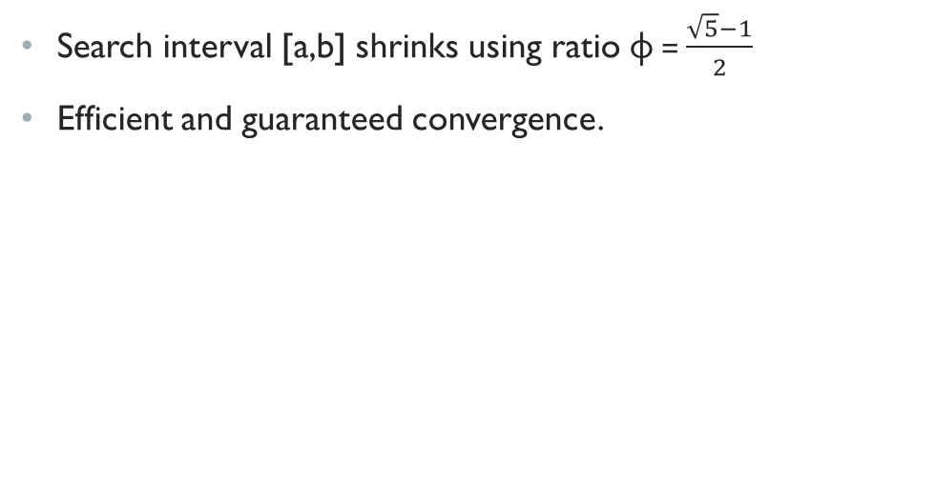
GOLDEN SECTION SEARCH

Slide 12
LINE SEARCH WITH GOLDEN SECTION
To find step size α along search direction d.
φ(α) = Loss(W + αd) minimized using golden ratio.
Does not require derivative of φ(α).
Note:
The loss along one direction is usually a U-shaped curve (meaning it goes down, reaches a lowest point, then goes up)
Golden Section Search is very good at finding the lowest point of a U-shape curve.

Slide 13
META-PARAMETER OPTIMIZATION
We treat x as hyperparameter.
Performance(x) = engine win-rate or dataset fit.
Optimal aggressiveness/meta-parameter (x*) found using Golden Section Search again.

Slide 14
FINAL ENGINE EVALUATION
Given board state s:
1. Convert to features f(s)
2. Compute E(W*, x*) = W*ᵀ(f(s) × x*)
3. Select move that maximizes evaluation.

Slide 15
MINIMAX SEARCH
USING EVALUATION FUNCTION IN MINIMAX
Minimax selects the best move by simulating possible future positions.
Maximizing player: tries to maximize evaluation score.
Minimizing player: tries to minimize evaluation score.
Recursively explores game tree up to a fixed depth.
Leaf nodes (depth = 0 or game over) evaluated using E(W, x).
Minimax propagates these evaluations upward to decide best move.
This links learned evaluation with search algorithm.

Slide 16
MINIMAX SCALING FOR MOVE SELECTION
Raw evaluations may vary widely between positions.
Scaling converts evaluation range to [0, 1] for stable move comparison.
scaled = (eval - min_eval) / (max_eval - min_eval + ε)
Helps avoid bias due to extreme value spikes.

Slide 17
ALPHA-BETA PRUNING
Enhances minimax efficiency by eliminating branches.
α (alpha): best value that maximizing player can guarantee.
β (beta): best value that minimizing player can guarantee.
If β ≤ α, further branch exploration is unnecessary.

Slide 18
CONTINUOUS ADAPTATION FRAMEWORK
Process:
AI plays games using Minimax + Learned Evaluation Function.
Each move stored as (state, move, reward, next_state) in replay buffer.
Mini-batches sampled periodically for efficient retraining.
Weights (W) updated via Conjugate Gradient optimization.
Meta-parameter (x) fine-tuned through Golden Section Search.
AI dynamically adjusts playstyle:
↑ Win rate → More aggressive (x↑)
↓ Win rate → More defensive (x↓)
Ongoing logging of win %, draw %, and avg. moves
Outcome:
Enables continuous learning, strategic stability, and adaptive play that evolves with experience.

Slide 19
SCENARIO
Key Insight
Scenario | Win % | Draw % | Loss % | Avg Moves (Decisive games)
Human-like player vs opponent(Static play) | 41% | 59% | 0% | 65.49
AI vs opponent (adaptive play using meta-parameter tuning) | 57% | 43% | 0% | 41.42
The Dynamic AI wins 16% more games than the human-controlled player.
It achieves victories with ~37% fewer moves, indicating more efficient and aggressive decision-making.
The adaptive meta-parameter tuning (x) helps optimize move selection to outplay the opponent faster.

Slide 20
CONCLUSION
Feature-based evaluation makes engine interpretable.
Conjugate Gradient provides efficient weight learning.
Meta-parameter x enables adaptive play styles (using Golden Section).
Scalable for stronger search algorithms (Alpha-Beta).
Empirical results confirm that the adaptive AI consistently outperforms static play strategies, achieving higher win rates and requiring significantly fewer moves to reach victory — validating the effectiveness of our dynamic meta-parameter learning approach.

Slide 21
THANK YOU
PRESENTED BY:
Arghyajit Nayak (431)
Arkoprovo Mondal(409)
Arnadeep Paul (421)
Biswarup Majumdar (414)
Raunak Nandy (425)
Kathakali Sardar (410)
Sohini Mandal (444)

