Slide 1
Blood Bank and Donor Management System

Slide 2
Members
Roll Number | Name
25P0320011 | Anushka Marcelo
25P0320032 | Riya Bandekar
25P0320035 | Rupali Arlekar
25P0320039 | Samiksha Karapurkar

Slide 3
Introduction
Web-based platform for blood donation management
Connects donors, patients, and hospitals
Helps find blood donors quickly during emergencies
Centralized system for storing donor information

Slide 4
Problem Statement
Difficulty finding donors in emergency situations
No centralized donor database
Time-consuming manual search process
Lack of communication between donors & patients

Slide 5
Objectives
Provide quick access to blood donors
Maintain organized donor database
Enable blood request submission
Improve communication between users
Reduce response time in emergencies

Slide 6
Proposed System
Online donor registration system
Search donors by blood group & location
Submit blood requests easily
Admin manages donors & requests
Real-time data access

Slide 7
Technologies Used
Frontend: HTML, CSS
Backend: PHP
Database: MySQL
Server: XAMPP

Slide 8
Key Features
Donor Registration
Search Donor
Blood Request Form
Donor List Display
Admin Panel
Request Approval System

Slide 9
System Modules
Donor Module – Register & store donor details
Search Module – Find donors easily
Request Module – Submit blood requests
Admin Module – Manage system data

Slide 10
Database Design
Tables Used:
donors
blood_requests
Admin
The database stores donor details and blood requests.

Slide 11
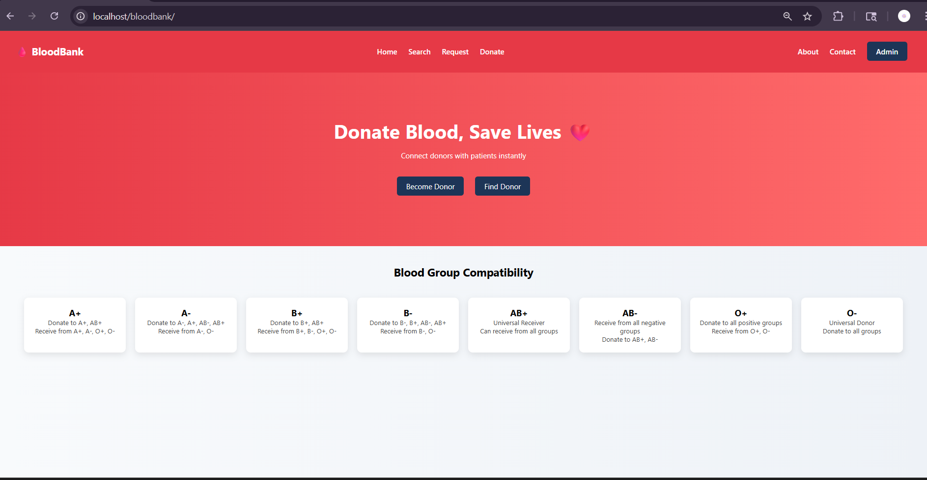

Slide 12
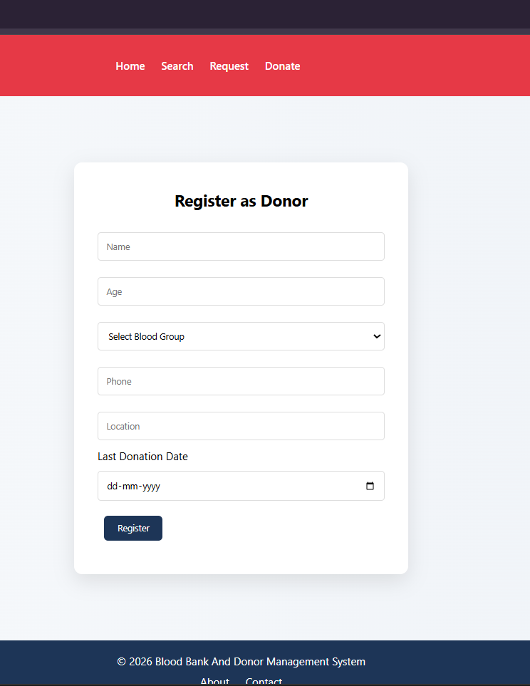
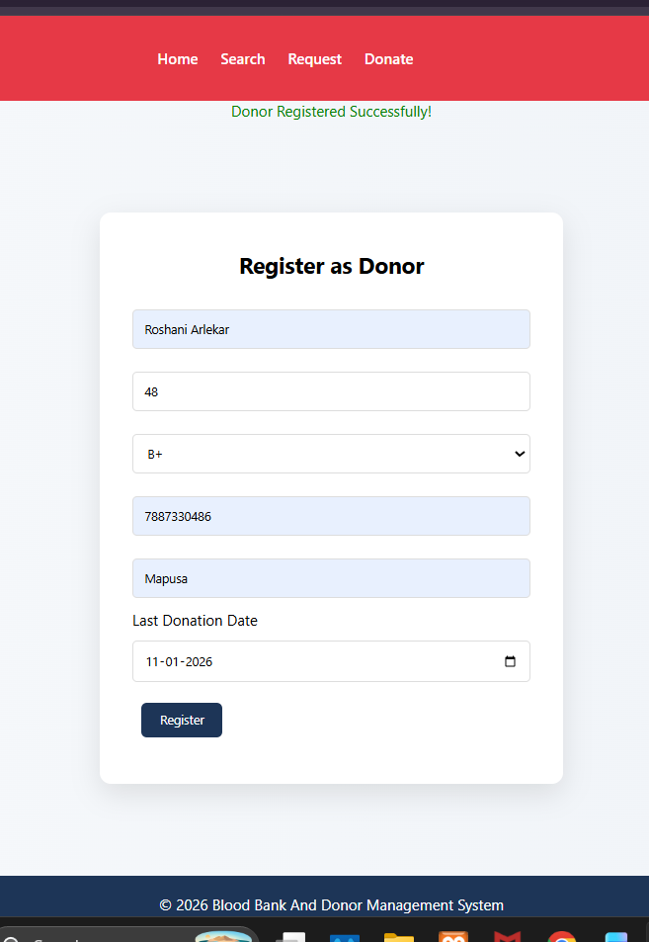

Slide 13
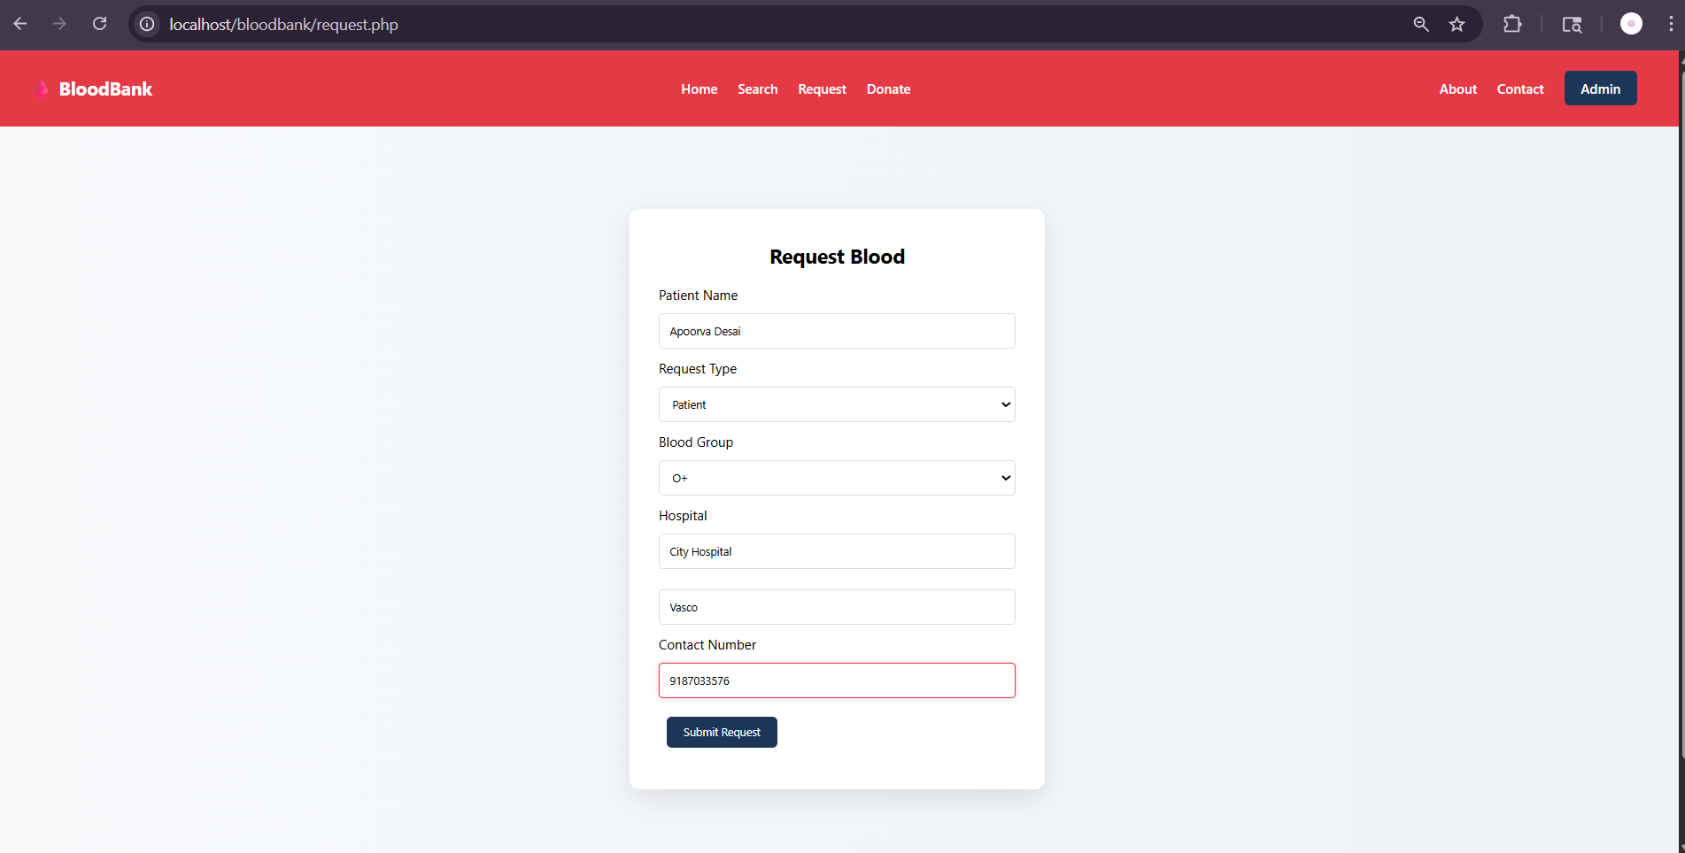

Slide 14
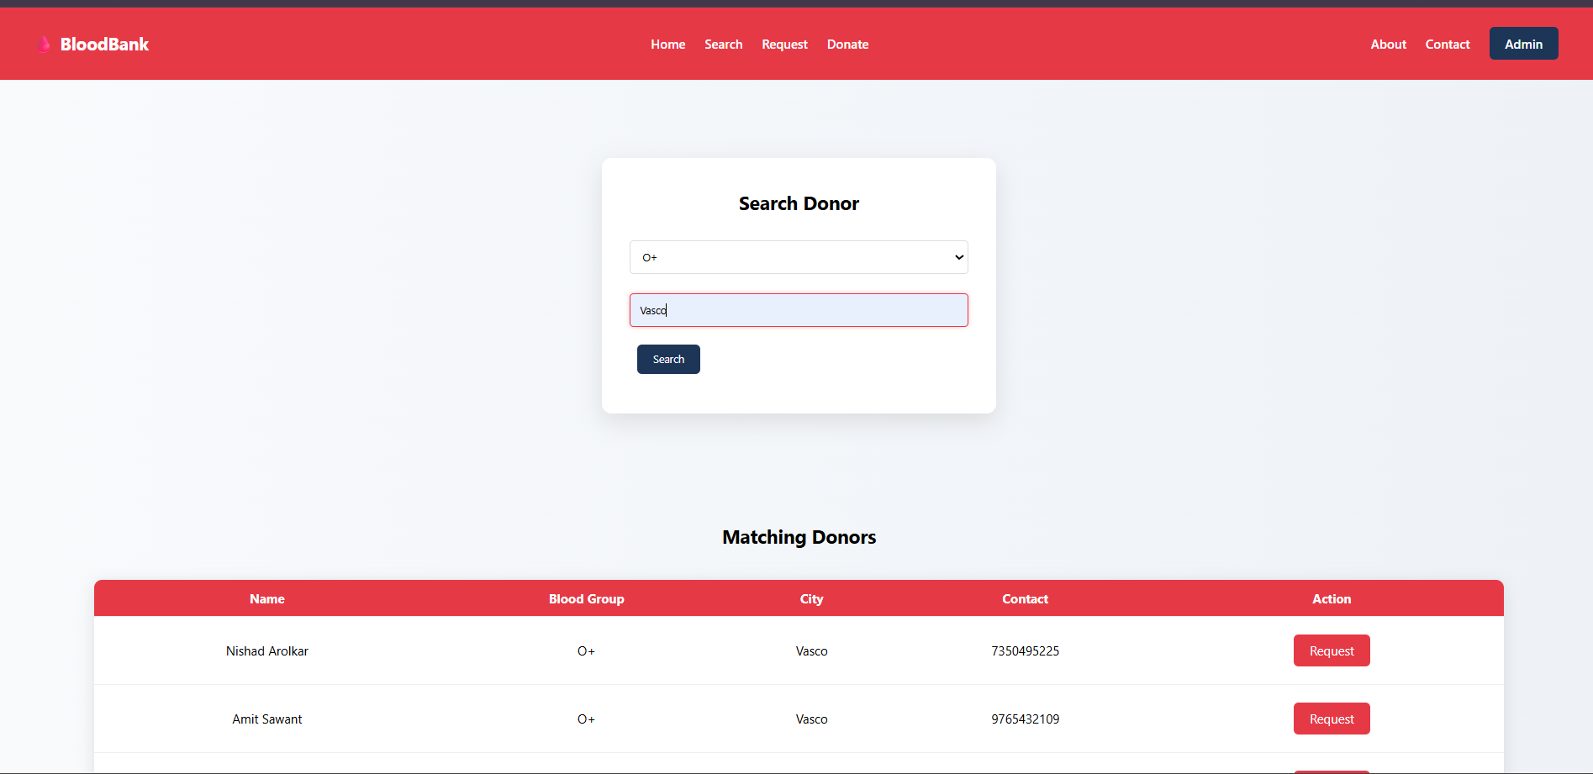

Slide 15
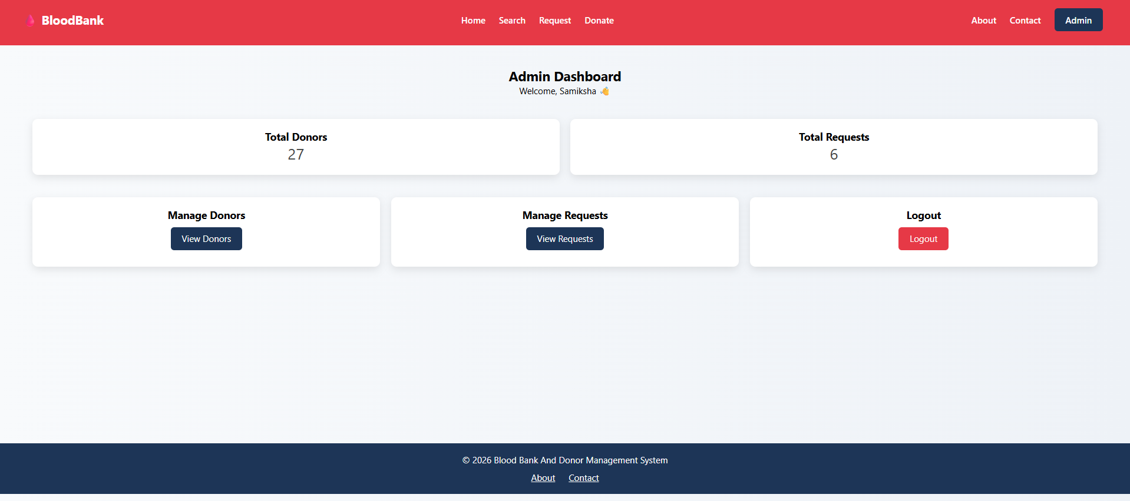

Slide 16
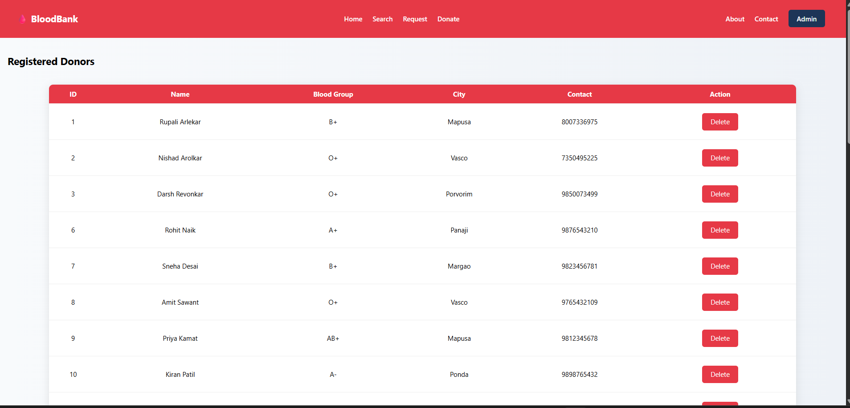

Slide 17
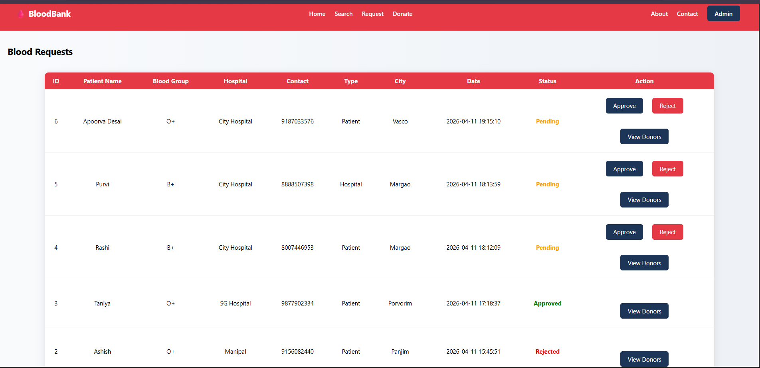

Slide 18
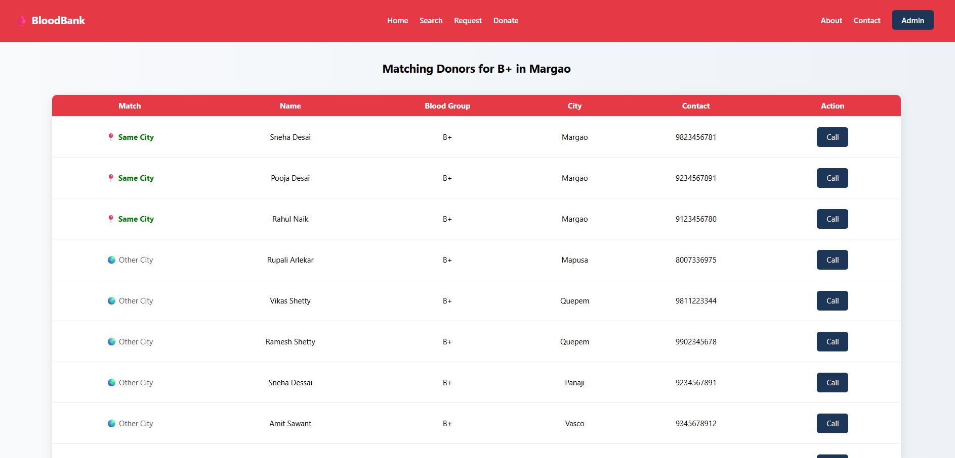

Slide 19
THANK YOU

