Slide 1
Automated
Aqua Farming Monitoring System
Kuluru Deepika - 18MIS1011
Meenapalli Sree Vaishnavi - 18MIS1032
Godugolla Karthik - 18MIS1070
Puvvada Rupa Sri Sai - 18MIS1104

Slide 2
1
Introduction
What is Aquaculture:
Aquaculture is a rapidly expanding and dynamic economic sector.
It is a controlled process of cultivating aquatic organisms, especially for human consumption. It is a similar concept of agriculture, but with fish instead of plants or livestock. Aquaculture is also referred to as fish farming

Slide 3
2
Problem Statement
With sudden climatic changes the parameters of water keep changing and that can be an issue which we face. Most of the farm workers are depending on manual testing which is a time-consuming process and might also give us inaccurate results as the parameters keep changing and might affect the fish in the pond and we can end up in a huge loss.

Slide 4
3
Societal Impact
Helps us take measures to maintain the proper environment for aquafarming.
Alternative Food Source
Increase Jobs in the Market
Reduce Sea Food Trade Deficit
Reduces Fishing Pressure on Wild Stock
Low Environmental Impact

Slide 5
4
Objectives
To equip the water body with a suitable device that automatically reads the necessary parameters 24/7.
To track the required parameters remotely without testing manually.
To send a notification to the user every time the water quality is bad.
To implement a machine learning algorithm to predict the water quality of the data.

Slide 6
5
Literature Survey
Sajal Saha, Rakibul Hasan Rajib, “IoT Based Automated Fish Farm Aquaculture Monitoring System” how they used Raspberry Pi,Arduino, various sensors and measured Temperature, pH, Electrical Conductivity and colour parameters of water.
Nikitha Rosaline, Dr.S.Sathyalakshimi,“IoT Based Aquaculture Monitoring and Control System” how they used WSN and IoT to observe the quality of the water and using six sensors how they measured dissolved oxygen, pH and temperature.
Sheetal Israni, HarshalMeharkure, Parag Yelore, “Application of IoT based System for Advance Agriculture in India,” International Journal of Innovative Research in Computer and Communication Engineering Vol. 3, Issue. 11, November 2015.

Slide 7
6
Proposed Methodology
The Aqua farming monitoring system will respond accordingly and send a message to the device describing the water quality.
As the sensors worked fine - We interfaced them with Arduino board using Arduino IDE
The required output will be displayed after giving the relay connection with the help of constraints provided
Adding a Wi-Fi module to each sensor and integrating them as one will read the values from each sensor
The values are uploaded on ThingSpeak platform with this and the data visualisation and analysis is done. Using MATLAB the graphs for the real-time data can be seen

Slide 8
7
Architecture Diagram

Slide 9
8
Modules
Implementation of the model
Implementation of the code
Interfacing hardware with the software (Cloud database)
Analyze and Visualize the data
Message to users device
Predicting the water parameters using various ML models

Slide 10
9
Dataset Used
A Dataset for Monitoring Water Quality Using Digital Sensors(Size=9623)
https://data.mendeley.com/datasets/34rczh25kc/4
Contains readings of data from different sensors.
Columns : Temperature, pH ,Turbidity , Water quality

Slide 11
10
Hardware Components
DTH11
pH Sensor
Turbidity Sensor
Arduino
Wi-Fi Module

Slide 12
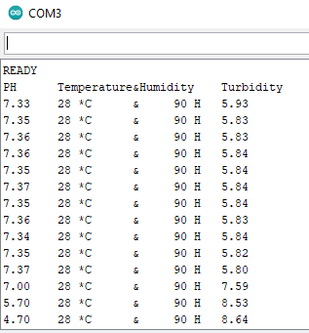
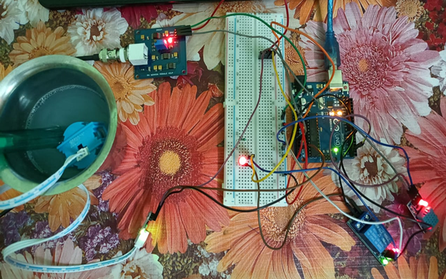
11
Output

Slide 13
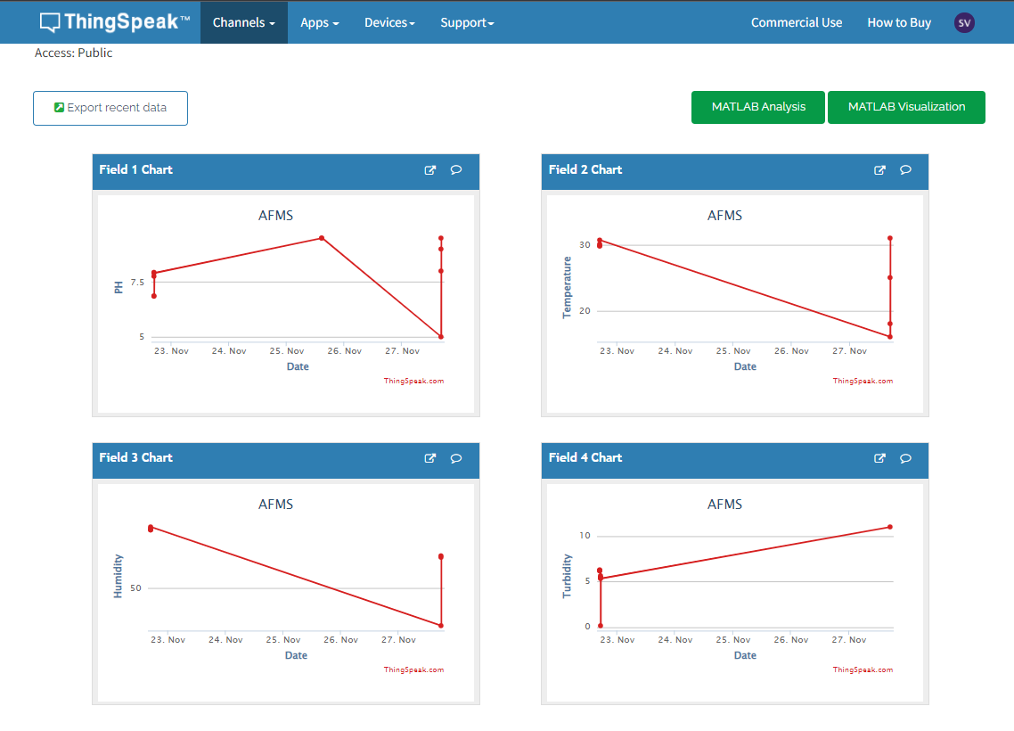
11
Output

Slide 14
11
Output

Slide 15
12
References
[1] Sajal Saha, Rakibul Hasan Rajib, "IoT Baes Automated Fish Farm Aquaculture Monitoring System" Conference paper (Oct 2018)
[2] Nikitha Rosaline, Dr.S.Sathyalakshimi, "IoT Based Aquaculture Monitoring and Control System" International Conference on Physics and Photonics Process in Nano Sciences (2019)
[3] Sheetal Israni, HarshalMeharkure, Parag Yelore, “Application of IoT based System for Advance Agriculture in India,” International Journal of Innovative Research in Computer and Communication Engineering Vol. 3, Issue. 11, November 2015.
[4] Nikesh Gondchawar, Prof. Dr. R. S. Kawitkar, “IoT based smart Agriculture, ” International Journal of advanced research in Computer and Communication Engineering, Vol.5, Issue. 6, June 2016.
[5] S. Kayalvizhi, Koushik Reddy G, Vivek Kumar P, VenkataPrasanth N, “Cyber Aqua Culture Monitoring System Using Arduino And Raspberry Pi,” International Journal of Advanced Research in Electrical, Electronics and Instrumentation Engineering, Vol. 4, Issue 5, Pg:2320-3765; May 2015.

Slide 16
THANK YOU

