Slide 1

MCA Major Project Mid Term Evaluation
Employee Task Management Tool
Under the guidance of
Dr. Arpana Sinhal
Department of Computer Applications
Faculty of Science, Technology and Architecture
Manipal University Jaipur
By
Rupa Kumari
23FS20MCA00062
2023-25

Slide 2
Outline
Introduction
Motivation
Process Model
Software Requirement Specification (SRS)
Data Flow Diagram (DFD)
Output
Conclusion
Future Scope

Slide 3
Introduction
An Employee Task Management (ETM) tool is a software designed to help individuals, teams, and organizations to manage their work efficiently.
It allows users to create, assign, and track tasks, ensuring smooth workflow and timely completion.

Slide 4
Motivation
Keeps Everything Organized All tasks, deadlines, and responsibilities are stored in one place, so no one has to dig through emails or chats to find important work.
Ensures Accountability Each task is assigned to a specific person, so there’s no confusion about who is responsible for what.
Helps Meet Deadlines Managers and employees can track progress in real time, preventing delays and ensuring work is completed on schedule.

Slide 5
Process Model
1. Task Creation
Admin create a new task with details like title, description, priority.
2. Task Assignment
The task is assigned to a specific employee with clear responsibilities.
3. Task Execution
The assigned employee works on the task, updating progress as needed.
4. Task Tracking & Monitoring
Admin and team members track task progress in real-time to ensure everything stays on schedule.
5. Task Review & Feedback
Once completed, the task is reviewed, and feedback is provided if any changes are needed.
6. Task Completion & Reporting
The final task is marked as complete, and reports are generated for better workflow analysis.

Slide 6
Software Requirement Specification (SRS)
Frontend Technologies
React – Component-based UI for a dynamic and interactive experience.
Next.js – Optimized performance with server-side rendering and routing.
Tailwind CSS – Lightweight and flexible styling for a modern UI.
MUI – Pre-built, customizable components for a consistent look and feel.
State Management
React Context API – Centralized state management for smooth data flow.
Data Fetching
Fetch / Axios – Efficient API communication for seamless data exchange.
Libraries & Tools
React-Toastify – Instant notifications for a better user experience.
Quill – Advanced rich text editor for detailed task descriptions.

Slide 7
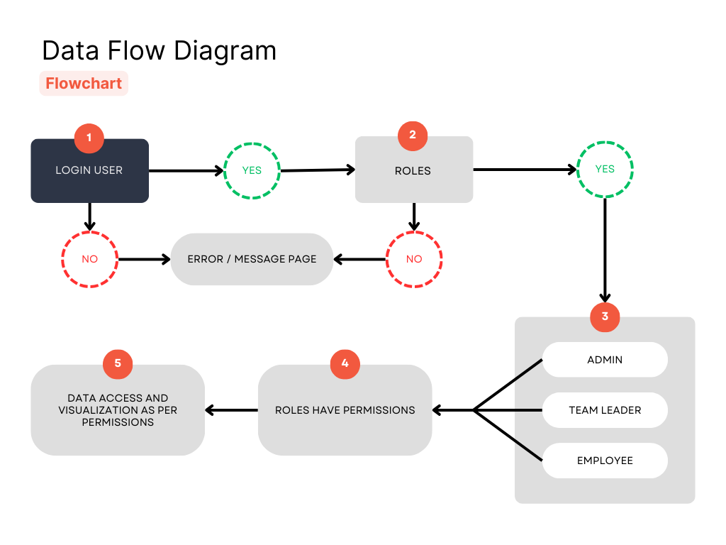
Data Flow Diagram (DFD)
User Login – Users enter credentials; valid users move forward, invalid users see an error.
Role Verification – The system checks assigned roles; unauthorized users are denied access.
Role Assignment – Users are classified as Admin, Team Leader, or Employee based on roles.
Permission Control – Each role gets specific access and functionalities.
Data Access – Users can view and manage data as per their permissions.

Slide 8
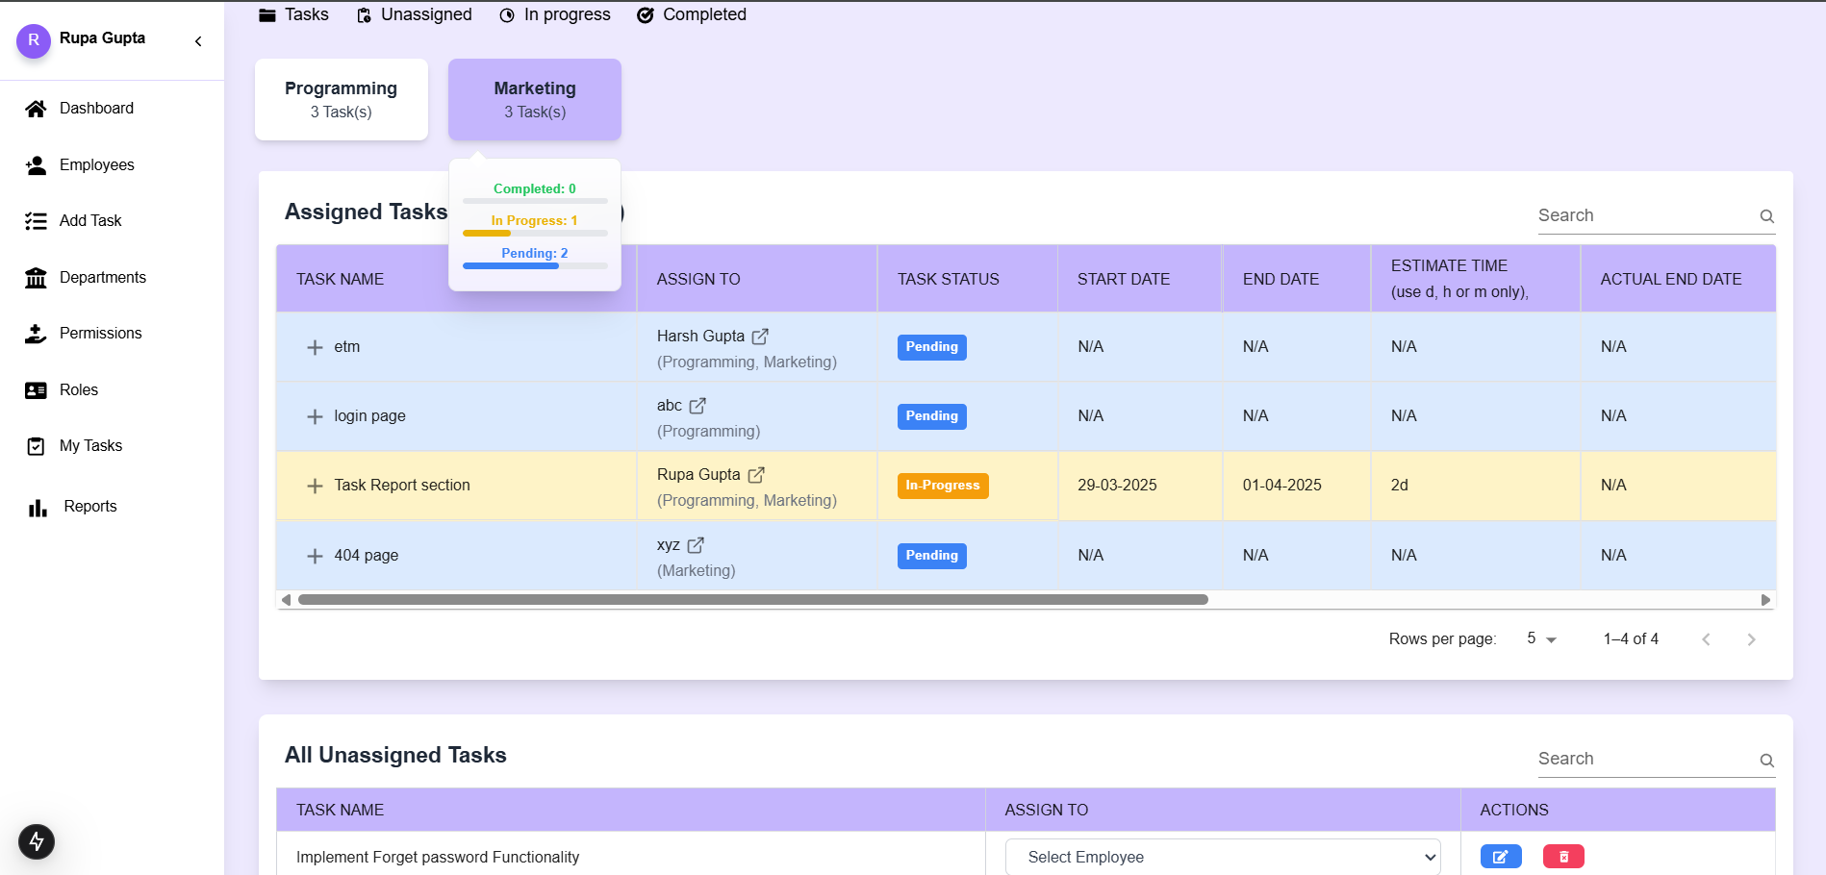
Output

Slide 9
Conclusion
The Project Management System is designed to enhance productivity and efficiency by providing a structured approach to task management, tracking, and reporting.
It enables seamless collaboration, ensures timely task completion, and offers real-time insights through role-based access to reports.

Slide 10
Future Scope
The goal is to scale the system globally and establish it as a widely adopted project management solution.
The system will be offered to other organizations, allowing them to manage their projects efficiently, just as we do.
Future enhancements will focus on seamless integration with industry-leading tools like Slack, Jira, and Trello.
Plans include cloud-based deployment for accessibility across different teams and organizations.
Advanced automation features will be introduced to optimize task tracking and reporting.
A mobile-friendly platform will be developed to enable on-the-go task management.

Slide 11
Thank You🙏

