Slide 1
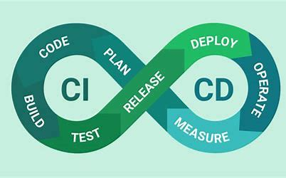




git CI/CD
Pipelines
Presented By : Rupak Sarkar

Slide 2
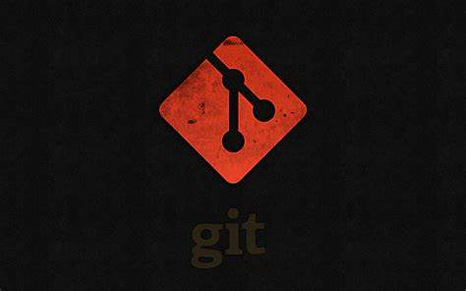

Contents
01
02
03
04
What is git ?
What is CI/CD ?
About CI
About CD

Slide 3

What is Git ?
Definition : Git is a distributed version control system created by Linus Torvalds in 2005.
Key Concepts in Git :
Repository: A directory which tracks all changes.
Commit: A snapshot of your repository at a specific point in time.
Branch: Independent line of development.
Merge: Bringing changes from one branch into another.
Clone: Copy of a Git repository.
Pull: Fetching changes from a remote repository and merging them into the current branch.
Push: Sending committed changes to a remote repository.

Slide 4
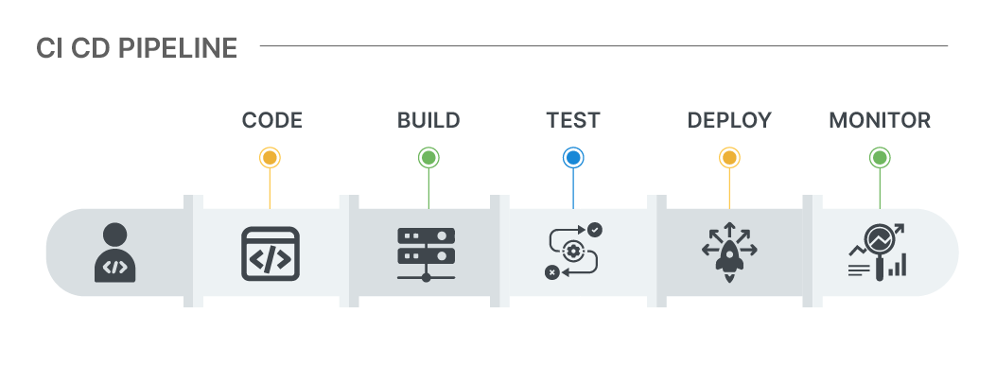
What is CI/CD?
Continuous Integration (CI) and Continuous Deployment/Delivery (CD) are methodologies used in modern software development to automate the integration, testing, and deployment of code.
The primary goal of CI/CD pipelines is to:
Streamline the software delivery process .
Improve collaboration .
Accelerate the time needed to deliver software changes to production .

Slide 5


Exploration of Continuous Integration (CI)
Overview
Benefits
=
Synchronization
CI pipelines usually include steps such as compiling code, running automated tests, and checking for
code quality and style.
CI involves integrating code changes from multiple developers into a shared repository, such as Git,
regularly.
This ensures that code changes are validated and merged together as frequently as possible.
Through the practice of CI, teams can identify issues or conflicts early on, thereby enabling faster.
feedback loops and mitigating the risk of integration problems.
Collaboration

Slide 6
Exploration of Continuous Deployment(CD)
=
Stages of CD Pipelines
Benefits of CD Pipelines
Automation of Deployment
CD pipelines also help ensure that software changes are delivered quickly, reliably, and with minimal manual intervention..
CD focuses on automating the deployment and delivery of software changes to production
environments.
CD pipelines include the additional stages that follow the CI process, such as deploying the app to staging environments, running additional tests, and then deploying the app to production if all tests are successfully passed.
Collaboration

Slide 7
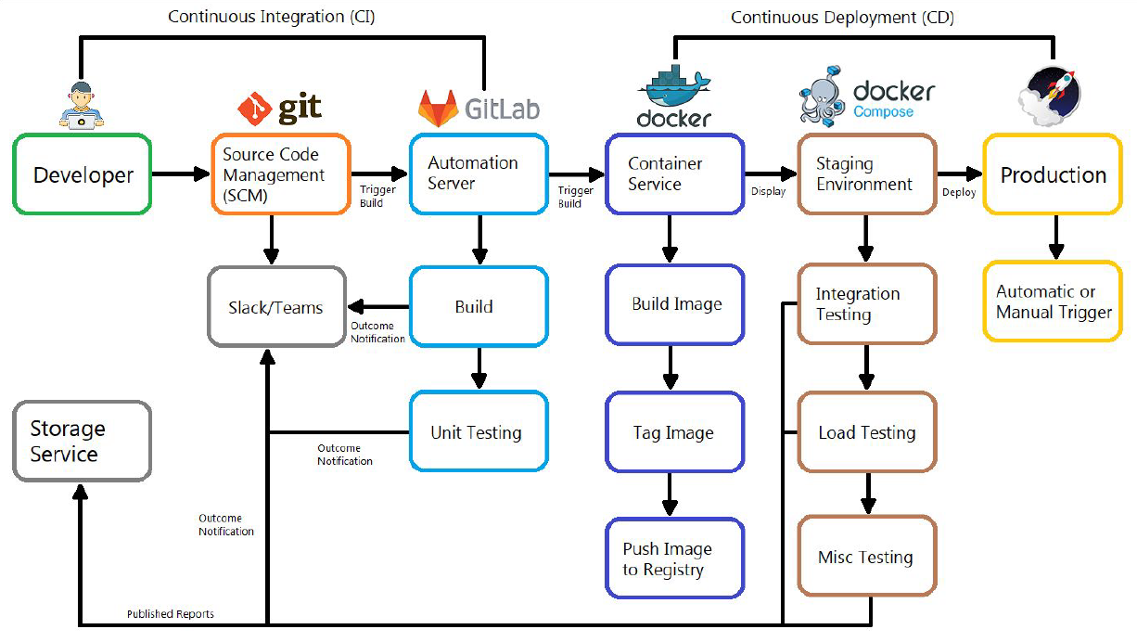

Slide 8
Thank You!

Slide 9
Resources Page
1.GitHub
2.Atlassian

