Slide 1
Deep Learning with Pytorch

Slide 2
Agenda
Introduction
Dataset Selection
Data Preprocessing
Model Selection and Architecture
Evaluation
Challenges faced
Lesson Learned

Slide 3
Introduction
The Indian Premier League (IPL) 2023 Players Images Dataset is a collection of images featuring players participating in the IPL cricket tournament.
Cricket is super popular in India and everywhere.
The dataset is great for people who love cricket, researchers, and anyone who likes working on entertainment industry.
It helps people study and understand the sports category in entertainment industry.

Slide 4
Dataset Selection
Source of Dataset : Kaggle
Images: 7510 Variety of players including action shots, player portraits, team celebrations, and many more.
Number of Classes : 10 (750 images per Class) Team Information: Covers all IPL teams, including Chennai Super Kings, Mumbai Indians, Royal Challengers Bangalore, etc.
Size and Format: Varies in size and format, commonly JPEG or PNG,

Slide 5
Data Preprocessing
Import Necessary Libraries
Define Image Transformations :
Compose transformations for training and testing data.
Resize, convert to tensor, and normalize.
Load and Split Dataset :
Load dataset from folder using ImageFolder.
Split dataset into training and validation sets.(90% in training and 10% in Validation)

Slide 6
Model Selection and Architecture
ResNet-50
Depth and Complexity
Improved Accuracy
Efficient Training and Inference
Effective for Complex Tasks

Slide 7
Model Training
Loss Function Selection:
Chose CrossEntropyLoss for its effectiveness with multiple classes.
Measures the disparity between predicted and actual classes.
Optimizer Choice:
Employed Adam optimizer for adaptive learning rate.
Learning Rate Setting:
Set learning rate to 0.02.
Controls the magnitude of model updates per training step.
Training Iterations:
Iterate over dataset for 50 epochs.

Slide 8
Model Training
Metrics Tracking:
Track loss and accuracy metrics for visualization and performance assessment.
Validation Evaluation:
Assess model performance on validation dataset.
Performance Assessment:
Generate confusion matrices for visual evaluation.

Slide 9
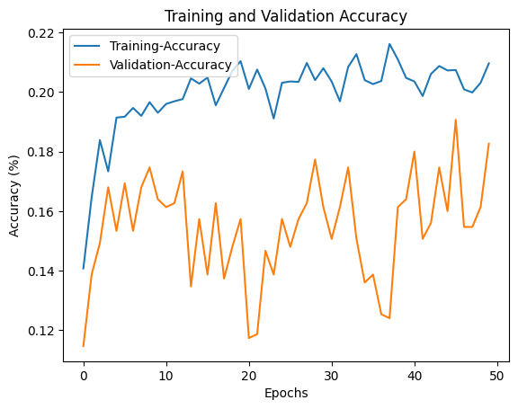
Evaluation Result
Training Epochs: 10
Accuracy Metrics:
Training Accuracy: 18.27%
Validation Accuracy: 20.96%

Slide 10
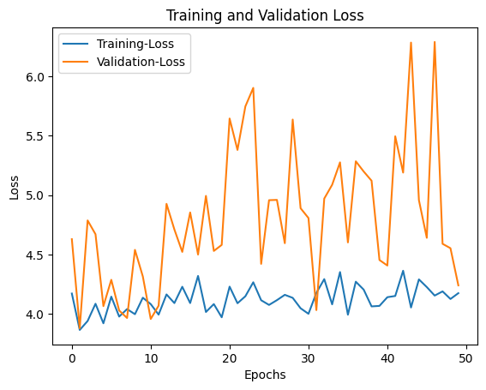
Evaluation Result
Loss Metrics:
Training Loss: 4.239
Validation Loss: 4.173

Slide 11
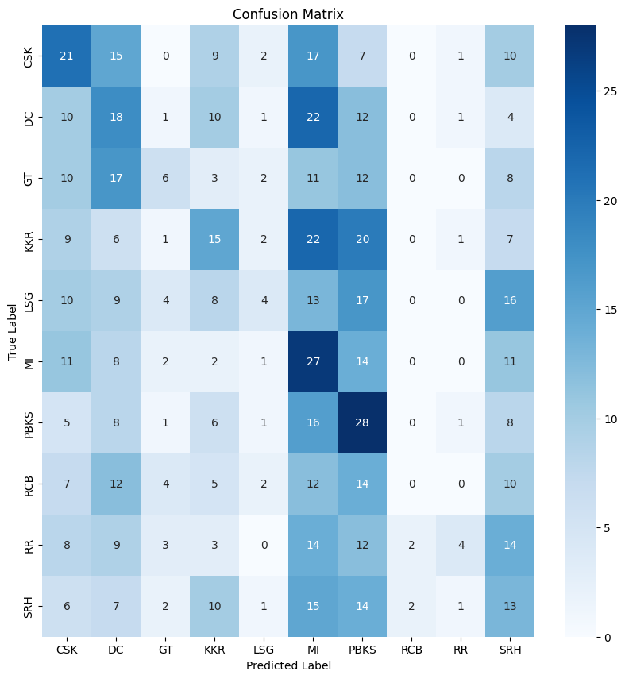
Confusion Matrix
It shows how often each class was predicted correctly or incorrectly by the model.
Rows represent actual labels, columns represent predicted labels.
Diagonal elements show the number of correct predictions for each class (e.g., 21 for SRH).
Off-diagonal elements show misclassifications (e.g., 15 SRH predicted as DC).
Bottom row shows the number of actual instances per class.
Far right column shows the number of misclassified instances per class (e.g., 25 for SRH).

Slide 12
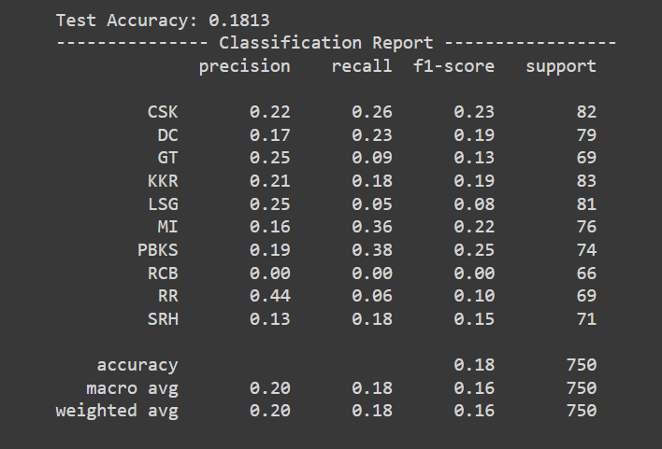
Classification Report:
The report shows precision, recall, and F1 scores for 10 different classes.
Precision is a measure of how accurate the model is. For example, a precision of 0.22 for class CSK means that 22% of the time the model predicted CSK, it was correct.
Recall is a measure of how well the model finds all of the relevant data. For example, a recall of 0.26 for class CSK means that the model found 26% of all the actual CSK data.
F1 score is a harmonic mean of precision and recall.
The weighted average F1 score is 0.16.
The accuracy of the model is 0.20.

Slide 13
Challenges :
Data Loading and processing
GPU utilization
Model selection
Loss Fluctuation
Data Accuracy
Underfitting/Overfitting

Slide 14
Learning :
Dataset Selection
Splitting Dataset
Image Transformation
Preprocessing
Hyper parameter Tuning

Slide 15
Thank you

