Slide 1

Information encoding standards
Final Project
9.24.XX

Slide 2

Agenda
INTRODUCTION
Project overview
Authorization & authentication
scaffolding and identity
Team
Closing

Slide 3

INTRODUCTION
Project overview
Empowering user data protection with Asp.net core authorization
Project Goal: Our primary goal is to create a web application that not only provides valuable functionality but also prioritizes the protection of user data through robust authorization practices.
Authorization Focus: We emphasize the implementation of a sophisticated authorization system within ASP.NET Core. This system categorizes users into three distinct security groups, each with specific permissions and responsibilities.
Security Groups:
Registered Users: Empowered to view all approved data and manage their own information.
Managers: Tasked with approving or rejecting contact data to maintain data integrity.
Administrators: Possessing the authority to approve/reject, edit, and delete any data within the system.
User-Centric Approach: Our application is designed with the end-user in mind, offering a seamless and secure experience for individuals at every access level.

Slide 4

Project Overview
Navigating Innovation: ASP.NET Core Web App
A Glimpse into Functionality and Security Measures
Technology Stack:
Leveraging the robust capabilities of ASP.NET Core.
Creating database using SSMS (SQL Server Management Studio).
Ensuring scalability, performance, and adaptability.
Functionality:
Users can create, view, edit, and delete their contact data.
Data is securely stored and associated with the respective user profiles.
Three distinct security groups dictate user permissions: Registered Users, Managers, and Administrators.
Providing an intuitive and user-friendly experience.
Scalability:
Designed to grow with evolving needs.
Ensuring a sustainable and future-proof solution.

Slide 5
Authorization overview
Guarding Access: Understanding Authorization in Web Applications
Authorization refers to the process that determines what a user is able to do. For example, an administrative user is allowed to create a document library, add documents, edit documents, and delete them. A non-administrative user working with the library is only authorized to read the documents.
Roles define permissions, ensuring a granular approach to access control.
Authentication ensures users are who they claim to be, a fundamental step before authorization.
Policies determine what actions each role is allowed to perform.
Ensuring that access permissions are finely tuned.
Differentiating between viewing, creating, editing, and deleting data based on user roles.

Slide 6
Empowering User Roles: Security Groups in Action
Security Groups
Registered Users:
Privileges:
View all approved data.
Edit and delete their own data.
Responsibilities:
Maintain and manage personal contact information.
Managers:
Privileges:
Approve or reject contact data submissions.
Responsibilities:
Ensure data integrity by reviewing and managing submissions.
Administrators:
Privileges:
Approve or reject contact data submissions.
Edit and delete any data within the system.
Responsibilities:
Oversee and manage the entire data repository.

Slide 7
Workflow Navigating Roles: Workflow Overview
User Submission Workflow:
Registered users create and submit contact data.
Managers review submissions, approving or rejecting entries based on data integrity.
Data Visibility:
Only approved data is made visible to registered users.
Administrators have full visibility and can access all data within the system.
Editing and Deletion:
Registered users can edit and delete their own data.
Administrators hold the authority to edit and delete any data within the system.
Role-Based Navigation:
The application dynamically adjusts the user interface based on the logged-in user's role.
This ensures that each security group interacts with the system in accordance with their assigned privileges.

Slide 8
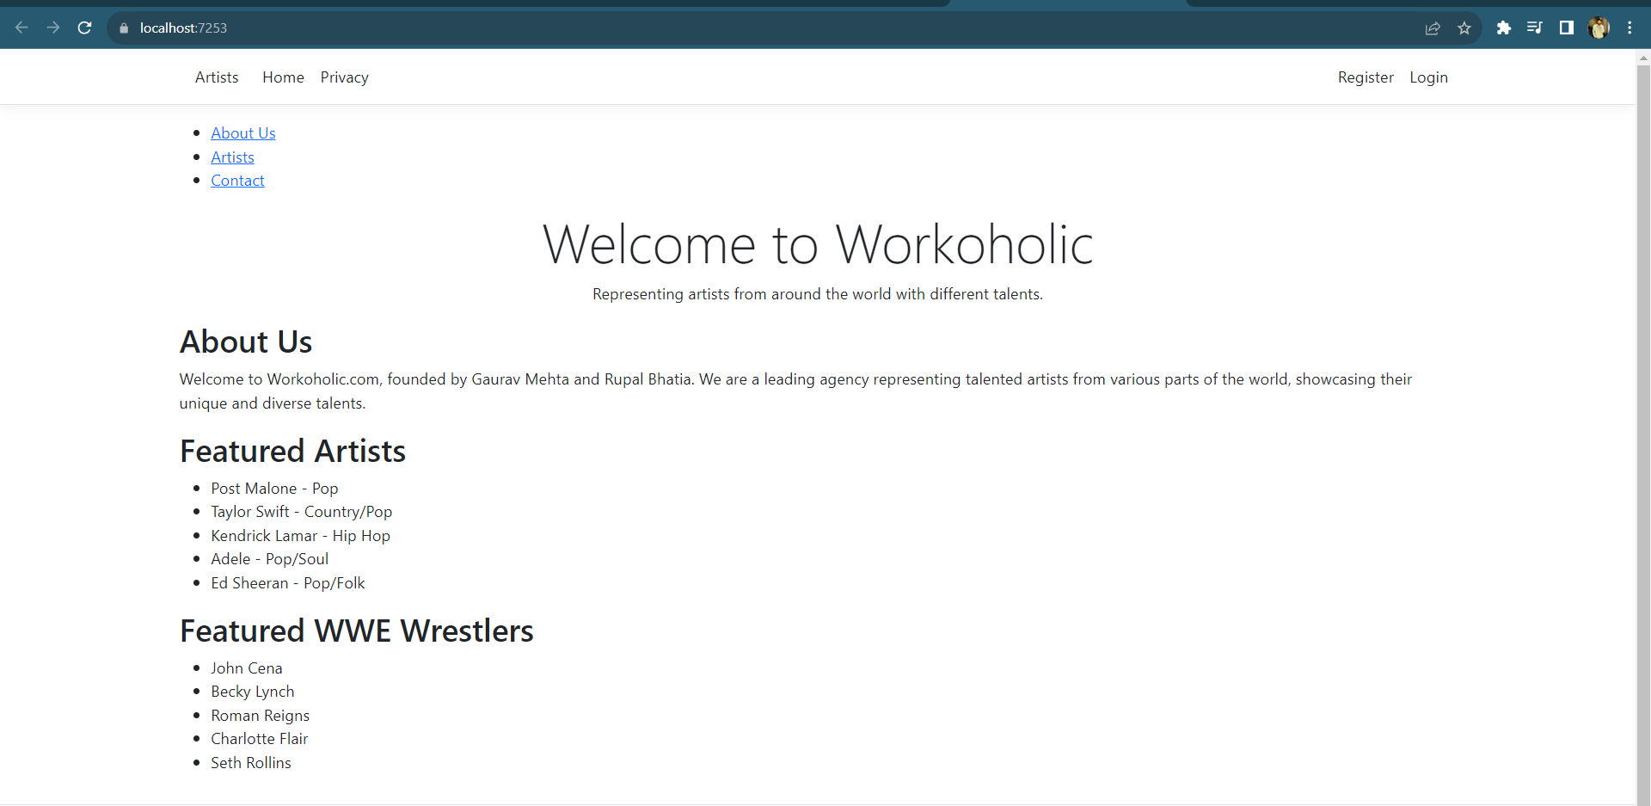

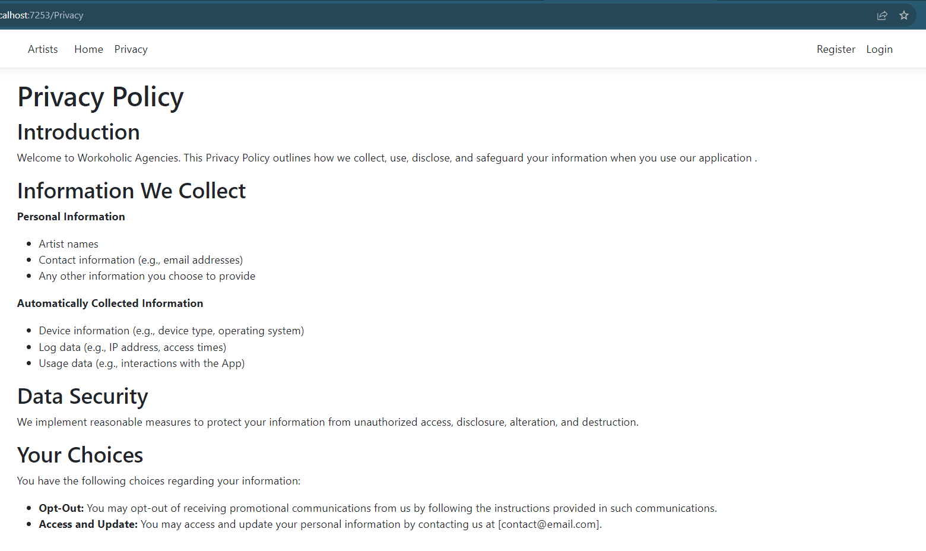
Home Page
Privacy Policy

Slide 9
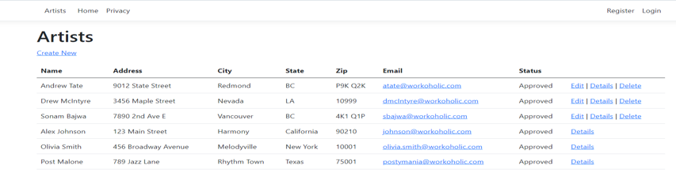
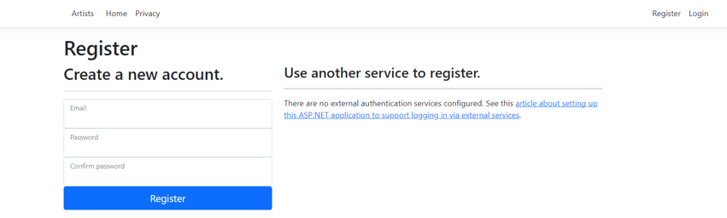
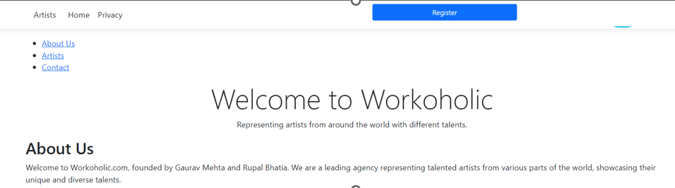
ARTISTS WE REPRESENT
NEW USER: REGISTER
LOGIN

Slide 10
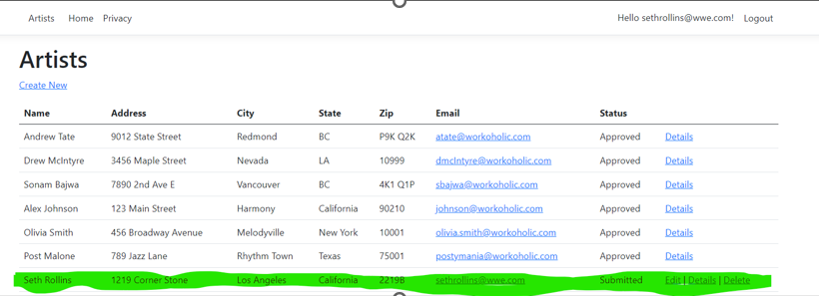
Create new contact under artists
REGULAR USER WILL BE UNABLE TO MODIFY OTHERS except his own

Slide 11
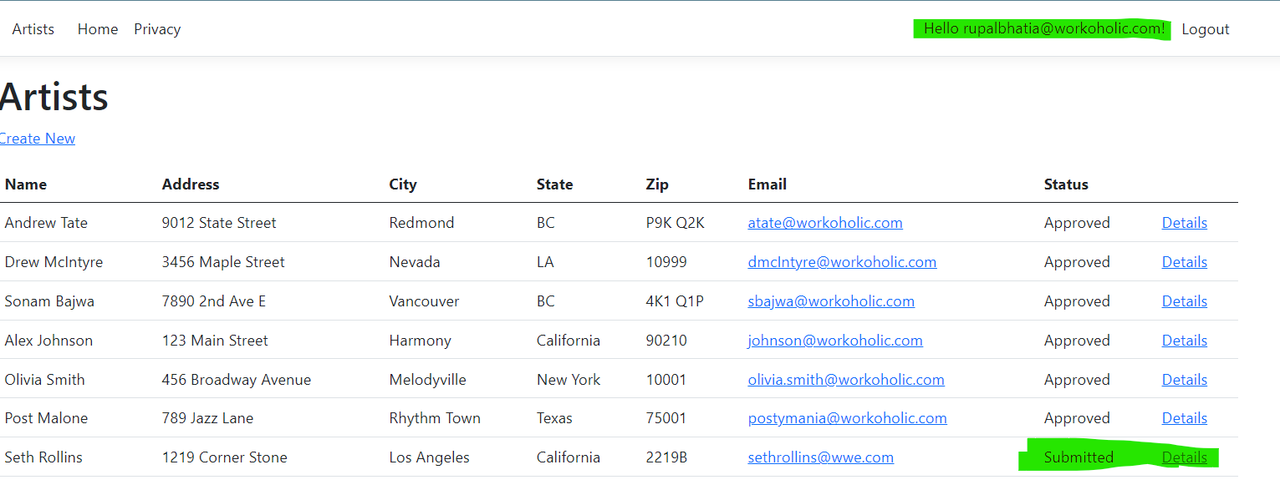
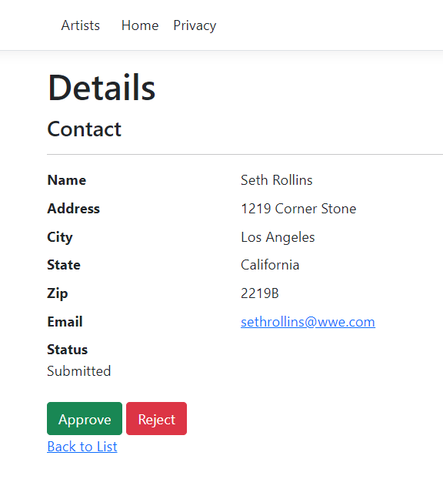
NOW MANGER: APPROVE OR REJECT
Approved in this case

Slide 12


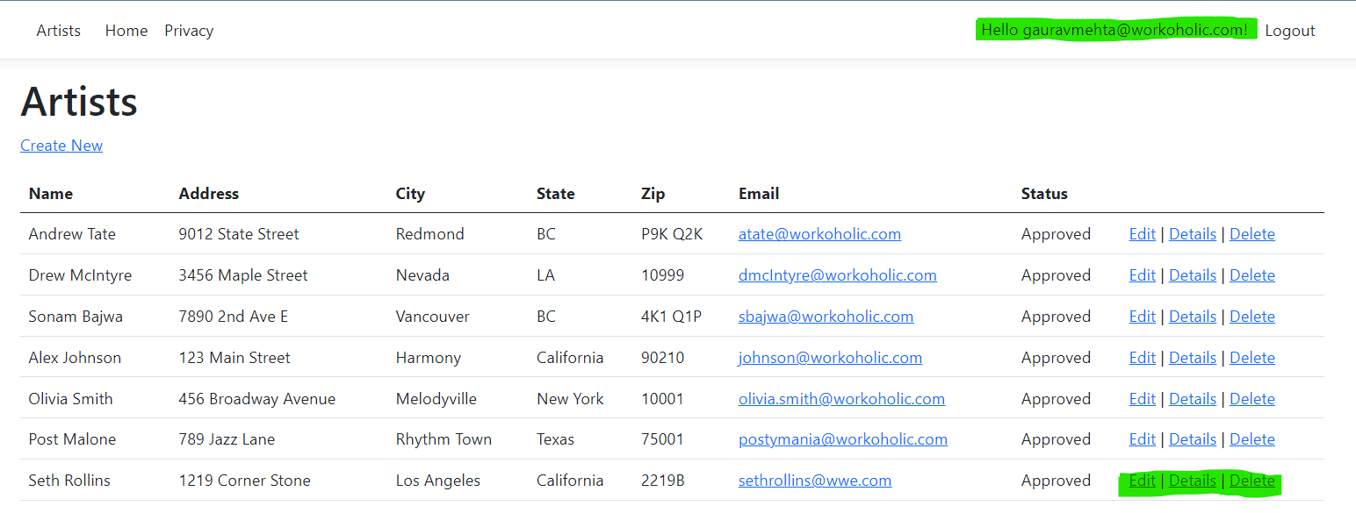
ADMIN CONTROL (COMPLETE PRIVILEDGES)

Slide 13

Scaffolding for Rapid Development:
Leveraged scaffolding to swiftly generate the initial project structure.
Automated repetitive tasks, reducing development time.
Utilized scaffolding to establish a solid foundation for our ASP.NET Core web app.
ASP.NET Core Identity Integration:
Seamlessly integrated ASP.NET Core Identity for secure user authentication.
Employed Identity to manage user roles, ensuring a structured approach to access control.
Utilized built-in Identity features for secure password hashing and user management.
Role Management with Identity:
Defined distinct roles for Registered Users, Managers, and Administrators.
Established a role-based hierarchy to dictate access permissions.
Integrated Identity's role management capabilities to assign and manage user roles.
User Authentication and Registration:
Implemented secure user authentication during login.
Leveraged Identity's features for user registration and account management.
Seamlessly integrated Identity into the overall scaffolding structure.
NuGet Packages for Enhanced Functionality:
Incorporated essential NuGet packages to extend the capabilities of our web app.
Mention specific packages and their roles (e.g., Microsoft.AspNetCore.Mvc, Microsoft.EntityFrameworkCore, etc.).
Leveraged these packages to enhance functionality, security, and overall project efficiency.
SCAFFOLDING AND IDENTITY INTEGRATION
Accelerating Development: Scaffolding and Identity Integration

Slide 14
Implementation Steps
Behind the Scenes: Implementing Authorization in ASP.NET Core
Scaffolding and ASP.NET Core Identity Integration:
Utilized scaffolding to quickly generate basic code structure.
Integrated ASP.NET Core Identity for user authentication and role management.
Leveraged scaffolding to streamline the setup of user and role management.
Role-Based Access Control (RBAC):
Established a role hierarchy defining the permissions for each security group.
Integrated RBAC principles to control access to specific resources and actions.
Authorization Policies:
Defined granular authorization policies based on user roles.
Policies dictate access rights for viewing, creating, editing, and deleting data.
Custom Middleware for Authorization:
Developed custom middleware to handle authorization checks.
Ensured that authorization checks are seamlessly integrated into the application's request-processing pipeline.
Testing and Validation:
Conducted thorough testing to validate the effectiveness of the authorization system.
Identified and addressed any potential security vulnerabilities.
Documentation and Training:
Documented the implemented authorization system for future reference.
Conducted training sessions to familiarize team members with the new security features.

Slide 15



THANK YOU
gaurav.mehta@mygeorgian.ca
Gaurav Mehta
rupal.bhatia@mygeorgian.ca
Rupal bhatia

