Slide 1

Tournament Management Software
for UA Badminton Club Customer CSC 536 Final Status
Junfeng Xu, Enfa George, Rupal Jain, Urvika Gola
Notes:
Hello, everyone. This is the U of A Badminton tournament software team.

Slide 2


Structure of the Presentation
Plan & Accomplishment
Final Status
Challenges
Project Management
Demo
Notes:
Today we will go over our plan & Accomplishments. The Final status of our project. Challenges we faced, project management. And a demo will be presented by my teammate Jenfung.

Slide 3

Plan & Accomplishment
Notes:
1 min

Slide 4
Plan and Accomplishment
Plan for this iteration
Integration of Tournament Creation and updation with DB
Database support for Events Registration on Players dashboard
Store player seeding information for each events by Admin
Making draw and display it on Public page to start the Tournament
Tracking current and finishes matches in Events page by Admin
Testing a complete flow from tournament creation to making draws to tracking matches.
Team accomplishment
Notes:
So here is the plan for this iteration:
Integrating Tournament Creation and updation with our database system, streamlining the entire process.
Players to conveniently register for events available directly from their dashboard. Admin to assign seeding to the players and our database will stores player seeding information.
To reduce manual effort for the admin in making tournament draws and to ensuring fair matchups, system will generate draws and display it on the public page, allowing players and public to follow along. Administrators can track live matches, assign court number, enter the final match score and change the status of the matches.
Testing the complete flow from tournament creation to tracking matches that could simplify tournament management.
Out team was able to accomplish all the tasks defined for this iteration.

Slide 5
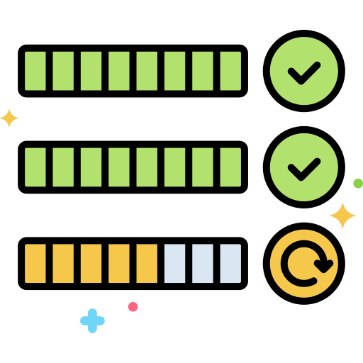
Final Status

Slide 6
Summary : High priority stories
As a tournament organizer, I want
secure way to sign into the admin page …
to assign points to tournament participants …
make draws for all the events in a tournament ..
As a tournament participant, I want to
create a user profile and edit it after creation …
sign up for the tournament with a straightforward user interface …
see the match results and
see tournament bracket update in real time on the tournament …

Slide 7
Summary : Low priority stories
As a tournament organizer, I want to
Easy-to-use user interface to record scores for each match, mark the winner, and
advance the winner during the tournament day …
Make the tournament in ABCD Drop Flight format …

Slide 8

Project Management
Notes:
Let’s now get into the project management principles

Slide 9
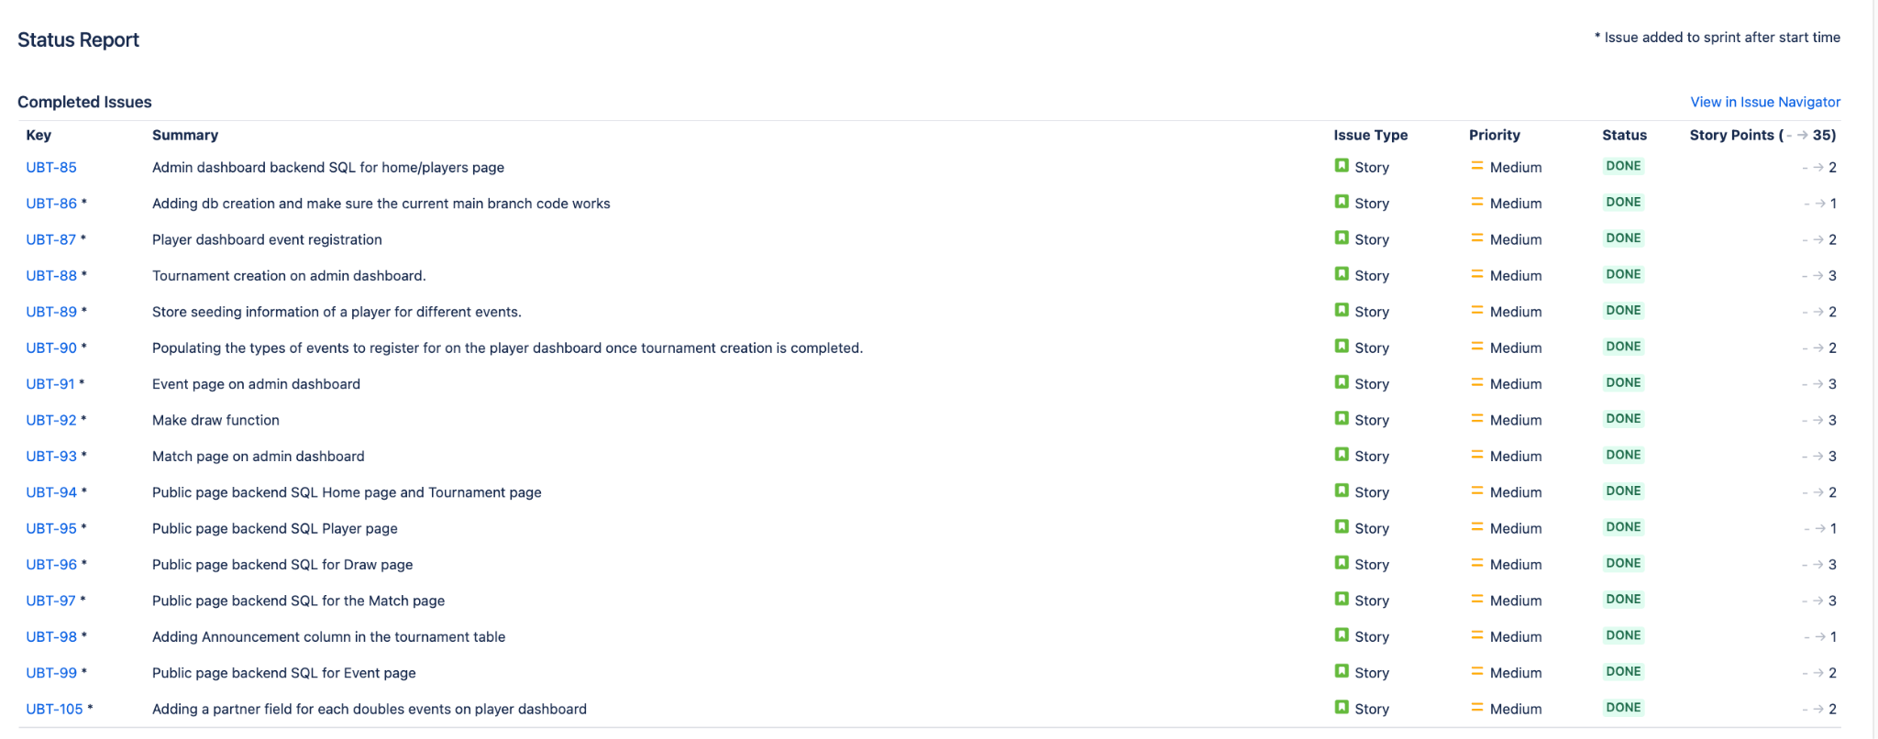
Sprint
Sprint Duration - 10/Apr/23 to 25/Apr/23
Notes:
Sprint lasted around 2 weeks, and to see our progress in depth, lets look at the burn up chart

Slide 10
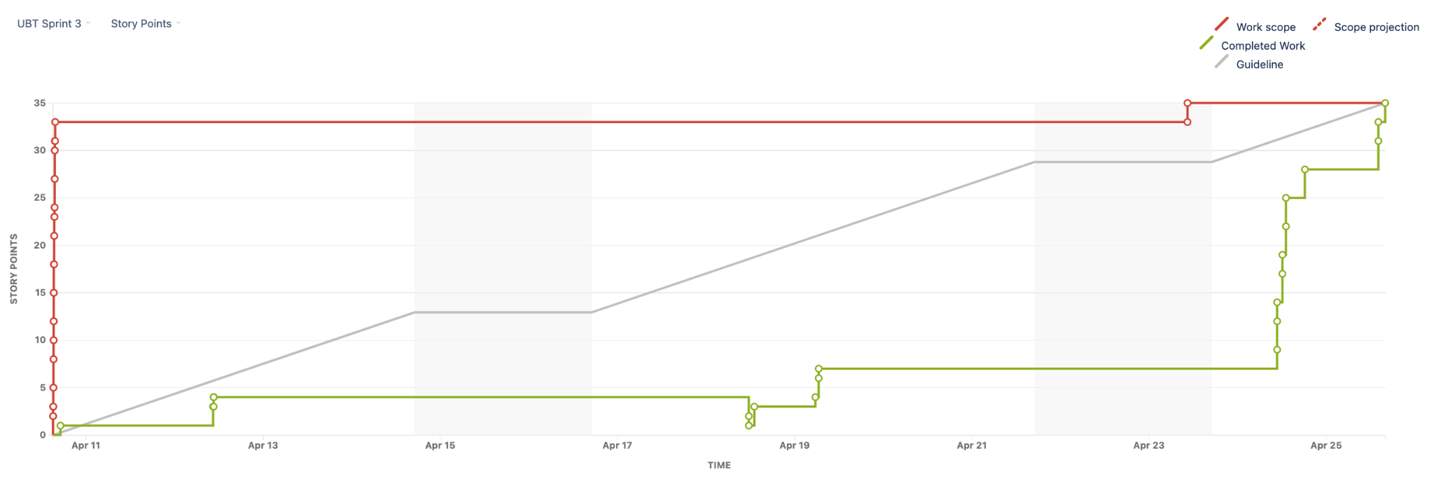
Burnup Chart
Notes:
On the x axis, we had 33 story points to burn during this sprint, and the green line indicates the amount of points we burnt throughout the duration, We can see that most of the work is burned near the end, which is primarily due to the fact that, although the code was completed much earlier, we wanted to thoroughly test the changes, giving us confidence that we could mark the story as complete.

Slide 11
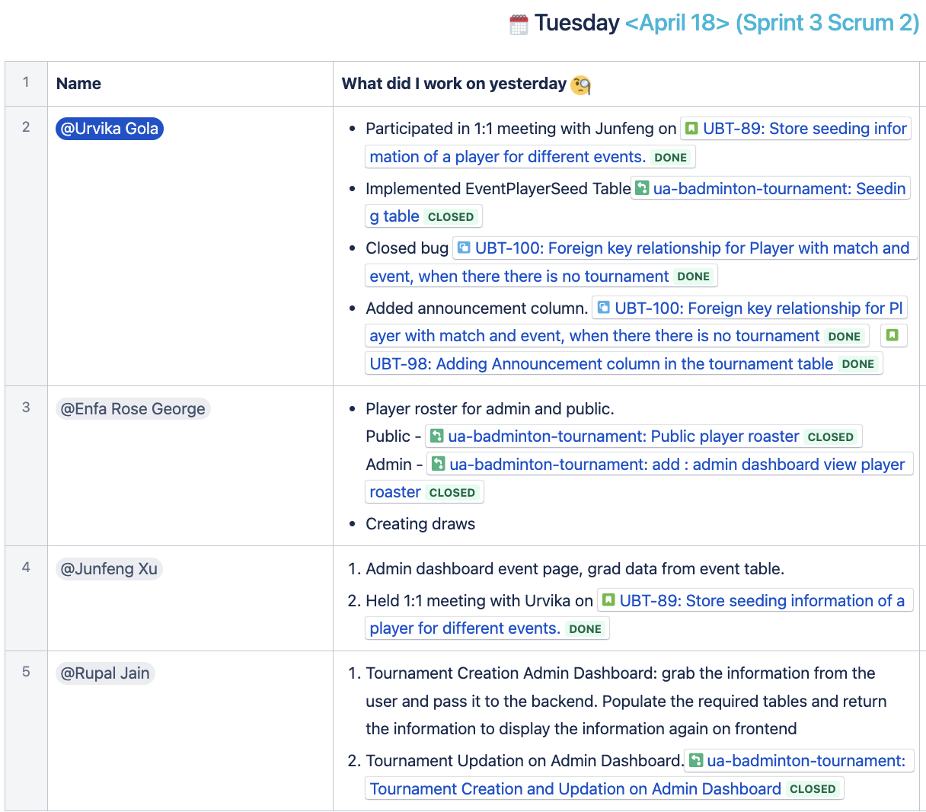
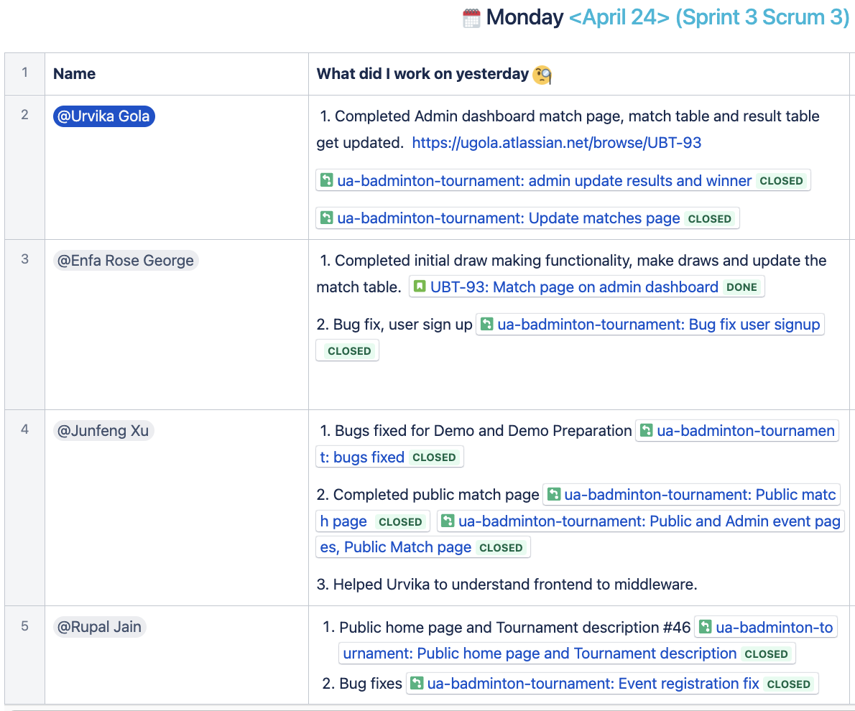
Scrum Dashboard
Notes:
Our sprint had 3 status update meetings, and this is a snapshot of two of those. Although our sprint goal was met, lets talk about the challenges we faced.

Slide 12



Challenges
Notes:
Lets talk about challenges we faced in this sprint and how we were able to overcome the roadblocks we encountered on our way.

Slide 13

Overcoming Technical Challenges - Sprint Retrospective
Challenge - Backend developers faced difficulty when transitioning from backend to frontend and middleware for project completion.
Solution: To address this challenge, team members mentored one another as they worked through new skills and concepts.
Impact: By working collaboratively and sharing knowledge, we were able to overcome the challenge of transitioning between frontend and backend development and complete our sprint objectives.
Notes:
One of the challenges we encountered during this sprint was when some of our backend developers needed to move to frontend development, and vice versa. As a result, some team faced technical difficulties as they navigated new technologies and workflows.
However, instead of seeing this as a hindrance, our team embraced the challenge and rallied together to provide support and assistance to one another. This included taking the time out of the regular meetings and provide 1:1 mentorship.
By working collaboratively we were able to overcome the challenge of this transition and meet our sprint objectives. This experience has shown us the importance of having a strong, supportive dynamics within the team.
Having said that lets see what our team has created, our product owner Junfeng will present the demo to you.

Slide 14


Slide 15


Slide 16

Notes:
We are now open for questions and answers.

