Slide 1



AW_Report_Rupal
View in Power BI
Last data refresh:
11/30/2021 10:20:37 PM UTC
Downloaded at:
11/30/2021 10:22:12 PM UTC

Slide 2
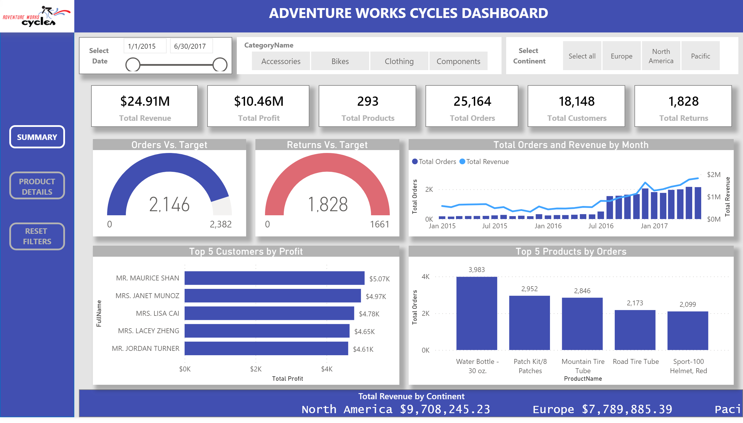
Summary Page
Notes:
shape
No alt text provided.
image
No alt text provided.
textbox
No alt text provided.
textbox
No alt text provided.
card
No alt text provided.
card
No alt text provided.
ScrollingTextVisual1448795304508
No alt text provided.
Top 5 Customers by Profit
No alt text provided.
textbox
No alt text provided.
slicer
No alt text provided.
textbox
No alt text provided.
textbox
No alt text provided.
slicer
No alt text provided.
textbox
No alt text provided.
slicer
No alt text provided.
card
No alt text provided.
Top 5 Products by Orders
No alt text provided.
Total Orders and Revenue by Month
No alt text provided.
Orders Vs. Target
No alt text provided.
Returns Vs. Target
No alt text provided.
actionButton
No alt text provided.
actionButton
No alt text provided.
textbox
No alt text provided.
shape
No alt text provided.
card
No alt text provided.
card
No alt text provided.
card
No alt text provided.

Slide 3
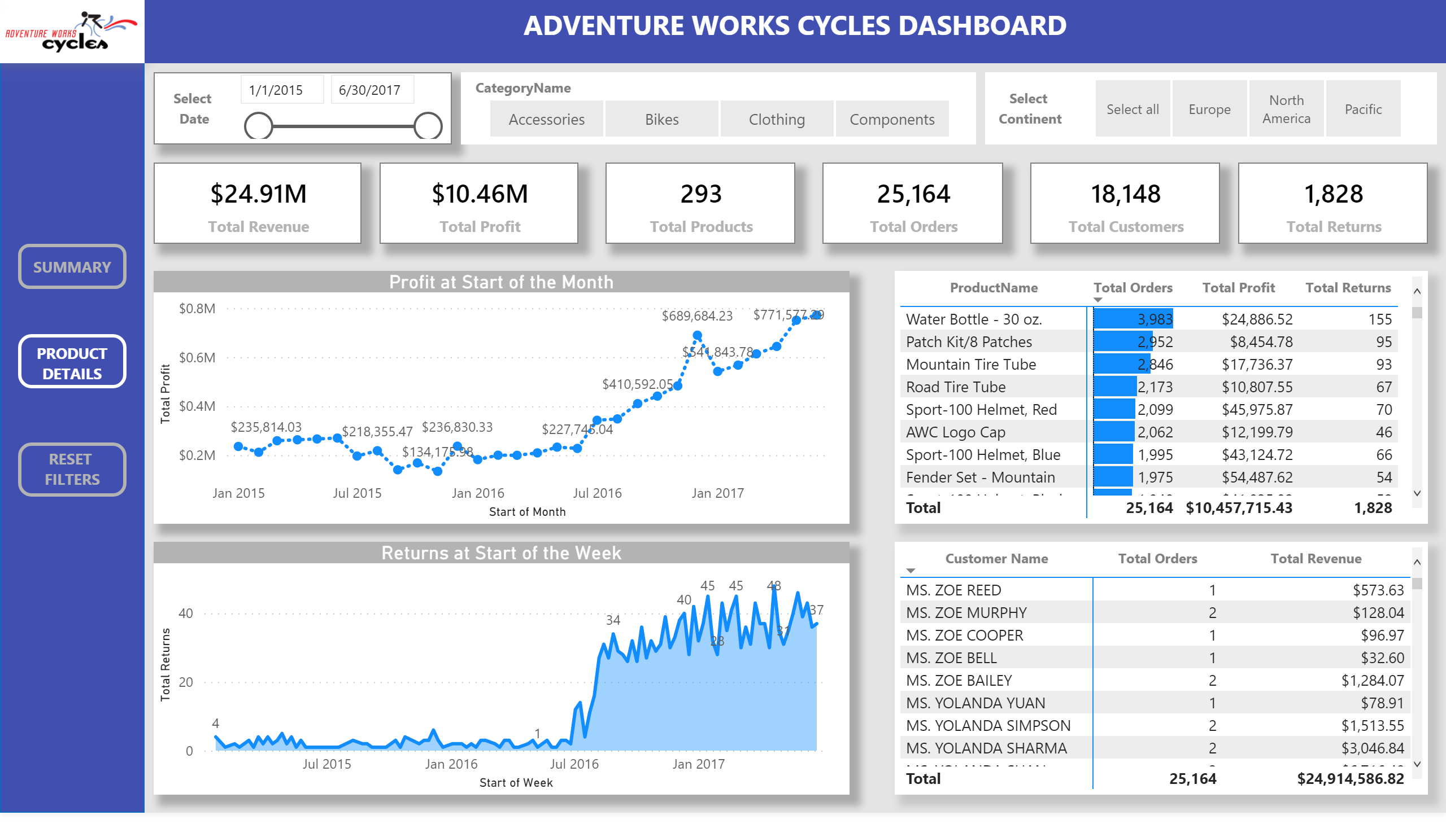
Product Details
Notes:
shape
No alt text provided.
image
No alt text provided.
textbox
No alt text provided.
textbox
No alt text provided.
textbox
No alt text provided.
slicer
No alt text provided.
textbox
No alt text provided.
textbox
No alt text provided.
slicer
No alt text provided.
textbox
No alt text provided.
slicer
No alt text provided.
actionButton
No alt text provided.
actionButton
No alt text provided.
textbox
No alt text provided.
shape
No alt text provided.
pivotTable
No alt text provided.
pivotTable
No alt text provided.
Profit at Start of the Month
No alt text provided.
Returns at Start of the Week
No alt text provided.
card
No alt text provided.
card
No alt text provided.
card
No alt text provided.
card
No alt text provided.
card
No alt text provided.
card
No alt text provided.

